Slide 1
College of Engineering,
Electrical Engineering Department
Class : Second Year
Subject : Digital Techniques
Adder Circuits
By:
Asst Lec. Basma Nazar
Master of Science in Electrical Engineering
(Electronic and Communication)

Slide 2
Adders:
The basin of using logical functions to perform arithmetic operations is Addition
A binary adder is a combinational circuit that performs the arithmetic operations of addition with binary numbers.
Subtract two number, or get perform multiplication and division by using addition

Slide 3
Type of binary adder circuits
There are two types of binary adder circuits
Half Adder (HA)
Full Adder (FA)

Slide 4
The Half Adder (HA):
x1 | x0 | y | C out
0 | 0 | 0 | 0
0 | 1 | 1 | 0
1 | 0 | 1 | 0
1 | 1 | 0 | 1
Block diagram
Truth tablr

Slide 5
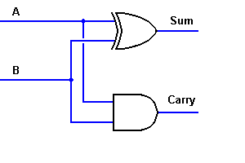
The Half Adder (HA):
Xo
X1
Y=$\overline{X_{0}}$ $X_{1}+X_{0}\overline{X_{1}}$ =$X_{0}⊕ X_{1}$
Cout=$X_{0 }X_{1}$
Circuit Symbol
Boolean Expressions

Slide 6
The Full Adder (FA):
C in | x1 | x0 | S | C out
0 | 0 | 0 | 0 | 0
0 | 0 | 1 | 1 | 0
0 | 1 | 0 | 1 | 0
0 | 1 | 1 | 0 | 1
1 | 0 | 0 | 1 | 0
1 | 0 | 1 | 0 | 1
1 | 1 | 0 | 0 | 1
1 | 1 | 1 | 1 | 1
Block diagram
Truth tablr

Slide 7
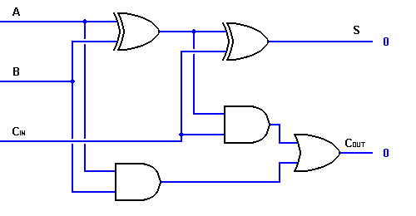
The Full Adder (FA):
Y= (X0 ⊕ X1) ⊕ Cin
Cout= Cin(X0 ⊕ X1) + X0X1
Circuit Symbol
Boolean Expressions

Slide 8
Parallel Adder
A n-bit binary adder have n full adder units that each take three one-bit inputs: A, B and carry Ci and which generate sum S and carry out Co,

Slide 9
Now we can add two binary bits together, accounting for a possible carry from the next lower order of magnitude, and sending a carry to the next higher order of magnitude

Slide 10
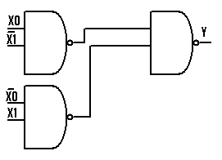
Example(1) Implementing Half adder circuit using NAND gates only

Slide 11
Example(2) :Implementing a function from a adding two numbers each has 3bits using Full adder only

Slide 12
HW. (1):Implementing Full adder circuit using NAND gates only
HW.(2) :Implementing a function from a adding two numbers each has 8bits using Full adder only

