Slide 1
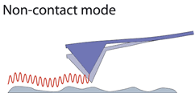
AFM modes
1- Contact Mode
The first and original mode of operation is contact mode. As the tip is raster-scanned across the surface, the lever is deflected as it moves over the surface topography.
There are two methods of imaging in contact mode: constant force or constant height. In constant force mode, the tip is continually adjusted to maintain a specified deflection. It is this adjustment that is used to display an image
2-Non-Contact Mode
Non-contact mode belongs to a family of AC modes, which refers to the use of an oscillating cantilever. A stiff cantilever is oscillated in the attractive regime, meaning that the tip is quite close to the sample, but not touching it (hence, non-contact). The forces between the tip and sample are quite low, on the order of pN (10-12 N). The detection scheme is based on measuring changes to the resonant frequency or amplitude of the cantilever as the interaction between the tip and sample dampen the oscillation.

Slide 2
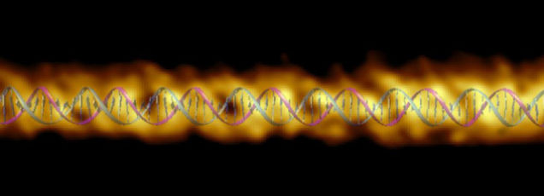
Fig -5- AFM image of DNA

Slide 3
Advantage of AFM, Unlike the electron microscope, which provides a two-dimensional projection or a two-dimensional image of a sample, the AFM provides a three-dimensional surface profile. In addition, samples viewed by AFM do not require any special treatments (such as metal/carbon coatings) that would irreversibly change or damage the sample, and does not typically suffer from charging artifacts in the final image. While an electron microscope needs an expensive vacuum environment for proper operation, most AFM modes can work perfectly well in ambient air or even a liquid environment
A disadvantage of AFM compared with the scanning electron microscope (SEM) is the single scan image size. In one pass, the SEM can image an area on the order of square millimeters with a depth of field on the order of millimeters, whereas the AFM can only image a maximum scanning area of about 150×150 micrometers and a maximum height on the order of 10-20 micrometers. One method of improving the scanned area size for AFM is by using parallel probes in a fashion similar to that of millipede data storage.
The scanning speed of an AFM is also a limitation. Traditionally, an AFM cannot scan images as fast as an SEM, requiring several minutes for a typical scan, while an SEM is capable of scanning at near real-time

