Slide 1
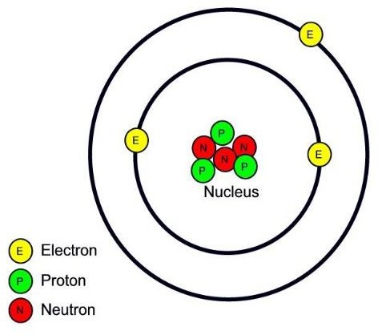
Electronic Physics
Dr. Ghusoon Mohsin Ali
The Atom
Figure 1 A Lithium atom structure has 3 protons and 3 neutrons inside the nucleus with 3 electrons orbiting around the nucleus
Each atom consists of a number of electrons moving in orbits around a heavy nucleus of protons and neutrons. The number of protons in the atom of an element gives its atomic number Z.
The Rutherford model of the atom
In 1911, Rutherford found that the atom consisted of a small, dense core
of positively charged particles in the center (or nucleus) of the atom, surrounded by a swirling ring of electrons Rutherford's atom resembled a
tiny solar system with the positively charged nucleus always at the center and the electrons revolving around the nucleus.
The positively charged particles in the nucleus of the atom were called protons. Protons carry an equal, but opposite, charge to electrons (e=1.602×10⁻¹⁹C), but protons are much larger and heavier than electrons.
Atoms are electrically neutral because the number of protons (+ charges) is equal to the number of electrons (- charges)
To identify this important characteristic of atoms, the term atomic number
(Z) is used to describe the number of protons in an atom. For example, Z = 1 for hydrogen and Z = 2 for helium.
As a specific illustration of this atom model consider the hydrogen atom.

Slide 2
Electronic Physics Dr. Ghusoon Mohsin Ali
The negatively charge electron experienced two opposing force.
1-The electrostatic attraction force (Fe) which is the result of attraction between the positive nucleus and the negative electron, from coulomb's law;
F =
e₁e₂
e
4πε r ²
N
o
where e1 is the charge of the nucleus, e2 is the charge of the electron (charge in coulombs) , εo is the permittivity of free space (8.85×10⁻¹² F/m), r is the separation between two particles (radius)
2-According to the Newton's law the electrostatic attraction force must be equal to the force (Fc) influencing the electron attempting to pull the electron a way from nucleus can be given by the formula;
Fc =
mv²
N
r
where m is the mass of the electron in kilograms (electronic mass=9.109×10⁻³¹kg, v is the velocity of the electron in meter per second.
The electron is held in a circular orbit by electrostatic attraction. The coulomb force of the attraction equal to the centripetal force of the orbiting electron.
F_{e} = F_{c}
For hydrogen atom
e₁ = e₂ = e

Slide 3
Electronic Physics
Dr. Ghusoon Mohsin Ali
_{e}2
2
₌ mv
4πε r
2
r
o
_{e}2
v² =
4πε mr
o
The kinetic energy Ek is given by the formula:
E_{k} =
mv²
J
2
_{e}2
^{Ek =} 8πε r
J
The energy of an electron in an
o
orbit is the sum of its kinetic (Ek) and potential (Ep) energies:
E = E_{k} + E_{p}
Let us assume that the potential energy is zero when the electron is an infinite distance from nucleus. Then the work done to bringing the electron from infinity to distance r from the proton EP.
r r
E_{P} = ∫ F_{e} dr = ∫
∞ ∞
_{e}2 _{e}2 _{e}2
−1 ]r
_{e}2
dr =
r
∫
∞
−2
dr = − r
4πε
= −
4πε r
2
4πε ^{r}
∞
4πε r
o
o
o
o
The total energy of an electron is
_{e}2 _{e}2
_{e}2
E =
−
= −
8πε r 4πε r
8πε r
o o
o

Slide 4
Electronic Physics
Dr. Ghusoon Mohsin Ali
Which gives the desired relationship between the radius and the energy of the electron. This equation shows that the total energy of electron is always negative.
The eV Unit of Energy
A units of energy called electron volt (eV) is defined as,
1eV=1.602×10⁻¹⁹ J
Example
Calculate the radius r of orbit and velocity of an electrons having total energy of -13.6 eV in a hydrogen atom.
Solution
E=-13.6×1.602×10⁻¹⁹ =-2.1787×10⁻¹⁸ J
_{e}2
(1.6×10⁻¹⁹ )²
r = −
= −
−11
8πε E
8×π ×8.85×10⁻¹²
× −2.1787×10
−18
= 5.29×10 m
o
_{e}2
(1.6×10⁻¹⁹ )²
4×π ×8.85×10⁻¹² × 5.29×10⁻¹¹ × 9.11×10⁻³¹
v =
4πε rm ⁼
o
=2.187×10⁶ m/s
The Photon Nature of light
The term photon denotes an amount of radiation energy equal to the
constant h times the frequency. This quantized nature of an electromagnetic wave was first introduced by Plank in 1901.
E = hf
f = ^{c}
λ

Slide 5
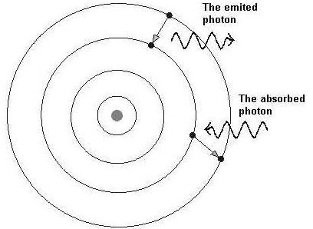
Electronic Physics Dr. Ghusoon Mohsin Ali
where h is the Plank's constant=6.626×10⁻³⁴J.s, c is the velocity of light=3×10⁸ m/s, and λ is the wavelength (m)
,,,,,,,,,,,,,,,,,,,,,,,,,,,,,,,,,,,,,,,,,,,,,,,,,,,,,,,,,,,,,,,,,,,,,,,,,,,,,,,,,,,,,,,,,,,,,,,,,,,,,,,,,,,,,,,,,,,,,,
Bohr's Model
In 1913 Neils Bohr organized all the information he could gather about
the hydrogen atom, and he then made some unique assumptions to
develop a model for the hydrogen atom which explained the hydrogen atom emission spectrum. His postulates were;
Not all energies as given by classical mechanics are allowed. The atom can possess only certain discrete energies. The electron does not emit radiation, and the electron is said to be in stationary or nonradiating state
In a transition from one stationary state to another stationary state for example from E2 to E1, radiation will be emitted. The frequency of this radiant energy is
_{f =} E₂ − E₁
h
Where h is the Plank constant (h=6.626×10⁻³⁴ J.s)
Fig 1.2. The electron emits or absorbs the energy changing the orbits.

Slide 6
Electronic Physics Dr. Ghusoon Mohsin Ali
A stationary state is determined by the condition that the angular momentum of the electron in this state is quantized and must be an integral multiple of h/2π. Thus
mvr = ^{nh}
2π
Where n is an integer
_{n} 2 _{h} 2
4π ²
2 2 2
m v r =
_{n}2 _{h} 2
4π ² m² v ²
2
r =
_{e}2 4πε_{o}m.r
v² =
r ² =
_{n}2_{h}2 . 4πε _{o} m.r
4π ²m²
_{e}2
r
₌ n²h²ε _{o}
π m e²
r =
h²ε
o
.n² = 0.053n²(nm)
1nm=10⁻⁹m
π m e²
r = n²a
0
a0; the radius of first orbit 0.053nm (Bohr radius)
E = −
_{e}2
= −
_{e}2
.
πme²
= −
me⁴ 1
. = −
13.6
eV
8πε r
8πε n² h²ε
8h²ε
2 _{n}2
_{n}2
o
o
o
o
n | Energy (Joules) | Energy (eV) | Radius(nm)
1 | -2.18 x 10⁻¹⁸ | -13.6 | 0.0529
2 | -5.45 x 10⁻¹⁹ | -3.39 | 0.212

Slide 7
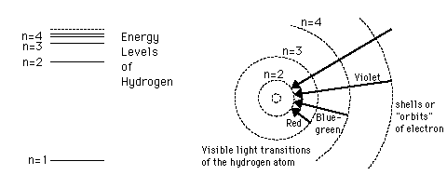
Electronic Physics
Dr. Ghusoon Mohsin Ali
3 | -2.42 x 10⁻¹⁹ | -1.51 | 0.476
4 | -1.36 x 10⁻¹⁹ | -0.85 | 0.846
5 | -0.87 x 10⁻¹⁹ | -0.54 | 1.32
6 | -0.61 x 10⁻¹⁹ | -0.3778 | 1.90
.... | 0 | 0
Fig. 1.3. Atomic Energy Level
Example
An electron with energy -1.5 eV loses energy and radiates light of wavelength 4.2×10⁻⁷ m. Calculate the new energy of the electron and its new orbital radius.
Solution
E = hf
f = =
c 3×10⁸
14
λ 4.2 ×10
-7
= 7.14×10 Hz
E=6.626×10⁻³⁴×7.14×10¹⁴=4.73×10⁻¹⁹ J
^{E}( J )
4.73×10⁻¹⁹
^{E(eV ) =} 1.602×10⁻¹⁹ ⁼ 1.602×10^{−19 = 2.95eV}
Lost energy
The new total energy
Etn=-1.5-2.95=-4.45 eV

Slide 8
Electronic Physics
Dr. Ghusoon Mohsin Ali
_{e}2
r = −
−10
8πε E
= 1.61×10 m
o
E = −
me⁴ 1
13.6
2
. = − eV
8h ε
2
2
2
o
n n
In a transition from one stationary state to another stationary state
_{f =} E₂ − E₁ ₌ E_{i}
E_{f}
h h
Where Ei and Ef are the quantum numbers of the final and initial state of the electron, respectively,
⎛ ₁ ₁ ⎞
E_{photon} == 13.6eV ⎜ −
⎟
⎜
2
2
i
⎟
⎝
n n
⎠
f
1
λ
⎛ ₁ ₁ ⎞
= R⎜ −
⎟
⎜
n
2
f
n
2
i
⎟
⎝ ⎠
R is Rydbeg's constant and equal to 1.09737×10⁷ m⁻¹
Example
Using Boher's model to calculate the frequency and wavelength of photon produced when an electron from third orbit to second orbit of hydrogen
atom.
Solution
⎛ 1 1 ⎞ ⎛ 1 1 ⎞
−19
E = 13.6⎜ − ⎟ = 13.6⎜ − ⎟ = 1.888eV = 3.02×10 J
photon
_{⎜ n}2 _{n}2 ⎟
_{⎜ 2}2 ₃2 ⎟
⎝
f
i
⎠
⎝
⎠

Slide 9
Electronic Physics
Dr. Ghusoon Mohsin Ali
E 3.02×10⁻¹⁹
15
f = =
h 6.626×10
3×10⁸
−34
= 0.455×10 Hz
λ = ^{c} =
f 0.455×10¹⁵
= 639.34nm
The mean life of an excited state ranges from 10⁻⁷ to 10⁻¹⁰ sec, the excited electron returning to its previous state after this time. In this transition the atom must lose an amount of energy equal to the difference in energy between the two states that it has occupied, this energy appearing in the form of radiation. According to Bohr this energy is emitted in the form of a photon of light, the frequency of radiation is given above.
It is customary to express the energy value of stationary states in eV and specify the emitted radiation by wavelength λ in Å rather than frequency in hertz so the follow equation
_{f =} E₂ − E₁
h
May be rewritten as
_{λ =} 12400
E₂ − E₁
Å
Example
A photon of wavelength of 1400Å is absorbed by an atom and two other
photons are emitted. If one of these is an 1850Å, what is the wavelength of the second photon?
Solution
The total energy of the absorbed photon in eV is

Slide 10
Electronic Physics
Dr. Ghusoon Mohsin Ali
E = ¹²⁴⁰⁰ = ¹²⁴⁰⁰ = 8.857eV
λ
1400
The energy of the emitted photon of wavelength 1850Å
E = ¹²⁴⁰⁰ = ¹²⁴⁰⁰ = 6.702eV
Since the energy of the
λ
1850
absorbed photon must equal to the total energy of the emitted photon
E₂ = E − E₁ = 8.857− 6.702 = 2.155eV
_{λ =} 12400 ₌ 12400 ₌ ₅₇₅₄
2
E₂ 2.155
Å
Ionization
As most loosely bond-electron of an atom is given more and more energy, it moves into stationary states which are farther and farther away from the
nucleus. The energy required to move the electron completely out of atom is called ionization potential.
Collisions of Electron with Atom
In order to excite or ionize an atom, energy must be supplied to it. This
energy may be supplied to the atom in various ways, one of them is electron impact. Suppose that an electron is accelerated by the potential applied to
a discharge tube. When this electron (has sufficient energy) collides with an atom, it may transfer enough of its energy to the atom to elevate it to one of the higher quantum state. If the energy of the electron at least equal to the ionization potential of the gas, it may deliver this energy to an electron of the atom and completely remove it from the parent atom. Three charged particle result from such ionizing collision; two electrons and a positive ion.

