Slide 1
Examples for polyline tool Lecture 7

Slide 2
1st Example:
Left-click the Polyline tool icon. The command line shows:
Command: _pline Specify start point: 40,250
Current line width is 0
Specify next point or [Arc/Halfwidth/Length/Undo/ Width]: w (Width)
Specify starting width 0 : 5
Specify ending width 5 : right-click
Specify next point or [Arc/Close/Halfwidth/Length/ Undo/Width]: 160,250
Specify next point or [prompts]: h (Halfwidth)
Specify starting half-width 2.5 : 1
Specify ending half-width 1 : right-click
Specify next point or [prompts]: 260,250
Specify next point or [prompts]: 260,180
Specify next point or [prompts]: w (Width)

Slide 3
Specify starting width 1 : 10
Specify ending width 10 : right-click
Specify next point or [prompts]: 260,120
Specify next point or [prompts]: h (Halfwidth)
Specify starting half-width 5 : 2
Specify ending half-width 2 : right-click
Specify next point or [prompts]: 160,120
Specify next point or [prompts]: w (Width)
Specify starting width 4 : 20
Specify ending width 20 : right-click
Specify next point or [prompts]: 40,120
Specify starting width 20 : 5
Specify ending width 5 : right-click
Specify next point or [prompts]: c (Close)
Command :

Slide 4
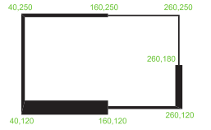

Slide 5
2nd Example:
Left-click the Polyline tool icon. The command line shows:
Command: _pline Specify start point: 80,170
Current line width is 0
Specify next point or [prompts]: w (Width)
Specify starting width 0 : 1
Specify ending width 1 : right-click
Specify next point or [prompts]: a (Arc)
Specify endpoint of arc or [prompts]: s (second pt)
Specify second point on arc: 160,250
Specify end point of arc: 240,170
Specify end point of arc or [prompts]: cl (Close)
Command:

Slide 6
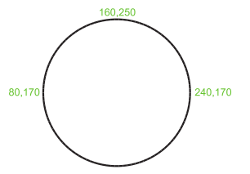
and the circle is formed:

Slide 7
3rd Example:
Left-click the Polyline tool icon. The command line shows:
Command: _pline Specify start point: 60,180
Current line width is 0
Specify next point or [prompts]: w (Width)
Specify starting width 0 : 1
Specify ending width 1 : right-click
Specify next point or [prompts]: 190,180
Specify next point or [prompts]: w (Width)
Specify starting width 1 : 20
Specify ending width 20 : 0
Specify next point or [prompts]: 265,180
Specify next point or [prompts]: right-click
Command:

Slide 8
and the arrow is formed:

