Slide 1
Transportation Engineering
Civil Engineering Department
4th Stage, 1st Semester, 2019-2020
10th Lecture: Traffic Characteristics, Density and Headways (part2)
Lecturer
Dr Maha Osamah
Dr Abeer K.Jameel

Slide 2
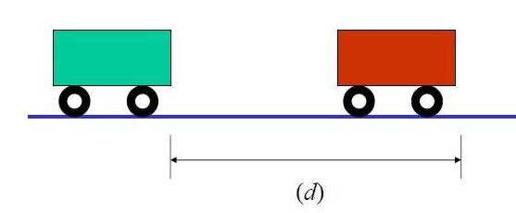
Traffic Characteristics: Density and Headways
Headway
Two types of headways describe the traffic characteristics,
Time headway and
Space headway

Slide 3
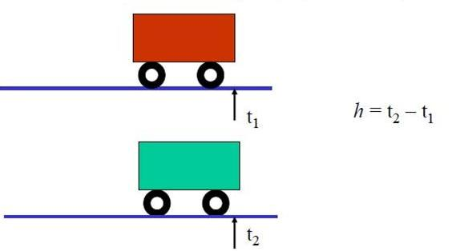
Traffic Characteristics: Density and Headways
Time Headway (ht):
Time between the arrivals of successive vehicles at specified time.
It can be computed as the difference between the time of the front of a vehicle arrives at a point on the highway (t1) and the time the front of the next vehicle arrives at the same point (t2).
It is usually expressed in seconds.

Slide 4
Traffic Characteristics: Density and Headways
Time Headway (ht):
The average time headway in a lane is directly related to the rate of flow:
$$ht = \frac{1\underset{→}{}3600}{Volume (vph)}$$
$(1 in hour unit, 3600 in second unit)$

Slide 5
Traffic Characteristics: Density and Headways
Space headways (hs)
It is the distance between the front of a vehicle and the front of the following vehicle.
It is usually expressed in meter.
The average spacing in the traffic lane can be directly related to the density of the lane
Hs=1000/D
Where:
D= the density of a lane, veh/km/ln
hs = the average space headway (m)

