Slide 1
Unique Properties of Nanomaterials
Assistant Professor
Dr. Raouf Mahmood

Slide 2
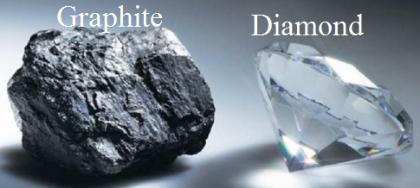
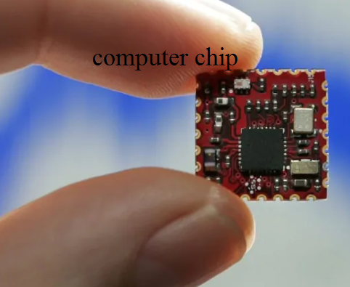
Introduction
If we have the ability to construct matter, atom by atom, we would be able to perform wonders. For example, we know that both graphite and diamond are made of pure carbon. Thus, in belief, if we are able to rearrange the atoms (carbon) in graphite at our discretion, it would be possible to make diamond! Or, if we could rearrange the atoms (silicon and oxygen) in sand (and add a few other trace elements), it should be possible to make a computer chip.

Slide 3
Introduction
Engineering at the nano-level can bring about large changes in the properties of the products. Also, the high defect concentration in nanomaterials results in novel and unique physical, chemical and mechanical properties of this class of materials.

Slide 4
MICROSTRUCTURE AND DEFECTS IN NANOCRYSTALLINE MATERIALS
In order to understand the novel properties of nanostructured materials, we need to understand the structure and its inter-relationship with properties. The microstructural features of importance in nanomaterials include:

Slide 5
MICROSTRUCTURE AND DEFECTS IN NANOCRYSTALLINE MATERIALS
• Grain size, distribution and morphology
• The nature of grain boundaries and interphase interfaces
• Nature of intra-grain defects
• Composition profiles across grains and interfaces
• Residual impurities from processing

Slide 6
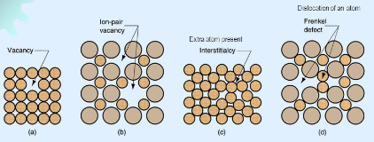
MICROSTRUCTURE AND DEFECTS IN NANOCRYSTALLINE MATERIALS
Crystal lattice imperfections, such as point, linear, planar and volume defects, lead to the structure-sensitive properties of materials. The atomic structure of nanostructured materials

Slide 7
DEFECTS IN CRYSTALLINE MATERIALS
Crystals are three-dimensional, periodic arrangements of atoms/molecules in space.
Any imperfection leading to disruption of periodicity is referred to as a ‘crystalline defect’. These defects are usually classified based on their dimensionality, namely, point defects (0D), line defects (1D), surface defects (2D) and volume defects (3D).

Slide 8
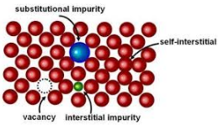
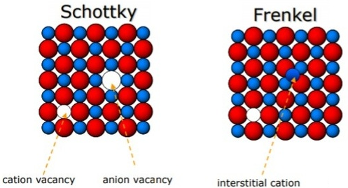
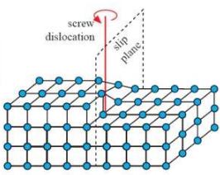
DEFECTS IN CRYSTALLINE MATERIALS
Vacancies, substitutional and interstitial solutes are the common point defects observed in metals and alloys. In case of ionic solids, Schottky (anion–cation vacancy pairs) and Frenkel (vacancy-interstitial pairs of the same ions) defects may also be observed. Dislocations are the most commonly observed line defects and refer to a missing plane of atoms. Among the surface defects, grain boundaries, twins, stacking faults and free surfaces

Slide 9
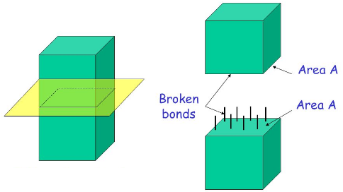
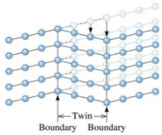
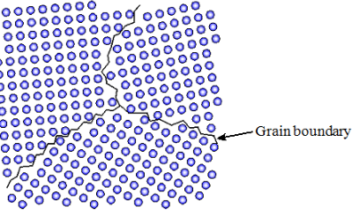
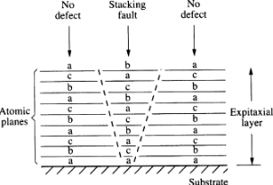
DEFECTS IN CRYSTALLINE MATERIALS
Among the surface defects, grain boundaries, twins, stacking faults and free surfaces are the most common. Inclusions, voids and micro cracks constitute the volume defects.

Slide 10
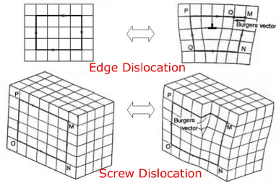
Dislocations
Missing rows of atoms in a crystal are regions of high energy and stress due to disruption of the atomic bonds in the plane. This provides a heavy force for dislocations to be done at surfaces or grain boundaries to minimize the strain energy of the crystal.
In effect, this may be treated as equivalent to an attractive force applied by the surface on dislocations in the crystal. This force is inversely proportional to the distance of separation and hence becomes negligible for dislocations farther than a critical distance. However, for dislocations close to the surface or grain boundary, the attractive force can be large enough to result in applying the dislocations. Hence, for a small distance from the surface and grain boundaries, one would not expect to find any dislocations.

Slide 11
Dislocations
Dislocations are, in general, stable in conventional microcrystalline materials, though not thermodynamically stable defects. However, when the magnitude of the critical distance becomes comparable with that of the grain size, as in nanomaterials, the stability of dislocations is changed significantly.

Slide 12
Dislocations
Hence, with decreasing grain size of nanograined materials, dislocation stability is reduced, due to the large grain boundary area. It is well known that dislocation mobility and interactions play a large role in determining the deformation and plastic flow behaviour of conventional crystalline materials. Hence, it is expected that the deformation behaviour of nanocrystalline materials is significantly different from that of conventional microcrystalline materials.

Slide 13
Dislocations
The typical dislocation density in annealed (hardened) crystalline materials is about 10¹º/cm. As the grain size is reduced to about 10 nm, the dislocation density can reduce by 2–3 orders or more and finally, below a critical grain size, dislocations are no longer stable, i.e., there will be no dislocations in the nanocrystalline materials below the critical grain size.

Slide 14
Dislocations
In contrast to whiskers (single crystals without dislocations), nanomaterials have a large number of grain boundaries as defects. Hence, the plastic deformation behaviour of the material cannot be governed by dislocation mechanisms. This can result in significantly different mechanical properties in nanomaterials below the critical sizes. The effect of decreasing dislocation density on the deformation mechanism is an area of significant scientific curiosity.

Slide 15
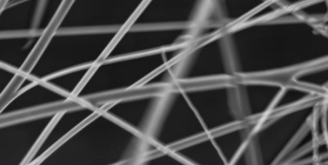
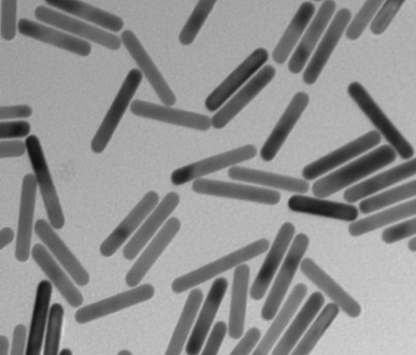
Twins, stacking faults and voids
planar defects are often observed, even after annealing, in many faceted nanomaterials, including nano rods and nanowires. These planar defects include twins and stacking faults (intrinsic or extrinsic), and are usually neglected by most analytical models.

Slide 16
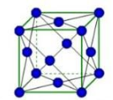
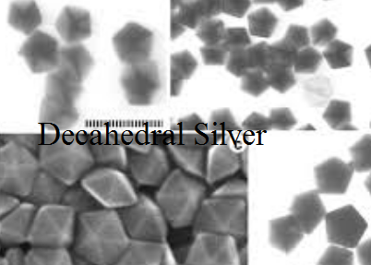
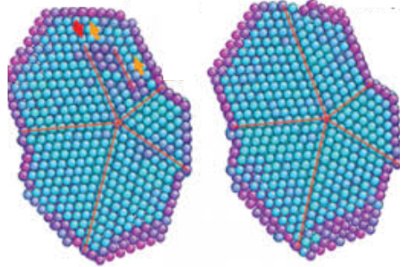
Twins, stacking faults and voids
For example, many bulk metals have the face-centred cubic structure, but nanocrystals and nanorods of the same material often exhibit various structural modifications such as single or multiple symmetric twinning, as well as five-fold cyclic twinning, resulting in decahedral and truncated decahedral nanostructures below critical sides.

Slide 17
Twins, stacking faults and voids
Twins are generally observed in crystals subjected to deformation under high strain rate or at low temperatures. During crystallization of liquid metal, it is expected that volume misfit strains can be easily accommodated in the liquid phase, and hence one does not expect the formation of twins in the nucleating crystals.

Slide 18
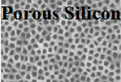
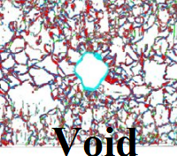
Twins, stacking faults and voids
Voids in nanocrystallites may be located at either
Triple junctions
Large porosities
Due to insufficient compaction and sintering of nanocrystallites synthesized from the powder method. Although both types of voids influence the behaviour of the nanocrystallites, the first is structurally more important. It is suggested that triple junction voids arise as a result of relaxation of nanocrystalline grain boundaries.

Slide 19
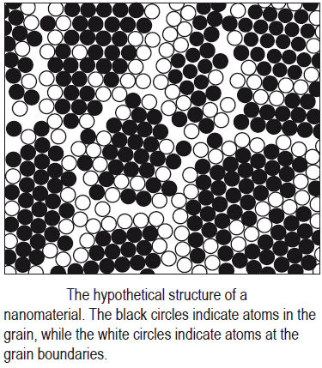
Grain boundaries, triple junctions and disclinations
A schematic representation of a hard-sphere mode of an equiaxed nanocrystalline metal as shown in Figure.
Two types of atoms can be distinguished:
Crystal atoms with nearest-neighbour configurations
corresponding to the lattice (black circles) .
Boundary atoms with a variety of interatomic spacings (white circles). Nanocrystalline materials typically contain a high number of interfaces with random orientation relationships, so, a substantial fraction of atoms lies in the interfaces.

Slide 20
Grain boundaries, triple junctions and disclinations
Assuming that the grains have the shape of spheres or cubes, the volume fraction of nanocrystalline materials associated with the boundaries (Vi) is estimated to be:
where δ is the average interface thickness and d is the average grain diameter. Thus, the volume fraction of interfaces can be as much as 60% for 5 nm grains, 30% for 10 nm grains, and about 3% for 100 nm grains, for a grain boundary thickness of 1 nm.

Slide 21
Grain boundaries, triple junctions and disclinations
According to the phase mixture model, many properties of nanocrystalline materials can be estimated by a simple rule of mixtures,
where subscripts cr and ῐc refer to the crystalline and intercrystalline components of nanocrystalline materials, and X and V denote the property and volume fraction of the respective components. Intercrystalline components include the grain boundaries, triple lines and quadruple nodes. Taking a cubic unit cell or a regular polyhedron unit cell of nanocrystalline materials, the volume fraction of each component can be expressed as follows:

Slide 22
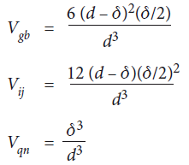
Grain boundaries, triple junctions and disclinations
Where the subscribes cr, gb, tj and qn refer to crystallite, grain boundary, triple lines and quadruple nodes, respectively; d and δ represent the grain size and grain boundary thickness.

Slide 23
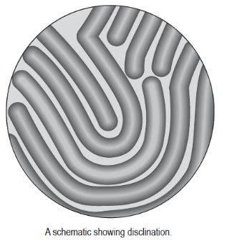
Grain boundaries, triple junctions and disclinations
When the grain size is smaller than about 20 nm, the total volume of the intercrystalline region (grain boundary and triple junctions) becomes significant. The density of grain boundaries in nanocrystals is very large (~ 10¹⁹ cm^{–3}) and there is wide distribution of interatomic spacing at these grain boundaries.
It has been suggested that the triple junctions can be
described based on the disclination defect model.
Disclinations (as Figure) are line defects
characterised by a rotation vector ω in contrast to
the translational vector b for dislocations.

Slide 24
Grain boundaries, triple junctions and disclinations
The triple junctions may be considered to form a network of disclinations. Theoretical calculations have shown that triple junction energies are comparable to dislocation energies, and that compensating disclinations play a significant role in the properties of nanocrystalline metals with grain size less than about 10 nm. These triple junctions are linear defects that play a significant role in the mechanical, thermodynamic and kinetic properties of polycrystals. This role may be particularly important in nanocrystalline materials, where the grain boundaries are short and contain a small number of structural units.

