Slide 1

Ministry of Higher Education &scientific Research
Al-Mustansiriya University
College of Engineering
Degree day method
(Section 2)
Asst. Prof. Dr. Hayder Mohammad Jaffal

Slide 2
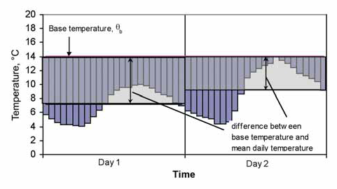
1- Introduction
Degree day is one of the common approximation method to determine total cooling and heating energy use based on statistical weather data. This method calculates the different temperature between base and ambient, then integrate it over time.
Figure (1) Basic definition of degree days

Slide 3
In building application, there are two main uses of degree days method. Those are:
to estimate energy consumption and carbon dioxide emissions due to space heating and cooling for new build and major refurbishment
for ongoing energy monitoring and analysis of existing buildings based on historical data .

Slide 4
Heating and cooling degree days can be used to help assess or compare different potential sites for development. They can also be used as a way of normalising weather between different sites, allowing comparison of the performance of different buildings, or for normalising weather between different years to assess the change in performance of a building.
The advantage of degree days technique lies in the relative ease and speed of use, since the information input required is available from the building design criteria. Contradict with full thermal simulation models degree-day calculations can be carried out manually or within computer spreadsheets.

Slide 5
2- Heating degree days
Heating degree days (HDD) are used to give an indication of the effect of outside air temperature on building energy consumption during a specified period of time. They represent the number of degrees and number of days that the outside air temperature at a specific location is lower than a specified base temperature (or balance point). This gives an indication of how much heating will be required in the building. Heating degree-day figures come with a "base temperature", and provide a measure of how much (in degrees), and for how long (in days), the outside temperature was below that base temperature. In the UK, the most readily available heating degree days come with a base temperature of 15.5°C. An example calculation: if the outside temperature was 2 degrees below the base temperature for 2 days, there would be a total of 4 heating degree days over that period (2 degrees * 2 days = 4 degree days).

Slide 6
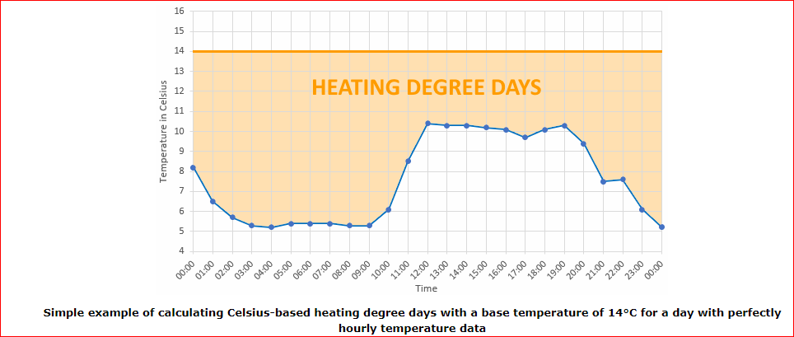

Slide 7
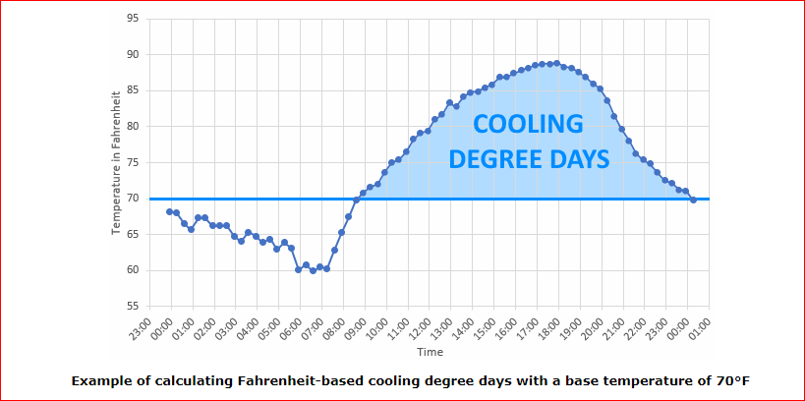
3- Cooling degree days
Cooling degree days (CDD) are used to give an indication of the effect of outside air temperature on building energy consumption during a specified period of time. They represent the number of degrees and number of days that the outside air temperature at a specific location is higher than a specified base temperature (or balance point). This gives an indication of how much cooling will be required in the building.

Slide 8
4- Balance Point Temperature
The balance point temperature (base temperature) is the average daily outside temperature at which a building maintains a comfortable indoor temperature without heating or cooling. At this outside temperature, the indoor heat gains (due to people, lighting, equipment, etc) "balance" with heat loss through windows, walls, roof and ventilation.
Here are a few of the factors that affect what the actual base temperature will be:
1-Indoor temperature. The warmer you keep it inside, the higher the base temperature will be.
2-Internal heat gains. Lights, appliances, and people add heat to the inside of the building. The more they add, the less your heating system needs to supply in winter and the lower the actual base temperature.

Slide 9
3-Rate of heat loss or gain. A building that loses heat faster in winter will have a higher base temperature than one that holds onto the heat.
4-Season. Solar gains change throughout the year. Wind patterns change. How a building is used changes. Indoor setpoints change, too, because of the effects above but also because of varying mean radiant temperature. (Naked people need building science, you know).

Slide 10

The balance pint temperature is obtained by solving the heat balance equation on the air inside of the house under these conditions. Generally, the heat balance equation on the inside air is where,
$${\left[UA\right]}_{tot}\left(T_{o}−T_{i}\right)+Q_{free}+Q_{equip}=0$$
[UA]tot = total UA-value for the building, including infiltration (W/ ̊ C)
To = average outdoor air temperature ( ̊ C)
Ti = average indoor air temperature ( ̊ C)
Qfree = total free heat from solar and internals (W)
Qequip = heat supplied by the heating/cooling equipment (W)

Slide 11


The total UA-value for the house is the building load coefficient, BLC, already determined. The balance point temperature, Tb, is then simply To when Qequip is zero. The above equation becomes,
$$BLC\left(T_{b}−T_{i}\right)+Q_{free}=0$$
making
$$T_{b}=T_{i}−\frac{Q_{free}}{BLC}$$

Slide 12
5- Degree day calculations
The degree day approach is based on the fact that the need of buildings in energy is directly proportional to a difference between mean daily temperature of ambient air and indoor temperature. The indoor temperature is the temperature of below or above which there is a need to spend energy to create comfortable conditions.
Heating degree day (HDD)
The difference between the base and hourly dry-bulb temperatures are summed up to estimate degree-hours in a specified period. The cumulative degree-hours of a day is divided by the number of hours in a day (=24) to get the daily degree-days, HDD.

Slide 13
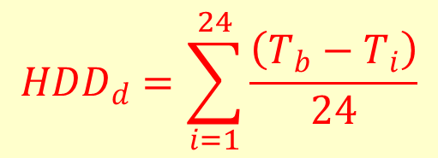
$${HDD}_{d}=\sum_{i=1}^{24}{\frac{\left(T_{b}−T_{i}\right)}{24}}$$
where Tb and Ti are base and ambinet temperatures ( ̊ C) at i-th hour of the day respectively.
For the Heating degree day calculation, the equation summarized as:

Slide 14

Tmax=maximum temperature ( ̊ C)
Tmin=minimum temperature ( ̊ C)
Tb=base temperature ( ̊ C)
HDDd=daily heating degree day ( ̊ C day)
Annual degree-days, HDD, is calculated by summing up daily, HDDt over a year, as shown in Eq. (2).
$${HDD}_{a}=\sum_{j=1}^{N}{{HDD}_{d,j}}$$
where, HDDd,jis daily HDD of the j-th day of the year and N isnumber of days in a year; i.e. 366 in a leap year, and 365 in others.

Slide 15
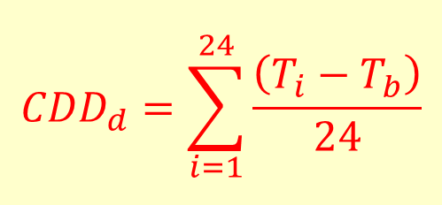
Cooling degree day (HDD)
The difference between the base and hourly dry-bulb temperatures are summed up to estimate degree-hours in a specified period. The cumulative degree-hours of a day is divided by the number of hours in a day (=24) to get the daily degree-days, HDD, as shown in Eq.
$${CDD}_{d}=\sum_{i=1}^{24}{\frac{\left(T_{i}−T_{b}\right)}{24}}$$
where Tb and Ti are base and ambinet temperatures ( ̊ C) at i-th hour of the day respectivelly.

Slide 16
For the Cooling degree day calculation, the equation summarized as:
Tmax=maximum temperature ( ̊ C)
Tmin=minimum temperature ( ̊ C)
Tb=base temperature ( ̊ C)
CDDd=daily cooling degree day ( ̊ C day)

Slide 17
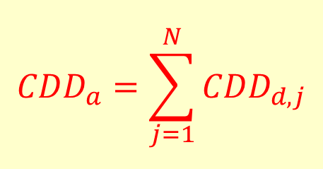
Annual degree-days, HDD, is calculated by summing up daily, HDDt over a year, as shown in Eq. (2).
$${CDD}_{a}=\sum_{j=1}^{N}{{CDD}_{d,j}}$$
where, CDDd,jis daily CDD of the j-th day of the year and N is number of days in a year; i.e. 366 in a leap year, and 365 in others.

Slide 18
6- Heat flow through building elements
Discussing about heat transfer in building element cannot be separated from the discussion about heat transfer process under transient condition. Since its does not directly change the temperature as heat flow occurs through it. Materials are capable to store thermal energy, which is called thermal mass. As the element needs time to heat up or cool down, its influence to indoor temperature change over time. In buildings, such elements included walls, roof, concrete furniture, etc. To investigate the behavior of thermal mass in building element, several approaches can be taken such as transfer function coefficient, radiant time series, and finite different method. The last method has an advantage in representing the problem either by physical or mathematical approach.

Slide 19


$${\left(UA\right)}_{com}=\sum{{\left(UA\right)}_{wall}}+\sum{{\left(UA\right)}_{window}}+\sum{{\left(UA\right)}_{door}}+\sum{{\left(UA\right)}_{ceiling}}+\sum{{\left(UA\right)}_{floor}}$$
Each component type (walls, windows, etc.) will have as many terms in its sum as components of that type defined by the user.
The U-value is calculated by :
$$UA=\frac{1}{R_{T}}=\frac{1}{R_{i}+\frac{∆x1}{k1}+\frac{∆x2}{k2}+…+R_{o}}$$

Slide 20

The U-value is calculated by :
$$UA=\frac{1}{R_{T}}=\frac{1}{R_{i}+\frac{∆x1}{k1}+\frac{∆x2}{k2}+…+R_{o}}$$
U =heat transfer coefficient (W/m² ̊ C)
RT= thermal resistance (m² ̊ C /W)
Ri=internal heat transfer resistance (̊ C /W)
Ro=external heat transfer resistance (̊ C /W)
Δxi=thickness of layer number i (m)
ki=thermal conductivity of layer number i (W/m ̊ C )

Slide 21


7-Heat flows to ventilation and infiltration
Ventilation is flow of ambient air that intentionally induced into the building to provide good air quality which is controlled. On the other hand infiltration is uncontrolled airflow that enter or leave a structure, such as air leakage through the cracks. Heat loss or gain through ventilation occurs during air exchanging process, when warm air change with the fresh outdoor air. The equation to calculate the heat loss through this mechanism is:
$$Q_{inf}=ρ_{a}{Cp}_{a}{\dot{V}}_{a}\left(T_{o}−T_{i}\right)={\left(UA\right)}_{inf}\left(T_{o}−T_{i}\right)$$
$${\left(UA\right)}_{inf}=ρ_{a}{Cp}_{a}{\dot{V}}_{a}$$

Slide 22
where,
Qinf is infiltration heat loss (W)
Cpa is specific heat capacity of air (J/kg ̊ C)
ρ is density of air (kg/m3)
V˙a is air volume flow(m3/s)
Ti is inside air temperature ( ̊ C)
To is outside air temperature ( ̊ C)
(UA)inf= infilteration loss coefficient (W/ ̊ C)

Slide 23
8- Building Load Coefficient (BLC)
Cooling load is the amount of heat energy need to be removed from a building, by the HVAC system, to maintain the expected indoor design temperature. In calculating cooling loads during design phase, heat gain from appliance, solar radiation, and all heat suppliers inside the building are included. This approach is taken to describe the worst case condition (the highest expected amount of heat) need to be maintain by the system. In defining cooling load, component that may affect are
• External: wall, roofs, windows, skylights, doors, partitions, ceilings and floors.
• Internal: lights, people, appliances, and equipment.
• Infiltration: air leakage and moisture migration.
• System: outdoor air, duct leakage and heat gain. reheat, fan and pump energy, and energy recovery.

Slide 24
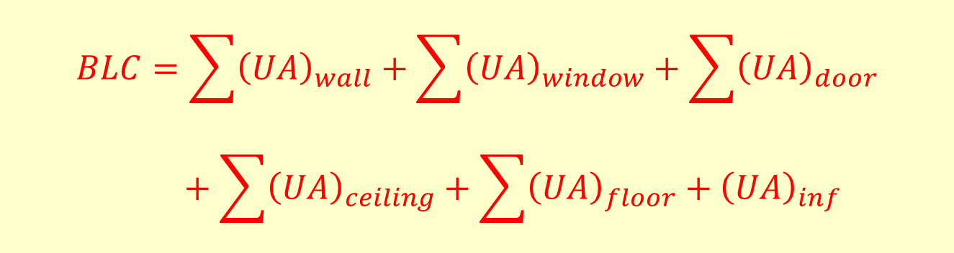
The total building load coefficient for the house is the sum of the individual component building load coefficients or UA-values:
$$BLC=\sum{{\left(UA\right)}_{wall}}+\sum{{\left(UA\right)}_{window}}+\sum{{\left(UA\right)}_{door}}+\sum{{\left(UA\right)}_{ceiling}}+\sum{{\left(UA\right)}_{floor}}+{\left(UA\right)}_{inf}$$

Slide 25
9- Load Calculation
Defining heating or cooling demand is basically calculating the building heat loss and gain to find the amount of energy needed to be transferred for maintaining comfortable indoor condition.
Heating load
Heating load is the rate which energy needs to be transferred to reach the desired room thermal condition. The determination of heating load is important in selecting the system to be installed, since the equipment is expected to meet the desired indoor condition, in all defined scenario. In determining the heating load during design phase, the definition of extreme condition is used, which most often occur at night when building is unoccupied.

Slide 26

Therefore, the assumption including, no solar gain trough glazing, no solar air effect on the building envelope, and no heat gains due to, occupants, light, etc.. Furthermore the building is assumed to be at steady temperature, so there is no energy released from storage. Based on this conservative assumption, the heating load define as,
$$HL=24×\frac{BLC}{η_{H}}×{HDD}_{a}$$
HL=heating load (W.h)
BLC=building load coefficient (W/ ̊ C)
HDDa= annual heating degree day ( ̊ C.day)
ηH= is the average efficiency of the heating system

Slide 27
Cooling load
Cooling load is the amount of heat energy need to be removed from a building, by the HVAC system, to maintain the expected indoor design temperature. In calculating cooling loads during design phase, heat gain from appliance, solar radiation, and all heat suppliers inside the building are included. This approach is taken to describe the worst case condition (the highest expected amount of heat) need to be maintain by the system. In defining cooling load, component that may affect are
• External: wall, roofs, windows, skylights, doors, partitions, ceilings and floors.
• Internal: lights, people, appliances, and equipment.
• Infiltration: air leakage and moisture migration.
• System: outdoor air, duct leakage and heat gain. reheat, fan and pump energy, and energy recovery.

Slide 28
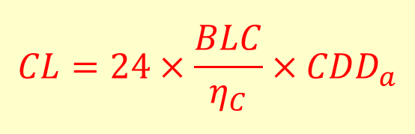
Based on this conservative assumption, the cooling load define as,
$$CL=24×\frac{BLC}{η_{C}}×{CDD}_{a}$$
CL=cooling load (W.h)
BLC=building load coefficient (W/ ̊ C)
CDDa= annual cooling degree day ( ̊ C.day)
ηC= is the average efficiency of the cooling system

Slide 29
Calculating Cooling Degree-Days - An Example:
For a hot summer month, if the average daily temperature is above 18°C for five days, you sum the total number of degrees above 18°C for those five days to get the number of degree-days of cooling in that month. Adding the values for each month gives you an annual total.

Slide 30
Example 1:
Find the heating and cooling load for the building located in Baghdad that has the following specifications:
(a) Inside design temperature
Ti=25 ̊ C for Summer
Ti=22 ̊ C for Winter
(b) Qfree=2400 W for Summer
Qfree=2100 W for Winter
(c) Building load coefficient is constant=600 W/ ̊ C
(d) Tmax= 34.3 ̊ C
(e) Tmin=10 ̊ C
Assuming that the heating system efficiency of 80% and cooling system efficiency of 75%.

Slide 31


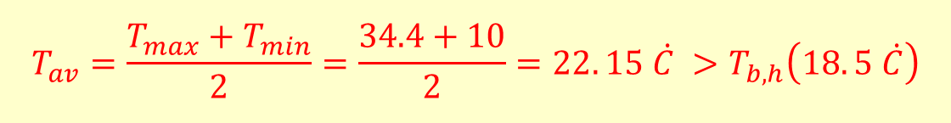

Solution:
$$T_{b}=T_{i}−\frac{Q_{free}}{BLC}$$
$$T_{b,c}=25−\frac{2400}{600}=21 \dot{C} for Summer$$
$$T_{b,h}=22−\frac{2100}{600}=18. 5 \dot{C} for Winter$$
For heating:
$$T_{av}=\frac{T_{max}+T_{min}}{2}=\frac{34.4+10}{2}=22. 15 \dot{C} >T_{b,h}\left(18. 5 \dot{C}\right)$$

Slide 32





$${HDD}_{d}=\frac{T_{b}−T_{min}}{4}=\frac{18.5−10}{4}=2. 125 \dot{C}.day$$
$${HDD}_{a}=2.125×365=776 \dot{C}.day$$
$$HL=24\frac{BLC}{η_{H}}{HDD}_{a}=24\frac{600}{0.8}776=13968000 W.hr$$
For cooling:
$$T_{min}(10\dot{C})<T_{b,c} (21\dot{C})$$
$${CDD}_{d}=\frac{T_{max}−T_{b}}{2}−\frac{T_{b}−T_{min}}{4}=\frac{34.3−21}{2}−\frac{21−10}{4}=3. 9 \dot{C}.day$$

Slide 33


$${CDD}_{a}=3.9×365=1424 \dot{C}.day$$
$$CL=24\frac{BLC}{η_{C}}{HDD}_{a}=24\frac{600}{0.75}1424=27340800 W.hr$$

Slide 34

Example 2:
Two similar buildings one in Baghdad and the other in Mosul have the same balance temperature (Tb=18.33 ̊ C). Calculate:
(a) The annual degree day for both buildings.
(b) The thermal load for heating and cooling.
Assuming for both buildings BLC=500 W/ ̊ C.
The following are giving:

Slide 35

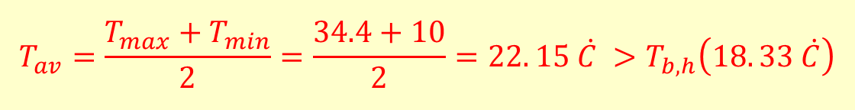

Solution:
For Baghdad:
Tmax=34.3 ̊ C
Tmin=10 ̊ C
Tb=18.33 ̊ C
Heating:
$$T_{av}=\frac{T_{max}+T_{min}}{2}=\frac{34.4+10}{2}=22. 15 \dot{C} >T_{b,h}\left(18. 33 \dot{C}\right)$$
$${HDD}_{d}=\frac{T_{b}−T_{min}}{4}=\frac{18.33−10}{4}=2. 0825 \dot{C}.day$$
$${HDD}_{a}=2.0825×365=760 \dot{C}.day$$

Slide 36




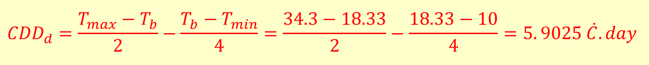
$$HL=24\frac{BLC}{η_{H}}{HDD}_{a}=24\frac{500}{1}760=9120000 W.hr$$
Cooling:
$$T_{min}(10\dot{C})<T_{b,c} (18.33\dot{C})$$
$${CDD}_{d}=\frac{T_{max}−T_{b}}{2}−\frac{T_{b}−T_{min}}{4}=\frac{34.3−18.33}{2}−\frac{18.33−10}{4}=5. 9025 \dot{C}.day$$
$${CDD}_{a}=5.9025×365=2154 \dot{C}.day$$
$$CL=24\frac{BLC}{η_{C}}{HDD}_{a}=24\frac{500}{1}2154=25848000 W.hr$$

Slide 37



For Mosul:
Tmax=33.3 ̊ C
Tmin=7.41 ̊ C
Tb=18.33 ̊ C
Heating:
$$T_{av}=\frac{T_{max}+T_{min}}{2}=\frac{33.3+7.41}{2}=20. 355 \dot{C} >T_{b,h}\left(18. 33 \dot{C}\right)$$
$${HDD}_{d}=\frac{T_{b}−T_{min}}{4}=\frac{18.33−7.41}{4}=2.73 \dot{C}.day$$
$${HDD}_{a}=2.73×365=996 \dot{C}.day$$

Slide 38





$$HL=24\frac{BLC}{η_{H}}{HDD}_{a}=24\frac{500}{1}996=11952000 W.hr$$
Cooling:
$$T_{min}(7.41 \dot{C})<T_{b,c} (18.33 \dot{C})$$
$${CDD}_{d}=\frac{T_{max}−T_{b}}{2}−\frac{T_{b}−T_{min}}{4}=\frac{33.3−18.33}{2}−\frac{18.33−7.41}{4}=4. 755 \dot{C}.day$$
$${CDD}_{a}=4.755×365=1736 \dot{C}.day$$
$$CL=24\frac{BLC}{η_{C}}{HDD}_{a}=24\frac{500}{1}1736=20832000 W.hr$$

Slide 39
Example 3:
What is the amount of energy that could be saved annually for the building located in Mosul if the thermostat setting of the inside design temperature (Ti) has been changed from 24 ̊ C to 25 ̊ C in Summer and from 23 ̊ C to 20 ̊ C in the Winter. Given that: Tmax=33.3 ̊ C
Tmin=7.41 ̊ C
Qfree=2500 W for Summer
Qfree=2000 W for Winter
BLC=500 W/ ̊ C
Repeat the calculation for Basrah and compare the results. For Basrah:
Tmax=34 ̊ C
Tmin=12.5 ̊ C
Assume constant values of Qfree and BLC for both cities.

Slide 40




Solution:
Mosul: if Ti=24 ̊ C
$$T_{b}=T_{i}−\frac{Q_{free}}{BLC}$$
For cooling:
If Ti=24 ̊ C
$$T_{b,c}=24−\frac{2500}{500}=19 \dot{C} for Summer$$
$$T_{min}(7.41 \dot{C})<T_{b,c} (19 \dot{C})$$
$${CDD}_{d}=\frac{T_{max}−T_{b}}{2}−\frac{T_{b}−T_{min}}{4}=\frac{33.3−19}{2}−\frac{19−7.41}{4}=4.2525 \dot{C}.day$$

Slide 41





$${CDD}_{a,24}=4.2525×365=1552 \dot{C}.day$$
For cooling:
If Ti=25 ̊ C
$$T_{b,c}=25−\frac{2500}{500}=20 \dot{C} for Summer$$
$$T_{min}(7.41 \dot{C})<T_{b,c} (20\dot{C})$$
$${CDD}_{d}=\frac{T_{max}−T_{b}}{2}−\frac{T_{b}−T_{min}}{4}=\frac{33.3−20}{2}−\frac{20−7.41}{4}=3. 5025 \dot{C}.day$$
$${CDD}_{a,25}=3.3525×365=1278 \dot{C}.day$$

Slide 42



$${∆CDD}_{a}={∆CDD}_{a,24}−{∆CDD}_{a,25}=1552−1278=274 \dot{C}.day$$
The energy saved is:
$$∆CL=24\frac{BLC}{η_{C}}{∆CDD}_{a}=24\frac{500}{1}274=3288000 W.hr$$
For heating:
If Ti=23 ̊ C
$$T_{b,h}=23−\frac{2000}{500}=19 \dot{C} for Winter$$
$$T_{av}=\frac{T_{max}+T_{min}}{2}=\frac{33.3+7.41}{2}=20. 355 \dot{C} >T_{b,h}\left(19 \dot{C}\right)$$

Slide 43





$${HDD}_{d}=\frac{T_{b}−T_{min}}{4}=\frac{19−7.41}{4}=2. 8975 \dot{C}.day$$
$${HDD}_{a,23}=2.8975×365=1058 \dot{C}.day$$
For heating:
If Ti=20 ̊ C
$$T_{b,h}=20−\frac{2000}{500}=16 \dot{C} for Winter$$
$$T_{av}=\frac{T_{max}+T_{min}}{2}=\frac{33.3+7.41}{2}=20. 355 \dot{C} >T_{b,h}\left(16 \dot{C}\right)$$
$${HDD}_{d}=\frac{T_{b}−T_{min}}{4}=\frac{16−7.41}{4}=2.1475 \dot{C}.day$$

Slide 44


$${HDD}_{a,20}=2.1475×365=784 \dot{C}.day$$
$${∆HDD}_{a}={∆HDD}_{a,23}−{∆HDD}_{a,20}=1058−784=274 \dot{C}.day$$
The energy saved is:
$$∆HL=24\frac{BLC}{η_{C}}{∆HDD}_{a}=24\frac{500}{1}274=3288000 W.hr$$
$${∆L}_{Mosul}=∆CL+∆HL=3288000+3288000=6576000 W.hr$$

Slide 45



Basrah: if Ti=24 ̊ C
$$T_{b}=T_{i}−\frac{Q_{free}}{BLC}$$
For cooling:
If Ti=24 ̊ C
$$T_{b,c}=24−\frac{2500}{500}=19 \dot{C} for Summer$$
$$T_{min}(12.5 \dot{C})<T_{b,c} (19 \dot{C})$$
$${CDD}_{d}=\frac{T_{max}−T_{b}}{2}−\frac{T_{b}−T_{min}}{4}=\frac{34−19}{2}−\frac{19−12.5}{4}=5.875 \dot{C}.day$$

Slide 46





$${CDD}_{a,24}=5.875×365=2144 \dot{C}.day$$
For cooling:
If Ti=25 ̊ C
$$T_{b,c}=25−\frac{2500}{500}=20 \dot{C} for Summer$$
$$T_{min}(12.5 \dot{C})<T_{b,c} (20\dot{C})$$
$${CDD}_{d}=\frac{T_{max}−T_{b}}{2}−\frac{T_{b}−T_{min}}{4}=\frac{34−20}{2}−\frac{20−12.5}{4}=5.125 \dot{C}.day$$
$${CDD}_{a,25}=5.125×365=1871 \dot{C}.day$$

Slide 47



$${∆CDD}_{a}={∆CDD}_{a,24}−{∆CDD}_{a,25}=2144−1871=273 \dot{C}.day$$
The energy saved is:
$$∆CL=24\frac{BLC}{η_{C}}{∆CDD}_{a}=24\frac{500}{1}273=3276000 W.hr$$
For heating:
If Ti=23 ̊ C
$$T_{b,h}=23−\frac{2000}{500}=19 \dot{C} for Winter$$
$$T_{av}=\frac{T_{max}+T_{min}}{2}=\frac{34+12.5}{2}=23. 25 \dot{C} >T_{b,h}\left(19 \dot{C}\right)$$

Slide 48




$${HDD}_{d}=\frac{T_{b}−T_{min}}{4}=\frac{19−12.5}{4}=1. 625 \dot{C}.day$$
$${HDD}_{a,23}=1.625×365=593 \dot{C}.day$$
For heating:
If Ti=20 ̊ C
$$T_{b,h}=20−\frac{2000}{500}=16 \dot{C} for Winter$$
$$T_{av}=\frac{T_{max}+T_{min}}{2}=\frac{34+12.5}{2}=23. 25 \dot{C} >T_{b,h}\left(16 \dot{C}\right)$$
$${HDD}_{d}=\frac{T_{b}−T_{min}}{4}=\frac{16−12.5}{4}=0.875 \dot{C}.day$$

Slide 49

$${HDD}_{a,20}=0.875×365=319 \dot{C}.day$$
$${∆HDD}_{a}={∆HDD}_{a,23}−{∆HDD}_{a,20}=593−319=274 \dot{C}.day$$
The energy saved is:
$$∆HL=24\frac{BLC}{η_{C}}{∆HDD}_{a}=24\frac{500}{1}274=3288000 W.hr$$
$${∆L}_{Basrah}=∆CL+∆HL=3276000+3288000=6564000 W.hr$$

