Slide 1
Ministry of Higher Education &scientific Research
Al-Mustansiriya University
College of Engineering
Energy management and applications
Zero energy building
(Section 4)
Asst. Prof. Dr. Hayder Mohammad Jaffal

Slide 2
1- Definition of Zero Energy Building
A zero-energy building (ZE), also known as a zero net energy (ZNE) building, net-zero energy building (NZEB), net zero building is a building with zero net energy consumption, meaning the total amount of energy used by the building on an annual basis is equal to the amount of renewable energy created on the site or in other definitions by renewable energy sources offsite. In some cases these buildings consequently contribute less overall greenhouse gas to the atmosphere during operations than similar non-ZNE buildings. They do at times consume non-renewable energy and produce greenhouse gases, but at other times reduce energy consumption and greenhouse gas production elsewhere by the same amount.

Slide 3
Fig. 1. Zero energy building

Slide 4
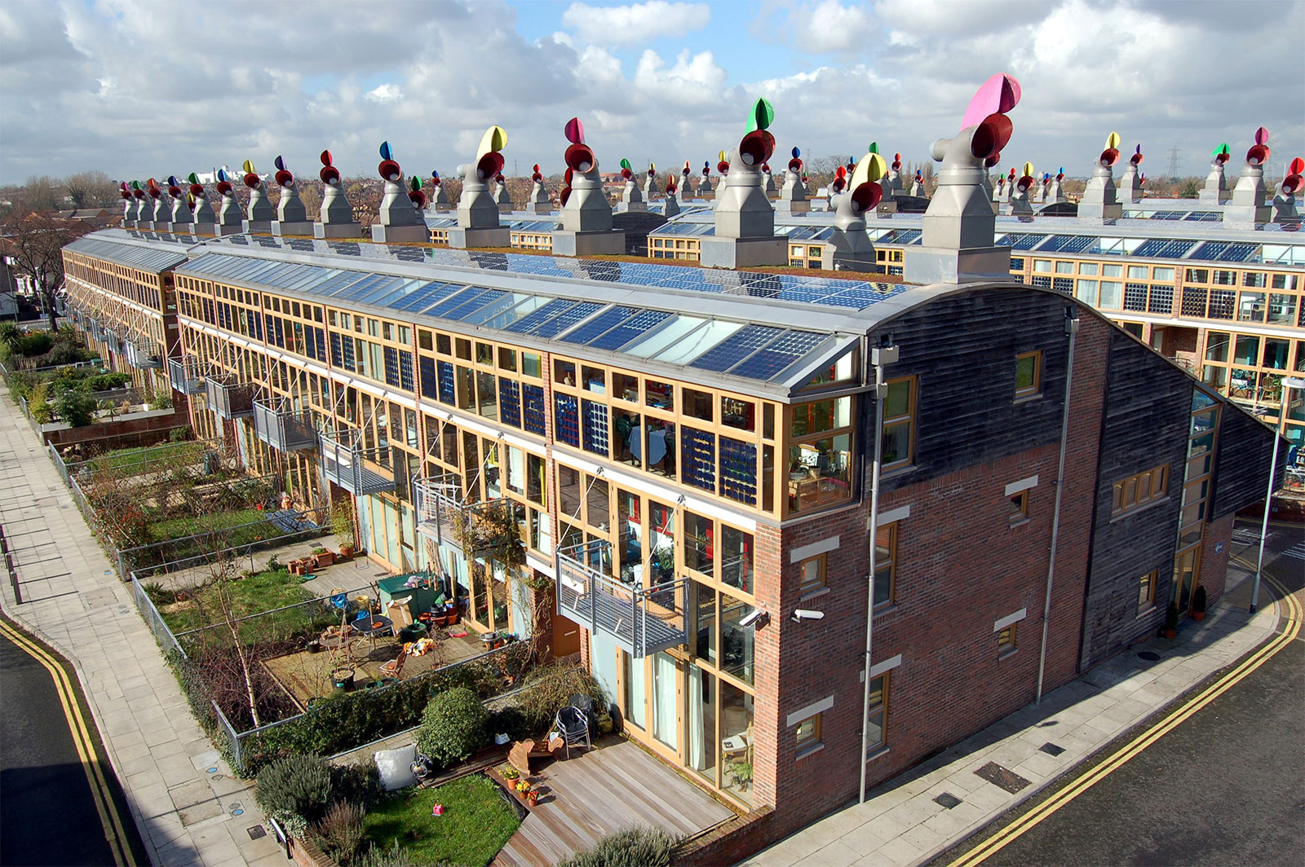
Fig. 2. Beddington Zero Energy Development (BedZED)

Slide 5
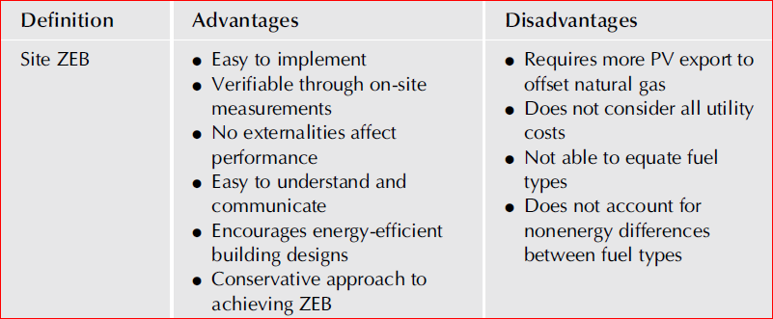
4 Ways to Define Net Zero Energy Use in Buildings:
1. Net Zero Site Energy: In this type of ZNE, the amount of energy provided by on-site renewable energy sources is equal to the amount of energy used by the building. In the United States, “zero net energy building” generally refers to this type of building.

Slide 6
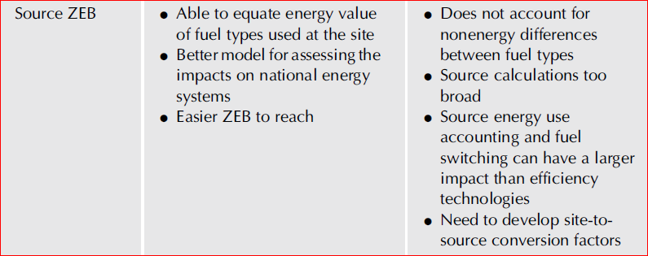
2. Net Zero Source Energy: This ZNE generates the same amount of energy as is used, including the energy used to transport the energy to the building. This type accounts for energy losses during electricity generation and transmission. These ZNEs must generate more electricity than zero net site energy buildings.

Slide 7
3. Net Zero Energy Emissions: A building that achieves net zero energy based on emissions, "produces at least as much emissions-free renewable energy as it uses from emissions-producing energy sources." How easy it is to do this depends greatly on the type of energy used and the location. A building in the Pacific Northwest, which has a high percentage of electricity generated by hydroelectric plants, can reach achieve net-zero energy emissions without much difficulty.

Slide 8
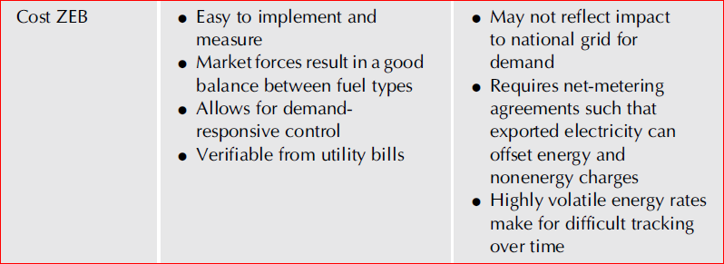
4. Net Zero Energy Costs: In this type of building, the cost of purchasing energy is balanced by income from sales of electricity to the grid of electricity generated on-site. Such a status depends on how a utility credits net electricity generation and the utility rate structure the building uses.

Slide 9
2- Design concept of ZEBs
Generally speaking, ZEB consists of two strategies—minimizing demand through energy-efficient measures (passive design) and using renewable energy and other technologies to meet remaining energy requirements (active design), as shown in Fig. 3. First one is the passive strategies which can reduce the energy demand of the ZEB as much as possible. The passive design strategies including shading, now-thermal bridge, air tightness design, natural ventilation and lighting, and high performance envelope. The other one is using high efficient active technologies which using renewable energy. Efficient lighting, energy efficient appliances, and fresh air heat recovery system are included in the active design. The cost-optimal model of ZEBs based on passive and active technologies should be evaluated carefully. The technical guidelines stipulate the minimum requirements for ZEBs to meet the relevant energy consumption indicators, air tightness indicators and indoor environmental parameters.

Slide 10
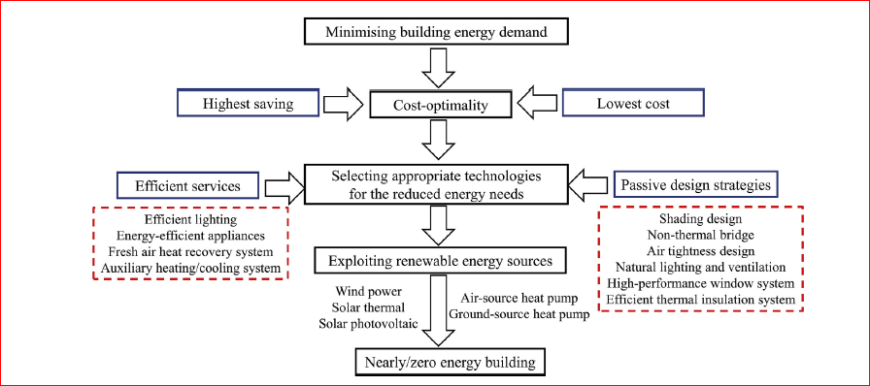
Fig. 3. Design concept of ZEBs

Slide 11
3- List of technologies applied
Various technologies are invented and developed respecting on specific conditions and requirements of the building. Fig.4 presents technologies installed and integrated in the building, which includes:
Smart double skin cladding system by adaptively movable louvers
Heat pump system by ground source/water utilization
Radiation cooling/heating panel system
Thermal mass utilization
Natural ventilation by chimney effect
Desiccant dehumidifier by exhaust heat from heat pump
LED lighting system
Potable water saving including rain water utilization
PV
Integrated building operation system by AI based control.

Slide 12
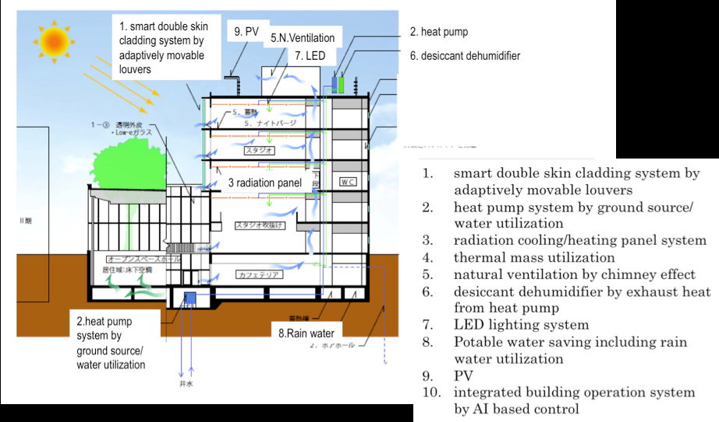
Fig. 4 Technologies applied to the building

Slide 13
4- Technologies developed and applied
Smart double skin cladding system by adaptively movable louvers
The west and east elevations of the building have considerable thermal load as well as an opportunity to utilize natural ventilation, natural light and heat radiation from sunrays in winter. In order to solve the contradict requirements on selective control of light heat and airflows, design team invented and developed smart double skin cladding system with adaptively movable louvers. In case of fixed windows, triple glazing sashes with inlet for natural ventilation are installed together with external sun shading. In case of openable windows, invented double skin system is applied; the system consists of movable vertical louvers and their frames. Each vertical louver unit is composed of double layered slat panels and a double glazed panel. (Respecting on that this double skin is installed in the west and east elevation, slats are installed vertically.) The unit can be rolled around vertical axis.

Slide 14
Consequently, as it is shown in Fig.3, both slat panels and glazed panel can face outside/inside selectively depending on outside conditions. In addition, white coloured side of slat and black coloured side of slat are also turned around, thus, both sides of slat can face outside selectively as well. Fig. 5 shows three modes of movable louvers. The mode A aims to minimize thermal load by sunrays in summer by letting white coloured side of slat face to reflect sunray rays. The mode B aims to maximize natural ventilation and natural light utilization in spring and in fall (i.e. when thermal load from outside is low) by letting slats and glass give maximum way to airflow and natural light from outside. The mode C intends to heat gains from sunrays in winter by letting black colour side of slats faces outside. Fig. 6 presents detailed mechanism how the double skin system works in summer and in winter.

Slide 15
Mode A
Mainly in the morning in summer, white coloured side of slat panels in movable louvers faces outside and the angle of louvers follows diurnal motion of the sun to prevent inclusion of sunrays to inside.
Mode B
Mainly in spring and in fall, movable louvers are open to outside to maximize natural ventilation. If outside temperature should be lower than inside in night in summer, natural ventilation is introduced through inlet within slat panels to facilitate night purge effect. The moving mechanism of louvers is manupirated by artificial intelligent controller.
Mode C
Mainly in the morning in summer (i.e. duration of time when sun altitude is relatively low), black coloured side of movable louvers faces outside in order to collect radiated heat from the sun and to stock them in upper flower slabs by utilizing its thermal mass. Even in the time when louvers are shut, visibility from inside to outside is assured by deliberate detailing of punching metal shape of slats.

Slide 16
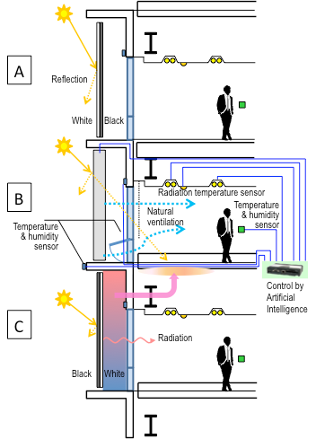
Fig. 5 Three modes of Smart double skin cladding system with adaptively movable louvers

Slide 17
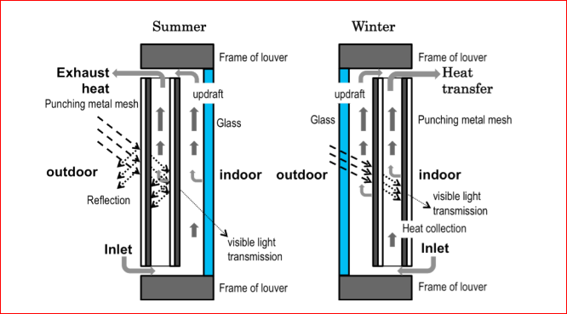
Fig. 6 Mechanism of smart double skin cladding system with adaptively movable louvers

Slide 18
Heat pump system by ground source/water utilization
In general, ground temperature is stable in all four seasons (in Tokyo, 16-17 degrees). Thus, utilization of ground and/or ground water as heat sources enables higher energy efficiency in heating and cooling of building. To utilize the potential of ground heat, the building applies ground source/water based heat pump system by installing 10 tubes of 100 meter length U shaped heat exchangers as well as a pair of wells in the underground of the building.

Slide 19
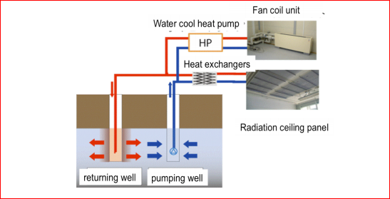
Fig. 7 Heat pump system by ground source/water utilization

Slide 20
Radiation cooling/heating panel system with desiccant dehumidifier
Conventional air conditioning method changes the temperature of air to warm or cool human’s body. This indirect warming and cooling via air includes waste and inefficiency in energy use. Contrarily, warming and cooling by radiation panel is a method to warm or cool human’s body directly. It does not need the energy for bringing air and for activating fans. It also avoids needless draft as well as upgrades indoor air quality and comfort. The installed ceiling panels have function of radiation panels. Before application to the building, performance of the radiation panels had been verified through experiments in laboratories. When radiation cooling system by ceiling panels is introduced, water drops by dew condensation around ceiling panel could be happened. In order to prevent such kind of dew condensation disaster, accurate control of indoor humidity is necessary.

Slide 21
Desiccant dehumidifier system is effective measure for non condensation. However, conventional desiccant technique has low energy use efficiency because of consumption heat for recovery of desiccant materials. To solve this problem, solar heat and/or exhaust heat needs to be utilized for recovery of desiccant materials. Desiccant dehumidifier system installed in this building utilizes exhaust heat from heat pump air conditioning system.
Fig. 8 Radiation cooling/heating panel system

Slide 22
Thermal mass utilization
The building is designed to stock heat gain in floor slabs by utilization of its thermal mass. Together with internally generated heat such as heat from lighting and computers, the building aims to make zero-heat-load for air conditioning in winter. In other seasons, night purge mechanism is introduced; structural members and spaces between ceiling and floor panels are cooled by natural ventilation in night in order to minimize cooling load when mechanical cooling system starts its operation in the morning.

Slide 23
LED lighting system and integrated system
Needless to say, the use of LED has advantage in energy conservation compared with conventional lighting. This building aims more higher efficiency than simple, stand alone use of LED. The building embodies integrated control system that maximizes use of natural light and facilitates complementary use of artificial light by LED with dimmer function. Fig. 6 shows outline of the integrated system. Previously mentioned louvers in double skin cladding system moves based on evaluation of the data from pyranometer; In case pyranometer would suggest that it is raining or cloudy, louvers moves to introduce maximum quantity of day light to inside. In case it would suggest bright and no direct sun rays, louvers also settle to the direction to introduce natural day light as much as possible. In case of sunny day with direct sun rays that could increase cooling load such as in summer, the louvers are settled to prevent inclusion of sun rays to inside of the building.

Slide 24
In case indoor space is warmed artificially, louvers are settled to proactively introduce heat gains. Together with and harmonised with adaptively controlled louver system, artificial light by LED is controlled. Motion sensors works to switch off and on LED lighting which is controlled to assure sufficient illumination intensity based on illuminometer. The system is manipulated by artificial intelligent controller.

Slide 25
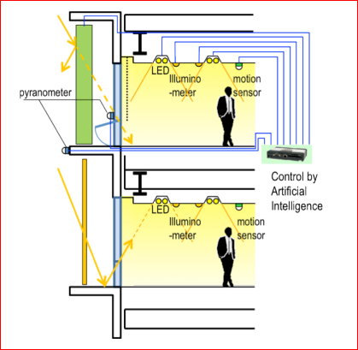
Fig.9 Integrated use of natural light and LED

Slide 26
PV (photovoltaic) system
Photovoltaic system by 300 meter square of thin-film solar modules are installed on the roof of the building. The maximum capacity of generation reaches to 30kw which is 10% of anticipated maximum peak load demand of electricity in summer. Annual total electric power generated by installed PV is estimated as 400GJ in primary energy basis. Generated electricity is designed to be used in the building (i.e. PV here is separated from network). The building also embodies continual monitoring system to measure site basis real efficiency of the PV.

Slide 27
Integrated building operation system by AI based control
The building embodies energy monitoring system based on the idea of information embedded building; the monitoring system consists of sensors of energy use, temperature, humidity, indoor air quality, illumination intensity etc. The real time basis data is transferred from sensors as digital data to server which is located off-site. The stocked and input data in the sever is analysed through the process shown in Fig.10. The visualised real time basis reporting of the analysis is accessible to all stakeholders of the building through WEB site. Consequently, the system is used as a device of benchmarking for building owners and users.

Slide 28
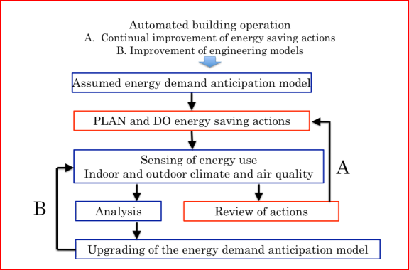
Fig.10 Proactive demand control system using real time energy monitoring and a sort of AI

Slide 29
5- Source Energy Calculations
Most building managers are familiar with site energy, the amount of energy consumed by a building as measured by utility meters. Site energy consumption can be useful for understanding the performance of the building and the building systems, but it does not tell the whole story of impacts from resource consumption and emissions associated with the energy use. In addition, site energy is not a good comparison metric for buildings that have different mixes of energy types, buildings with on-site energy generation, such as photovoltaic, or buildings with cogeneration units. Therefore, to assess the relative efficiencies of buildings with varying fuel types, it is necessary to convert these types of energy into equivalent units of raw fuel consumed in generating one unit of energy consumed on-site. To achieve this equivalency, the convention of source energy is utilized.

Slide 30
When energy is consumed on-site, the conversion to source energy must account for the energy consumed in the extraction, processing and transport of primary fuels such as coal, oil and natural gas; energy losses in thermal combustion in power generation plants; and energy losses in transmission and distribution to the building site. The Zero Energy Building definition uses national average ratios to accomplish the conversion to source energy because the use of national average source-site ratios ensures that no specific building will be credited (or penalized) for the relative efficiency of its energy provider(s). Source energy is calculated from delivered energy and exported energy for each energy type using source energy conversion factors. Source energy conversion factors are applied to convert energy delivered and exported on-site into the total equivalent source energy. The source energy conversion factors utilized are from ASHRAE Standard 105 . While on-site renewable energy is a carbon-free, zero-energy-loss resource, when it is exported to the grid as electricity, it displaces electricity that would be required from the grid.

Slide 31
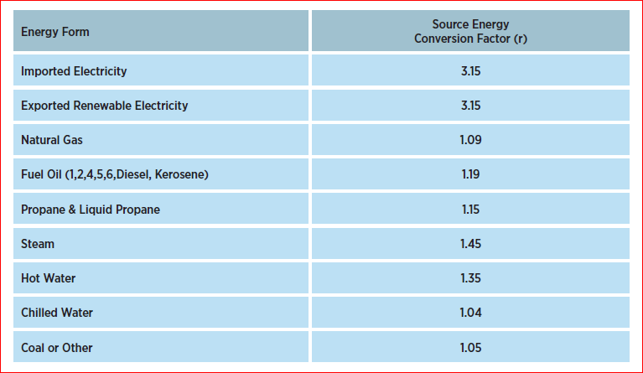
Table 1 – National Average Source Energy Conversion Factors

Slide 32
Source energy would be calculated using the following formula:
$$E_{source}=\sum_{i}{\left(E_{del,i}r_{del,i}\right)}−\sum_{i}{\left(E_{exp,i}r_{exp,i}\right)}$$
Where:
Edel,i= is the delivered energy for energy type i;
Eexp,i= is the exported on-site renewable energy for energy type i;
rdel,i= is the source energy conversion factor for the delivered energy type i;
rexp,i= is the source energy conversion factor for the exported energy type i;

Slide 33
Example 1:
A building has the following actual annual delivered energy of 300,000 kBtu electricity. The on-site renewable exported energy is 320,000 kBtu electricity from photovoltaics. (Note: The equation is using energy transferred across the site boundary and does not include on-site renewable energy consumed by the building).
Solution:
Using the formula above, the annual source energy balance would be:
$$E_{source}=\sum_{i}{\left(E_{del,i}r_{del,i}\right)}−\sum_{i}{\left(E_{exp,i}r_{exp,i}\right)}$$

Slide 34
$$E_{source}=\left(300000 kBtu×3.15\right)−\left(320000 kBtu×3.15\right)$$
$$E_{source}=945000 kBtu−1008000 kBtu$$
$$E_{source}=−63000 kBtu$$
Since Esource ≤ 0, the building would be a Zero Energy Building.

Slide 35
Example 2:
A building has the following actual annual delivered energy types: 200,000 kBtu electricity, 60,000 kBtu natural gas and 100,000 kBtu chilled water. The on-site renewable exported energy is 260,000 kBtu electricity from photovoltaics.
Solution:
Using the formula above, the annual source energy balance would be:
$$E_{source}=\sum_{i}{\left(E_{del,i}r_{del,i}\right)}−\sum_{i}{\left(E_{exp,i}r_{exp,i}\right)}$$

Slide 36
$$E_{source}=[\left(200000 kBtu×3.15\right)+\left(60000 kBtu×1.09\right)+\left(100000 kBtu×1.04\right)]−\left(260000 kBtu×3.15\right)$$
$$E_{source}=799400 kBtu−819000 kBtu$$
$$E_{source}=−19600 kBtu$$
Since Esource ≤ 0, the building would be a Zero Energy Building.

Slide 37
Example 3:
A building with CHP has the following actual annual delivered energy types: 120,000 kBtu electricity and 260,000 kBtu natural gas. The on-site renewable exported energy is 210,000 kBtu electricity from photovoltaics.
Solution:
Using the formula above, the annual source energy balance would be:
$$E_{source}=\sum_{i}{\left(E_{del,i}r_{del,i}\right)}−\sum_{i}{\left(E_{exp,i}r_{exp,i}\right)}$$

Slide 38
$$E_{source}=[\left(120000 kBtu×3.15\right)+\left(260000 kBtu×1.09\right)]−\left(210000 kBtu×3.15\right)$$
$$E_{source}=661400 kBtu−661500 kBtu$$
$$E_{source}=−100 kBtu$$
Since Esource ≤ 0, the building would be a Zero Energy Building.

