Slide 1
Parabolic symmetrical curve:
Types:

Slide 2
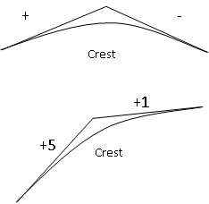
Parabolic symmetrical curve:
Types:

Slide 3
Parabolic symmetrical curve:
Types:
g1 > g2

Slide 4
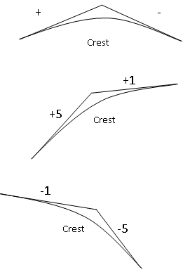
Parabolic symmetrical curve:
Types:
g1 > g2

Slide 5
Parabolic symmetrical curve:
Types:
g1 > g2

Slide 6
Parabolic symmetrical curve:
Types:
g1 > g2
g1 < g2

Slide 7
Parabolic symmetrical curve:
Types:
g1 > g2
g1 < g2
A = g2 – g1 = (-)

Slide 8
Parabolic symmetrical curve:
Types:
g1 > g2
g1 < g2
A = g2 – g1 = (-)
⸫ The signal of A and r = (-)

Slide 9
Parabolic symmetrical curve:
Types:
g1 > g2
g1 < g2
A = g2 – g1 = (-)
⸫ The signal of A and r = (-)

Slide 10
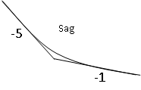
Parabolic symmetrical curve:
Types:
g1 > g2
g1 < g2
A = g2 – g1 = (-)
⸫ The signal of A and r = (-)

Slide 11
Parabolic symmetrical curve:
Types:
g1 > g2
g1 > g2
g1 < g2
A = g2 – g1 = (-)
⸫ The signal of A and r = (-)

Slide 12
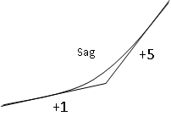
Parabolic symmetrical curve:
Types:
g1 > g2
g1 > g2
g1 < g2
A = g2 – g1 = (-)
⸫ The signal of A and r = (-)

Slide 13
Parabolic symmetrical curve:
Types:
g1 > g2
g1 > g2
g1 < g2
g1 < g2
A = g2 – g1 = (-)
⸫ The signal of A and r = (-)

Slide 14
Parabolic symmetrical curve:
Types:
g1 > g2
g1 > g2
g1 < g2
g1 < g2
A = g2 – g1 = (-)
A = g2 – g1 = (+)
⸫ The signal of A and r = (-)

Slide 15
Parabolic symmetrical curve:
Types:
g1 > g2
g1 > g2
g1 < g2
g1 < g2
A = g2 – g1 = (-)
A = g2 – g1 = (+)
⸫ The signal of A and r = (-)
⸫ The signal of A and r = (+)

Slide 18
Distance to highest and lowest points in crest and sag curves

Slide 19
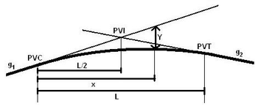
Distance to highest and lowest points in crest and sag curves

Slide 20
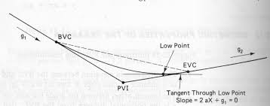

Slide 21
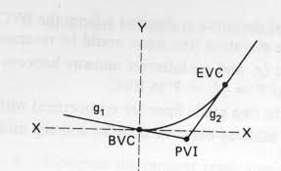

Slide 22
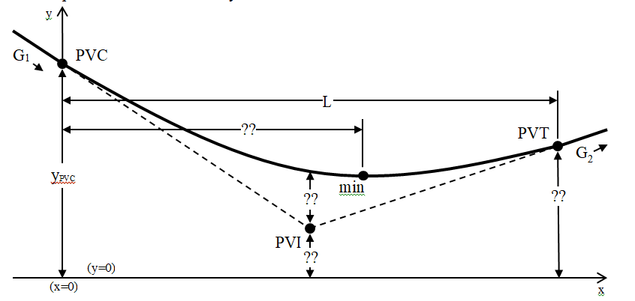

Slide 23
1. Distances are measured horizontally and vertically
2. Rate of change in slope with distance is constant = r
3. e = e
L= length of vertical curve measured horizontally.
St. = station = 100 m
1 St. = 1+00
g₁, g₂ = percent longitudinal grades or slopes of tangents.
+g = upgrade, -g = downgrade
A = algebraic difference in grades = g₂ – g₁

Slide 24
r= rate of change in grade per station (or 100m) = A/L
P.V.C. (PVC) = point of beginning of vertical curve = Point of vertical curvature
P.V.I. (PVI) = point of vertical intersection or vertex = Point of vertical Intersection
P.V.T. (PVT) = point of vertical tangency = end of V.C.
∆y = difference in elevation between tangent & curve
∆e = difference in elevation at P.V.I.
X = horizontal distance in stations from P.V.C. or P.V.T. to the required point.
Y= elevation of point on curve

