Slide 1
$$Example : Is the function y=\left\{\begin{aligned}2x+3 x≤4 \\ 7+\frac{16}{x} x>4\end{aligned}\right\} continuous at x=4$$
$$f\left(4\right)=2\left(4\right)+3=11 →define$$
$$\lim_{x→4}\left(2x+3\right)=11 , \lim_{x→4}\left(7+\frac{16}{x}\right)=11 →exist$$
$$\lim_{x→4}{f\left(x\right)=f\left(4\right)=11 → f is continuous at x=4}$$
$$Example: Is the function f\left(x\right)=\left\{\begin{aligned}\sqrt{x+2} x<2 \\ x^{2}−2 2≤x<3 \\ 2x+5 x≥3\end{aligned}\right\} continuous at x=2$$
$and x=3$
$$f\left(2\right)={x^{2}−2=2}^{2}−2=2$$
$$\lim_{x→2}{(\sqrt{x+20}=\sqrt{4}=2 , \lim_{x→2}\left(x^{2}−2\right)=2}$$
$$\lim_{x→2}{f\left(x\right)=f\left(2\right)=2 }$$
$$The function is continuous at x=2$$

Slide 2
$$f\left(3\right)=2x+5=2\left(3\right)+5=11$$
$$\lim_{x→3}{( x^{2}−2)}=7 , \lim_{x→3}\left(2x+5\right)=11$$
$$\lim_{x→3}{f\left(x\right)=does not exist → the function is discontinuous at x=3}$$
$$Example: f\left(x\right)=\left\{\begin{aligned}2x+5 x<−1 \\ x^{2}+2 x>−1 \\ 5 x=−1\end{aligned}\right\} is continuous at x=−1$$
$$f\left(−1\right)=5$$
$$\lim_{x→−1}\left(2x+5\right)=3 , \lim_{x→−1}\left(x^{2}+2\right)=3 →the \lim_{x→−1}{f\left(x\right) is exist}$$
$$\lim_{x→−1}{f\left(x\right)≠f\left(−1\right) → the function is discontinuous at x=−1}$$

Slide 3
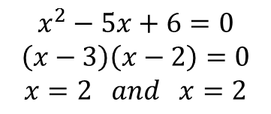
$$Example: Where is the function f\left(x\right)=\frac{x^{2}−9}{x^{2}−5x+6} continuous?$$
$$x^{2}−5x+6=0$$
$$\left(x−3\right)\left(x−2\right)=0$$
$$x=2 and x=2$$
$$∴ f\left(x\right) is continuous at every points except at x=3 and x=2$$
Differentiation
The derivative of a function at a point is to measure the rate of change at that point.
If y =f(x) be a function , then the derivative of f with respect to x is defined by
$$\frac{dy}{dx}=y^{′}=\lim_{h→0}{\frac{f\left(x+h\right)−f(x)}{h}=slope of tangent line}$$

Slide 4
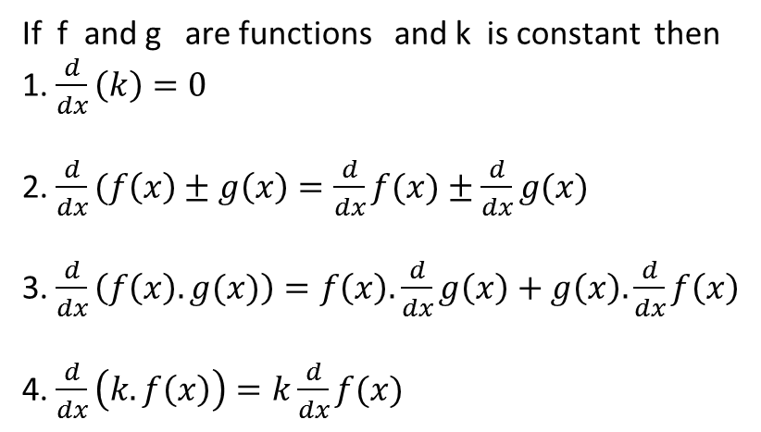
$$Example: Use the definition of derivative to find the derivative of f\left(x\right)=x^{2}$$
$$\frac{dy}{dx}=\lim_{h→0}{\frac{{\left(x+h\right)}^{2}−x^{2}}{h}}=\lim_{h→0}{\frac{x^{2}+2xh+h^{2}−x^{2}}{h}}$$
$$=\lim_{h→0}{\frac{h(2x+h)}{h}=2x}$$
If f and g are functions and k is constant then
1. $\frac{d}{dx}\left(k\right)=0$
2. $\frac{d}{dx}(f\left(x\right)±g\left(x\right)=\frac{d}{dx}f(x)±\frac{d}{dx}g(x)$
3. $\frac{d}{dx}\left(f\left(x\right).g(x)\right)=f\left(x\right).\frac{d}{dx}g\left(x\right)+g\left(x\right).\frac{d}{dx}f\left(x\right)$
4. $\frac{d}{dx}\left(k. f\left(x\right)\right)=k\frac{d}{dx}f(x)$

Slide 5
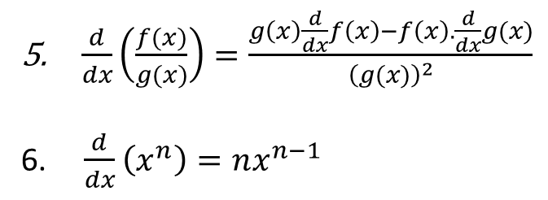
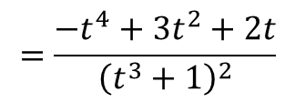
$\frac{d}{dx}\left(\frac{f(x)}{g(x)}\right)=\frac{g\left(x\right)\frac{d}{dx}f\left(x\right)−f\left(x\right).\frac{d}{dx}g(x)}{{\left(g(x)\right)}^{2}}$
6. $\frac{d}{dx}\left(x^{n}\right)=nx^{n−1}$
$$Example: Find \frac{dy}{dx} for y=\left(x^{2}+1\right)\left(x^{3}+3\right)$$
$$\frac{dy}{dx}=\left(x^{2}+1\right)\left(3x^{2}\right)+\left(x^{3}+3\right)2x$$
$$=3x^{4}+3x^{2}+2x^{4}+6x$$
$$=5x^{4}+3x^{2}+6x$$
$$Example: Find the derivative of y=\frac{t^{2}−1}{t^{3}+1}$$
$$\frac{dy}{dx}=\frac{\left(t^{3}+1\right).2t−\left(t^{2}−1\right).3t^{2}}{{\left(t^{3}+1\right)}^{2}}=\frac{2t^{4}+2t−3t^{4}+3t^{2}}{{\left(t^{3}+1\right)}^{2}}$$
$$=\frac{−t^{4}+3t^{2}+2t}{{\left(t^{3}+1\right)}^{2}}$$

