Slide 1
Second and higher order derivatives
The second derivative is written as
$$f^{′′}\left(x\right)=\frac{d^{2}y}{dx^{2}}=\frac{dy^{′}}{dx}=y^{′′}$$
The third derivative is
$$\frac{d^{3}y}{dx^{3}}=y^{′′′}$$
The fourth derivative is
$$\frac{d^{4}y}{dx^{4}}=y^{(4)}$$
Example: Find the first four derivatives of
$$y=x^{3}−3 x^{2}+ 2$$
$$\frac{dy}{dx}=3x^{2}−6x$$
$$\frac{d^{2}y}{dx^{2}}=6x−6$$
$$\frac{d^{3}y}{dx^{3}}=6$$
$$\frac{d^{4}y}{dx^{4}}=0$$

Slide 2
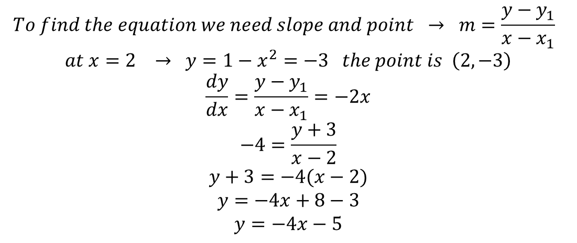
$$Example: Find \frac{dy}{dx} of y=\frac{x}{x^{2}+1}(2x^{3}+2x^{2})$$
$$\frac{dy}{dx}=\frac{x}{x^{2}+1}\left(6x^{2}+4x\right)+(2x^{3}+2x^{2})\frac{\left(x^{2}+1\right)−x(2x)}{{\left(x^{2}+1\right)}^{2}}$$
$$=\frac{x(6x^{2}+4x)}{x^{2}+1}+2x^{2}\left(x+1\right)\frac{−x^{2}+1}{{\left(x^{2}+1\right)}^{2}}$$
$$Example:Find the equation for the line that is tangent to y=(1−x)(1+x)$$
$$at the point where x=2$$
$$To find the equation we need slope and point → m=\frac{y−y_{1}}{x−x_{1}}$$
$$at x=2 → y=1−x^{2}=−3 the point is \left(2, −3\right)$$
$$\frac{dy}{dx}=\frac{y−y_{1}}{x−x_{1}}=−2x$$
$$−4=\frac{y+3}{x−2}$$
$$y+3=−4(x−2)$$
$$y=−4x+8−3$$
$$y=−4x−5$$

Slide 3
Derivative of Trigonometric functions
To calculate the derivative of f(x)= sin x
$$\frac{dy}{dx}=\lim_{h→0}{\frac{f\left(x+h\right)−f(x)}{h}}$$
$$=\lim_{h→0}{\frac{\sin\left(x+h\right)−sinx}{h}}=\lim_{h→0}{\frac{sinx\cos{h+cosx\sin{h−sinx}}}{h}}$$
$$=\lim_{h→0}{\frac{sinx\left(cosh−1\right)+cosx\sin{h}}{h}}$$
$$=\lim_{h→0}{ sinx \frac{\cos{h−1}}{h}+\lim_{h→0}{\frac{cosx sinh}{h}}}$$
$$=0+\cos{x=\cos{x}}$$
$$∴\frac{d}{dx}\left(sinx\right)=\cos{x} ,\frac{d}{dx}(\cos{x)=−sinx}$$
$$\frac{d}{dx}(\tan{x)=\sec^{2}x} ,\frac{d}{dx}\left(cotx\right)=−\csc^{2}x$$
$$\frac{d}{dx}(\sec{x)=\sec{x\tan{x ,\frac{d}{dx}(\csc{x)=−\csc{x\cot{x}}}}}}$$

Slide 4
$$Example: Find y^{′′} if y=sec x$$
$$\frac{dy}{dx}=\sec{x\tan{x}}$$
$$\frac{d^{2}y}{dx^{2}}=\sec{x \sec^{2}x+\tan{x}\sec{x\tan{x}}}$$
$$=\sec^{3}x+\tan^{2}x \sec{x }$$
Chain Rule
$$If y=f\left(u\right) and u=g\left(x\right) then$$
$$\frac{dy}{dx}=\frac{dy}{du}. \frac{du}{dx}$$
$$Example: Let y=u^{2} and u=3x^{2}+1 , find \frac{dy}{dx}$$
$$\frac{dy}{dx}=\frac{dy}{du}.\frac{du}{dx}=2u. 6x=12 ux$$
$$=12x(3x^{2}+1)$$

Slide 5
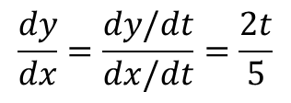
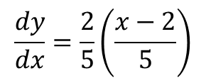
$$Example: Let y= t^{2} and x=5t+2 , find \frac{dy}{dx}$$
$$\frac{dy}{dx}=\frac{dy/dt}{dx/dt}=\frac{2t}{5}$$
$$\frac{dy}{dx}=\frac{2}{5}\left(\frac{x−2}{5}\right)$$
$$Example:Find \frac{dy}{dx} if 5y^{2}+sin y=x^{2}$$
$$10y \frac{dy}{dx}+cosy \frac{dy}{dx}=2x$$
$$\frac{dy}{dx}(10y+\cos{y)=2x}$$
$$\frac{dy}{dx}=\frac{2x}{10y+\cos{y}}$$

Slide 6
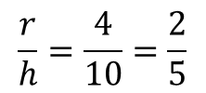
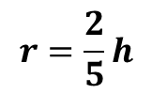
Example
$$\frac{r}{h}=\frac{4}{10}=\frac{2}{5}$$
$$r=\frac{2}{5}h$$

Slide 7
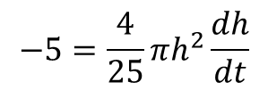
$$\frac{dh}{dt}=? , V=\frac{1}{3}πr^{2}h$$
$$V=\frac{1}{3}π\frac{4}{25}h^{3}=\frac{4}{75}πh^{3}$$
$$\frac{dV}{dt}=\frac{4}{75}π. 3h^{2}\frac{dh}{dt}$$
$$−5=\frac{4}{25}πh^{2}\frac{dh}{dt}$$
$$\frac{dh}{dt}=\frac{−125}{4πh^{2}}=\frac{−125 }{4π(36)}=−0.276 \frac{ft}{min}$$

