Slide 1
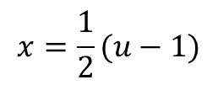
Substitution Rule
$$\int{f \left(g\left(x\right)g^{′}(x)\right)=\int{f\left(u\right)du}}$$
Example
$$Evaluate \int{x\sqrt{2x+1}}dx$$
$$u=2x+1 → du=2dx$$
$$x=\frac{1}{2}(u−1)$$
$$\int{\frac{1}{4}\left(u−1\right)u^{\frac{1}{2}}du= \frac{1}{4}\int{\left(u^{\frac{3}{2}}−u^{\frac{1}{2}}\right)du}}$$
$$=\frac{1}{4}\left(\frac{2}{5}u^{\frac{5}{2}}−\frac{2}{3}u^{\frac{3}{2}}\right)+c$$
$$=\frac{1}{4}\left[\frac{2}{5}{\left(2x+1\right)}^{\frac{5}{2}}−\frac{2}{3}{\left(2x+1\right)}^{\frac{3}{2}}\right]+c$$
$$=\frac{1}{10}{\left(2x+1\right)}^{\frac{5}{2}}−\frac{1}{6}{\left(2x+1\right)}^{\frac{3}{2}}+c$$

Slide 2
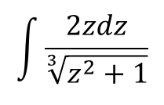
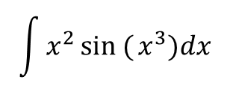
Example
$$\int{\frac{2zdz}{\sqrt[3]{z^{2}+1}}}$$
$$u=z^{2}+1 → du=2zdz$$
$$\int{\frac{du}{u^{\frac{1}{3}}}=\int{u^{−\frac{1}{3}}du=\frac{3}{2}u^{\frac{2}{3}}+c}}$$
$$=\frac{3}{2}{\left(z^{2}+1\right)}^{\frac{2}{3}}+c$$
Example
$$\int{x^{2}sin ({x^{3})dx}}$$
$$u=x^{3} → du=3x^{2}dx$$
$$=\int{\frac{1}{3}sinu du=−\frac{1}{3}cosu+c}$$
$$=−\frac{1}{3}\cos{x^{3}+c}$$

Slide 3
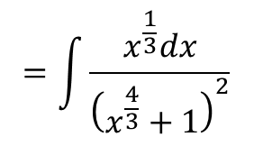
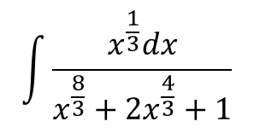
Example:
$$\int{\frac{x^{\frac{1}{3}}dx}{x^{\frac{8}{3}}+2x^{\frac{4}{3}}+1}}$$
$$=\int{\frac{x^{\frac{1}{3}}dx}{{\left(x^{\frac{4}{3}}+1\right)}^{2}}}$$
$$u=x^{\frac{4}{3}}+1 → du=\frac{4}{3}x^{\frac{1}{3}}dx$$
$$=\frac{3}{4}\int{\frac{du}{u^{2}}=\frac{3}{4}\int{u^{−2}du=\frac{−3}{4}u^{−1}+c=−\frac{3}{4\left(x^{\frac{4}{3}}+1\right)}+c}}$$
Example:
$$Evaluate \int{\sqrt{3−2s} ds}$$
$$u=3−2s → du=−2ds$$
$$\int{−\frac{1}{2}u^{\frac{1}{2}}}du=−\frac{1}{3}u^{\frac{3}{2}}+c=−\frac{1}{3}{\left(3−2s\right)}^{\frac{3}{2}}+c$$

Slide 4
Area Between Curves
Example: Find the area of the region enclosed by the parabola $y=2−x^{2}$ and the line
$y=−x$
$$y=−x$$
0, 2
-1,1
$$\frac{dy}{dx}=−2x=0 → x=0 ∴y=2$$
$$P(0, 2)$$
2,-2
$$\frac{d^{2}y}{dx^{2}}=−2 ∴ P\left(0, 2\right) is maximum$$
$$−x=2−x^{2} → x^{2}−x−2=0$$
$$\left(x−2\right)\left(x+1\right)=0$$
$$x=2 → y=−2 P(2, −2)$$
$$or x=−1 → y=1 P(−1, 1)$$
$$A=\int_{−1}^{2}{ydx=\int_{−1}^{2}{\left(2−x^{2}+x\right)dx={{\left[2x−\frac{x^{3}}{3}+\frac{x^{2}}{2}\right]}_{−1}}^{2}}}$$
$$=4−\frac{8}{3}+\frac{4}{2}−\left(−2+\frac{1}{3}+\frac{1}{2}\right)=\frac{9}{2}$$

