Slide 1
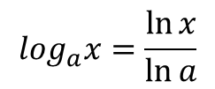
Logarithms with base a
For any positive number $a≠1, \log_{a}x$ is the inverse function of $a^{x}$
When $a=e$ , we have $\log_{e}x=(inverse of e^{x})=\ln{x}$
The function $\log_{10}x$ is sometimes written simply as
$\log{x}$ and is called the common logarithm of x
$$a^{\log_{a}x}=x x>0$$
$$\log_{a}\left(a^{x}\right)=x all x$$
$$let y=\log_{a}x → x=a^{y}$$
$$\ln{x=y\ln{a ∴ y=\frac{\ln{x}}{\ln{a}}}}$$
$$\log_{a}x=\frac{\ln{x}}{\ln{a}}$$
$$\frac{d}{dx}\left(\log_{a}u\right)=\frac{d}{dx}\left(\frac{\ln{u}}{\ln{a}}\right)=\frac{1}{\ln{a}}.\frac{1}{u}.\frac{du}{dx}$$

Slide 2
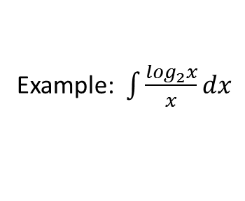
Example: $\frac{d}{dx}\log_{10}(3x+1)$
$$=\frac{d}{dx}\left(\frac{ln⁡(3x+1)}{\ln{10}}\right)=\frac{1}{\ln{10}}.\frac{1}{⁡(3x+1)}.3=\frac{3}{\ln\left(10\right).(3x+1)}$$
Example: $\int{\frac{\log_{2}x}{x}dx}$
$$=\int{\frac{\frac{\ln{x}}{\ln{2}}}{x}dx=\frac{1}{\ln{2}}\int{\frac{\ln{x}}{x}dx}}$$
$$u=\ln{x →du=\frac{dx}{x}}$$
$$=\frac{1}{\ln{2}}\int{udu=\frac{1}{\ln{2}}\frac{u^{2}}{2}+c}$$
$$=\frac{1}{\ln{2}}. \frac{{\left(lnx\right)}^{2}}{2}+c=\frac{{\left(lnx\right)}^{2}}{2\ln{2}}+c$$
Example: $Solve the differential equation \frac{dy}{dt}=ky$
$$\frac{dy}{y}=kdt → \ln{y=kt+c}$$
$$y=e^{kt+c}=e^{kt}.e^{c}$$
$$y=A e^{kt}$$

Slide 3
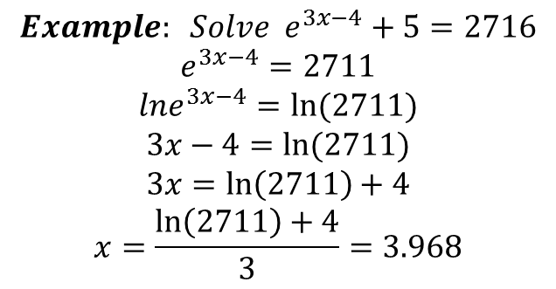
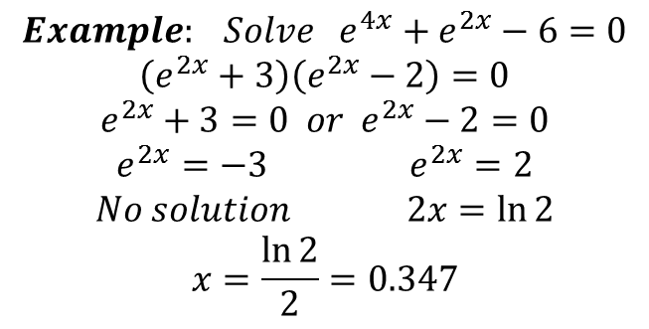
$$Example: Solve e^{3x−4}+5=2716$$
$$e^{3x−4}=2711$$
$$lne^{3x−4}=ln⁡(2711)$$
$$3x−4=\ln{(2711)}$$
$$3x=\ln\left(2711\right)+4$$
$$x=\frac{\ln\left(2711\right)+4}{3}=3.968$$
$Example: Solve {10}^{x}=41$
$$\log{{10}^{x}=\log{41}}$$
$$x=\log{41}$$
$$Example: Solve e^{4x}+e^{2x}−6=0$$
$$\left(e^{2x}+3\right)\left(e^{2x}−2\right)=0$$
$$e^{2x}+3=0 or e^{2x}−2=0$$
$$e^{2x}=−3 e^{2x}=2$$
$$No solution 2x=\ln{2}$$
$$x=\frac{\ln{2}}{2}=0.347$$

Slide 4
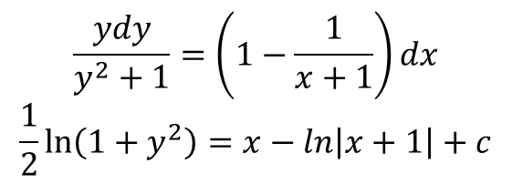
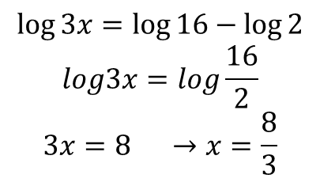
Example: $Solve the differential equation \frac{dy}{dx}=\left(1+y\right)e^{x} , y>−1$
$$\frac{dy}{1+y}=e^{x}dx → \ln\left(1+y\right)=e^{x}+c$$
Example: Solve the equation $y\left(x+1\right)\frac{dy}{dx}=x(y^{2}+1)$
$$y\left(x+1\right)dy=x\left(y^{2}+1\right)dx$$
$$\frac{ydy}{y^{2}+1}=\frac{xdx}{x+1}$$
$$\frac{x}{x+1}=1−\frac{1}{x+1}$$
$$\frac{ydy}{y^{2}+1}=\left(1−\frac{1}{x+1}\right)dx$$
$$\frac{1}{2}\ln\left(1+y^{2}\right)=x−ln\left|x+1\right|+c$$
$$Example:Solve \log{x+\log{3=2\log{4−\log{2}}}}$$
$$\log{3x=\log{16−\log{2}}}$$
$$log3x=log\frac{16}{2}$$
$$3x=8 →x=\frac{8}{3}$$

Slide 5
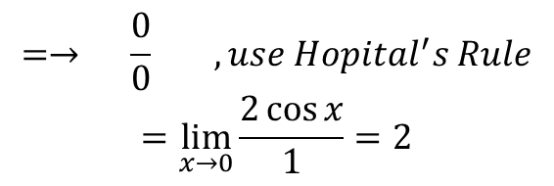
Indeterminate forms and Hopital’s Rule
Using Hopital’s Rule to find the limits of some sequences
Theorem $If \lim_{x→a}{\frac{f(x)}{g(x)}=\frac{0}{0} or \frac{∞}{∞}} then \lim_{x→a}{\frac{f(x)}{g(x)}=\lim_{x→a}{\frac{f^{′}(x)}{g^{′}(x)}}}$
$$Example: Find \lim_{x→0}{\frac{\sin{2x}}{x}}$$
$$=→ \frac{0}{0} , use Hopital^{′}s Rule$$
$$=\lim_{x→0}{\frac{2\cos{x}}{1}=2}$$
$$Example: Find \lim_{x→∞}{\frac{x^{2}+x−1}{2x^{2}+5}}$$
$$= → \frac{∞}{∞} use Hopital^{′}s Rule$$
$$=\lim_{x→∞}{\frac{2x+1}{4x} → \frac{∞}{∞} , use Hopital^{′}s Rule second time}$$
$$=\lim_{x→∞}{\frac{2}{4}=\frac{1}{2}}$$

Slide 6
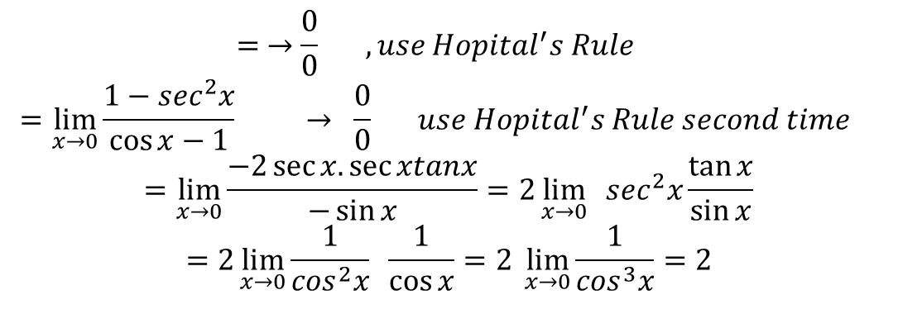
$$Example: Find \lim_{x→0}{\frac{x−\tan{x}}{\sin{x−x}}}$$
$$= →\frac{0}{0} , use Hopital^{′}s Rule$$
$$=\lim_{x→0}{\frac{1−\sec^{2}x}{\cos{x−1}} → \frac{0}{0} use Hopital^{′}s Rule second time }$$
$$=\lim_{x→0}{\frac{−2\sec{x.\sec{xtanx}}}{−\sin{x}}=2\lim_{x→0}{ \sec^{2}x\frac{\tan{x}}{\sin{x}}}}$$
$$=2\lim_{x→0}{\frac{1}{\cos^{2}x} \frac{1}{\cos{x}}=2 \lim_{x→0}{\frac{1}{\cos^{3}x}=2}}$$
Indeterminate form $0−∞ →\frac{0}{0} or \frac{∞}{∞}$
$$Example: Find \lim_{x→0}{x\ln{x}}$$
$$= 0. ∞ or \lim_{x→0}{\frac{\ln{x}}{\frac{1}{x}} → \frac{∞}{∞} , use Hopital^{′}s Rule}$$
$$\lim_{x→0}{\frac{\frac{1}{x}}{−\frac{1}{x^{2}}}=\lim_{x→0}\left(−x\right)=0}$$

Slide 7
$$Example:Find \lim_{x→\frac{π}{4}}\left(1−\tan{x}\right)\sec{2x }$$
$$=0.∞ or \lim_{x→\frac{π}{4}}{\frac{1−\tan{x}}{\frac{1}{\sec{2x}}}=\lim_{x→\frac{π}{4}}{\frac{1−\tan{x}}{\cos{2x}}}=\frac{0}{0} , use Hopital^{′}s Rule}$$
$$=\lim_{x→\frac{π}{4}}{\frac{−\sec^{2}x}{−2\sin{2x}}=\lim_{x→\frac{π}{4}}{\frac{\frac{1}{\cos^{2}x}}{2\sin{2x}}=\frac{2}{2}}=1}$$
Indeterminate form $∞−∞ →\frac{0}{0} or \frac{∞}{∞}$
$$Example:Find \lim_{x→0}\left(\frac{1}{x}−\frac{1}{sinx}\right)$$
$=$ $∞−∞ or =\lim_{x→0}{\frac{sin x−x}{xsin x}=\frac{0}{0} use Hopital^{′}s Rule}$
$$=\lim_{x→0}{\frac{\cos{x−1}}{xcos x+sinx}= \frac{0}{0} , use Hopital^{′}s Rule second time}$$
$$=\lim_{x→0}{\frac{−\sin{x}}{−xsin x+\cos{x}+\cos{x}}=\frac{0}{2}=0}$$

Slide 8
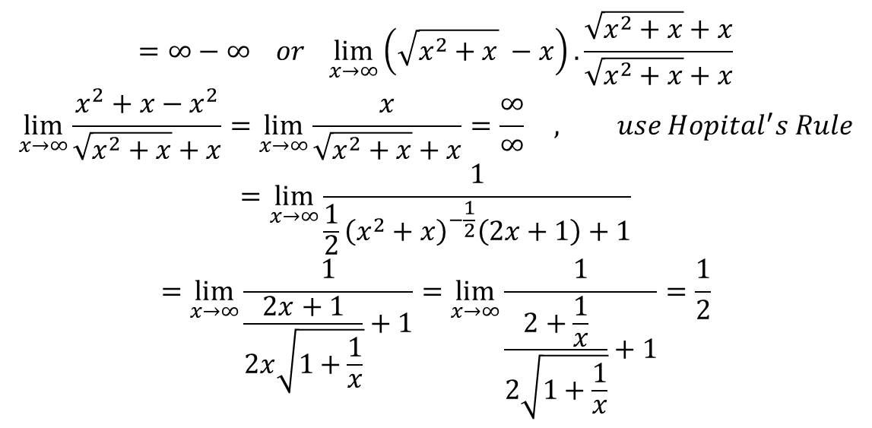
$$Example:Find \lim_{x→∞}\left(\sqrt{x^{2}+x} −x\right)$$
$$=∞−∞ or \lim_{x→∞}\left(\sqrt{x^{2}+x} −x\right).\frac{\sqrt{x^{2}+x}+x}{\sqrt{x^{2}+x}+x}$$
$$\lim_{x→∞}{\frac{x^{2}+x−x^{2}}{\sqrt{x^{2}+x}+x}=\lim_{x→∞}{\frac{x}{\sqrt{x^{2}+x}+x}=\frac{∞}{∞} , use Hopital^{′}s Rule}}$$
$$=\lim_{x→∞}{\frac{1}{\frac{1}{2}{\left(x^{2}+x\right)}^{−\frac{1}{2}}\left(2x+1\right)+1}}$$
$$=\lim_{x→∞}{\frac{1}{\frac{2x+1}{2x\sqrt{1+\frac{1}{x}}}+1}}=\lim_{x→∞}{\frac{1}{\frac{2+\frac{1}{x}}{2\sqrt{1+\frac{1}{x}}}+1}=\frac{1}{2}}$$
$$The form 0^{0}, ∞^{0} , 1^{∞}$$
$$example: Find \lim_{x→0}{{\left(1+x\right)}^{\frac{1}{x}}}$$
$$=1^{∞} → y={\left(1+x\right)}^{\frac{1}{x}}$$
$$\ln{y=\frac{1}{x}\ln\left(1+x\right)}$$

Slide 9
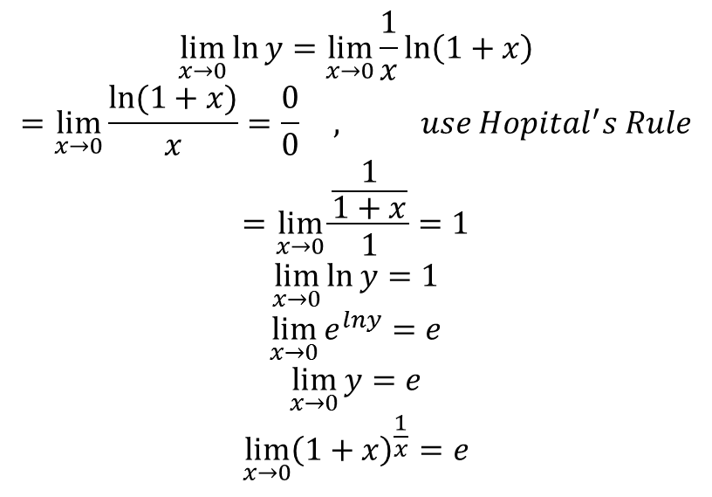
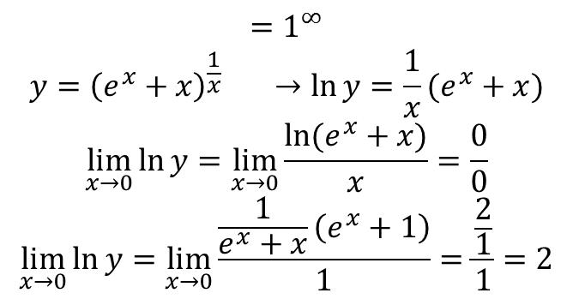
$$\lim_{x→0}{\ln{y=\lim_{x→0}{\frac{1}{x}\ln\left(1+x\right)}}}$$
$$=\lim_{x→0}{\frac{ln⁡(1+x)}{x}=\frac{0}{0} , use Hopital^{′}s Rule}$$
$$=\lim_{x→0}{\frac{\frac{1}{1+x}}{1}=1}$$
$$\lim_{x→0}{\ln{y=1}}$$
$$\lim_{x→0}{e^{lny}=e}$$
$$\lim_{x→0}{y=e}$$
$$\lim_{x→0}{{\left(1+x\right)}^{\frac{1}{x}}=e}$$
$$Example: Find \lim_{x→0}{{\left(e^{x}+x\right)}^{\frac{1}{x}}}$$
$$=1^{∞}$$
$$y={\left(e^{x}+x\right)}^{\frac{1}{x}} →\ln{y=\frac{1}{x}(e^{x}+x)}$$
$$\lim_{x→0}{\ln{y=\lim_{x→0}{\frac{ln⁡(e^{x}+x)}{x}}}}=\frac{0}{0}$$
$$\lim_{x→0}{\ln{y=\lim_{x→0}{\frac{\frac{1}{e^{x}+x}\left(e^{x}+1\right)}{1}}=\frac{\frac{2}{1}}{1}=2}}$$

Slide 10
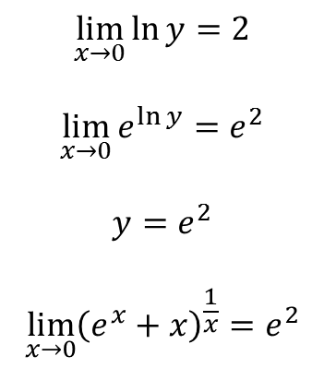
$$\lim_{x→0}{\ln{y=2}}$$
$$\lim_{x→0}{e^{\ln{y}}=e^{2}}$$
$$y=e^{2}$$
$$\lim_{x→0}{{\left(e^{x}+x\right)}^{\frac{1}{x}}=e^{2}}$$

