Slide 1
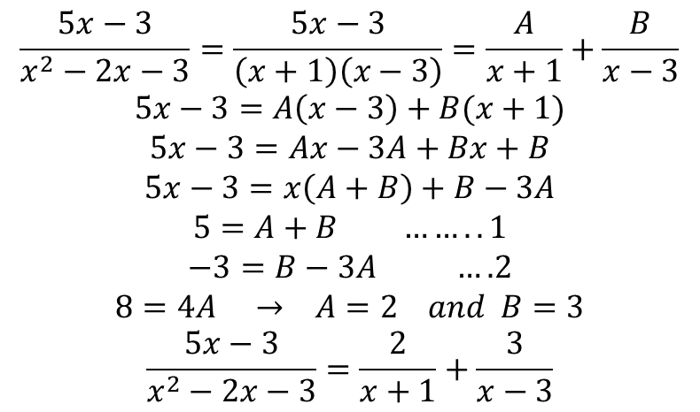
Integration of rational functions by Partial Fractions
This method shows how to express a rational functions as a sum of simpler fractions, called
Partial fraction of which are easily integrated.
$$Example: \int{\frac{5x−3}{x^{2}−2x−3}dx=\int{\frac{2 dx}{x+1}}+\int{\frac{3 dx}{x−3}}}$$
$$u=x+1 →du=dx and v=x−3 →dv=dx$$
$$=2ln\left|x+1\right|+3\ln\left|x−3\right|+c$$
$$\frac{5x−3}{x^{2}−2x−3}=\frac{5x−3}{\left(x+1\right)\left(x−3\right)}=\frac{A}{x+1}+\frac{B}{x−3}$$
$$5x−3=A\left(x−3\right)+B(x+1)$$
$$5x−3=Ax−3A+Bx+B$$
$$5x−3=x\left(A+B\right)+B−3A$$
$$5=A+B …….. 1$$
$$−3=B−3A ….2$$
$$8=4A → A=2 and B=3$$
$$\frac{5x−3}{x^{2}−2x−3}=\frac{2}{x+1}+\frac{3}{x−3}$$

Slide 2
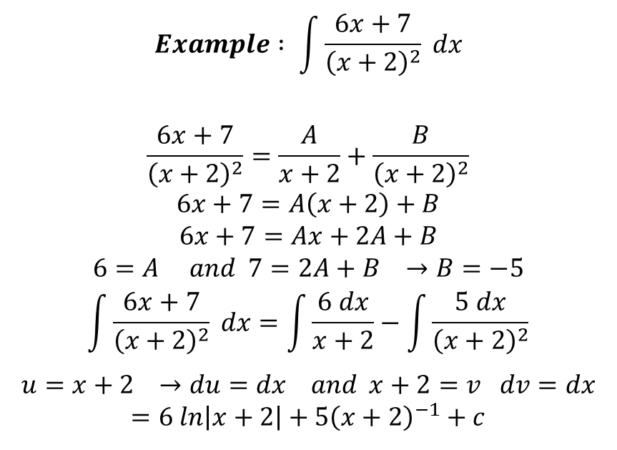
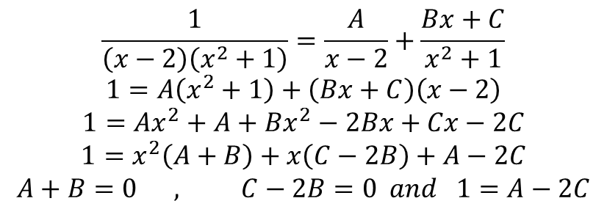
$$Example : \int{\frac{6x+7}{{\left(x+2\right)}^{2}}} dx$$
$$\frac{6x+7}{{\left(x+2\right)}^{2}}=\frac{A}{x+2}+\frac{B}{{\left(x+2\right)}^{2}}$$
$$6x+7=A\left(x+2\right)+B$$
$$6x+7=Ax+2A+B$$
$$6=A and 7=2A+B →B=−5$$
$$\int{\frac{6x+7}{{\left(x+2\right)}^{2}} dx}=\int{\frac{6 dx}{x+2}}−\int{\frac{5 dx}{{\left(x+2\right)}^{2}}}$$
$$u=x+2 →du=dx and x+2=v dv=dx$$
$$=6 ln\left|x+2\right|+5{\left(x+2\right)}^{−1}+c$$
$$Example: Evaluate \int{\frac{dx}{\left(x−2\right)\left(x^{2}+1\right)}}$$
$$\frac{1}{\left(x−2\right)\left(x^{2}+1\right)}=\frac{A}{x−2}+\frac{Bx+C}{x^{2}+1}$$
$$1=A\left(x^{2}+1\right)+\left(Bx+C\right)\left(x−2\right)$$
$$1=Ax^{2}+A+Bx^{2}−2Bx+Cx−2C$$
$$1=x^{2}\left(A+B\right)+x\left(C−2B\right)+A−2C$$
$$A+B=0 , C−2B=0 and 1=A−2C$$

Slide 3
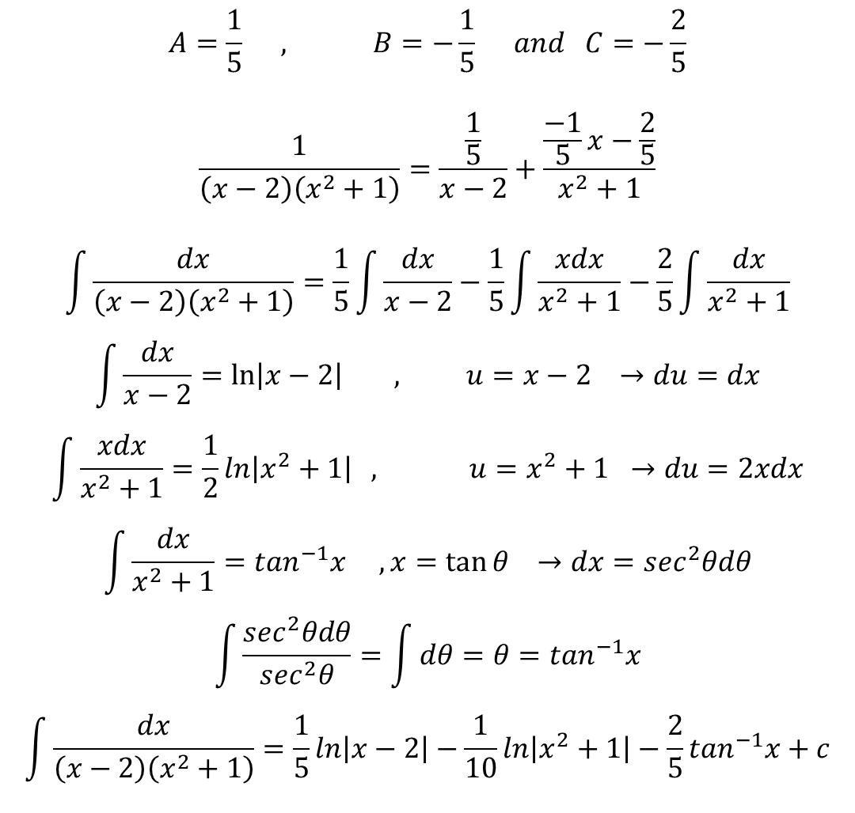
$$A=\frac{1}{5} , B=−\frac{1}{5} and C=−\frac{2}{5}$$
$$\frac{1}{\left(x−2\right)\left(x^{2}+1\right)}=\frac{\frac{1}{5}}{x−2}+\frac{\frac{−1}{5}x−\frac{2}{5}}{x^{2}+1}$$
$$\int{\frac{dx}{\left(x−2\right)\left(x^{2}+1\right)}}=\frac{1}{5}\int{\frac{dx}{x−2}−\frac{1}{5}\int{\frac{xdx}{x^{2}+1}−\frac{2}{5}\int{\frac{dx}{x^{2}+1}}}}$$
$$\int{\frac{dx}{x−2}=\ln\left|x−2\right| , u=x−2 →du=dx}$$
$$\int{\frac{xdx}{x^{2}+1}=\frac{1}{2}ln\left|x^{2}+1\right|} , u=x^{2}+1 →du=2xdx$$
$$\int{\frac{dx}{x^{2}+1}=\tan^{−1}x , x=\tan{θ →dx=\sec^{2}θdθ}}$$
$$\int{\frac{\sec^{2}θdθ}{\sec^{2}θ}=\int{dθ=θ=\tan^{−1}x}}$$
$$\int{\frac{dx}{\left(x−2\right)\left(x^{2}+1\right)}}=\frac{1}{5}ln\left|x−2\right|−\frac{1}{10}ln\left|x^{2}+1\right|−\frac{2}{5}\tan^{−1}x+c$$

Slide 4
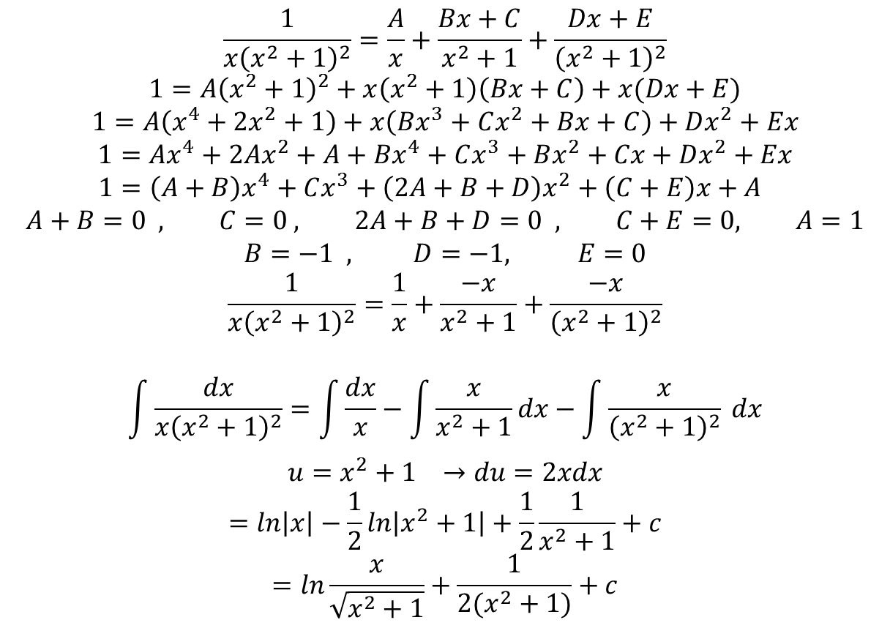
$$Example: \int{\frac{dx}{x{\left(x^{2}+1\right)}^{2}}}$$
$$\frac{1}{x{\left(x^{2}+1\right)}^{2}}=\frac{A}{x}+\frac{Bx+C}{x^{2}+1}+\frac{Dx+E}{{\left(x^{2}+1\right)}^{2}}$$
$$1=A{\left(x^{2}+1\right)}^{2}+x\left(x^{2}+1\right)\left(Bx+C\right)+x(Dx+E)$$
$$1=A\left(x^{4}+2x^{2}+1\right)+x\left(Bx^{3}+Cx^{2}+Bx+C\right)+Dx^{2}+Ex$$
$$1=Ax^{4}+2Ax^{2}+A+Bx^{4}+Cx^{3}+Bx^{2}+Cx+Dx^{2}+Ex$$
$$1=\left(A+B\right)x^{4}+Cx^{3}+\left(2A+B+D\right)x^{2}+\left(C+E\right)x+A$$
$$A+B=0 , C=0 , 2A+B+D=0 , C+E=0, A=1$$
$$B=−1 , D=−1, E=0$$
$$\frac{1}{x{\left(x^{2}+1\right)}^{2}}=\frac{1}{x}+\frac{−x}{x^{2}+1}+\frac{−x}{{\left(x^{2}+1\right)}^{2}}$$
$$\int{\frac{dx}{x{\left(x^{2}+1\right)}^{2}}}=\int{\frac{dx}{x}−\int{\frac{x}{x^{2}+1}dx−\int{\frac{x}{{\left(x^{2}+1\right)}^{2}} dx}}}$$
$$u=x^{2}+1 →du=2xdx$$
$$=ln\left|x\right|−\frac{1}{2}ln\left|x^{2}+1\right|+\frac{1}{2}\frac{1}{x^{2}+1}+c$$
$$=ln\frac{x}{\sqrt{x^{2}+1}}+\frac{1}{2(x^{2}+1)}+c$$

Slide 5
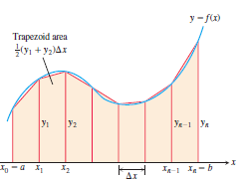
Numerical Integration
Integration two such methods, the Trapezoidal Rule and Simpson’s Rule.
Trapezoidal Approximation
It is based on approximating the region between a curve and the x-axis with trapezoids instead
of rectangles as in figure. The length of each subinterval is
$$∆x=\frac{b−a}{n}=step size$$
The area of the trapezoid that lies above the ith
Subinterval is
$$T=\frac{∆x}{2}(y_{o}+{2y}_{1}+2y_{2}+…+y_{n})$$

Slide 6
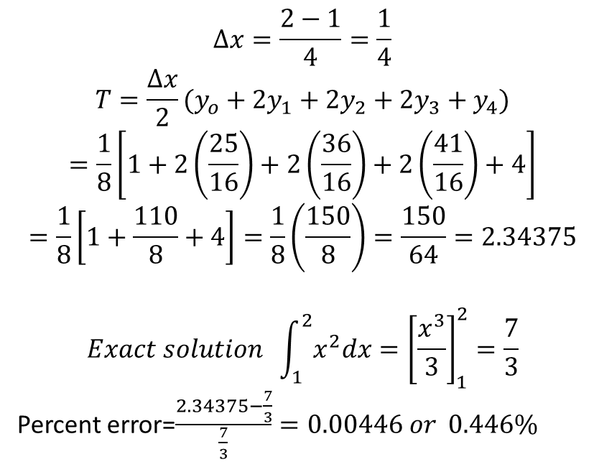
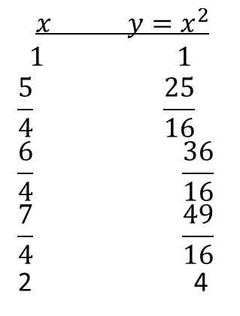
Example: Use the Trapezoidal Rule with n=4 to estimate $\int_{1}^{2}{x^{2}dx}$. Compare the estimate with
the exact value.
$$∆x=\frac{2−1}{4}=\frac{1}{4}$$
$$T=\frac{∆x}{2}(y_{o}+2y_{1}+2y_{2}+2y_{3}+y_{4})$$
$$=\frac{1}{8}\left[1+2\left(\frac{25}{16}\right)+2\left(\frac{36}{16}\right)+2\left(\frac{41}{16}\right)+4\right]$$
$$=\frac{1}{8}\left[1+\frac{110}{8}+4\right]=\frac{1}{8}\left(\frac{150}{8}\right)=\frac{150}{64}=2.34375$$
$$Exact solution \int_{1}^{2}{x^{2}dx}={\left[\frac{x^{3}}{3}\right]}_{1}^{2}=\frac{7}{3}$$
Percent error=$\frac{2.34375−\frac{7}{3}}{\frac{7}{3}}=0.00446 or 0.446\%$
$$x y=x^{2}$$
$$1 1$$
$$\frac{5}{4} \frac{25}{16}$$
$$\frac{6}{4} \frac{36}{16}$$
$$\frac{7}{4} \frac{49}{16}$$
2 4

Slide 7
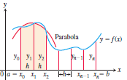
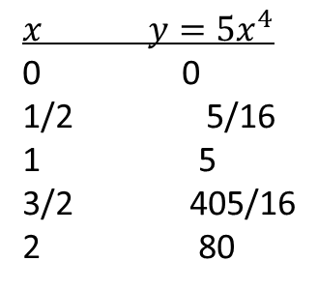
$$A=\frac{h}{3}\left(y_{o}+4y_{1}+2y_{2}+4y_{3}+2y_{4}+…+y_{n}\right)$$
Example: Use Simpson’s Rule with n=4 to approximate
$\int_{0}^{2}{5x^{4}dx}$
$$∆x=\frac{2−0}{4}=\frac{1}{2}$$
$$A=\frac{h}{3}(y_{o}+{4y}_{1}+2y_{2}+4y_{3}+y_{4})$$
$$=\frac{1}{6}\left[0+4\left(\frac{5}{16}\right)+2\left(5\right)+4\left(\frac{405}{16}\right)+80 \right]$$
$$=32\frac{1}{12}$$
$$x y=5x^{4}$$
0 0
1/2 5/16
1 5
3/2 405/16
2 80

Slide 8
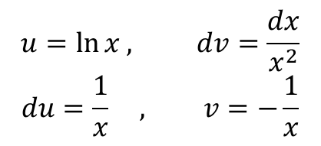
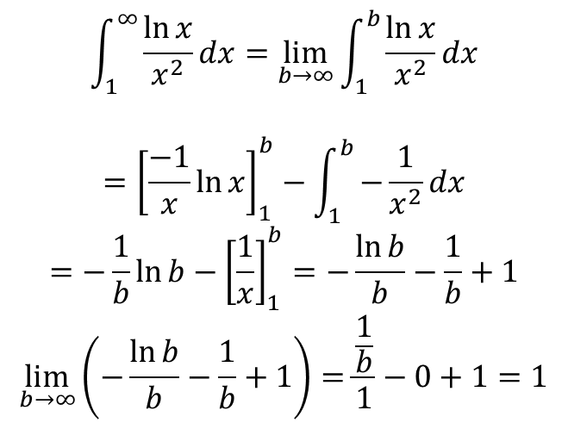
Improper Integrals
The integral for the area under the curve of $y=\frac{1}{\sqrt{x}}$ between x=0 and x=1 is an example
for which the range of integrand is infinite. This integral is said to be improper and is calculated
as limit .
Example: Is the area under the curve $y=\frac{\ln{x}}{x^{2}}$ from x=1 to x=$∞$ finite? If so, what its value?
$$\int_{1}^{∞}{\frac{\ln{x}}{x^{2}}dx=\lim_{b→∞}{\int_{1}^{b}{\frac{\ln{x}}{x^{2}}dx}}}$$
$$={\left[\frac{−1}{x}\ln{x}\right]}_{1}^{b}−\int_{1}^{b}{−\frac{1}{x^{2}}dx}$$
$$=−\frac{1}{b}\ln{b−{\left[\frac{1}{x}\right]}_{1}^{b}=−\frac{\ln{b}}{b}−\frac{1}{b}+1}$$
$$\lim_{b→∞}\left(−\frac{\ln{b}}{b}−\frac{1}{b}+1\right)=\frac{\frac{1}{b}}{1}−0+1=1$$
$$u=\ln{x , dv=\frac{dx}{x^{2}}}$$
$$du=\frac{1}{x} , v=−\frac{1}{x}$$

Slide 9
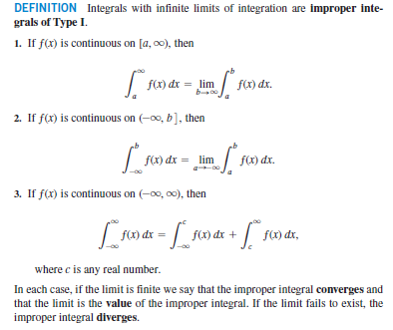
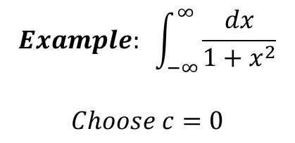
$$Example: \int_{−∞}^{∞}{\frac{dx}{1+x^{2}}}$$
$$Choose c=0$$

Slide 10
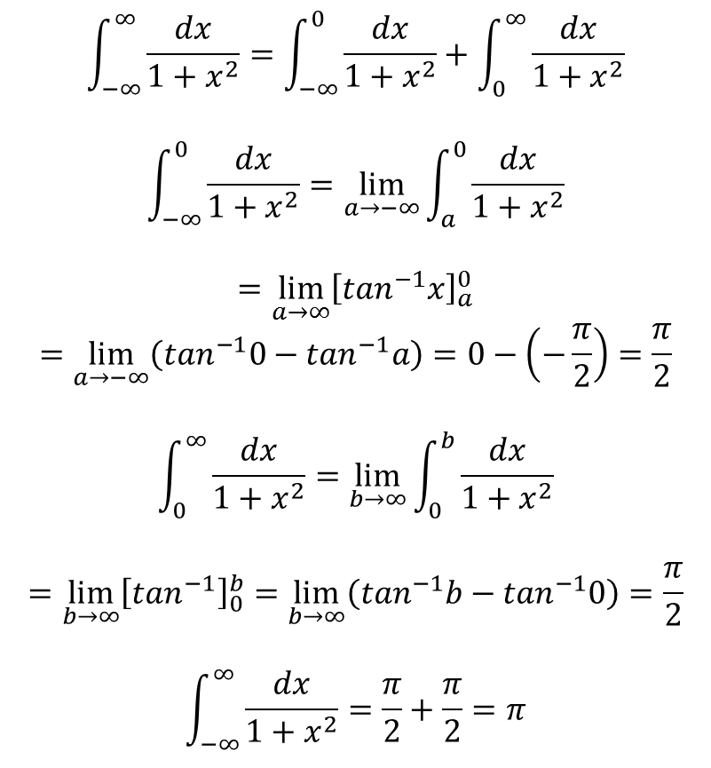
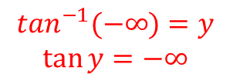
$$\int_{−∞}^{∞}{\frac{dx}{1+x^{2}}=\int_{−∞}^{0}{\frac{dx}{1+x^{2}}}+\int_{0}^{∞}{\frac{dx}{1+x^{2}}}}$$
$$\int_{−∞}^{0}{\frac{dx}{1+x^{2}}=\lim_{a→−∞}{\int_{a}^{0}{\frac{dx}{1+x^{2}}}}}$$
$$=\lim_{a→∞}{{\left[\tan^{−1}x\right]}_{a}^{0}}$$
$$=\lim_{a→−∞}\left(\tan^{−1}0−\tan^{−1}a\right)=0−\left(−\frac{π}{2}\right)=\frac{π}{2}$$
$$\int_{0}^{∞}{\frac{dx}{1+x^{2}}=\lim_{b→∞}{\int_{0}^{b}{\frac{dx}{1+x^{2}}}}}$$
$$=\lim_{b→∞}{{\left[\tan^{−1}\right]}_{0}^{b}=\lim_{b→∞}\left(\tan^{−1}b−\tan^{−1}0\right)}=\frac{π}{2}$$
$$\int_{−∞}^{∞}{\frac{dx}{1+x^{2}}=\frac{π}{2}+\frac{π}{2}=π}$$
$$x=\tan{θ →dx=\sec^{2}θdθ}$$
$$\tan^{−1}(−∞)=y$$
$$\tan{y=−∞}$$

Slide 11
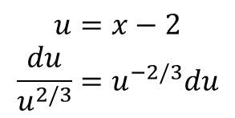
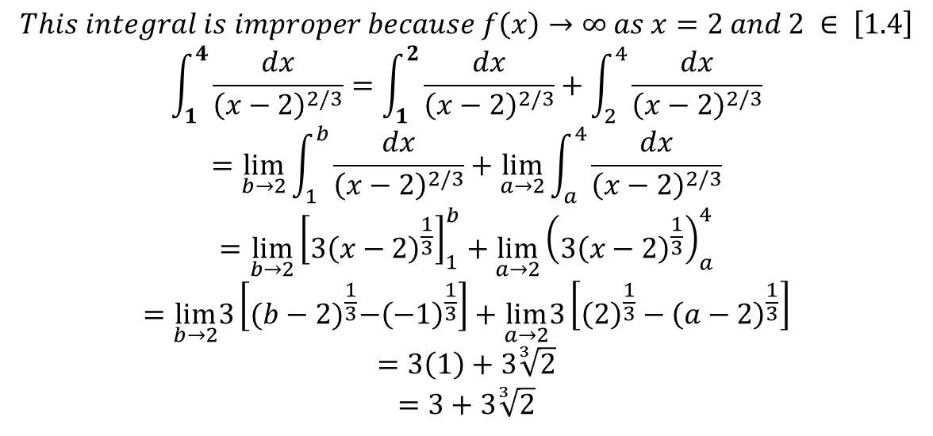
$$Example: \int_{−∞}^{0}{e^{x}dx}$$
$$=\lim_{a→−∞}{\int_{a}^{0}{e^{x}dx=\lim_{a→−∞}{{\left[e^{x}\right]}_{a}^{0}=\lim_{a→−∞}\left(e^{0}−e^{a}\right)}}}=1−0=1$$
$$Example:Evaluate \int_{1}^{4}{\frac{dx}{{\left(x−2\right)}^{2/3}}}$$
$$This integral is improper because f\left(x\right)→∞ as x=2 and 2 ∈ \left[1.4\right]$$
$$\int_{1}^{4}{\frac{dx}{{\left(x−2\right)}^{2/3}}}=\int_{1}^{2}{\frac{dx}{{\left(x−2\right)}^{2/3}}+\int_{2}^{4}{\frac{dx}{{\left(x−2\right)}^{2/3}}}}$$
$$=\lim_{b→2}{\int_{1}^{b}{\frac{dx}{{\left(x−2\right)}^{2/3}}+\lim_{a→2}{\int_{a}^{4}{\frac{dx}{{\left(x−2\right)}^{2/3}}}}}}$$
$$=\lim_{b→2}{{\left[3{\left(x−2\right)}^{\frac{1}{3}}\right]}_{1}^{b}+\lim_{a→2}{{\left(3{\left(x−2\right)}^{\frac{1}{3}}\right)}_{a}^{4}}}$$
$$=\lim_{b→2}3\left[{(b−2)}^{\frac{1}{3}}−{\left(−1\right)}^{\frac{1}{3}}\right]+\lim_{a→2}3\left[{\left(2\right)}^{\frac{1}{3}}−{\left(a−2\right)}^{\frac{1}{3}}\right]$$
$$=3\left(1\right)+3\sqrt[3]{2}$$
$$=3+3\sqrt[3]{2}$$
$$u=x−2$$
$$\frac{du}{u^{2/3}}=u^{−2/3}du$$

