Slide 1
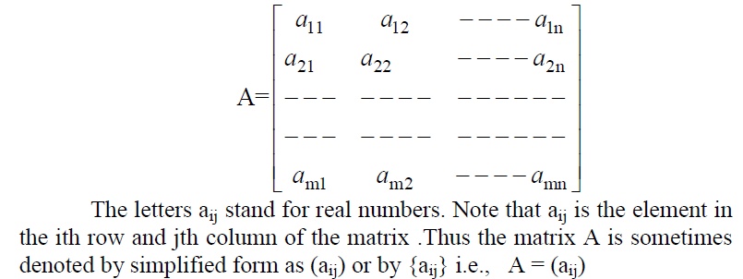

Slide 2
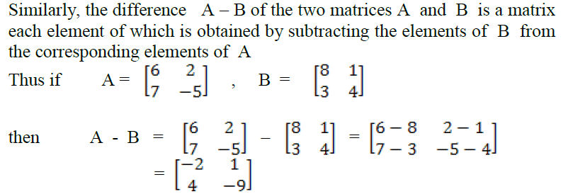

Slide 3
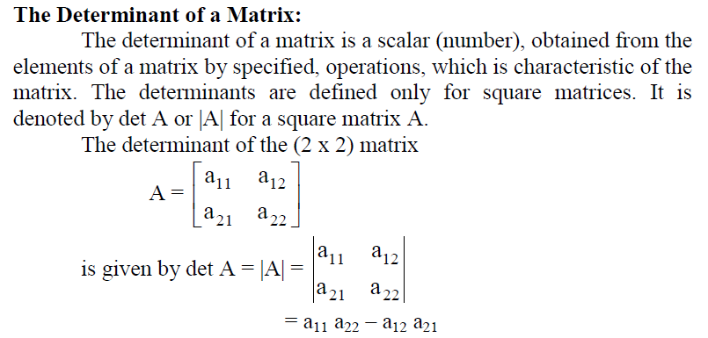

Slide 4
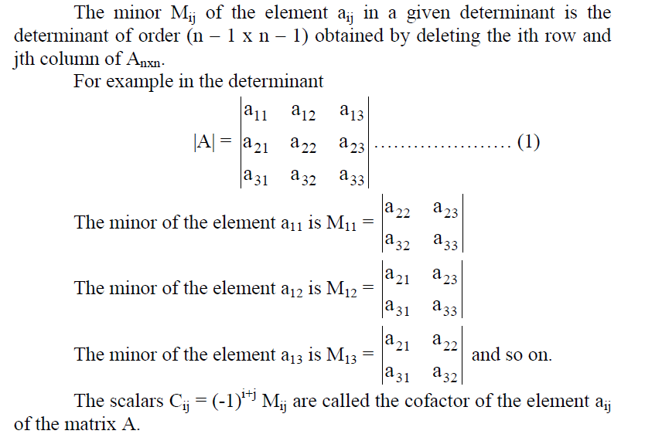

Slide 5
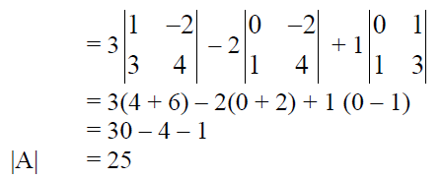
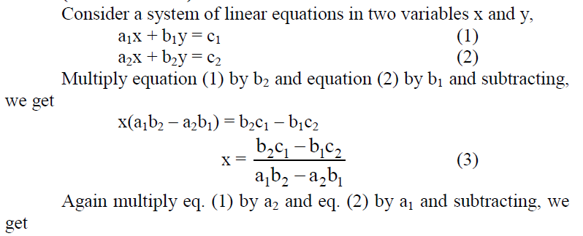
$$Example: If A=\left[\begin{matrix}3 & 2 & 1 \\ 0 & 1 & −2 \\ 1 & 3 & 4\end{matrix}\right]$$
$$Find\det{A?}$$

Slide 6
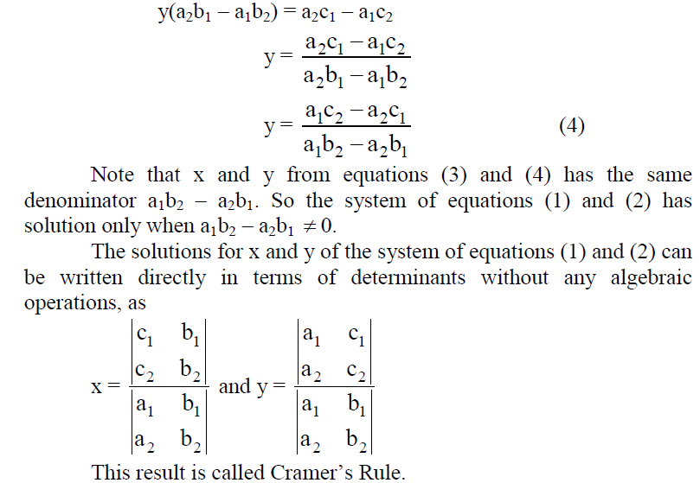

Slide 7
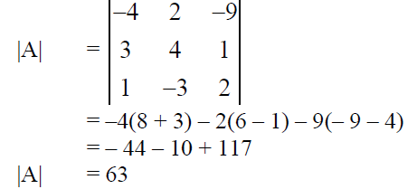
Example:

Slide 8
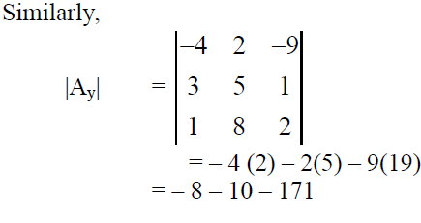
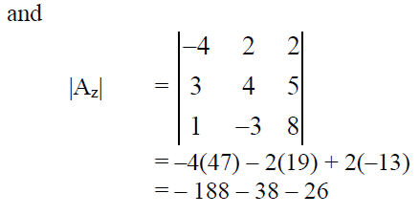

Slide 9
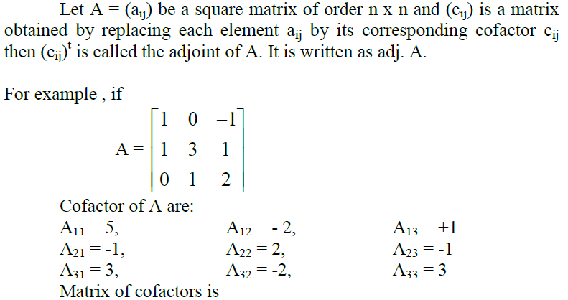

Slide 10
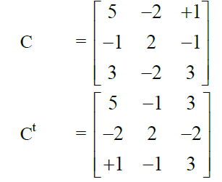

Slide 11
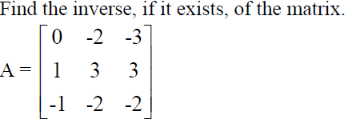
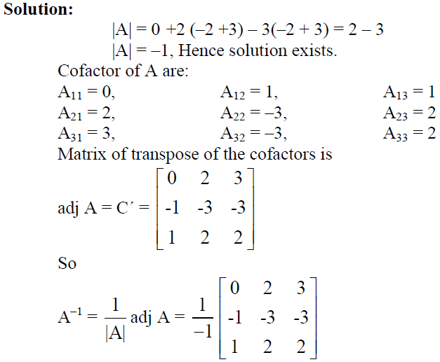
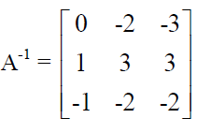
Example
$$→$$

Slide 12
To check $A.A^{−1}=1$
$$\left[\begin{matrix}0 & −2 & −3 \\ 1 & 3 & 3 \\ −1 & −2 & −2\end{matrix}\right].\left[\begin{matrix}0 & −2 & −3 \\ 1 & 3 & 3 \\ −1 & −2 & −2\end{matrix}\right]=\left[\begin{matrix}1 & 0 & 0 \\ 0 & 1 & 0 \\ 0 & 0 & 1\end{matrix}\right]$$
$$Solution of linear equations by Inverse Matrix$$
Consider linear equations
$$a_{11}x_{1}+a_{12}x_{2}+a_{13}x_{3}=b_{1}$$
$$a_{21}x_{1}+a_{22}x_{2}+a_{23}x_{3}=b_{2}$$
$$a_{31}x_{1}+a_{32}x_{2}+a_{33}x_{3}=b_{3}$$
$$\left[\begin{matrix}a_{11} & a_{12} & a_{13} \\ a_{21} & a_{22} & a_{23} \\ a_{31} & a_{32} & a_{33}\end{matrix}\right]\left[\begin{matrix}x_{1} \\ x_{2} \\ x_{3}\end{matrix}\right]=\left[\begin{matrix}b_{1} \\ b_{2} \\ b_{3}\end{matrix}\right]$$
$$\left[A\right].\left[X\right]=\left[B\right]$$
$$AX=B$$
$$A^{−1}.AX=A^{−1}B$$
$$X=A^{−1}B$$

Slide 13
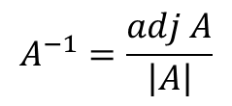
Example
$$A=\left|\begin{matrix}4 & 8 & 1 \\ 2 & −3 & 2 \\ 1 & 7 & −3\end{matrix}\right|=4\left(−5\right)+8\left(8\right)+1\left(17\right)=61$$
$$A^{−1} is exist$$
$$A^{−1}=\frac{adj A}{\left|A\right|}$$
$$C=\left[\begin{matrix}−5 & 8 & 17 \\ 31 & −13 & −20 \\ 19 & −6 & −28\end{matrix}\right]$$
$$→ Adj A=\left[\begin{matrix}−5 & 31 & 19 \\ 8 & −13 & −6 \\ 17 & −20 & −28\end{matrix}\right]$$
$$A^{−1}=\frac{1}{61}\left[\begin{matrix}−5 & 31 & 19 \\ 8 & −13 & −6 \\ 17 & −20 & −28\end{matrix}\right]$$

Slide 14
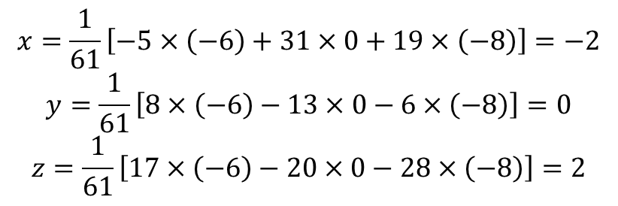
$$X=A^{−1}B=\frac{1}{61}\left[\begin{matrix}−5 & 31 & 19 \\ 8 & −13 & −6 \\ 17 & −20 & −28\end{matrix}\right]\left[\begin{matrix}−6 \\ 0 \\ −8\end{matrix}\right]$$
$$x=\frac{1}{61}\left[−5×\left(−6\right)+31×0+19×\left(−8\right)\right]=−2$$
$$y=\frac{1}{61}\left[8×\left(−6\right)−13×0−6×\left(−8\right)\right]=0$$
$$z=\frac{1}{61}\left[17×\left(−6\right)−20×0−28×\left(−8\right)\right]=2$$

