Slide 1
Inorganic Spectra By Dr. Ahmed Hussein
Lecture: 2
Infra – red spectra of
coordination compounds

Slide 2
2 – Complexes of ethylenediamine and it`s derivatives:
The conformation of ethylenediamine(en) in metal complexes is of particular interest in coordination chemistry. It was found that the CH₂ rocking mode couples strongly with the NH₂ rocking and CN stretching modes that appear in the same frequency region. X – ray analysis of the trans – [[Co(en)₂Cl₂]Cl indicate that the chelating ethylenediamine takes the gauche conformation ( Fig – 1a ).
The M – N stretching vibrations have been assigned in the region ( 410 – 380 cm⁻¹ ) for [M(en) ₃]⁺² ion ( M = Zn, Cd, Fe, Ni, Co and Mn) and in the region ( 550 – 400 cm⁻¹ ) for M = Cu, Pd and Pt. For [M(en) ₂X₂ ], the stretching band shifted to 400 – 260 cm⁻¹ for the first group and to 420 – 360 cm⁻¹ for the second group. To distinguish between cis and trans isomers we should compare the spectra in the region (1700 – 1500 cm⁻¹ ) (NH₂ bending ), 950 – 850 cm⁻¹ ( CH₂ rocking) and 610 – 500 cm⁻¹ ( M – N stretching).
Ethylenediamine take the trans conformation when it function as a bridging group between two metal atoms ( Fig. – 1b ), the infra – red spectra found to be quite simple when compared with other conformations.
The Infra – red spectra of diethylenetriamine (dien) complexes have been reported for [Pd(dien)X]X and [Co(dien)(en)X]X₂ . The later exist in four isomeric forms ( Fig. – 2a ). Their infra – red spectra revealed that two of these isomers contain dien in the mer – configurations , while the other two take the fac – configuration .
The infra – red spectra of triethylenetetraamine ( trien ) complexes as [M(trien)X₂ ]X , M = Cr, Co and Rh, have been measured and their infra – red spectra were reported. These compounds give three isomers ( Fig. – 2b) which can be distinguished, for example , by CH₂ rocking vibration in the region 920 – 870 cm⁻¹. For Co complex cis – α – isomer exhibit two strong bands at 905 and 870 cm⁻¹ , and cis – β – isomer shoe four bands at 918, 898, 868 and 862 cm⁻¹ , while trans isomer give only one band at 874 cm⁻¹ with a weak band at 912 cm⁻¹ .

Slide 3
Fig. – 1 a) Rotational isomers of 1,2 – disubstituted ethane b) Structure of bridging en

Slide 4
Fig. – 2 a) Structure of [Co(dien)(en)X] b) Structure of [M(trien)X₂ ]X

Slide 5
3 – Complexes of Pyridine and it`s derivatives:
In pyridine metal complexes, the vibrational frequencies of M – N and M – X are very useful in elucidating the stereochemistry of the complexes . For example the complex fac – [Rh(py) ₃Cl₃] exhibit two Rh – py bands , while the mer – isomer show three Rh – py bands near 250 cm⁻¹ ( Fig. – 3 ).
For cyanopyridine complexes, the infra – red spectra were used to determine whether the coordination occur through the nitrile or the pyridine nitrogen. It was found that 3 – and 4 – cyanopyridine complexes coordinate to the metal through the pyridine nitrogen, while the 2 – cyanopyridine coordinate to the metal via the nitrile nitrogen.
Imidazole and it`s derivatives forms a complexes with many transition metals. Imidazole is biologicaly important since imidazole nitrogen of histidyl residue coordinate to metal ion in many metalloprotiens, thus the identification of the v ( M – N ) in biological systems provides a valuable information about the structure of the active side of a metalloprotiens.
Infra – red spectra of 2,2 – bipyridine and it`s analogues showed that the high frequencies bands does not affected in the complexes since they are not metal sensitive, while the low frequency bands ( M – N vibrations ) were affected depending on the oxidation state and the type of the metal ion, which can be summarize as follows :
1 – In terms of MO theory, Cr(III), Cr(II), Cr(I), Cr(0), V(II), V(0), Ti(I), Ti(0), Fe(III), Fe(II) and Co(III) have filled or partly filled t₂g ( bonding) and empty eg(antibonding) orbitals. The v( M – N) for these metal complexes are in the region 300 – 390 cm⁻¹
2 – On the other hand, Co(II), Co(I), Co(0), Mn(II), Mn(0), Mn(-1), Ni(II), Cu(II) and Zn(II) have filled or partly filled eg orbitals The v( M – N) for these metal complexes are in the region 180 – 290 cm⁻¹ .
3 – No change in frequencies recorded for Cr(II) – Cr(0) and Co(II) – Co(0), while a dramatic decrease were recorded for Co(III) – Co(II).
4 – The former series in 1 and 2 indicate that the strength of the bond M – N not changed.

Slide 6
Fig. – 3 Infra – red spectra of A) fac – and B) mer –
of the complex [Rh(py)₃Cl₃]

Slide 7
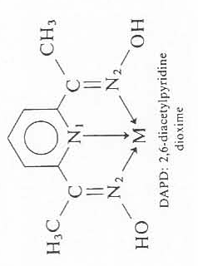
Depending upon the nature of alkyl group ( R ), an alkyl – substituted α – diimine ( R – N = CH – CH = N – R ) coordinates to the metal [Pt(II) or Pd(II)] as monodentate or bidentate (chelating) ligand. The stretching band for C = N was observed at 1615 – 1624 cm⁻¹ for monodentate coordination and at 1590 – 1604 cm⁻¹ for bidentate coordination.
The metal isotop technique has been used to assign the M – N vibration of metal complexes with many other ligand . For example the complex [M(DAPD)] , it was found that the stretching vibration for Ni – N₂ was higher than Ni – N₁ (why?).
For the complex [M(DMNAPY], the M – N stretching frequencies are lower than those of the corresponding tris – bipy complexes due to the weakening of the M – N bond as a result to the strain of four membered chelate ring of the [M(DMNAPY] complexes.

Slide 8
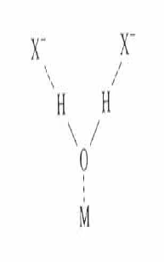
4 – Lattice water and Aquo Complexes :
Water in inorganic salt may be classified as lattice or coordinated water . There is ,however, no definite borderline between the two. The former term denote water molecules trapped in the crystalline lattice, either by weak hydrogen bonds to the anion or by weak ionic bonds to the metal, or by both ; where as the latter denotes water molecules bonded to the metal through partially covalent bonds. Spectra of water molecules are highly sensitive to their surroundings.
In general lattice water absorbs at 3350 – 3200 cm⁻¹ ( antisymmetric and symmetric OH stretching) and at 1630 – 1600 cm⁻¹ (HOH bending). Rotational oscillations of water molecules can be classified into three types depending on the directions of the principal action of rotation ( left figure). In addition to the three fundamental modes of the free water molecules, coordinated water exhibits other modes .
Vibrational spectroscopy is very important in elucidating of structures of aqua complexes. For example, TiCl₃.6H₂ O should be formulated as trans – [Ti(H₂O) ₂Cl₂]Cl.2H₂O since it exhibit only one TiO stretching( about 500 cm⁻¹ ) and one TiCl stretching ( 336 cm⁻¹ )

Slide 9
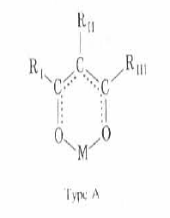
5 – Hydroxo ( OH ) complexes:
The spectra of hydroxo complexes are expected to be similar to those of metal hydroxide. The hydroxo group can be distinguished from the aqua group since the former lack the HOH bending mode near 1600 cm⁻¹ . Furthermore the hydroxo complexes exhibit the MOH bending mode below 1200 cm⁻¹ . For example, this mode is at 1150 cm⁻¹ for the complex [Sn(OH) ₆] ⁻² ion and at 1165 cm⁻¹ for [Pt(OH) ₆ ] ⁻². The OH group can also form bridging group between two metals which give a bending mode at 955 cm⁻¹ .
6 – Aldehydes , Ketones and Esters:
In aldehydes , ketones and easters the v (C=O) shifted to a lower region , while the v (C – O) shifted to a higher region. The amount of shift depending on metal ions , which seem to obey the Irving – Williams order.
β – diketones form a metal chelate ring with the metal ion ( fig, ). Acetylacetonate is the most common example for metal complexes , which can form a square planar geometry with 1 : 2 (M:L) and octahedral with 1 : 3 (M:L). The spectra showed two strong bands at 1577 and 1529 cm⁻¹ assigned for C ….C coupled with C … O and C …O coupled with C …C . The vibration of M – O are most interesting, since they give us a direct information about the strength of M – O bond ( Fig – 4 ).

Slide 10
Fig. – 4 Infra – red spectra of some acetylacetonate metal complexes

Slide 11
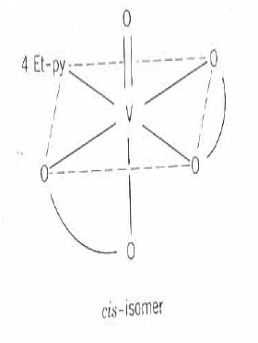
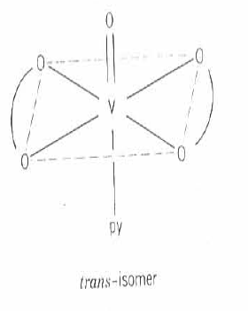
Complexes of [M(acac) ₂ X ₂] may take the cis – or trans - structure. Although the steric and electronic consideration will favor the trans – isomer, the grate stability of cis – isomer is expected in terms of metal – ligand π - bonding. This is the case of [Ti(acac) ₂F ₂ ], which take the cis - configuration with two v(TiF) at 633 and 618 cm⁻¹ . In case of [Re(acac) ₂ Cl ₂ ], however, both forms can be isolated , the trans – isomer exhibit one v(ReO) and one v(ReCl) at 464 and 309 cm⁻¹ respectively, while each one of these bands split into two in the cis – isomer( 472 , 460 cm⁻¹ for v(ReO) and 346,333 cm⁻¹ for v(ReCl) respectively).
For [VO(acac) ₂L], were L is a substituted pyridine, both cis – and trans – isomer can be expected. They can be distinguished by their infra – red spectra, since v(V – O ) and v(V = O) of the cis – isomer are lower than those for trans – isomer. In addition to that , in cis – isomer v(V – O ) split into two bands.

