Slide 1
AL-Mustansiriyah University
College of science
Biology Dept.
Zoology
4th class
Laboratory Technique LAB.
(7)
NAME :

Slide 2
Animal laboratory
Animal testing, also known as animal experimentation, animal research and in vivo testing, is the use of non-human animals in experiments that seek to control the variables that affect the behavior or biological system under study.

Slide 3
The most important species of laboratory animals
Mouse – most frequently used. Ppharmacology, genetics of mammals, virology, models of human diseases (mutant strains, transgenic and knock-out mice)
Rat – physiology of cognitive processes, behaviour, models of diabetes
Rabbit – serology, insulin quantification, pyrogens quantification, tests of irritable effect of chemical substances on the cornea
Cat – study of CNS and respiratory system
Dog – use in electrophysiology, neurophysiology
Guinea-pig – in microbiology and serology, physiology of the auditory system
Hamster - genetics
Pig – training of surgical techniques, temporary covering of burns with porcine skin
Primates – rhesus monkey, baboon, chimpanzee – use in neurology, virology, behaviour
Frog – physiology of blood circulation, electrophysiology
Fish,insects...

Slide 4
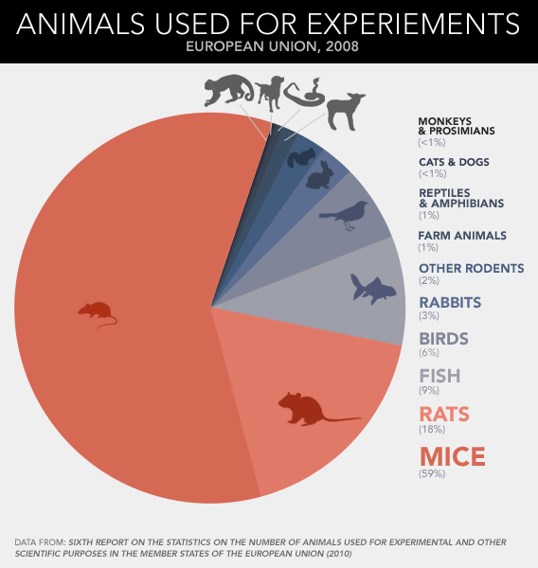

Slide 5
Examples of use in research:
Cancer
Down Syndrome
Diabetes
Leukemia
Allergies
respiratory diseases
Nutritional research

Slide 6
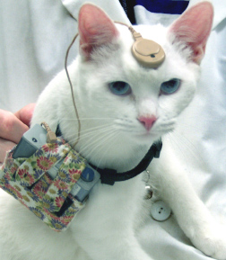
Overview
Some people are troubled by the use of animals in research. Each individual must make decisions about the kind of research he/she wishes to perform.

Slide 7
Justification for using animals
Q. Why is this the right animal model?
  A. Research should be undertaken with a clear scientific purpose.
  B. There should be a reasonable expectation that the research will:
    1. Increase knowledge of the processes underlying the evolution, development, maintenance, alteration, control, or biological significance of behavior
    2. Increase understanding of the species under study
    3. Provide results that benefit the health or welfare of humans or other animals.

Slide 8
Transportation Issues
I. Proper packaging
II. Timely shipping
III. Appropriate care upon arrival
Once the animals arrive:
  Adequate Veterinary Care
  Consultation with the principal investigator to minimize pain and distress.

Slide 9
Housing Standards
I. Heating, cooling, and temperature
II. Ventilation
III. Compatible groupings
IV. Exercise
V. Food and water
VI. Psychological well-being

Slide 10
Disposal
The return of wild-caught animals to the field can carry substantial risks
  To the formerly captive animals and to the ecosystem.
  Animals reared in the laboratory should not be released
    In most cases, they cannot survive or they may survive by disrupting the natural ecology.
Proper (humane) euthanasia

