Slide 1
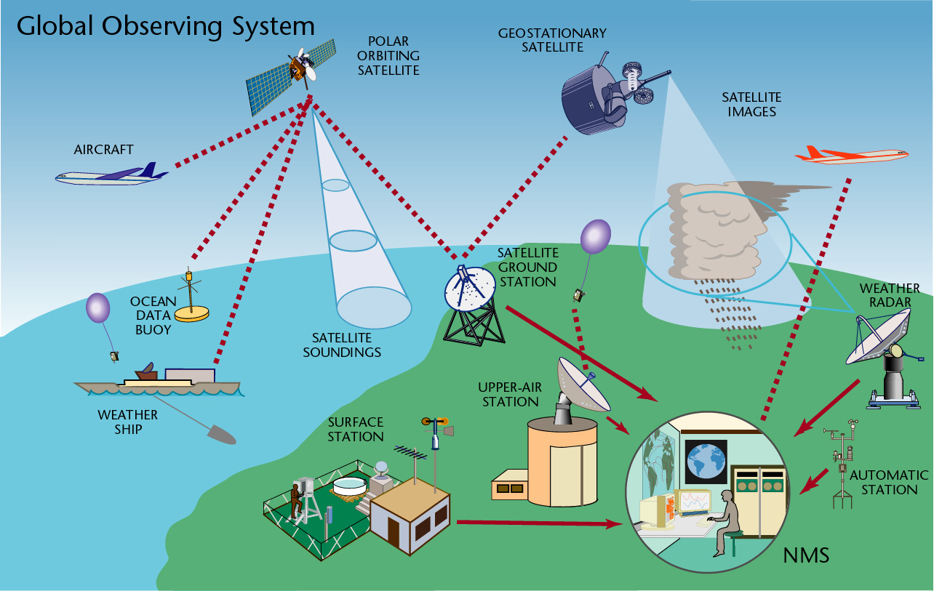
The Course of
Meteorological Instrumentation and Observations
MUSTANSIRIYAH UNIVERSITY
COLLEGE OF SCIENCES
ATMOSPHERIC SCIENCES DEPARTMENT
2018-2019
Dr. Sama Khalid Mohammed
SECOND STAGE

Slide 2
Welcome Students! ☺
To LECTURE SIX
Pressure & wind

Slide 3
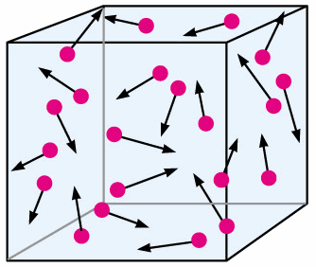
Pressure
Pressure: Force F exerted by the air molecules over a given area A.
where 100Pa = 1mb
Atmospheric pressure is created by the weight of the atmosphere per unit area above the observation point, it can vary depending on ambient temperature, altitude and local weather conditions.
It is a fundamental atmospheric quantity in providing synoptic information and because of its close relationship with height and atmospheric thickness.
Accurate measurement by radiosondes, serve to define the dynamical state of the atmosphere.

Slide 4
If a gas is static and not flowing, the measured pressure is the same in all directions which is the static pressure. But if the gas is moving, the measured pressure depends on the direction of motion. This leads to the definition of the dynamic pressure.
Measuring pressure can only be done when you compare it against another known pressure. This pressure is called the reference pressure. Depending on what the reference pressure is, gives us three different categories: absolute pressure, gage pressure, and differential pressure.
The atmospheric pressure must be measured as absolute pressure, Its value at mean sea level is approximately

Slide 5
Surface pressure measurements are conventionally corrected for the variation in pressure with height, which shows a reduction of about 1 hPa per 10 m of altitude near the surface.
The pressure as observed without correction for altitude is known as the station pressure, whereas the mean sea level pressure is that corrected to the universally agreed sea level datum.
A measuring instrument for atmospheric pressure is known as a barometer, and one able to produce a chart record is known as a barograph.
The desirable accuracy in pressure measurement at the surface or aloft is about ±0.1 hPa, equivalent to 1 part in 10⁴, which is a very demanding requirement for a routine scientific measurement.

Slide 6
Barometers
Instruments to measure atmospheric pressure have been used for over three centuries, and have been traditionally divided into two broad categories, depending on whether they use a liquid (usually mercury) as the sensing element, or not (aneroid barometers).
Mercury barometers measure pressure by determining the height of a liquid column, which is related to pressure by the hydrostatic equation.
Aneroid barometers use a thin metal chamber or diaphragm, having a membrane which deforms under pressure differences which can be measured mechanically or electronically.

Slide 7
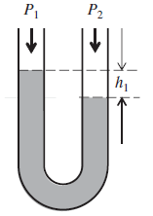
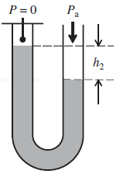
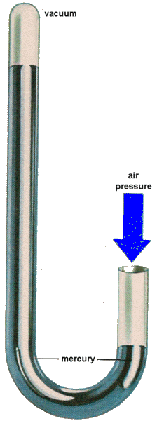
Liquid barometers
Pressure differences can be measured by the change in position of a liquid in a tube. If the tube is made symmetric, such as in a ‘U’ shaped tube, the difference in height of the fluid between one side and the other depends directly on the pressure difference applied and the density of the liquid concerned.
The difference in height Δh is related to the pressure difference ΔP by the hydrostatic equation ΔP = Δh𝜌g ,
where 𝜌 is the liquid’s density and g acceleration due to gravity. The pressure difference and height difference are related by P₂ − P₁ = h1𝜌g ,
but, if the tube is sealed and evacuated, to establish a vacuum, the atmospheric pressure and height vary directly together as P_{a} = h₂𝜌g ,
This configuration is adapted to provide the operating principle of the liquid barometer.

Slide 8
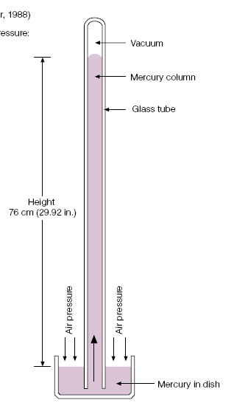
A mercury-in-glass barometer is a standard instrument for measuring static pressure. In this instrument, two columns connected at the base are used, one evacuated and sealed at the top of the column and so subject to no pressure, and the other exposed to the atmosphere at the top. The difference in height between the two columns depends on the atmospheric pressure and the known density of mercury and is therefore used to infer the pressure.
Mercury has a low vapor pressure at the temperatures required, and is easily cleaned.
It does not wet the glass walls of tubes, which leads to formation of a convex meniscus, providing a well-defined measurement datum.
A disadvantage is that mercury does show appreciable thermal expansion, also mercury barometers are not very portable so are unsuitable for remote automatic data logging. Usually used as free standing devices for station barometers. Mercury is a cumulative poison, absorbed through the skin.

Slide 9
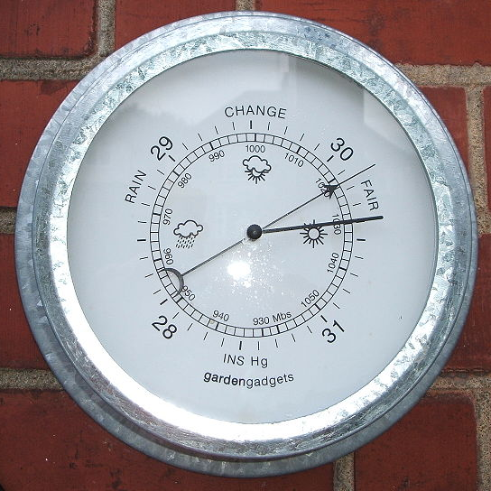
Aneroid Barometer
Aneroid barometers are more convenient to use than mercury barometers and avoid the hazard associated with use of mercury.
An aneroid barometer uses a small, flexible metal box called an aneroid cell (sensor). This aneroid capsule (cell) is made from an alloy of beryllium and copper. The evacuated capsule (or usually more capsules) is prevented from collapsing by a strong spring. Small changes in external air pressure cause the cell to expand or contract. This change in dimension can be monitored mechanically or electrically.
This expansion and contraction drives mechanical levers such that the tiny movements of the capsule are amplified and displayed on the face of the aneroid barometer. The properties of the mechanism limits accuracy of the dial reading, as it may stick or exhibit hysteresis.

Slide 10
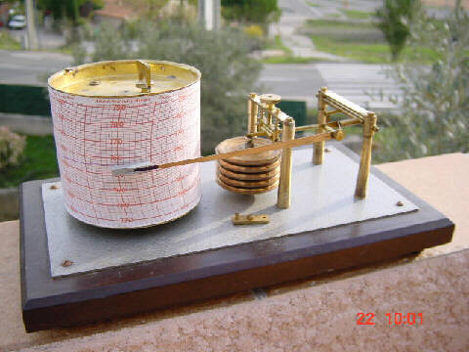
Barographs
In a barograph, multiple aneroid capsules are connected together “to increase the sensitivity to pressure changes” to move a needle on a smoked foil or to move a pen upon paper, both of which are attached to a drum moved by clockwork.
The barograph is usually set up to measure the mean sea level pressure without correction, as, although not very accurate (±1 hPa), its importance is in providing a continuous record of pressure tendency.

Slide 11
Flexible diaphragm sensors
These are based on a similar principle to that of an aneroid capsule, but rely either on detecting the flexing of a thin silicon diaphragm with changes in pressure, or changes in capacitance associated with changes in the separation between the diaphragm and a fixed plate. The latter type of sensor can be very small and light, and is used in radiosondes for measuring the pressure at the altitude reached by the instrument package.

Slide 12
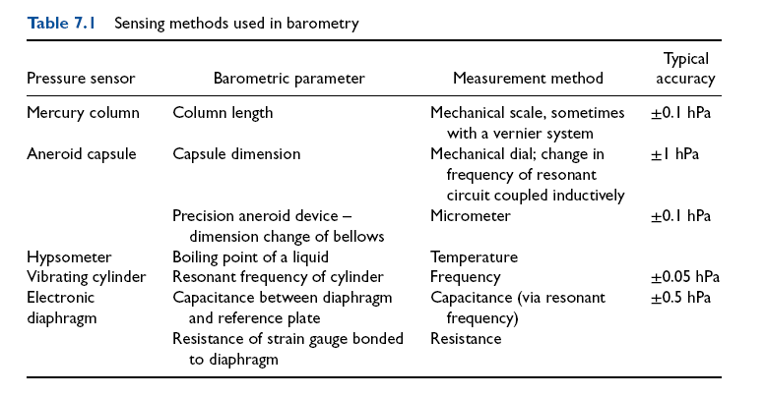

Slide 13
Wind Speed and Direction
Although airflow in the atmosphere is a three-dimensional velocity field, it is the horizontal component of its motion which is commonly measured, because the vertical component is generally much smaller.
Measuring the horizontal air velocity determines the wind vector V = (u, v), where u is the west to-east (zonal) component, and v the south-to-north (meridional) component.
Often only the magnitude of the vector (i.e. the wind speed, which is usually given the symbol U) is measured, with the wind direction measured entirely independently.
An instrument for measuring the wind speed is known as anemometer; the mechanical device turned by the wind to indicate the direction from which the wind is blowing is a wind vane.
Properties used to determine wind speed include the flow’s kinetic energy (dynamic) (cup and propeller anemometers), cooling (hot wire or film anemometer) and the effective speed of sound in a moving reference frame (sonic anemometer).

Slide 14
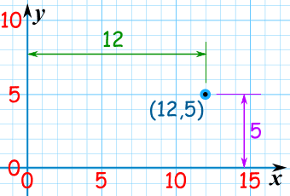
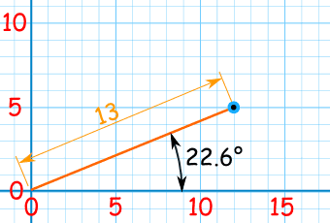
Cartesian Coordinates
Using Cartesian Coordinates we mark a point by how far long and how far up it is:
Polar Coordinates
Using Polar Coordinates we mark a point by how far away, and what angle it is:

Slide 15
Wind Measurements
Wind measurements are usually taken in the polar coordinate, in which winds are written as two components: wind speed and direction.
Local right-hand Cartesian coordinate
W
Up
y
North
V
O
x
East
O
U
Polar coordinate

Slide 16
Conversion to speed and direction
Conversion to U and V
Unites of wind speeds
m/s, mile/h, km/h, knot, …
Wind sensors
Wind sensors have three classes of instruments:
1. dynamic force anemometers
2. pressure pulse frequency anemometers
3. thermal anemometers

Slide 17
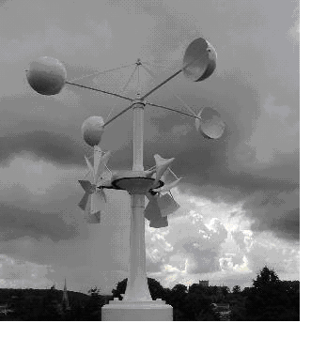
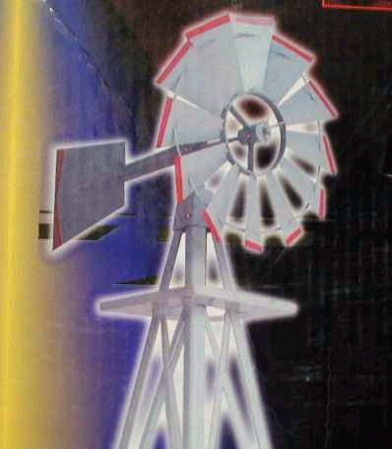
Dynamic force anemometers: they consist of cup anemometers, vane windmill, and gill-type anemometers .
The rotation rate is proportional to wind speed, which sometimes drives an electrical generator that gives voltage output which is proportional to the wind speed.
The inertia of the sensor determines the threshold. Thus, the smaller and lighter of the sensor, the more sensitive it is.
Cup anemometer
Vane windmill
Gill-type anemometer
Notes:
عزم العطالة (بالإنجليزية: Moment of inertia) أو عزم القصور الذاتي أو الكتلة الزاوية هو مقياس مقاومة الجسم للتغيرات في معدل دورانه، يمكن وصف مدى صعوبة أو سهولة تغيير سرعة الدوران لجسم من خلال عزم القصور الذاتي. لو فرضنا قرصين متساويين في الكتلة وأحدهما ذو قطر أو اسطوانة اوسع من الآخر سنلاحظ أن القرص ذو القطر الأوسع يحتاج لبذل جهد أكبر لتدويره لسرعة دورانية متساوية والعكس صحيح حيث يظل القرص ذو القطر الأكبر محافظا على دورانه لفترة أطول من الآخر.

Slide 18
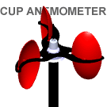
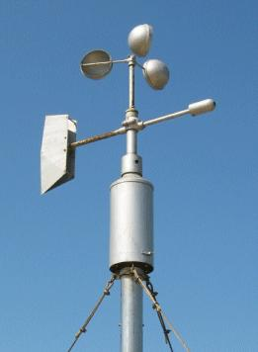
Cup anemometer
A typical cup anemometer has three conical or hemispherical collecting cups mounted at equal distances from a vertical shaft by equally spaced horizontal supporting arms. The vertical shaft rotates on bearings arranged to cause as little mechanical loading as possible. The asymmetry of the cup arrangement ensures that the anemometer always rotates the same way irrespective of the direction of the incoming wind.
Anemometer factor :is the actual relationship between the speed of the wind and the speed of the cups. It depends on the dimensions of the cups and arms, and the relationship may vary for different anemometers.
To determine wind direction for cup anemometer is to add a separate of wind vane for directional readings.

Slide 19
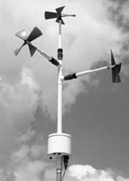
Propeller anemometer
In contrast to a cup anemometer, a propeller anemometer provides a directional response, and, if the sensing propeller is made of lightweight material, it can be accelerated and decelerated rapidly by the wind. Examples of propeller anemometers are Gill Propeller Anemometer. These use a ‘helicoidal’ design of lightweight propeller, mounted on a shaft to drive a small DC generator.
The starting speed is much lower than for most cup anemometers (typically 0.2 m s⁻¹ ). This type of anemometer is suitable for measuring turbulent fluctuations of air speed along one direction. Unfortunately, Equation above is only approximated for relatively small angles (typically less than 30º), due to the effect of one blade interrupting the flow to another blade, known as blade sheltering.

Slide 20
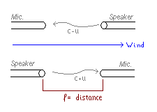
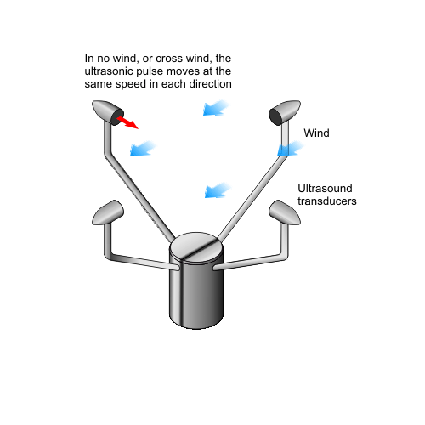
Pressure pulse frequency anemometers(sonic anemometer )
It measures the variation of speed of sound with wind
The device sends a synchronized sound pulse and measures the difference in time of sound.
u is the velocity of the wind, is the distance, and c is the speed of sound.
The best way to get the wind direction is to measure the components in all three directions, Sonic anemometers can take measurements with very fine temporal resolution, which make them well suited for turbulence measurements.

Slide 21
The lack of moving parts makes them appropriate for long term use in exposed automated weather stations and weather buoys where the accuracy and reliability of traditional cup-and-vane anemometers is negatively affected by salty air or large amounts of dust.
Their main disadvantage is the distortion of the flow itself by the structure supporting the transducers, which requires a correction based upon wind tunnel measurements to minimize the effect.
2-D (wind speed and wind direction) sonic anemometers are widely used in applications such as weather stations, ship navigation, wind turbines, aviation and weather buoys.
Most sonic anemometer can also measure temperature.

Slide 22
Thermal anemometers (hot wire anemometers )
It uses a very fine wire (on the order of several micrometers) electrically heated up to some temperature above the ambient.
Air flowing through the wire has a cooling effect on the wire. As the electrical resistance of most metals is dependent upon the temperature of the metal (tungsten is a popular choice for hot-wires), a relationship can be obtained between the resistance of the wire and the flow velocity.

Slide 23
Upper atmosphere measurements
Measurements made above the surface are important for forecasting analyses and for research applications because of the information they provide on the atmosphere’s vertical structure.
Data obtained within the atmosphere (i.e. in situ measurements) can be provided by sensors carried on aircraft or balloon platforms.
Balloon-carried sensors are routinely used internationally to provide data for forecast initialization, launched at thousands of sites daily as well as more specialist surveys, for example to monitor stratospheric ozone.
In some cases, such as emergency situations concerning the release of radioactivity or volcanic eruptions, balloon carried probes can provide the only source of safe in situ sampling throughout the troposphere.
A balloon-carried measuring probe returning data by radio is known as a radiosonde.

Slide 24
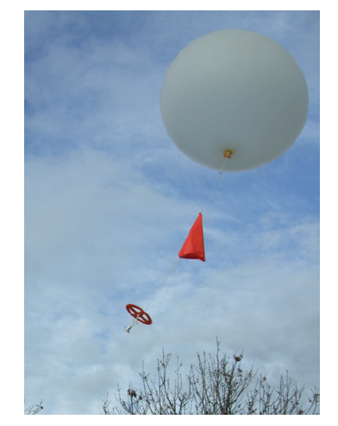
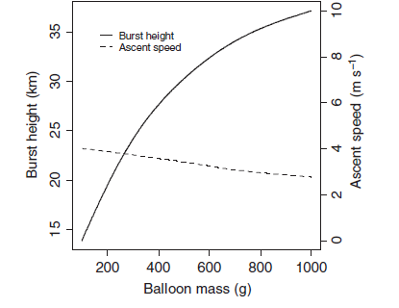
Radiosonde
Radiosondes instrument packages are carried by balloons to the upper troposphere or above, during which vertical profiles are obtained of pressure, temperature and humidity. In addition, changes in position during the ascent are used to derive the wind speed and direction. Measurements are telemetered to a ground station by a radio transmitter
Sounding balloons
A latex balloon of mass between about 200 g and 1000 g is inflated with the lighter than air gases of helium or hydrogen to allow free lift to be obtained. The balloon eventually bursts from expansion, and the radiosonde package descends by parachute. The figure shows the typical variation in burst height with balloon mass. Larger balloons reach greater burst heights for the same payload: compared with the range of burst heights, there is much less variation in ascent speed with the balloon size.

Slide 25
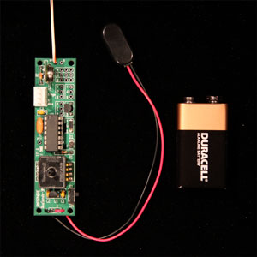
Radiosonde technology
The sensors carried by a radiosonde have to provide an electrical output, such as a voltage, current or frequency.
A key requirement for a radiosonde is its battery power supply, which must sustain the operation of the device as it becomes colder and more distant from the receiving station.
As the radiosonde is carried aloft, sensors on the radiosonde measure profiles of pressure, temperature, and humidity. These sensors are linked to a battery powered, radio transmitter that sends the sensor measurements to a sensitive ground receiver that detect and process signals. By tracking the position of the radiosonde, information on wind speed and direction aloft is also obtained. When winds are incorporated into the observation, it is termed a rawinsonde observation.

Slide 26
Radiosondes may also encounter vigorous turbulent motion associated with rapid updrafts or jet streams. In addition, the full radiosonde package needs to be lightweight to minimize the amount of lifting gas required, as well as being disposable and inexpensive.
Significant changes in the meteorological parameters are entered into a minicomputer, which converts them into coded messages. These messages are relayed through various communications systems to all parts of the world.

Slide 27
Remote Sensing in Meteorology
In-situ 'observing' network stations only measure atmospheric conditions at specific locations/points and times, thus it leaves gaps in weather information both spatially (in space) on the order of several kilometers to thousands of kilometers and temporally (in time) on the order of minutes to 12 hours.
Remotely sensed data (satellite and radar) are vital to operational weather forecasters because they fill in the spatial and temporal gaps left by the observing network. These data complement and add to the surface and upper-air data to form a more complete and continuous picture of atmospheric conditions.

Slide 28
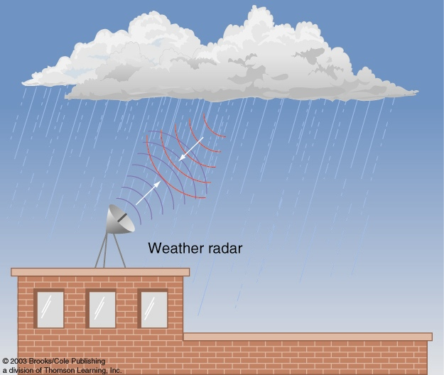
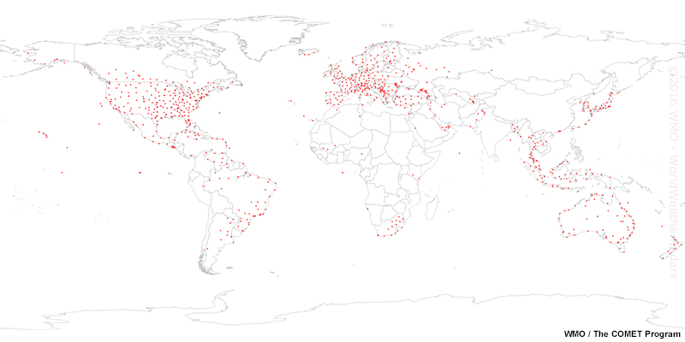
Weather radar
Radar: RAdio Detection And Ranging
Active remote sensing technique.
Radars work by transmitting electromagnetic pulses of energy (EM waves that fall into the microwave (1 mm < λ < 75 cm)). The energy is reflected and scattered off of particles in the atmosphere, including precipitation, clouds, airplanes, birds and insects.
Some of the energy returns to the radar and is received by the antenna and receiver. The data are processed to determine information about the scatters in the atmosphere.

Slide 30
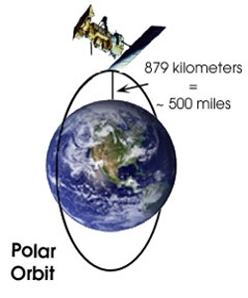
Satellite Data
Satellite-borne sensors have the unique vantage of observing Earth and its atmosphere from orbit using remote sensing techniques. weather satellites sense the radiation to indicate the presence of clouds, water vapor, and surface features.
Polar-orbiting
Polar-orbiting satellites orbit the earth longitudinally passing directly over the poles at an altitude of about 850 km. With each orbit, the satellite sees an area that is west of the previous pass.
Because these satellites are in a low orbit and look directly down, the images they record show great detail about meteorological and non-meteorological features. While images record great detail, polar-orbiting satellites capture only a few images per location every day. These satellites provide excellent imagery of the polar regions though.

Slide 31
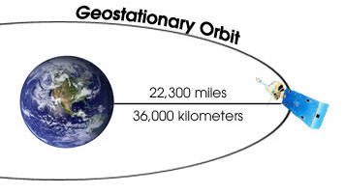
Geostationary Orbiting
Geostationary satellites revolve with the earth in a west-to-east direction directly over the equator at an altitude of 36,000 km.
Since the satellite revolves at the same speed and in the same direction as the earth, it always has the same view of the earth's surface. These satellites are in a higher orbit than polar-orbiting satellites; therefore each image covers a much greater area. While geostationary satellites record less detail than POES, they capture many images of the same locations every day.

Slide 32
THE END OF THE COURSE

