Slide 1
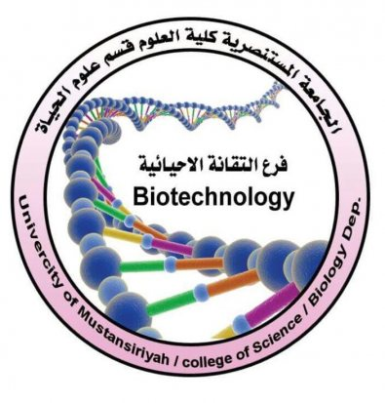
Hormones Sadeq Kaabi
بسم الله الرحمن الرحيم
Fourth grade
First semester
2018-2019
Diagnostic Medical Microbiology-Laboratory Manual

Slide 2
Hormones
Definition
-- chemical messengers
-- secreted by endocrine gland or cells
-- released into the blood
-- effects on target cells through receptors
-- This effect may be either excitatory or inhibitory in its action.

Slide 3
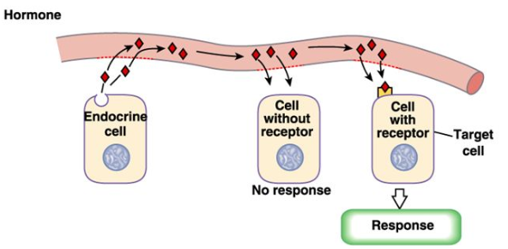

Slide 4
Properties of Hormones
1. Hormones are produced by a specialized glands and are secreted directly into the blood stream.
2. Hormones are transported by the blood stream from the endocrine cells to serve as ‘chemi­cal messenger’ which act on target cells or organs by regulating the rates of specific metabolic reactions.
3. Hormones exert their effects not where they are locally produced, but on other tissues of the body.
4. Hormones are required in very small amounts and their effect may be excitatory or inhibitory depending upon their concentration and the physiological state of the responding tissue.
5. Hormones belong to different types of chemical structure. They may be steroids, proteins, peptides or amino acid derivatives

Slide 5
Chemical Nature of Hormones
All the hormones are organic substances of varying structural complexity. Chemically, they may belong to any of the following categories.
(a) Steroid Hormones:
The hormones secreted by the adrenal cortex, testes, ovaries and placenta are composed of steroids e.g., cortisone, aldosterone, testosterone, estrogen, progesterone.
(b) Proteinous Hormones:
e.g., somatotrophic, thyrotrophic and gonadotrophic hormones secreted by the anterior region of hypothalamus gland and insulin hormone secreted by pancreas.
(c) Catecholamine:
e.g., epinephrine (adrenaline), norepinephrine (noradrenaline) secreted by the adrenal medulla, and dopamine.
(d) Amino acid derivative:
e.g., thyroxine hormone secreted by the thyroid gland.
(e) Peptide Hormones: e.g., melanocyte stimulating hormone, the hormones oxytocin and vasopressin, adrenocorticotrophic hormone, calcitonin and parathormone.

Slide 6
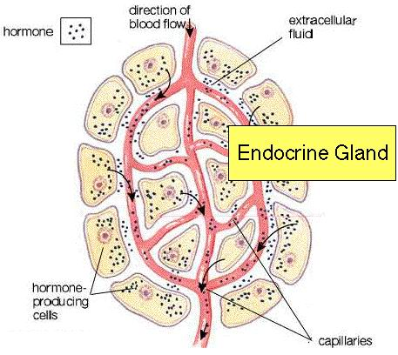
Characteristic of endocrine gland
Without duct
The endocrine cells arranged in cluster, follicle or cords
Rich in capillaries
The secretion is hormone which transported by blood circulation

Slide 8
Endocrine vs. Nervous regulation
Endocrine regulation
-broadcasts its hormonal
messages to essentially all cells
-by secretion into blood and
extracellular fluid
-requires a receiver to get the
message
-slow and wider
Neural regulation
-exerts point-to-point
-control through nerves
-electrical in nature and fast

Slide 9
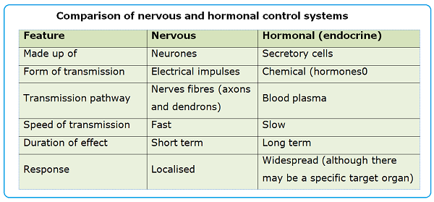

Slide 10
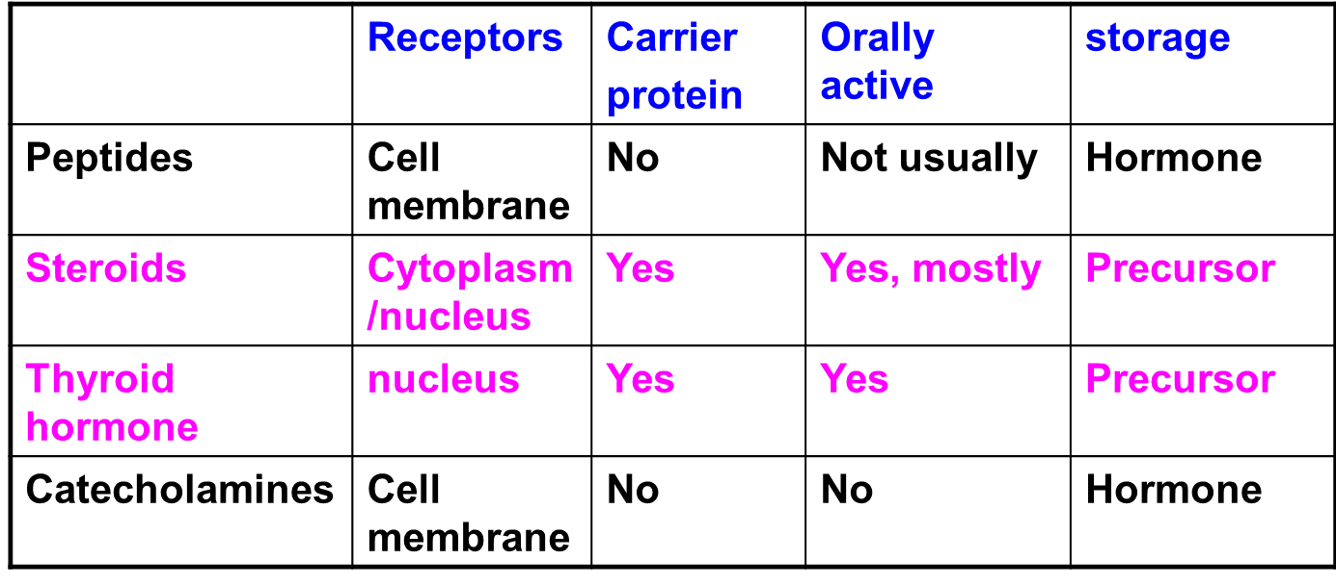
The comparison of hormones

Slide 11
The transport of hormones
1. Peptide and CA: water-soluble
2. Steroids and thyroid hormone:
bound to proteins
Eg. Thyroid hormones binding globulin (THBG)
Cortisol binding globulin (CBG)
Sex hormones binding globulin (SHBG)
Effects of hormone binding proteins:
(1) Increase the solubility
(2) Create an accessible reserve
(3) Increase the biological half time

Slide 12
Classification of Hormones: Steroid
Steroid Hormones:
Lipid soluble, chemically derived from cholesterol
Enter target cells
Activate specific genes to produce specific proteins
Slower acting than nonsteroid hormones, minutes to hours

Slide 13
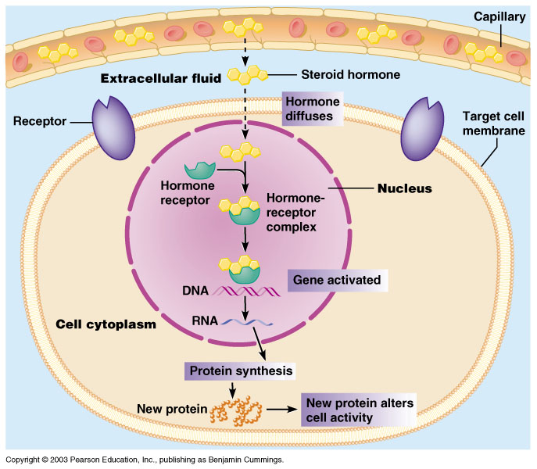
Steroid Hormone Action on a Target Cell

Slide 14
Classification of Hormones: Nonsteroid
Nonsteroid hormones:
Water soluble
Bind to receptors on target cell membranes
Work through intermediate mechanisms to activate existing enzymes
Faster action than steroid hormones, seconds to minutes

Slide 15
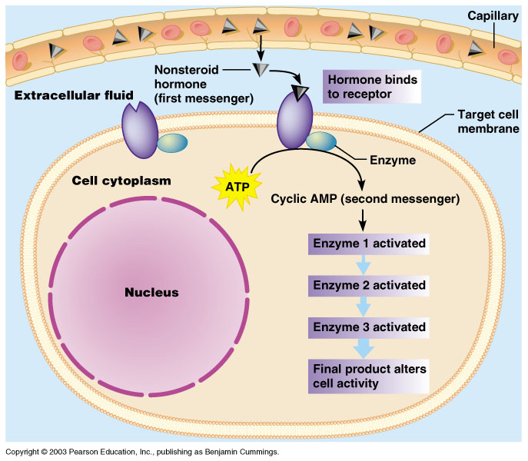
Nonsteroid Hormone Action on a Target Cell

Slide 16
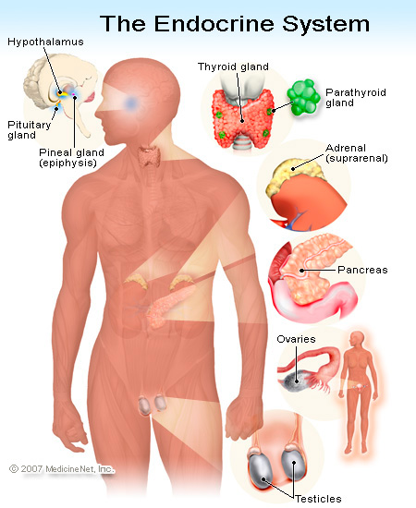
The major glands of the endocrine system are the hypothalamus, pituitary, thyroid, parathyroids, adrenals, pineal body, and the reproductive organs (ovaries and testes). The pancreas is also a part of this system; it has a role in hormone production as well as in digestion.
The endocrine system is regulated by feedback.

Slide 17
1- Hypothalamus
Functions of Hypothalamus
- Releasing hormones
- Regulating body temperature
- maintaining daily physiological cycles
- controlling appetite
- managing of sexual behavior
- regulating emotional responses

Slide 18
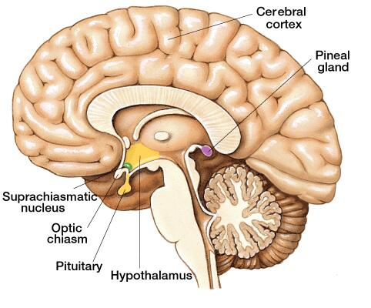

Slide 19
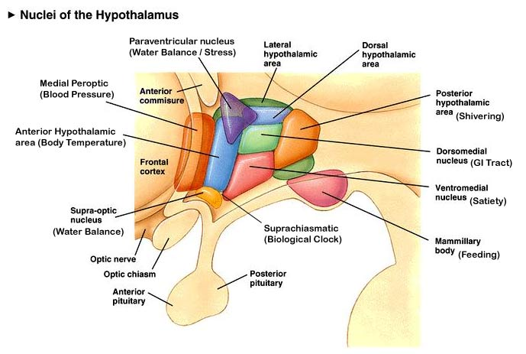

Slide 20
Some of the most important hormones produced in the anterior region include:
Corticotropin-releasing hormone (CRH). CRH is involved in the body’s response to both physical and emotional stress. It signals the pituitary gland to produce a hormone called adrenocorticotropic hormone (ACTH). ACTH triggers the production of cortisol, an important stress hormone.
Thyrotropin-releasing hormone (TRH). TRH production stimulates the pituitary gland to produce thyroid-stimulating hormone (TSH). TSH plays an important role in the function of many body parts, such as the heart, gastrointestinal tract, and muscles.
Gonadotropin-releasing hormone (GnRH). GnRH production causes the pituitary gland to produce important reproductive hormones, such as follicle-stimulating hormone (FSH) and luteinizing hormone (LH).

Slide 21
Oxytocin. This hormone controls many important behaviors and emotions, such as sexual arousal, trust, recognition, and maternal behavior. It’s also involved in some functions of the reproductive system, such as childbirth and lactation.
Vasopressin. Also called antidiuretic hormone (ADH), this hormone regulates water levels in the body. When vasopressin is released, it signals the kidneys to absorb water.
Somatostatin. Somatostatin works to stop the pituitary gland from releasing certain hormones, including growth hormones and thyroid-stimulating hormones.
The anterior region of the hypothalamus also helps regulate body temperature through sweat. It also maintains circadian rhythms. These are physical and behavioral changes that occur on a daily cycle. For example, being awake during the day and sleeping at nighttime is a circadian rhythm related to the presence or absence of light.

Slide 22
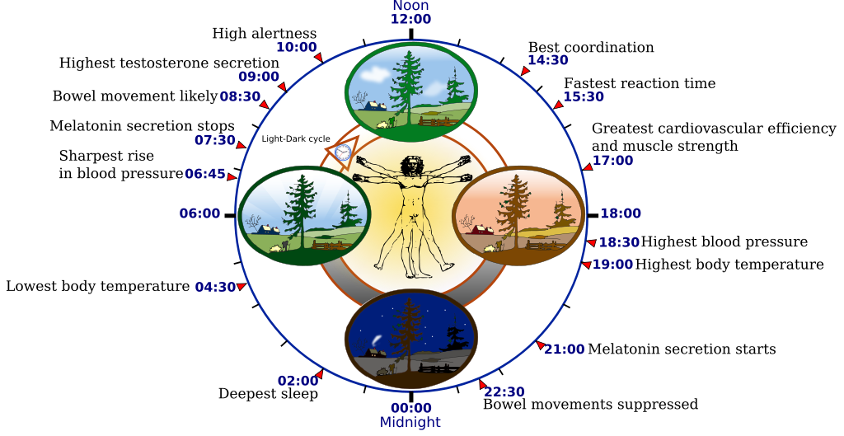
Circadian rhythm

Slide 23
Functions of Middle and posterior region
Middle region helps control appetite, and involved in releasing growth hormone-releasing hormone (GHRH). GHRH stimulates the pituitary gland to produce growth hormone. This is responsible for the growth and development of the body.
Posterior region
The posterior hypothalamic nucleus helps regulate body temperature by causing shivering and blocking sweat production.
The role of the mammillary nuclei is less clear. Doctors believe it’s involved in memory function.

Slide 24
Hypothalamic dysfunction plays a role in many conditions, including:
Diabetes insipidus. If the hypothalamus doesn’t produce and release enough vasopressin, the kidneys can remove too much water. This causes increased urination and thirst. Unlike people with diabetes mellitus, people with diabetes insipidus have stable blood sugar levels.
Prader-Willi syndrome. This is a rare, inherited disorder. It causes the hypothalamus to not register when someone is full after eating. People with Prader-Willi syndrome have a constant urge to eat, increasing their risk of obesity. Additional symptoms include a slower metabolism and decreased muscle.
Hypopituitarism. This disorder happens when the pituitary gland doesn’t produce enough hormones. While it’s usually caused by damage to the pituitary gland, hypothalamic dysfunction can also cause it. Many hormones produced by the hypothalamus directly affect those produced by the pituitary gland.

Slide 25
Symptoms of hypothalamic conditions
Hypothalamic conditions can cause a range of symptoms. Which symptoms you may experience depend on the part of the hypothalamus and types of hormones involved.
Some symptoms that could signal a hypothalamus problem include:
- unusually high or low blood pressure
- body temperature fluctuations
- unexplained weight gain or loss
- changes in appetite
- insomnia
- infertility
- short stature
- delayed onset of puberty
- dehydration
- frequent urination

Slide 26
2- Pituitary Gland
Also called the “Master Gland” because it controls the actions of many other endocrine glands.
Small structure located at the base of the brain.
Divided into 2 lobes:
Anterior (Front) Lobe
Posterior (Rear) Lobe

Slide 27
Pituitary gland anatomy and function
The pituitary gland is small and oval-shaped. It’s located behind your nose, near the underside of your brain. It’s attached to the hypothalamus by a stalklike structure.
The hypothalamus is a small area of your brain. It’s very important in controlling the balance of your bodily functions. It controls the release of hormones from the pituitary gland.
The pituitary gland can be divided into two different parts: the anterior and posterior lobes.

Slide 28
Anterior lobe
The anterior lobe of your pituitary gland is made up of several different types of cells that produce and release different types of hormones, including:
Growth hormone. Growth hormone regulates growth and physical development. It can stimulate growth in almost all of your tissues. Its primary targets are bones and muscles.
Thyroid-stimulating hormone. This hormone activates your thyroid to release thyroid hormones. Your thyroid gland and the hormones it produces are crucial for metabolism.
Adrenocorticotropic hormone. This hormone stimulates your adrenal glands to produce cortisol and other hormones.
Follicle-stimulating hormone. Follicle-stimulating hormone is involved with estrogen secretion and the growth of egg cells in women. It’s also important for sperm cell production in men.

Slide 29
Luteinizing hormone. Luteinizing hormone is involved in the production of estrogen in women and testosterone in men.
Prolactin. Prolactin helps women who are breastfeeding produce milk.
Endorphins. Endorphins have pain-relieving properties and are thought to be connected to the “pleasure centers” of the brain.
Enkephalins. Enkephalins are closely related to endorphins and have similar pain-relieving effects.
Beta-melanocyte-stimulating hormone. This hormone helps to stimulate increased pigmentation of your skin in response to exposure to ultraviolet radiation.

Slide 30
Posterior lobe
The posterior lobe of the pituitary gland also secretes hormones. These hormones are usually produced in your hypothalamus and stored in the posterior lobe until they’re released.
Hormones stored in the posterior lobe include:
Vasopressin. This is also called antidiuretic hormone. It helps your body conserve water and prevent dehydration.
Oxytocin. This hormone stimulates the release of breast milk. It also stimulates contractions of the uterus during labor.

Slide 31
Pituitary gland conditions
Several conditions can affect your pituitary gland. Most are caused by a tumor in or around the pituitary gland. This can impact the release of hormones.
Examples of pituitary gland disorders include:
Pituitary tumors. Pituitary tumors are usually noncancerous. However, they often interfere with the release of hormones. They can also press against other areas of your brain, leading to vision problems or headaches.
Hypopituitarism. This condition causes your pituitary gland to produce very little or none of one or more of its hormones. This can affect things like growth or reproductive system function.
Acromegaly. In this condition, your pituitary gland produces too much growth hormone. This can lead to excessive growth, especially of your hands and feet. It’s often associated with pituitary tumors.

Slide 32
· Diabetes insipidus. This can be caused by a problem with the release of vasopressin. It’s usually due to a head injury, surgery, or a tumor. As a result, people with this condition pass large amounts of heavily diluted urine. They may also feel like they need to drink a lot of water or other fluids.
· Cushing’s disease. The pituitary gland releases too much adrenocorticotropic hormone in people with this condition. This can lead to easy bruising, high blood pressure, weakness, and weight gain. It’s often caused by a tumor near or in the pituitary gland.
· Hyperprolactinemia. In this condition, your blood contains an unusually high amount of prolactin. This can lead to infertility and a decreased sex drive.
· Traumatic brain injury. This involves a sudden blow to your brain. Depending on the injury, it can sometimes damage your pituitary gland and cause problems with memory, communication, or behavior.

Slide 33
Symptoms of a pituitary gland condition
Your pituitary gland is involved in a range of things, so any condition involving it can produce a diverse set of symptoms.
Make an appointment with your doctor if you regularly notice:
headaches
weakness or fatigue
high blood pressure
unexplained weight gain
trouble sleeping
changes in psychological state, including mood swings or depressions
memory loss
reproductive issues, including infertility, erectile dysfunction
, and irregular periods
excessive or unusual hair growth
lactating when you’re not nursing
Most of the conditions that cause these symptoms are easy to treat and manage once you determine the underlying cause.

Slide 34
3- Thyroid gland
The thyroid gland is found in front of the trachea (wind pipe) in your neck. The gland is divided into 2 lobes (right and left) and is connected in the middle by a thin bridge of thyroid tissue, known as the isthmus. Because of the 2 connected lobes, the thyroid has been described as being shaped like a butterfly, or a bow tie.
The thyroid cartilage, which is the largest cartilage of the larynx (voice box) lies just above the thyroid gland and is sometimes known as the Adam's apple.
A normal-sized thyroid gland cannot be seen in the neck, and can barely be felt. It is only when certain conditions result in an enlarged thyroid gland (known as goitre), that a bulge may be seen or felt just underneath the Adam’s apple.

Slide 35
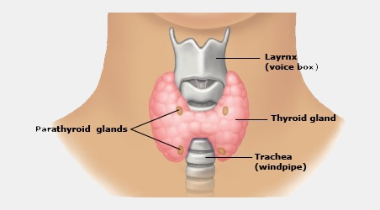

Slide 36
Function of thyroid gland
The thyroid gland secretes hormones to regulate many metabolic processes, including growth and energy expenditure. If the thyroid gland is overactive or sluggish, the metabolism will be affected, leading to a variety of symptoms that are easily misdiagnosed. Around one in 20 people will experience some form of thyroid dysfunction in their lifetime. Women are more susceptible than men.

Slide 37
- The thyroid gland produces two primary hormones - thyroxine (also referred to as T4) and tri-iodothyronine (also referred to as T3). The numbers 3 and 4 refer to the number of atoms of iodine in the hormones. Iodine is essential for the production of thyroid hormones and humans need about 150 mcg each day.
- Of the two hormones produced, T3 is more active than T4, but is produced in much smaller quantities (90% T4 and 10% T3). T4 has a lesser effect, but most is converted to T3 by enzymes that remove one iodine atom. The greater the amount of T3 and T4 circulating in the blood, the faster the metabolism. Lower amounts of T3 and T4 result in a reduced metabolism.

Slide 38
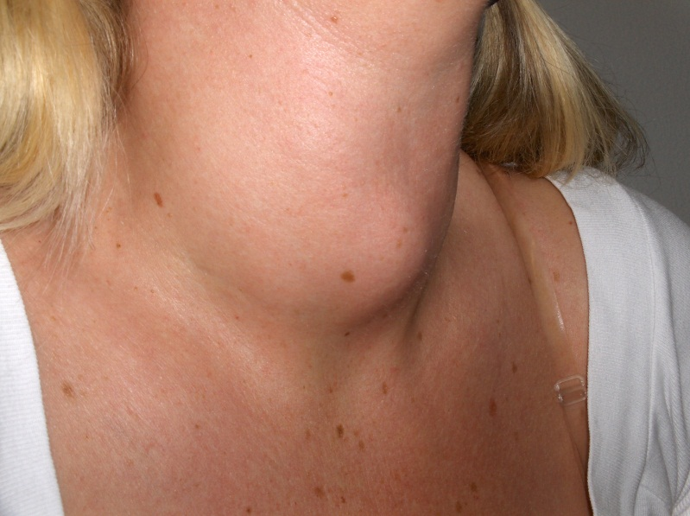
Goitre
An enlargement of the thyroid gland is called a ‘goitre’. A shortage of iodine in the diet is a common cause of goitre, especially in areas where the soil has little iodine. If a person’s diet is too low in iodine, the pituitary keeps sending chemical messages to the thyroid, but without effect. In attempting to make more thyroid hormone, the gland gets larger and larger. This is also common with underactive thyroids, as the pituitary attempts to speed them up. Overactive thyroids can also produce goitres because their overactivity is often due to overstimulation. Goitres indicate a problem with the thyroid or iodine intake.

Slide 39
Overactive thyroid (hyperthyroidism)
An overactive thyroid releases too much T4 and T3 into the bloodstream, causing the metabolism to speed up too much. The most common cause is Graves’ disease. This is an autoimmune condition in which antibodies behave like TSH and stimulate the thyroid uncontrollably. Complications of untreated hyperthyroidism include liver damage and heart failure, which can lead to death. Symptoms of an overactive thyroid include: Rapid pulse
Tremor (shaking) of the hands
Sweating and sensitivity to heat
Weight loss (despite an increased appetite)
Nervousness, agitation and anxiety
Fatigue
Diarrhoea
Bulging eyes
Goitre.

Slide 40
Underactive thyroid (hypothyroidism)
An underactive thyroid releases too little T4 and T3 into the bloodstream, causing the metabolism to slow down too much. The most common cause is Hashimoto’s disease. This is an autoimmune condition in which white blood cells and antibodies attack the thyroid gland. If not treated, the metabolism will continue to slow and will ultimately (in 10 to 15 years) lead to death. Symptoms include:
- Lethargy and fatigue
- Feeling cold (even on warm days)
- Unusual weight gain
- Depression
- Reduced concentration (brain fog)
- Puffiness of the face
- Hair loss
- Dry skin
- Constipation
- Goitre.
When these symptoms increase, the condition may be called myxoedema. Congenital hypothyroidism must be urgently treated to avoid serious brain damage. All newborn babies are now screened for this condition.

Slide 41
Other thyroid gland disorders
Other disorders of the thyroid gland include:
Nodules - lumps in the thyroid. Some are groups of uncontrollably overactive thyroid cells. These are called ‘hot’ nodules and cause hyperthyroidism. Other nodules are ‘cold’. These are generally harmless, but about 20 per cent will be cancerous.
Cancer - thyroid cancer is uncommon and is readily treatable, especially if detected early.

Slide 42
Calcitonin
The major source of calcitonin , a protein hormone, is from the parafollicular or C cells in the thyroid gland, but it is also synthesized in a wide variety of other tissues, including the lung and intestinal tract. The function of calcition is a hormone known to participate in calcium and phosphorus metabolism. In particular, calcitonin has the ability to decrease blood calcium levels by bone and kidney. Besides, malignant tumors arising from thyroid C-cells (medullary thyroid carcinoma: MTC) usually produce elevated levels of calcitonin. Measurement of serum calcitonin is used in the follow-up of patients that have surgical removal of the thyroid gland.

Slide 43
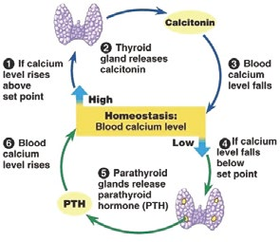
Calcitonin and Parathyroid hormone

Slide 44
4- Parathyroid Glands
The parathyroid glands are four small glands that have the sole purpose of secreting parathyroid hormone to regulate the calcium level in our bodies.
The parathyroid essentially helps the nervous and muscular systems function properly. Calcium is the primary element that causes muscles to contract, and calcium levels are very important to the normal conduction of electrical currents along nerves.
Anatomy of the Parathyroid Glands
The four parathyroids are typically found on the back side of the thyroid. They’re about the size and shape of a grain of rice.

Slide 45
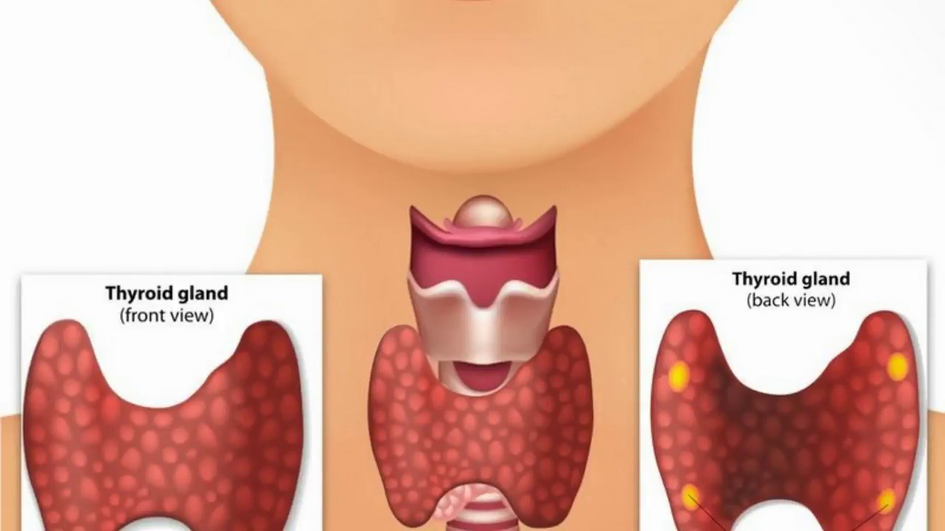

Slide 46
Parathyroid Hormone
Parathyroid hormone (PTH) has a very powerful influence on the cells of your bones by causing them to release their calcium into the bloodstream.
PTH regulates how much calcium is absorbed from your diet, how much calcium is excreted by your kidneys, and how much calcium is stored in your bones.
We store many pounds of calcium in our bones, and it is readily available to the rest of the body at the request of the parathyroid glands.
PTH increases the formation of active vitamin D, and it is active vitamin D that increases intestinal calcium and phosphorus absorption.

Slide 47
Diseases and Disorders of the Parathyroid
When the parathyroid releases too much or too little PTH, it adversely affects your body in a variety of ways. Below are common diseases and disorders associated with the parathyroid glands:
Hyperparathyroidism: The most common disease of parathyroid glands is hyperparathyroidism, which is characterized by excess PTH hormone, regardless of calcium levels. In other words, the parathyroid glands continue to make large amounts of PTH even when the calcium level is normal, and they should not be making the hormone at all.

Slide 48
Hypoparathyroidism: Hypoparathyroidism is the combination of symptoms due to inadequate parathyroid hormone production. This leads to decreased blood levels of calcium (hypocalcemia) and increased levels of blood phosphorus (hyperphosphatemia).This is a rare condition and most commonly occurs because of damage or removal of parathyroid glands during parathyroid or thyroid surgery.
Osteoporosis: When one of the parathyroid glands is overactive, it releases too much PTH hormone. This causes your bones to release calcium constantly into the blood stream. Without enough calcium in your bones, they lose their density and hardness. Osteoporosis is characterized by this loss of calcium and bone density.
The parathyroid glands have a single responsibility—regulating calcium levels. The glands are important members of endocrine system, but they are also integral to the proper functioning of the nervous and muscular systems.

Slide 49
Thymus
The thymus is a specialized primary lymphoid organ of the immune system. Within the thymus, T cells mature. T cells are critical to the adaptive immune system, where the body adapts specifically to foreign invaders. The thymus is composed of two identical lobes and is located anatomically in the anterior superior mediastinum, in front of the heart and behind the sternum.

Slide 50
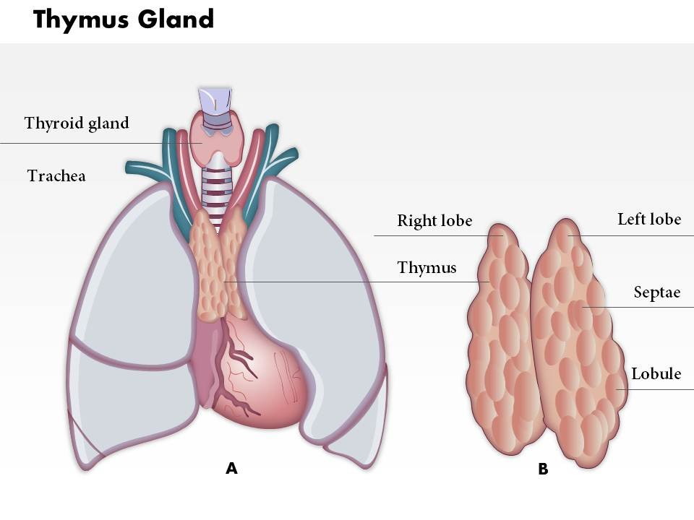

Slide 51
The thymus provides an inductive environment for development of T cells from hematopoietic progenitor cells. In addition, thymic stromal cells allow for the selection of a functional and self-tolerant T cell repertoire. Therefore, one of the most important roles of the thymus is the induction of central tolerance.
The thymus is largest and most active during the neonatal and pre-adolescent periods. By the early teens, the thymus begins to atrophy and thymic stroma is mostly replaced by adipose (fat) tissue. Nevertheless, residual T lymphopoiesis continues throughout adult life.

Slide 52
Thymosin: The Hormone of the Thymus
Thymosin stimulates the development of T cells. Throughout your childhood years, white blood cells called lymphocytes pass through the thymus, where they are transformed into T cells.
Once T cells have fully matured in the thymus, they migrate to the lymph nodes (groups of immune system cells) throughout the body, where they aid the immune system in fighting disease. However, some lymphocytes, regardless if they reside in the lymph nodes or thymus, can develop into cancers (known as Hodgkin disease and non-Hodgkin lymphomas).
Though the thymus gland is only active until puberty, its double-duty function as an endocrine and lymphatic gland plays a significant role in your long-term health.

Slide 53
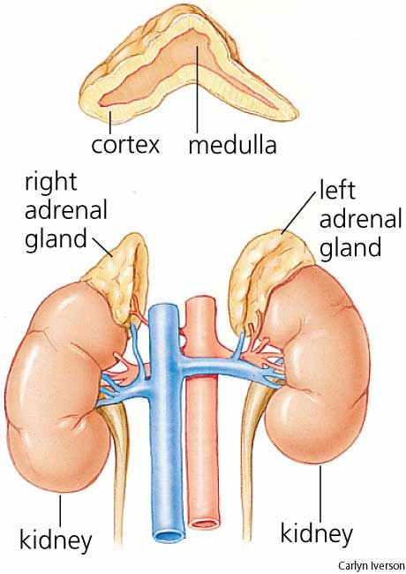
Adrenal Glands
Suprarenal glands
Anatomy of the Adrenal Glands
The adrenal glands are two, triangular-shaped organs that measure about 1.5 inches in height and 3 inches in length. They are located on top of each kidney. Their name directly relates to their location (ad—near or at; renes—kidneys).
Each adrenal gland is comprised of two distinct structures—the outer part of the adrenal glands is called the adrenal cortex. The inner region is known as the adrenal medulla.

Slide 54
The adrenal glands are two glands that sit on top of your kidneys that are made up of two distinct parts.
The adrenal cortex—the outer part of the gland—produces hormones that are vital to life, such as cortisol (which helps regulate metabolism and helps your body respond to stress) and aldosterone (which helps control blood pressure).
The adrenal medulla—the inner part of the gland—produces nonessential (that is, you don’t need them to live) hormones, such as adrenaline (which helps your body react to stress).

Slide 55
Adrenal Cortex Hormones
The adrenal cortex produces two main groups of corticosteroid hormones—glucocorticoids and mineralcorticoids. The release of glucocorticoids is triggered by the hypothalamus and pituitary gland. Mineralcorticoids are mediated by signals triggered by the kidney.
When the hypothalamus produces corticotrophin-releasing hormone (CRH), it stimulates the pituitary gland to release adrenal corticotrophic hormone (ACTH). These hormones, in turn, alert the adrenal glands to produce corticosteroid hormones.

Slide 56
Glucocorticoids released by the adrenal cortex include:
Hydrocortisone: Commonly known as cortisol, it regulates how the body converts fats, proteins, and carbohydrates to energy. It also helps regulate blood pressure and cardiovascular function.
Corticosterone: This hormone works with hydrocortisone to regulate immune response and suppress inflammatory reactions.
The principle mineralcorticoid is |aldosterone, which maintains the right balance of salt and water while helping control blood pressure.
There is a third class of hormone released by the adrenal cortex, known as sex steroids or sex hormones. The adrenal cortex releases small amounts of male and female sex hormones. However, their impact is usually overshadowed by the greater amounts of hormones (such as estrogen and testosterone) released by the ovaries or testes.

Slide 57
Adrenal Medulla Hormones
Unlike the adrenal cortex, the adrenal medulla does not perform any vital functions. That is, you don’t need it to live. But that hardly means the adrenal medulla is useless. The hormones of the adrenal medulla are released after the sympathetic nervous system is stimulated, which occurs when you’re stressed. As such, the adrenal medulla helps you deal with physical and emotional stress.
Hormones secreted by the adrenal medulla are:
Epinephrine (Adrenaline): This hormone rapidly responds to stress by increasing your heart rate and rushing blood to the muscles and brain. It also spikes your blood sugar level by helping convert glycogen to glucose in the liver. (Glycogen is the liver’s storage form of glucose.)
Norepinephrine (Noradrenaline): This hormone works with epinephrine in responding to stress. However, it can cause vasoconstriction (the narrowing of blood vessels). This results in high blood pressure.

Slide 58
Pancreas

Slide 59
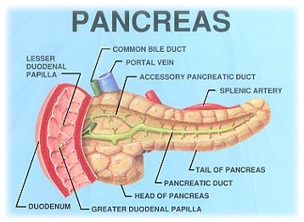

Slide 60
Pancreas is both exocrine and endocrine gland. The exocrinal part secretes pancreatic fluid into the duodenum after a meal. The endocrinal part secretes various types of hormones. These are produced by a specialized tissue in the pancreas and then released to the capillary system and reached the liver by the portal venous circulation. The specialized tissue is called islets of Langerhans. Islets of Langerhans represent approximately 1-2 % of the pancreas. Three types of cells are regonized in these islets.
A cells – producing glucagon (25% of all islet cells).
B cells – producing insulin (60% of all islet cells).
D cells – producing somatostatin (10% of all islet cells).
F cells – producing panceratic polypeptide (5% of all islet cells).

Slide 61
Islets of Langerhans play a crucial role in carbohydrate metabolism and so in a plasma glucose concentration. It involves:
Glycolysis – the anaerobic conversion of glucose to lactate. Occurs in the red blood cells, renal medulla and skeletal muscles.
Glycogenesis – the synthesis of glycogen from glucose. Glucose is stored ( in liver, muscle) in the form of glycogen and this serves to maintain a constant plasma glucose concentration.
Glycogenolysis – the breakdown of glycogen to glucose.
Gluconeogenesis – the production of glucose from non-sugar molecules (amino acids, lactate, glycerol)
Lipolysis – the breakdown of triacylglycerols into glycerol and free fatty acids.
Lipogenesis – the synthesis of triacylglycerols.

Slide 62
Functions of Insulin
Insulin has anabolic and lipogenic effects. It promotes the storage of glucose in the liver and also activates enzymes to promote glycolysis and glycogenesis. In addition, it promotes the uptake and storage of amino acids in the form of proteins and promotes growth. Insulin also increases the amount of GLUT-4. (Glucose transporters in skeletal myocytes. So that glucose can enter. Glucose can enter the cell in two different ways. One is with sodium as a secondary active transport and the other one is through glucose transports, facilitated diffusion.)

Slide 64
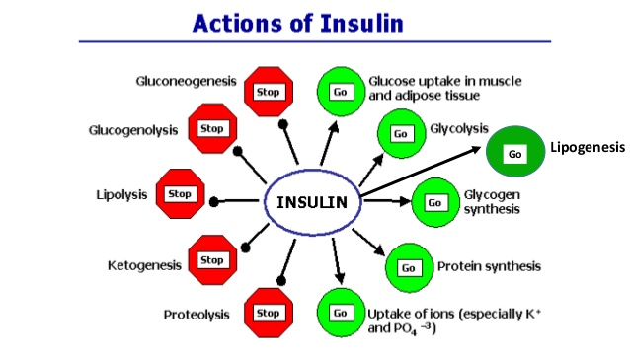

Slide 65
Insulin Deficiency and Excess Diseases
Diabetes mellitus, arguably the most important metabolic disease of man, is an insulin deficiency state. It also is a significant cause of disease in dogs and cats. Two principal forms of this disease are recognized:
Type I or insulin-dependent diabetes mellitus is the result of a frank deficiency of insulin. The onset of this disease typically is in childhood. It is due to destruction pancreatic beta cells, most likely the result of autoimmunity to one or more components of those cells. Many of the acute effects of this disease can be controlled by insulin replacement therapy. Maintaining tight control of blood glucose concentrations by monitoring, treatment with insulin and dietary management will minimize the long-term adverse effects of this disorder on blood vessels, nerves and other organ systems, allowing a healthy life.

Slide 66
Type II or non-insulin-dependent diabetes mellitus begins as a syndrome of insulin resistance. That is, target tissues fail to respond appropriately to insulin. Typically, the onset of this disease is in adulthood. Despite monumental research efforts, the precise nature of the defects leading to type II diabetes have been difficult to ascertain, and the pathogenesis of this condition is plainly multifactorial. Obesity is clearly a major risk factor, but in some cases of extreme obesity in humans and animals, insulin sensitivity is normal. Because there is not, at least initially, an inability to secrete adequate amounts of insulin, insulin injections are not useful for therapy. Rather the disease is controlled through dietary therapy and hypoglycemic agents.
Hyperinsulinemia or excessive insulin secretion is most commonly a consequence of insulin resistance, associated with type 2 diabetes or the metabolic syndrome. More rarely, hyperinsulinemia results from an insulin-secreting tumor (insulinoma) in the pancreas. Hyperinsulinemia due to accidental or deliberate injection of excessive insulin is dangerous and can be acutely life-threatening because blood levels of glucose drop rapidly and the brain becomes starved for energy (insulin shock).

Slide 67
Glucagon
Glucagon is a peptide. Glucagon secretion is stimulated by amino acids, arginin and alanin, from digested proteins. And also by hypoglycemia as a result of physical exercise. And sympathic impulses. The secretion is inhibited by glucose, somatostatin and high plasma concetrations of free fatty acids.
Function
Glucagon mainly antagonise insulin. The signal from glucagon receptor is spread via cAMP. Glucagon increases glycogenolysis in the liver, stimulates gluconeogenesis from lactate, protein degradation and lipolysis. Its main role is to maintain the normal blood glucose level between meals to ensure a constant energy supply.

Slide 68
Somatostatin
Somatostatin is released in response to higher plasma concentrations of glucose and arginine. It inhibits the release of insulin and also the secretion of glucagon. During the deficiency of glucose this process does not occur due to the release of catecholamines that inhibit the secretion of somatostatin.

Slide 70
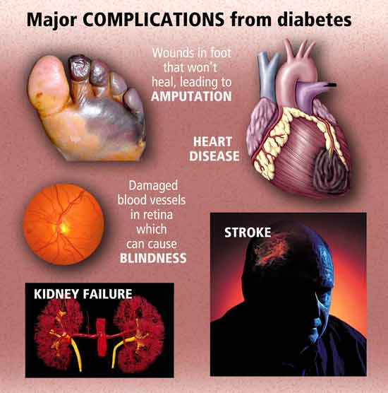

Slide 72
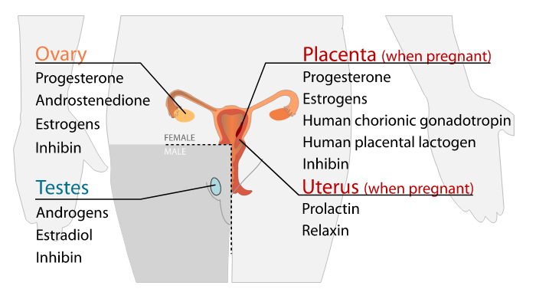
Gonadal Hormones

Slide 73
Ovaries
Estrogen, Progesterone, and Reproduction
The ovaries maintain the health of the female reproductive system.
They secrete two main hormones—estrogen and progesterone.
Diseases associated with the ovaries include ovarian cysts, ovarian cancer, menstrual cycle disorders, and polycystic ovarian syndrome.

Slide 74
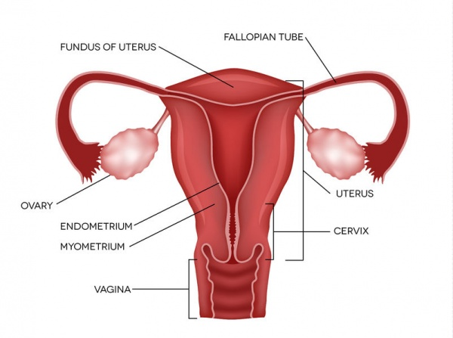

Slide 75
Hormones of the Ovaries
Ovaries produce and release two groups of sex hormones—progesterone and estrogen. There are actually three major estrogens, known as estradiol, estrone, and estriol. These substances work together to promote the healthy development of female sex characteristics during puberty and to ensure fertility.
Estrogen (estradiol, specifically) is instrumental in breast development, fat distribution in the hips, legs, and breasts, and the development of reproductive organs.
To a lesser extent, the ovaries release the hormone relaxin prior to giving birth. Another minor hormone is inhibin, which is important for signaling to the pituitary to inhibit follicle-stimulating hormone secretion.

Slide 76
Progesterone and Estrogen Production and Function
Progesterone and estrogen are necessary to prepare the uterus for menstruation, and their release is triggered by the hypothalamus.
Once you reach puberty, the ovaries release a single egg each month (the ovaries typically alternate releasing an egg)—this is called ovulation. The hypothalamus sends a signal to the pituitary gland to release gonadotrophic substances (follicle stimulating hormone and luteinizing hormone). These hormones are essential to normal reproductive function—including regulation of the menstrual cycle.
As the egg migrates down the fallopian tube, progesterone is released. It is secreted by a temporary gland formed within the ovary after ovulation called the corpus luteum. Progesterone prepares the body for pregnancy by causing the uterine lining to thicken. If a woman is not pregnant, the corpus luteum disappears.

Slide 77
If a woman is pregnant, the pregnancy will trigger high levels of estrogen and progesterone, which prevent further eggs from maturing. Progesterone is secreted to prevent uterine contractions that may disturb the growing embryo. The hormone also prepares the breasts for lactation.
Increased estrogen levels near the end of pregnancy alert the pituitary gland to release oxytocin, which causes uterine contractions. Before delivery, the ovaries release relaxin, which as the name suggests, loosens the pelvic ligaments in preparation for labor.
More hormones are released during pregnancy than at any other time of a woman’s life, but during menopause—which marks the end of fertility—estrogen levels fall fast. This can lead to a range of complications.

Slide 78
Diseases and Disorders of the Ovaries
Osteoporosis: Osteoporosis is commonly associated with menopause, just like mood swings and hot flashes.
Menopause is marked by the rapid loss of estrogen. The role estrogen play in bone loss can best be described in terms of a battle between osteoclasts (bone absorbing cells) and osteoblasts (bone producing cells). Estrogen is on the side of the osteoblasts, but as the estrogens diminish, the osteoblasts are discouraged from producing more bone. As such, the osteoclasts win by absorbing more bone than is being produced by the osteoblasts.
Estrogen replacement therapy during menopause protects bone mass and helps protect against the risk of osteoporotic fractures.

Slide 79
Ovarian Cancer: Ovarian cancer is an extremely serious, but rare, disease. Its symptoms usually don’t become apparent until the cancer has progressed into the later stages. Symptoms of ovarian cancer include: persistent abdominal pain, indigestion, bloating, abnormal uterine bleeding, and pain during sexual intercourse. These are common problems, so in the great majority of cases, they will not indicate cancer. However, it’s important you pay attention to your body and discuss anything out of the ordinary—no matter how insignificant you think it may be—with your doctor.

Slide 80
Ovarian Cysts: Ovarian cysts are fluid-filled sacs that affect women of all ages, though mostly women of child-bearing age. Cysts are very common—and they can range in size from a pea to a grapefruit. The majority of cysts are harmless, though larger cysts (those larger than 5 cm in diameter) may need to be surgically removed because large cysts can twist the ovary and disrupt its blood supply. Cysts can form for a variety of reasons. Oftentimes, they’re simply part of normal menstruation. You may experience no symptoms, and the cysts will go away after a few cycles. These are known as functional cysts. The great majority of cysts are benign. But abnormal or pathological cysts, such as those in polycystic ovary syndrome (PCOS), may cause painful symptoms. Treatment for ovarian cysts depends on the size and type of cyst. If you’re experiencing pain, talk to your doctor. He or she will determine what treatment is best for you.

Slide 81
Polycystic Ovary Syndrome: Polycystic means “many cysts.” Interestingly, the National Institutes of Health (NIH) criteria for diagnosing PCOS do not require the presence of polycystic ovaries by pelvic ultrasound. The NIH criteria are based on signs of hyperandrogenism (or elevated androgens) and oligo/amenorrhea. Other key characteristics include infertility, irregular menstruation, acne, and increased hair growth on the face and body. PCOS is essentially caused by a hormone imbalance—many of the symptoms are caused by increased production of androgens. These patients usually have high free testosterone levels.

Slide 82
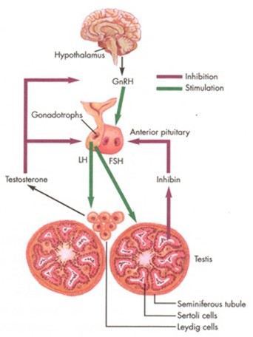
Testes

Slide 83
Testes
The testes secrete testosterone, which is necessary for proper physical development in boys.
In adulthood, testosterone maintains libido, muscle strength, and bone density.
Disorders of the testes are caused by too little testosterone production.
The testes (or testicles) are a pair of sperm-producing organs that maintain the health of the male reproductive system. The testes are known as gonads. Their female counterpart are the ovaries.
In addition to their role in the male reproductive system, the testes also have the distinction of being an endocrine gland because they secrete testosterone—a hormone that is vital to the normal development of male physical characteristics.

Slide 84
Testosterone
Testosterone is necessary for proper physical development in boys. It is the primary androgen, which is the term for any substance that stimulates and/or maintains masculine development. During puberty, testosterone is involved in many of the processes that transition a boy to manhood, including:
Healthy development of male sex organs
Growth of facial and body hair
Lowering of the voice
Increase in height
Increase in muscle mass
Growth of the Adam’s apple
The importance of testosterone is not limited to puberty. Throughout adulthood, the hormone is integral in a variety of functions, such as:
Maintaining libido
Sperm production
Maintaining muscle strength and mass
Promoting healthy bone density

Slide 85
Testosterone Production
The hypothalamus and pituitary gland control how much testosterone the testes produce and secrete.
The hypothalamus sends a signal to the pituitary gland to release gonadotrophic substances (follicle stimulating hormone and luteinizing hormone). Luteinizing hormone (LH) stimulates testosterone production. If too much testosterone is produced, the hypothalamus alerts the pituitary gland to make less LH, which tells the testes to decrease testosterone levels.

Slide 86
Disorders of the Testes: Hypogonadism
Hypogonadism is a testicular disorder associated with low testosterone. Having testosterone levels that are too low causes a variety of problems, including:
Decreased sex drive
Diminished muscle mass
Low sperm count (reduced fertility)
Loss of body hair
There are two types of hypogonadism—primary and secondary. Primary refers to a defect with the testicles, and secondary involves a problem in the pituitary gland that indirectly affects testosterone production.

Slide 87
The condition may be caused by many things and is most commonly the result of:
Aging
Defects in the pituitary and/or hypothalamus, such as pituitary tumors (which adversely affect the pituitary’s ability to function normally) and high prolactin levels (too much of the hormone causes a drop in testosterone levels)
Medications
Testes-based conditions, such as severe injury, and radiation or chemotherapy, can all deplete testosterone levels
The testes play a vital role not only in the male reproductive system but in the endocrine system as well. The release of the hormone testosterone is integral to the healthy development of male physical characteristics.

