Slide 1
ELFA and ECL Sadeq Kaabi
بسم الله الرحمن الرحيم
Fourth grade
First semester
2018-2019

Slide 5
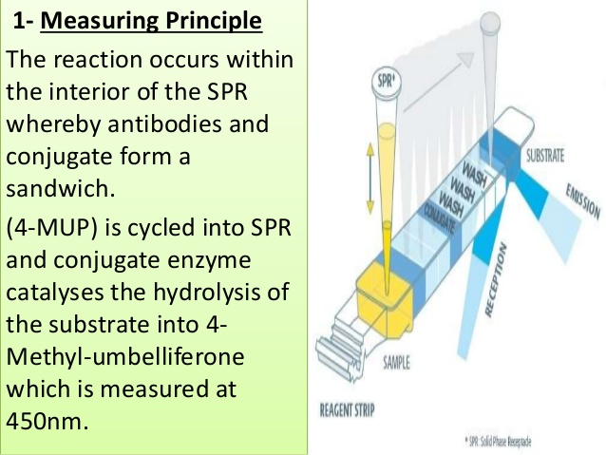

Slide 7
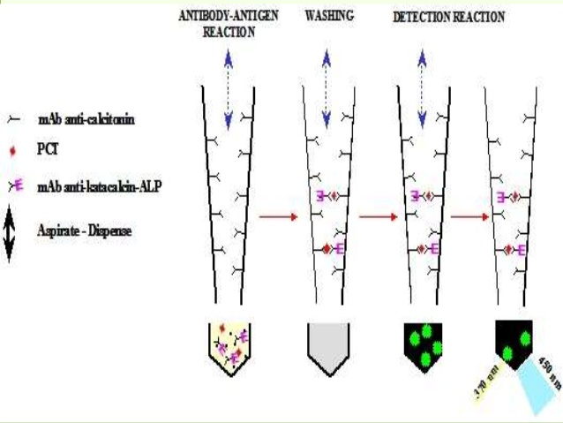
-Procalcitonin

Slide 11
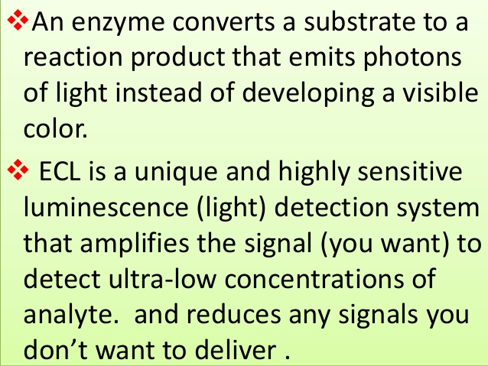

Slide 16
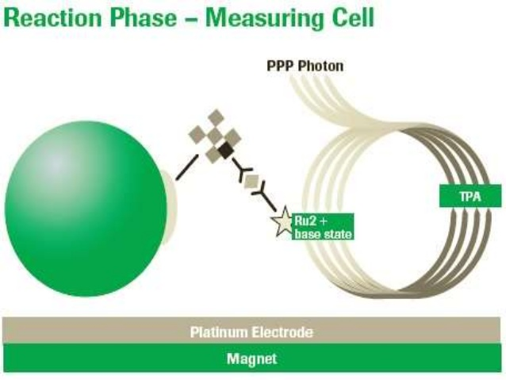

Slide 20
A comparative analysis on three different fully automated anti-toxoplasm IgM immunoassays

