Slide 1
The Course of Atmospheric Thermodynamics
MUSTANSIRIYAH UNIVERSITY
COLLEGE OF SCIENCES
ATMOSPHERIC SCIENCES DEPARTMENT
2019-2020
Dr. Sama Khalid Mohammed
SECOND STAGE
Lecture 1

Slide 2
This lecture including the following items
Recall the forms of energy
Overview of the Earth’s Atmosphere
Composition of the Atmosphere
Vertical Structure of the Atmosphere
Pressure (hydrostatic eq. )
Temperature
Pressure decrease in an isothermal atmosphere
Density
Geopotential and Geopotential Height
Thickness and the hypsometric equation

Slide 3
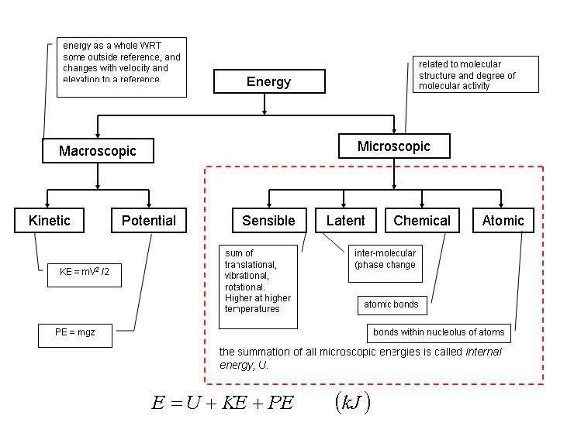
Forms of Energy

Slide 4
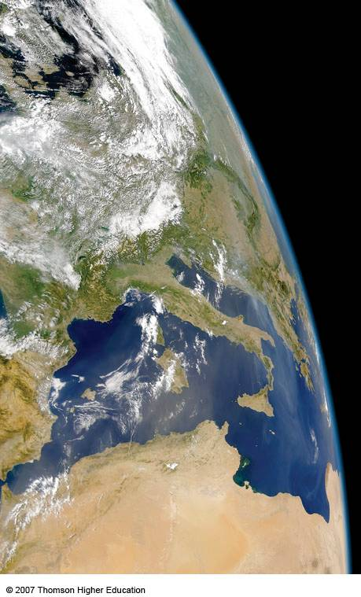
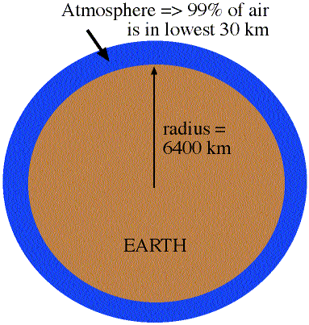
Overview of the Earth’s Atmosphere
The Atmosphere is really a thin envelope surrounding the earth
99% of atmosphere is in lowest 30 km
earth's radius is about 6400 km
So, the atmospheric depth is 30 km/6400 km= 0.5% of earth's radius

Slide 5
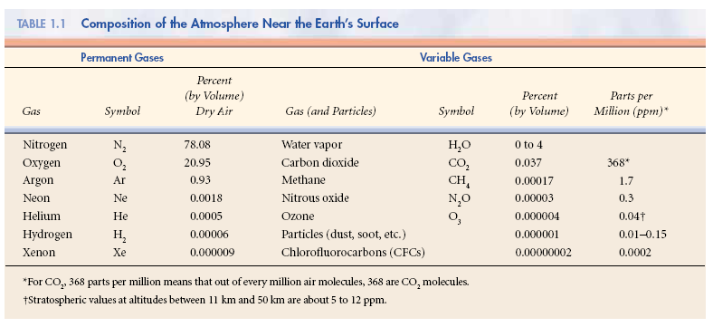
Composition of the Atmosphere
The earth’s atmosphere is a thin, gaseous envelope comprised mostly of nitrogen (N₂) and oxygen (O₂), with small amounts of other gases, such as water vapor (H₂O) and carbon dioxide (CO₂). Nested in the atmosphere are clouds of liquid water and ice crystals.

Slide 6
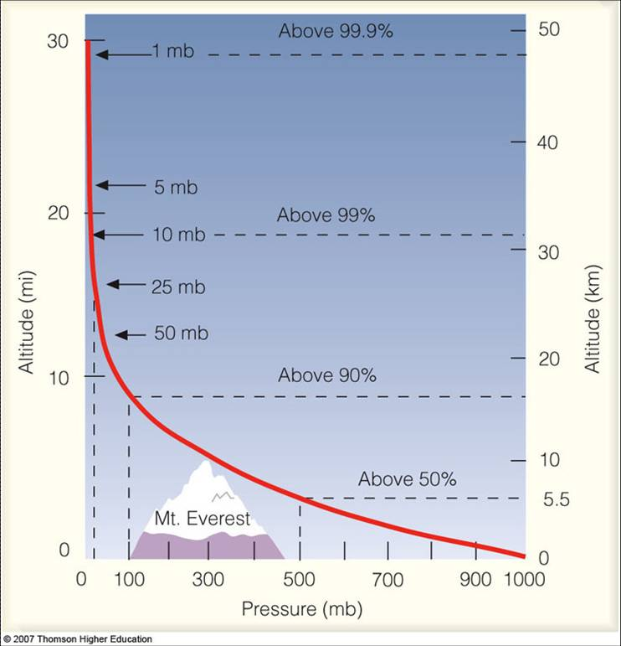
Vertical Structure of the Atmosphere
Vertical Profile of Pressure
Pressure = Force/Area
Force is a push or a pull exerted from one object to another
Atmospheric Pressure decreases with height.... in a similar manner as density

Slide 7
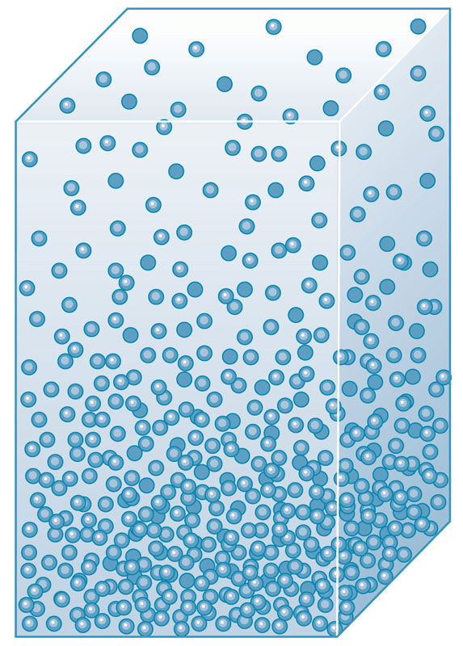
The Hydrostatic Equation
Air pressure at any height in the atmosphere is due to the force per unit area exerted against a surface by the weight of the air molecules above that surface. This “weight” results from the pull of gravity
That explains why pressure decreases with increasing height above the ground
P2
P1 > P2
However, pressure gradients cause a force that points from regions with high pressure towards regions with low pressure (vertical Gradient Pressure).
That explains why the atmosphere does not collapses on the ground and does not escape to the space
P1

Slide 8
The Hydrostatic Equation
Consider “g” the gravity acceleration (m/s²)
Consider that δp is negative ( that is, z increases p decreases)
Vertical Gradient Acceleration=Force/mass
In a hydrostatic equilibrium, and considering the limit as δz → 0
or:
pressure p + δp
pressure p
δz
Z
Gravity acceleration
Hydrostatic Equation

Slide 9
Vertical Structure of the Atmosphere
There are two types of pressure:
Hydrostatic pressure, which is just due to the weight of the air above you.
Dynamic pressure, which is due to the motion of the air.
In meteorology, dynamic pressure is usually very small, and we will assume for now that atmospheric pressure is solely due to hydrostatic pressure.
To find how pressure changes with height we start with the hydrostatic equation

Slide 10
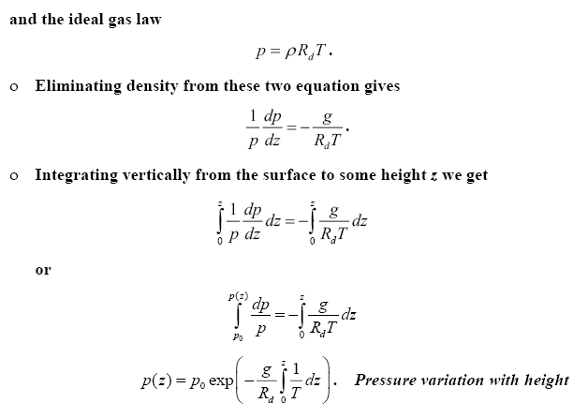
Vertical Structure of the Atmosphere
This Equation is used to obtain a relationship between pressure and height, used by altimeters to measure pressure and calculate altitude above sea level, in which Aircraft altimeters are essentially barometers that are calibrated to read altitude above mean sea level

Slide 11
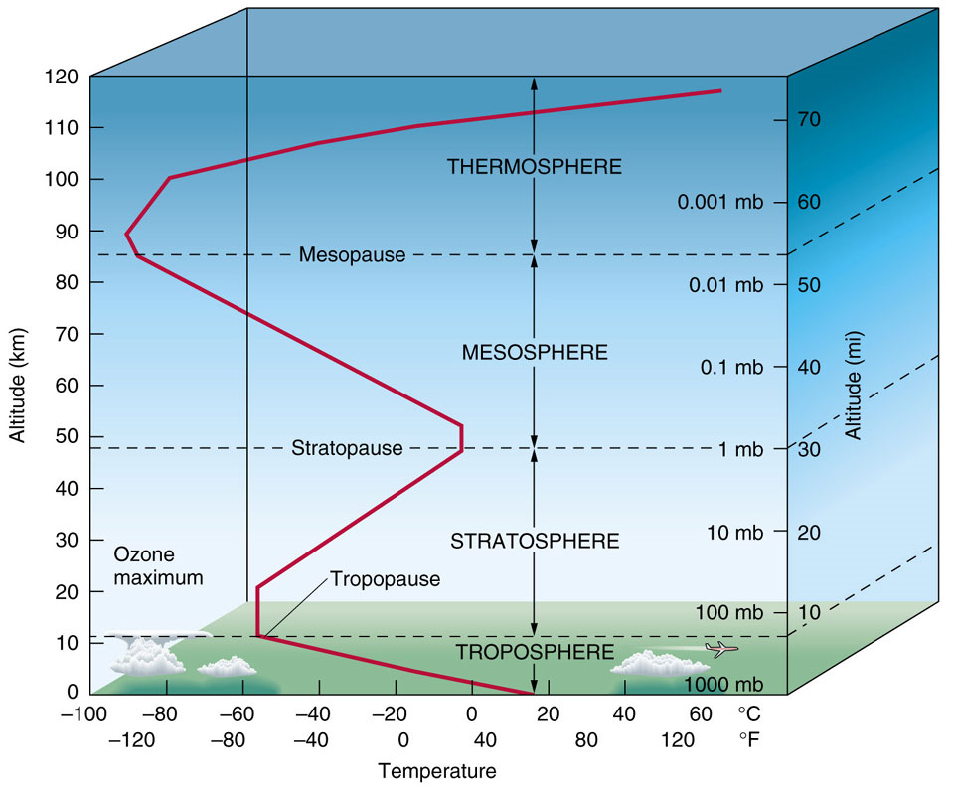
Vertical Structure of the Atmosphere
Vertical Profile of Temperature
There are distinct layers in the atmosphere where the temperature either increases or decreases with height.

Slide 12
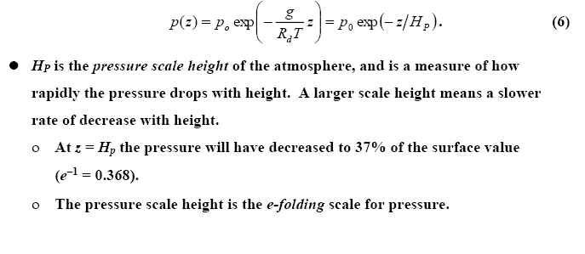
Vertical Structure of the Atmosphere
Pressure decrease in an isothermal atmosphere
Absolute temperature varies by only 20% or so through the troposphere, so we can get an idea how pressure changes with height by assuming a constant temperature (isothermal atmosphere). If this is done, the expression for the pressure profile becomes

Slide 13
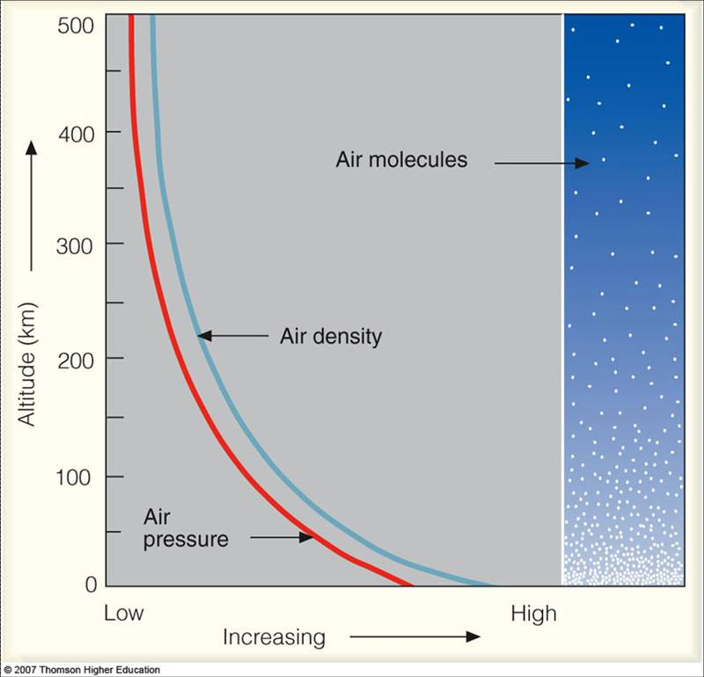
Vertical Structure of the Atmosphere
Vertical Profile of Density
density = mass/volume (grams/m³)
so, the density of air is computed by determining the mass of air in a given volume.
The density of air decreases with height.
Riddles: Why are there more air molecules near the ground than higher in the atmosphere?
Notes:
http://apollo.lsc.vsc.edu/classes/met130/index.html

Slide 14
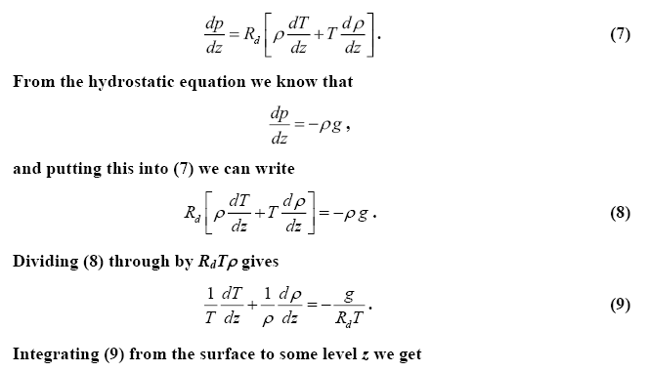
Vertical Structure of the Atmosphere
Vertical Profile of Density
We can also use the hydrostatic equation and the equation of state to find how density changes with height. We first start by differentiating the ideal gas law with respect to height to get
Notes:
http://apollo.lsc.vsc.edu/classes/met130/index.html

Slide 15
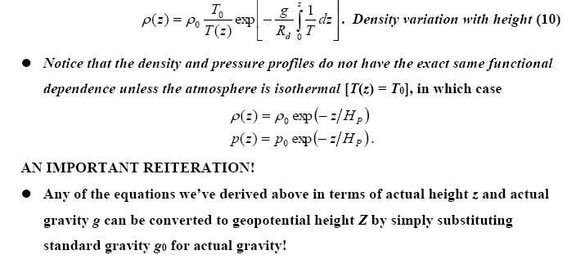
Vertical Structure of the Atmosphere
Notes:
http://apollo.lsc.vsc.edu/classes/met130/index.html

Slide 16
GEOPOTENTIAL Φ(z)
The acceleration due to gravity is not constant. It varies from place to place, with the largest variation due to latitude.
What we call gravity is the combination of the gravitational acceleration and the centrifugal acceleration from the Earth’s rotation.
Though small, the variation in gravity must be accounted for. We do this via the concept of geopotential.
Geopotential is defined as the potential energy of a unit mass relative to sea level, numerically equal to the work that would be done in lifting the unit mass from sea level to the height at which the mass is located; commonly expressed in terms of dynamic height or geopotential height.

Slide 17
GEOPOTENTIAL Φ(z)
A surface of constant geopotential represents a surface along which all objects of the same mass have the same potential energy.
If gravity were constant, a geopotential surface would lie at a constant altitude. Since gravity is not constant, a geopotential surface will have varying altitude. The geopotential Φ(z) at height z is thus given by:
or

Slide 18
Geopotential Height Z
The Geopotential height is defined as:
Where g_{o} is the globally averaged acceleration due to gravity at the Earth’s surface called standard gravity (~ 9.81m/s²).
Geopotential height is expressed in geopotential meters, abbreviated as gpm.
Geopotential height is used as the vertical coordinate in most atmospheric applications in which energy plays an important role (e.g., in large-scale atmospheric motions). Values of z (actual height) and Z are almost the same in the lower atmosphere where g_{o} ~ g
Z
dz

Slide 19
Geopotential Height Z
If the change in gravity with height is ignored, geopotential height and geometric height are related via
If the local gravity is stronger than standard gravity, then Z > z.
If the local gravity is weaker than standard gravity, then Z < z.
Gravity varies, at the North Pole is approximately 9.83 m/s₂, while at the Equator it is about 9.78 m/s₂.
Therefore, g/g₀ ~ 1, and for many applications we can ignore the difference between geopotential and geometric height, since Z ~ z.
But, keep in mind that they are different, and at times this difference, though small, is very important and cannot be neglected.
z(km) | Z(km) | g(ms⁻²)
0 | 0 | 9.81
1 | 1.00 | 9.80
10 | 9.99 | 9.77
100 | 98.47 | 9.50

Slide 20
Thickness and the hypsometric equation
The hypsometric equation tells us that the thickness between two pressure levels is directly proportional to the average temperature within the layer.
We can use thickness as a measure of the average temperature of a layer.
We can use contours of thickness in a similar manner to how we use isotherms.
Colder layers are thinner, warmer layers are thicker.

Slide 21
Why using hypsometric equation
Weather observing stations measure station pressure, which must be converted to sea-level pressure for reporting and plotting on weather charts.
The method of calculating the sea-level pressure is called pressure reduction or reducing the pressure to sea-level
Sea-level pressure reduction is accomplished via the hypsometric equation, treating Z₁ = 0 as sea level, and Z₂ = Z_{sta} as the geopotential height of the station.
This means p1 = p_{sl}, the sea-level pressure, P₂ = P_{sta}, the station pressure, and by Rearranging hypsometric equation with these definitions give:
There are different formulas used in various applications according to the layer-average temperature in the hypothetical atmospheric layer between the surface and sea level.

