Slide 1
Third type of con. T. :- specialized con. T.
Adipose tissue :
Adipose cell {adipocytes} are very large cell specialized for energy storage in lipid droplets. There are two types of adipose tissue.
1.White adipose tissue:- found in many organs, adipocytes of this type are very large cell contain one large lipid droplet causing the nucleus and cytoplasm to be pushed acid.

Slide 2
2.Brown adipose tissue: -
found in newborn: in the back, neck and shoulders.
In adults found in: scattered areas. Adipocytes are smaller than those of white fat it contain many small lipid droplets in the cytoplasm with central nucleus.

Slide 3
Figure 6-1
Notes:
White adipose tissue.
White or unilocular adipose tissue is commonly seen in sections of many human organs. (a) Large white adipocytes (A) are seen in the connective tissue associated with small blood vessels. The fat cells are empty because lipid was dissolved away in slide preparation. Nuclei at the cell membranes are visible in some of the fat cells. X100. H&E.
(b) Large (empty) adipocytes predominate in this typical white adipose tissue, which shows only a small portion of microvasculature. In a single histologic section, nuclei of most very large adipocytes are not included. X100. H&E.
(c) Tissue was fixed here with osmium tetroxide, which preserves lipid (L) and stains it black. Many adipocytes in this slide retain at least part of their large lipid droplets. X440. Osmium tetroxide.
(d) The specimen here was from a young mammal, and the adipocytes marked with asterisks are not yet unilocular, having many small lipid droplets in their cytoplasm, which indicates that their differentiation is not yet complete. The eccentric nuclei of unilocular cells are indicated by arrowheads. X200. PT.

Slide 4
Figure 6-4
Notes:
Brown adipose tissue.
(a) Brown adipose tissue is shown here around a small blood vessel (BV) and adjacent white adipose tissue at the top of the photo. Brown adipocytes are slightly smaller and characteristically contain many small lipid droplets and central spherical nuclei. If the lipid has been dissolved from the cells, as shown here, the many mitochondria among the lipid spaces are retained and can be easily discerned. X200. PT.
(b) A diagram of a single multilocular adipocyte showing the central nucleus, numerous small lipid droplets (yellow), and many mitochondria. Also shown is a sympathetic nerve ending that releases norepinephrine to stimulate mitochondrial production of heat.

Slide 5
Cartilage tissue :
Tough flexible form of specialized con. T. that structurally supports certain soft Tissue and provides cushioned low friction surfaces in joints.
●Cartilage composed of:
Extracellular matrix {ECM}:- flexible mass contain collagen and elastic fibers.
Its structure which is firm consistency allows the tissue to bear mechanical stress without distortion.

Slide 6
b) Chondrocytes :- cells of cartilage embedded in ECM .
The ECM synthesized and maintained by these cells.
Chondrocytes located in { D shape} cavities called lacunae .
These cells divided inside the lacunae to form a group of cells called cell nest.
c) Perichonderum: - Sheath of dense con. Tissue that surround the cartilage.
NOTE /
Cartilage always lacks blood vessels, lymphatics and nerves but the Perichonderum is usually vascularized.

Slide 7
Types of cartilage: 3
Hyaline cartilage: flexible and resilient
Chondrocytes appear spherical
Lacuna – cavity in matrix holding chondrocyte
Collagen the only fiber
Elastic cartilage: highly bendable
Matrix with elastic as well as collagen fibers
Epiglottis, larynx and outer ear
Fibrocartilage: resists compression and tension
Rows of thick collagen fibers alternating with rows of chondrocytes (in matrix)
Knee menisci and fibrosis of intervertebral discs

Slide 8
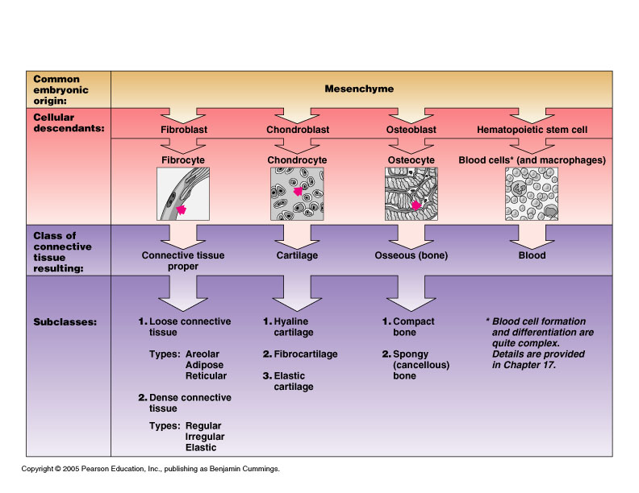
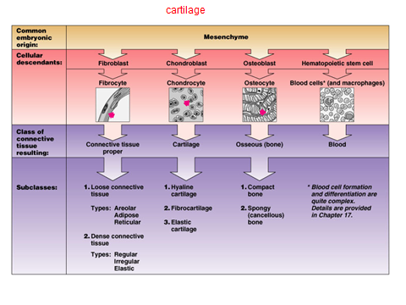

Slide 10
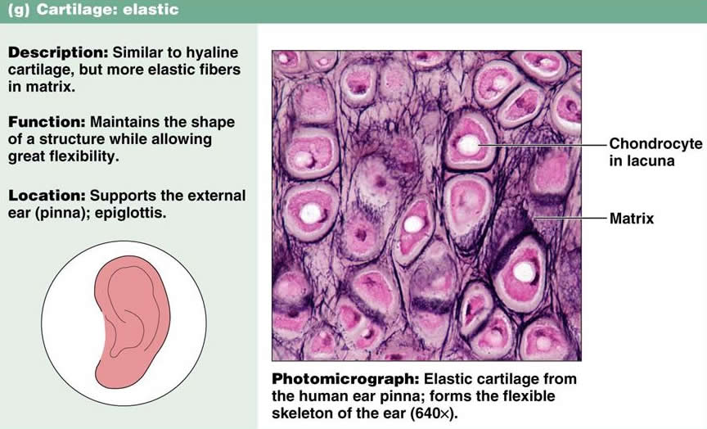
Elastic cartilage

Slide 11
Fibrocartilage

Slide 12
