Slide 1
The Course of Atmospheric Thermodynamics
MUSTANSIRIYAH UNIVERSITY
COLLEGE OF SCIENCES
ATMOSPHERIC SCIENCES DEPARTMENT
2020-2021
Dr. Sama Khalid Mohammed
SECOND STAGE
Lecture 6

Slide 2
THIS LECTURE INCLUDING THE FOLLOWING ITEMS
Phase Change
Recall some terms that we learned in the first course of “Fundamentals of Thermodynamics”
Entropy

Slide 3
PHASE CHANGE
Water vapor is an invisible gas that becomes visible when it changes into larger liquid or solid (ice) particles.
This process of transformation is known as a change of state or, simply, a phase change.
The heat energy required to change a substance, such as water, from one state to another is called latent heat.
But why is this heat referred to as “latent”?

Slide 4
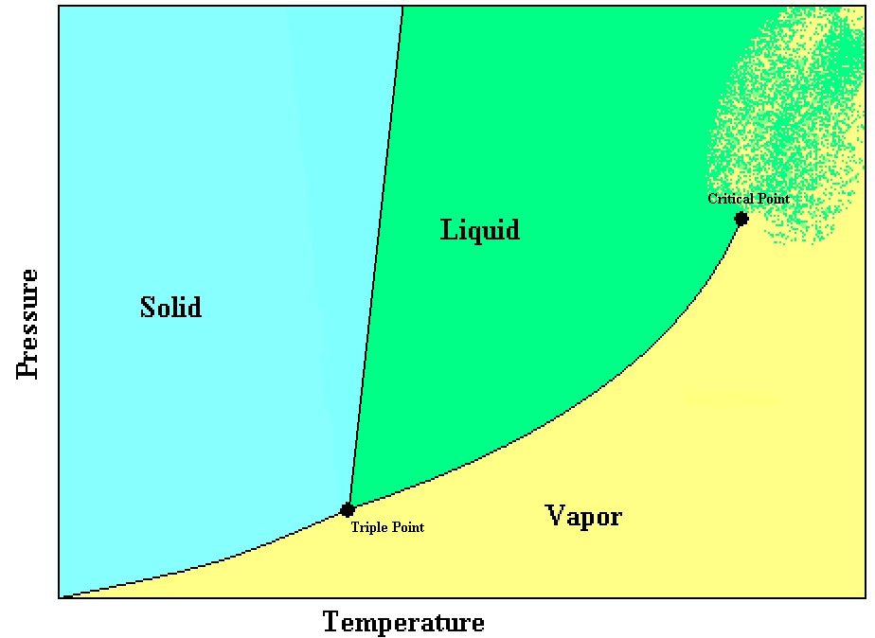
PHASE CHANGE
A phase change is a change between solid, liquid, or vapor (gas).
A system may even have more than one solid or liquid phase such as Carbon with two solid phases (graphite & diamond).
The phase of a system in equilibrium can be represented on a phase diagram.
The lines separating the phases represent points where the two phases can coexist.
The triple point represents the one and only point on the diagram where all three phases can coexist.

Slide 5
PHASE CHANGE
The critical point occurs at the end of the vapor-to-liquid transition line. At temperatures above the critical temperature, or pressures above the critical pressure there is no distinction between the liquid and vapor phases.
The slope of the solid-to-liquid transition line shows how the melting point changes with pressure.
An increase in pressure will increase the melting point.

Slide 6
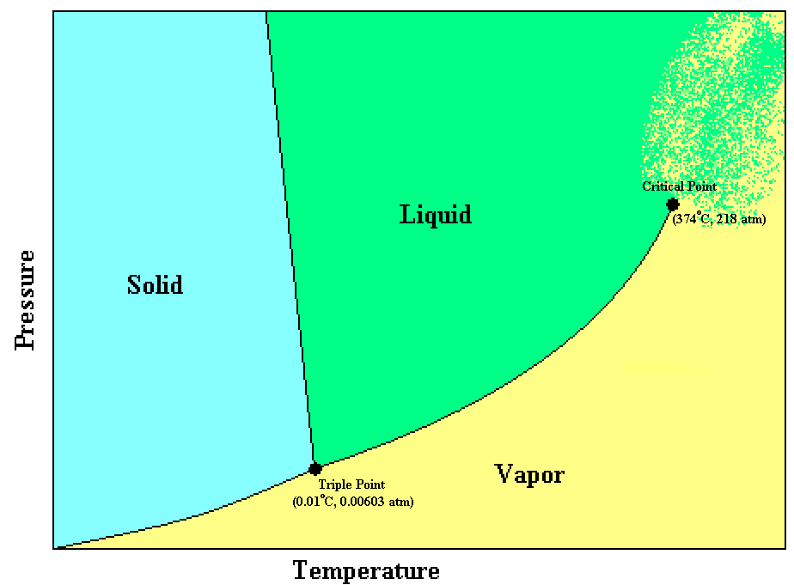
PHASE CHANGE
Water is one of the few substances that can exist in all three phases at the temperatures and pressures found in the Earth’s atmosphere.
A unique feature of water is that the solid-to-liquid transition line slopes upward to the left, instead of to the right.

Slide 7
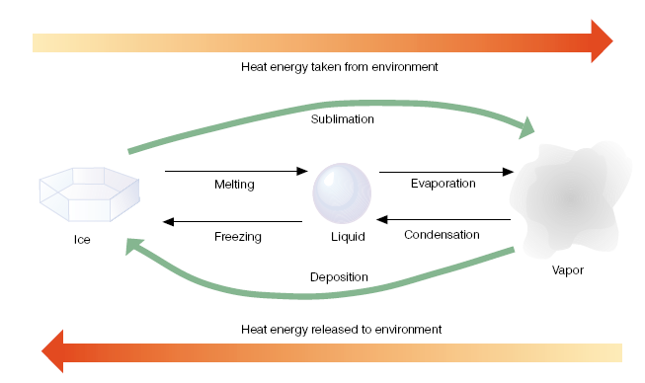
PHASE CHANGE
When the change of state is from left to right, heat is absorbed by the substance and taken away from the environment.
The processes of melting, evaporation, and sublimation (ice to vapor) all cool the environment.

Slide 8
PHASE CHANGE
When the change of state is from right to left, heat energy is given up by the substance and added to the environment.
The processes of freezing, condensation, and deposition (vapor to ice) all warm their surroundings.

Slide 9
Latent heat is an important source of atmospheric energy, why ??????
Once vapor molecules become separated from the earth’s surface, they are swept away by the wind rising to high altitudes where the air is cold, the vapor changes into liquid and ice cloud particles. During these processes, a huge amount of heat energy is released into the environment. Water vapor evaporated from warm, tropical water can be carried into polar regions, where it condenses and gives up its heat energy.
Thus, evaporation-transportation-condensation is an extremely important mechanism for the relocation of heat energy (as well as water) in the atmosphere.

Slide 10
FYI: A REVIEW OF STATE VARIABLES
The thermodynamic state of a simple system in thermodynamic equilibrium is completely characterized by specifying the internal energy (U), volume (V), and the number of moles, n_{i}, of each of its components.
Example: The thermodynamic state of a one-component, closed system in equilibrium can be completely described by any two state variables (other than mass or moles).
The state variables have two important properties:
The change in any of the state variables (say U) doesn’t depend on the path of the system on a thermodynamic diagram.
It only depends on the endpoints.

Slide 11
FYI: A REVIEW OF STATE VARIABLES
Mathematically, this means that differentials of state functions are exact differentials.
Here the problem is going to appear, because HEAT & WORK is not a state variables !!!!!!
But Heat and work are modes of transfer of energy, thus how can we deal with them to know about the state of thermodynamic System ???

Slide 12
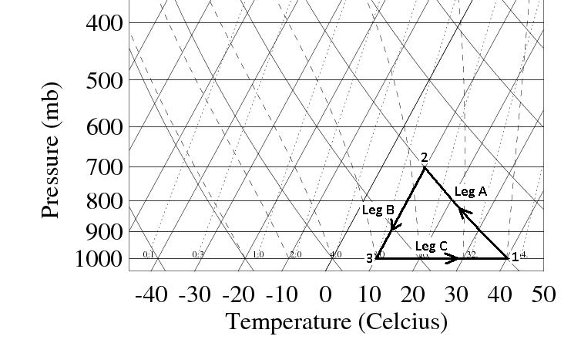
FYI: HEAT IS NOT A STATE VARIABLE
We know why work is not a state variable, but what about heat ????
Imagine that an air parcel starts out at Point 1 on the skew-T diagram shown below. The initial pressure and temperature are p1 and T1. The parcel moves in a reversible, closed cycle around the path shown. The three legs of the path are:
Leg A: Adiabatic expansion to pressure p2.
Leg B: Isothermal compression back to pressure p1.
Leg C: Isobaric heating back to temperature T1.
https://www.weather.gov/jetstream/skewt

Slide 13
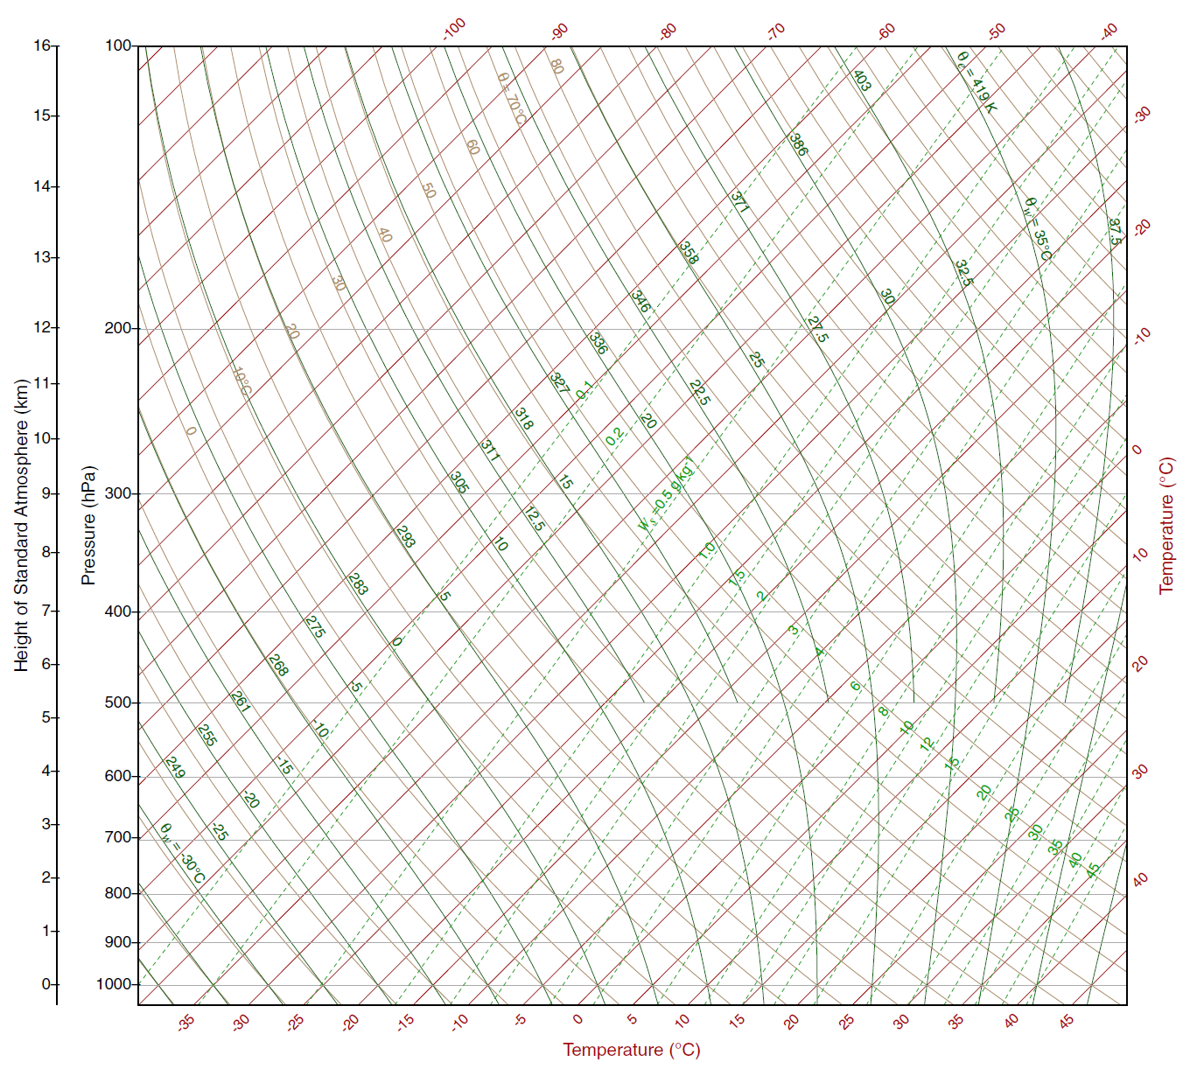
Leg A: Adiabatic expansion to pressure p2.
Leg B: Isothermal compression back to pressure p1.
Leg C: Isobaric heating back to temperature T1.
isobar
isotherm
dry adiabat
saturated adiabat
B
A
saturation mixing ratio
C

Slide 14
FYI: HEAT IS NOT A STATE VARIABLE

Slide 15
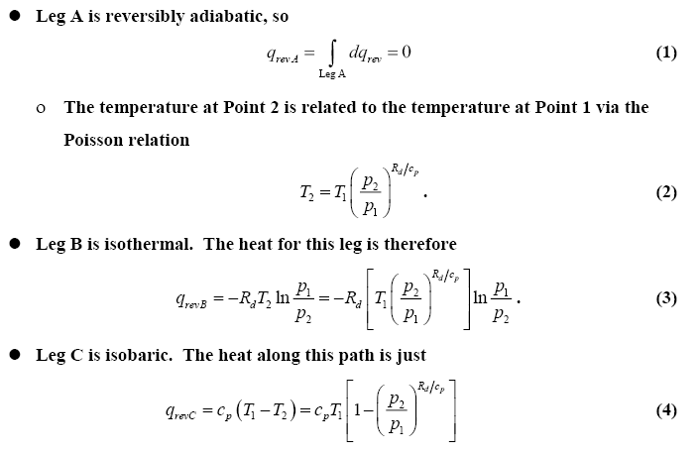
FYI: HEAT IS NOT A STATE VARIABLE

Slide 16
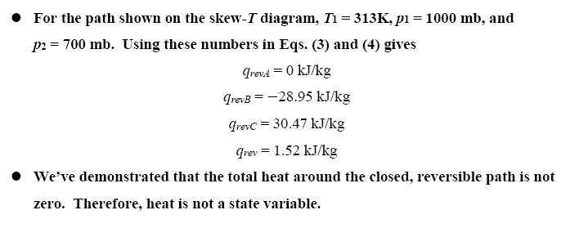
FYI: HEAT IS NOT A STATE VARIABLE
Thus, the total heat around the closed, reversible path is not zero. Therefore, heat is not a state variable.

Slide 17
FYI: HEAT IS NOT A STATE VARIABLE

Slide 18
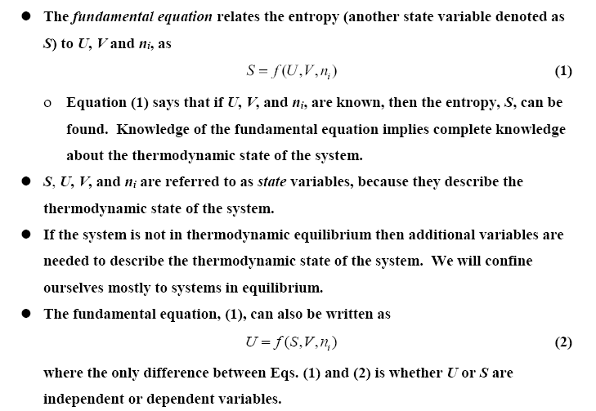
The Fundamental Equation and Entropy

Slide 19
The Fundamental Equation and Entropy
PAY ATTENTION WHY WE DIVIDED BY T ???

Slide 20
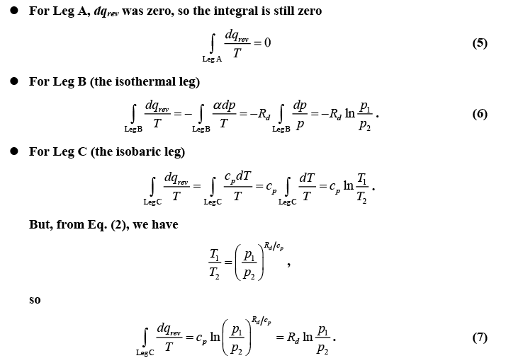
FYI: The Fundamental Equation and Entropy

Slide 21
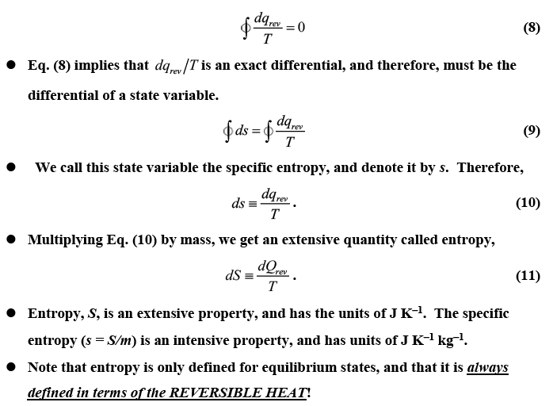
Entropy

Slide 22
Entropy

Slide 23
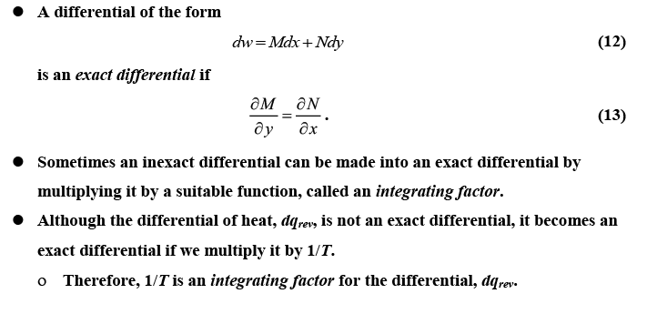
Why we divided the HEAT Q by T ?

Slide 24
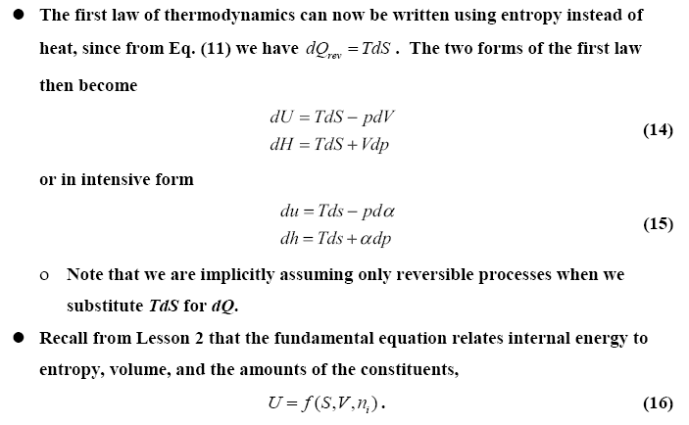
What are the thermodynamic definition of temperature & pressure using Entropy and 1st law of thermodynamics???

Slide 25
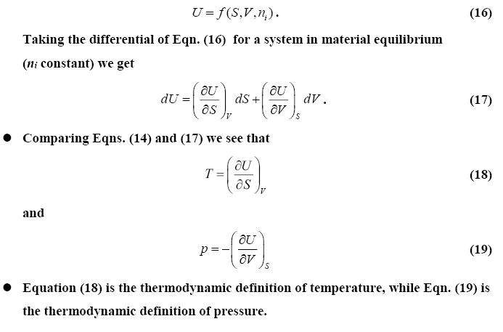
What are the thermodynamic definition of temperature & pressure using Entropy and 1st law of thermodynamics???

