Slide 1
Aerosols atmospheric Chemistry
By
Ahmed Fattah hassoon

Slide 2
first lecture
1. Sources and sinks of atmospheric aerosols
1.1. Sources of aerosol particles
1.2. Sink processes

Slide 3
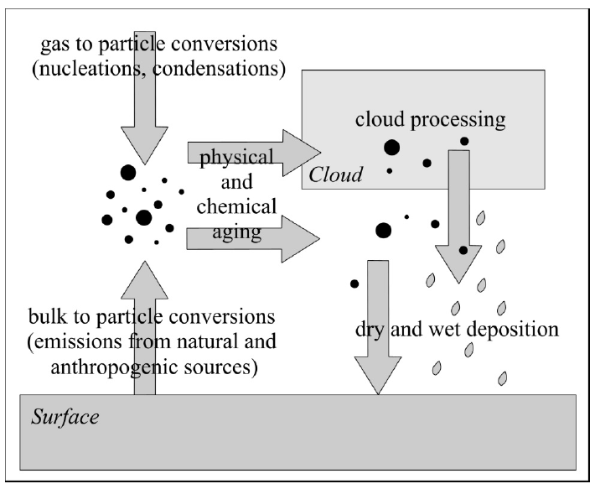
1.1 SOURCES OF AEROSOLS
Aerosol is a system of solid or liquid particles suspended by a mixture of gases. The term aerosols covers a wide spectrum of small particles, like sea salt particles, mineral dust, pollen, drops of sulphuric acid and many others.
After the emission of aerosol particles, they undergo various physical and chemical processes. During these processes, size, composition and structure of particles can be changed. Finally, they can be removed from the atmosphere to the surfaces by dry or wet deposition processes , figure 1
Figure 1: Atmospheric cycles of aerosol particles

Slide 4
Aerosols originate from a wide variety of natural and anthropogenic sources. Various aerosol particles are generated through a combination of physical, chemical and biological processes. Based on the formation processes, different source types can be distinguished.
Primary particles emitted directly to the atmosphere as liquids or solids, through a wide range of processes (Bulk-to-Particle Conversion, BPC). Some particles formed by nucleation1 and condensation2 of precursor gases (Gas-To-Particle Conversation, GPC), and others from the reactions of dissolved substance in cloud droplets.
Nucleation: defined as creation of molecular embryos or clusters prior to formation of a new phase during the transformation of vapor → liquid → solid. Nucleation can occur within the original phase (homogeneous nucleation), or on another phase, e.g. on a small particles (heterogeneous nucleation).
During Bulk-to-Particle Conversion, many different aerosol particles are generated from solid or liquid base materials.
Oceans and dry continental regions are the two main natural sources of atmospheric aerosol. A large amount of water droplets and sea salts are released to the atmosphere through sea spray and air bubbles at the surface of the seas (Figure 9.2).

Slide 5
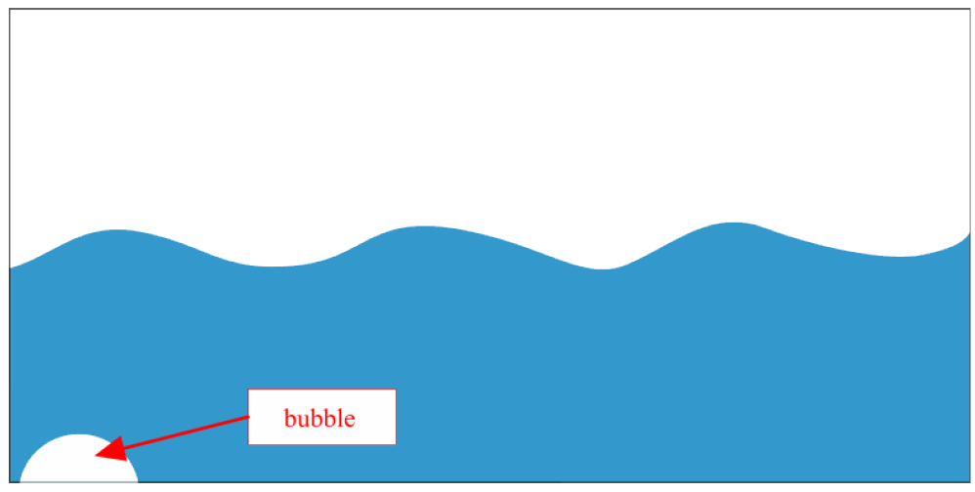
As a water droplet evaporates, the salt is left suspended into the atmosphere forming a maritime aerosol particle (e.g. sodium-chloride (NaCl), magnesium sulphate (MgSO4)).
Other major source of primary particles is the windblown mineral dust from dry continental area, like deserts and semi arid regions. Further natural sources are volcanic ash, clay particles from soil erosion and biological materials (plant debris, pollen etc.).
Additionally, different particles are formed by anthropogenic activities, like biomass burning, combustion of fossil fuel or industrial activities (Table 9.1).
Figure : Droplet formation during the bursting of small bubble

Slide 6
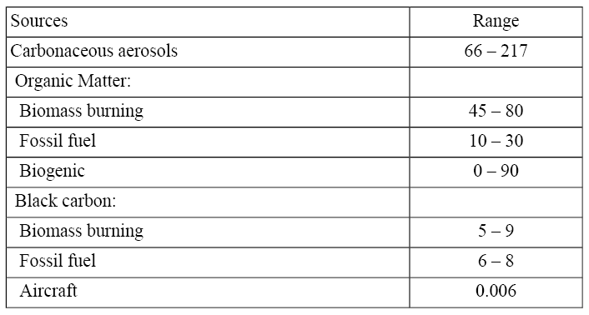
Two basic processes can cause the formation of secondary particles: an existing particle may grow through material condensing from gas phase, or new particle may forms through homogeneous nucleation.
Table 9.1: Primary particle emissions (Tg / year) Source: IPCC (2001)

Slide 7
Some other particles can form or transform by cloud droplets. When a cloud condensation nucleus as an aerosol particle dissolves in the water, and then reacts with other substances, it can build new aerosol substance and form a new aerosol particle when the water evaporates.
Cloud condensation nuclei (CCN): define as hygroscopic aerosol particles that can serve as nuclei of atmospheric cloud droplets, where, water vapour condenses on particles .

Slide 8
Fine aerosol particles (less than 1 mm in radius) originate almost exclusively from condensation of precursor gases.
precursor gas sulfuric acid (H2SO4), produced in the atmosphere by oxidation of sulfur dioxide (${SO}_{2}$) emitted from fossil fuel combustion, volcanoes, and other sources. H2SO4 has a low vapor pressure over $H_{\text{2}}{SO}_{\text{4}}$-H2O solutions and condenses under all atmospheric conditions to form aqueous sulfate particles, figure below.
The composition of these sulfate particles can then be modified by condensation of other gases with low vapor pressure including NH3, HNO3, and organic compounds. Organic carbon represents a major fraction of the fine aerosol (Figure) and is contributed mainly by condensation of large hydrocarbons of biogenic and anthropogenic origin.
Another important component of the fine aerosol is soot produced by condensation of gases during combustion. Soot as commonly defined includes both elemental carbon and black organic aggregates.

Slide 9
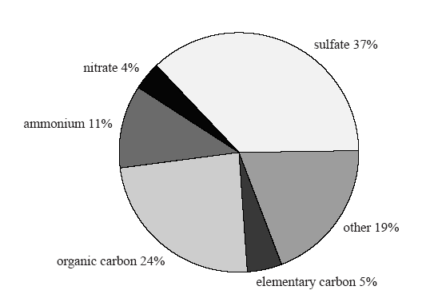
Figure 1: Typical composition of fine continental aerosol. Adapted

Slide 10
Mechanical action of the wind on the Earth’s surface emits sea salt, soil dust, and vegetation debris into the atmosphere. These aerosols consist mainly of coarse particles 1-10 mm in radius.
Particles finer than 1 mm are difficult to generate mechanically because they have large area-to-volume ratios and hence their surface tension per unit aerosol volume is high.
Particles coarser than 10 mm are not easily lifted by the wind and have short atmospheric lifetimes because of their large sedimentation velocities.
Gas molecules are typically in the ${10}^{\text{−}\text{4}}$-${10}^{\text{−}\text{3}}$mm size range. Clustering of gas molecules (nucleation) produces ultrafine aerosols in the ${10}^{\text{−}\text{3}}$-${10}^{\text{−}\text{2}}$mm size range. These ultrafine aerosols grow rapidly to the 0.01-1 mm fine aerosol size range by condensation of gases and by coagulation (collisions between particles during their random motions).
Growth beyond 1 mm is much slower because the particles are by then too large to grow rapidly by condensation of gases, and because the slower random motion of large particles reduces the coagulation rate.

Slide 11
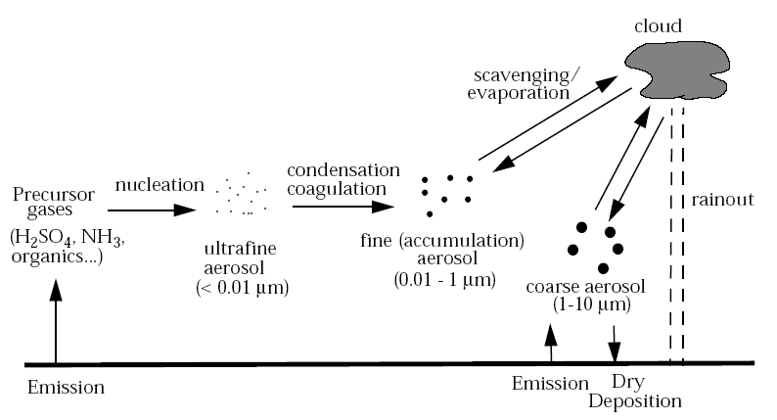
Figure 2: illustrates the different processes involved in the production, growth, and eventual removal of atmospheric aerosol particles.

Slide 12
1.2. Sink processes
Aerosols can be removed from the atmosphere by different ways in the function of their size and disposition. Two main types of removing processes of aerosol particles are wet and dry deposition .
In an annual global mean, about 80–90% of aerosol particles are removed from the atmosphere by in-cloud and below-cloud scavenging (wet deposition). Remaining part of particles is removed by different ways of dry deposition.
Wet deposition processes (the main sink of atmospheric aerosol particles): Rain-out and washout: a part of cloud droplets form precipitation which reaches Earth’s surface removing aerosols from cloud and from the column of air below the cloud.

Slide 13
Dry deposition processes (less important on a global scale):
Turbulent diffusion: for larger particles (with a diameter larger than 1 µm) eddy diffusivity becomes important.
Gravitational settling (sedimentation): larger particles are influenced more by gravity and fall back to the surface. This process becomes increasingly important for particle sizes above 1 µm.
Impaction: if a particle cannot follow the flow streamline around an obstacle (e.g. a larger particle), small particle can hit this obstacle (Figure 9.3).
Interception: if an object is not directly in the path of particle moving in the gas stream (as in case of impaction), but particle approaches the edge of the obstacles, it may collected by the obstacle (Figure 9.4).
Brownian diffusion: randomly moving smaller particles bump each other (thermal coagulation4) or to a larger obstacles [Particle coagulation: define as a process, in which small particles collide with each other and coalesce completely to form a larger particle] (Figure 9.5).
This process dominates for particle sizes below 0.2 µm. Brownian diffusion coefficients increase as particle diameter decreases.

Slide 14
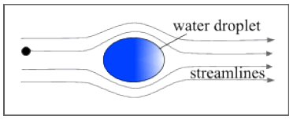
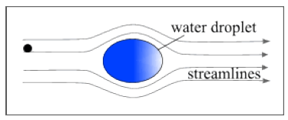
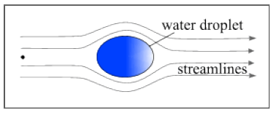
Figure 9.3: Impaction of an aerosol particle on an obstacle (for example on a larger water droplet)
Figure 9.4: Particle interception by an obstacle (for example by a larger water droplet)
Figure 9.5: Brownian diffusion of a small aerosol particle

Slide 15
Aerosol particles originating from condensation of gases tend therefore to accumulate in the 0.01-1 mm size range, often called the accumulation mode (as opposed to the ultrafine mode or the coarse mode). These particles are too small to sediment at a significant rate, and are removed from the atmosphere mainly by scavenging by cloud droplets and subsequent rainout (or direct scavenging by raindrops).
Coarse particles emitted by wind action are similarly removed by rainout. In addition they sediment at a significant rate, providing another pathway for removal. The sedimentation velocity of a 10 mm radius particle at sea level is 1.2 cm/s, as compared to 0.014 cm/s for a 0.1 mm particle.
The bulk of the atmospheric aerosol mass is present in the lower troposphere, reflecting the short residence time of aerosols against deposition (~1-2 weeks ). Aerosol concentrations in the upper troposphere are typically 1-2 orders of magnitude lower than in the lower troposphere.

Slide 16
The stratosphere contains however an ubiquitous H2SO4-H2O aerosol layer at 15-25 km altitude, which plays an important role for stratospheric ozone chemistry. This layer arises from the oxidation of carbonyl sulfide (COS), a biogenic gas with an atmospheric lifetime sufficiently long to penetrate the stratosphere.
It is augmented episodically by oxidation of SO2 discharged in the stratosphere from large volcanic eruptions such as Mt. Pinatubo in 1991. Although the stratospheric source of H2SO4 from COS oxidation is less than 0.1% of the tropospheric source of H2SO4, the lifetime of aerosols in the stratosphere is much longer than in the troposphere due to the lack of precipitation.

Slide 17
second lecture
2. Physical and chemical characteristics of aerosols
2.1. Concentrations:
2.2. Size distribution:
2.3. Chemical composition
2.4. Water solubility
2.5. Atmospheric lifetime

Slide 18
2. Physical and chemical characteristics of aerosols
The environmental impacts of atmospheric particles depend on their physical, chemical properties, lifetimes and abundances.
The concentration, size distribution and composition of atmospheric aerosol particles are highly variable both temporally and spatially.

Slide 19
2.1. Concentrations:
Different measures are commonly used to describe the aerosol concentration: table below show these are number, area, volume and mass concentrations (Table 1) , units used to measure and also mathematics formala.
Table 1: Commonly methods used measures of aerosol concentration

Slide 20
In the lower troposphere, the total particle number concentration typically varies in the range of about ${\text{10}}^{\text{2}}$–${\text{10}}^{\text{5}}{\text{cm}}^{\text{–}\text{3}}$, and typical mass concentration varies between 1 and 100 µg ${\text{m}}^{\text{–}\text{3}}$ (Table 2).
Aerosol concentrations in the free troposphere are typically 1–2 orders of magnitude lower than in the atmospheric boundary layer.
PMx (particulate matter with diameter smaller than x µm) is another often-used measure to describe the aerosol mass concentration. PM (2.5) and PM (10) are routinely monitored values.
Table 2: Number concentration and mass concentration of aerosol particles at different locations

Slide 21
2.2. Size distribution:
Aerosol particles in the atmosphere have widely variable shapes. Their dimensions are usually characterized by a particle diameter, which span over four orders of magnitude, from a few nanometers to around 100 μm.
Particle size is one of the most important parameters to describe the behaviour of aerosols, affecting both their lifetime, physical and chemical properties. Distribution of aerosol particles is generally defined by their number, surface or volume (Figure 3).

Slide 22
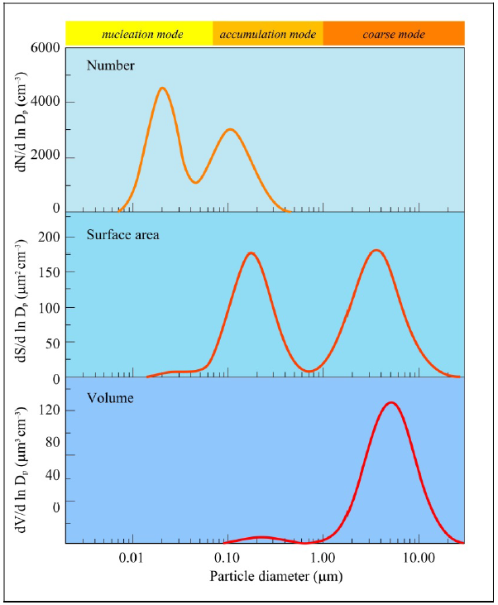
Based on particle distributions, different groups of atmospheric particles can be separated:
nucleation (Aitken) mode (particle diameter < 0.1 µm),
accumulation mode (particle diameter: 0.1 µm > d > 1 µm),
coarse mode (particle diameter d > 1 µm).
Figure 3: Number, surface and volume distributions of aerosol particles. The areas below the curves correspond to the total aerosol number, surface and volume, respectively.

Slide 23
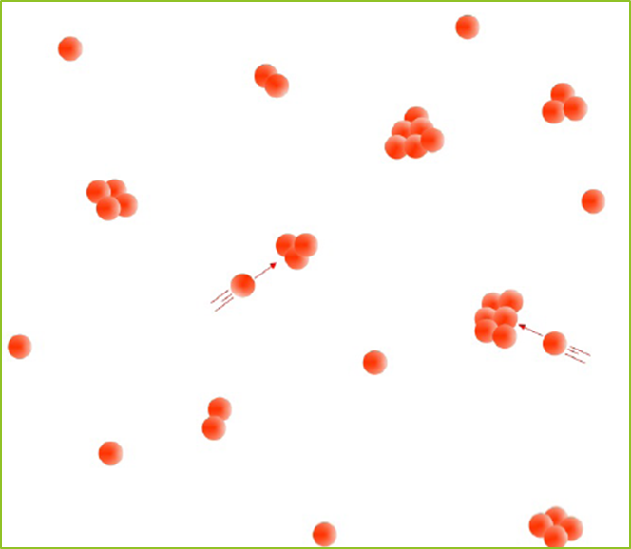
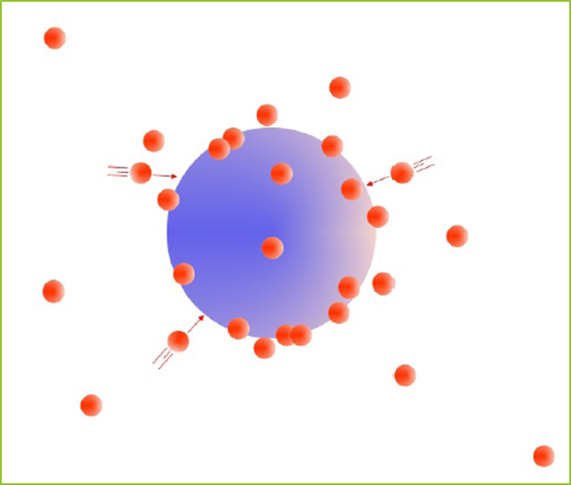
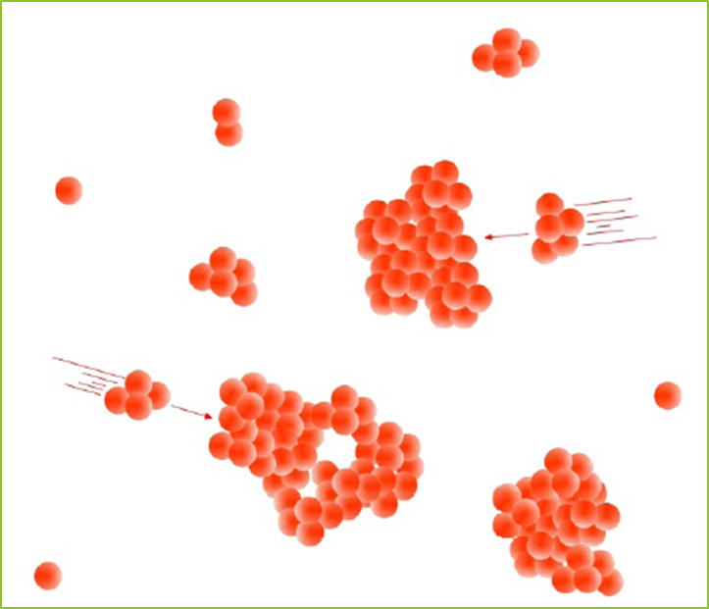
Aerosol particles below 0.1 µm in diameter constitute the nucleation (or Aitken) mode. The smallest range of these particles (with particle diameter is lower than 0.01 µm) sometimes called ultrafine mode. These particles are produced by homogeneous and heterogeneous nucleation processes (Figure 4).
They can form during natural gas-to particle condensation (Figure 5) or during condensation of hot vapor in combustion processes.
Due to their rapid coagulation (Figure 6) or random impaction onto surfaces, the lifetime of these small particles is very short (order of minutes to hours).
Figure 4: Homogeneous nucleation
of aerosol particles
Figure 5: Condensation of aerosol
particles
Figure 6: Coagulation of
aerosol particles

Slide 24
Larger aerosol particles in the size range 0.1 to 1 µm in diameter can accumulate in the atmosphere because their removal mechanisms are least efficient. Their lifetime in the atmosphere is 7–10 days and during this period they can transported to a long distance from their sources.
Particles belonging to this accumulation mode are formed mainly by coagulation (Figure 6) of smaller particles or condensation of vapours onto existing particles, and during these mechanisms they growth into this size range.
The Coarse mode contains particles with diameter larger than 1.0 μm. These particles mostly emitted to the atmosphere during mechanical processes from both natural and anthropogenic sources (e.g. sea-salt particles from ocean surface, soil and mineral dust, biological materials). Due to their relatively large mass, they have short atmospheric lifetimes because of their rapid sedimentation.

Slide 25
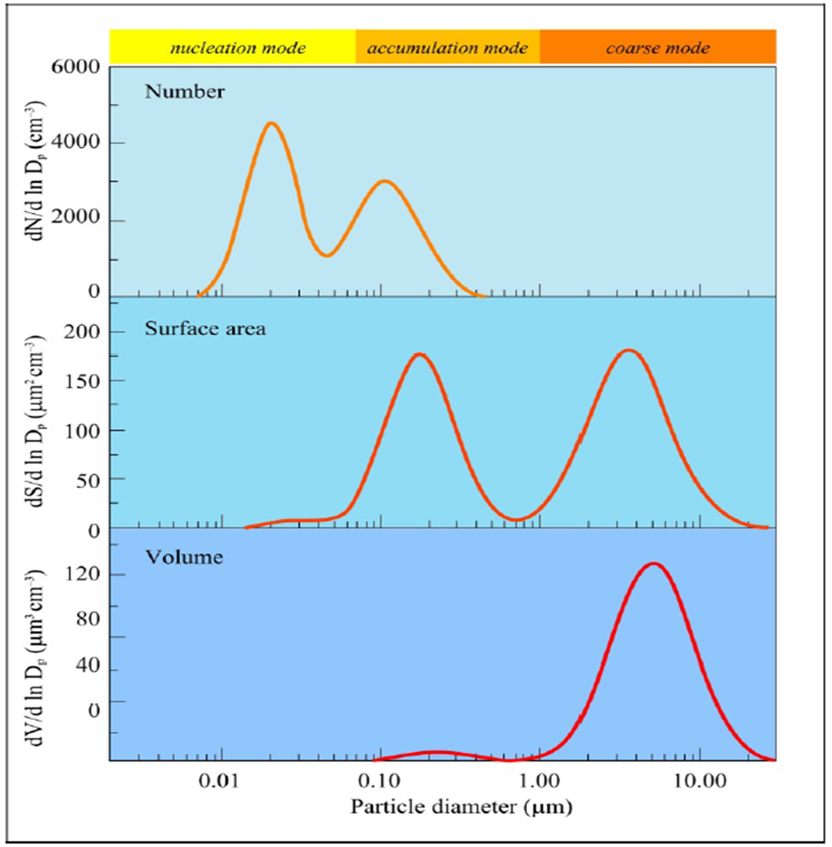
The distribution of atmospheric aerosol particles can be seen in Figure 3.
Small particles in nucleation mode constitute the majority of atmospheric particles by number. However due to their small sizes, their contribution to the total mass of aerosols are very small (around a few percent).
The Accumulation mode particles have the greatest surface area. The mass or volume concentration is dominated by the aerosols in coarse and accumulation modes.
Size, area and volume distributions of aerosol particles show characteristic pattern at different locations (e.g. urban, rural, remote continental or marine regions).

Slide 26
2.3. Chemical composition
The atmospheric aerosol has a very complex and variable chemical composition. Due to the various sources and transformations, each particle has individual composition.
Atmospheric aerosols are generally composed of variable amounts of sulphate, nitrate, ammonium, sea salt, crustal elements and carbonaceous compounds (elemental and organic carbon) and other organic materials.
Fine particles predominantly contain sulphate, nitrate, ammonium, elemental and organic carbon and certain trace metals (e.g. lead, cadmium, nickel, copper etc.).
The primary components of coarse particle fraction are dust, crustal elements, nitrate, sodium, chloride and biogenic organic particles (e.g. pollen, spores, plant fragments etc.).
The main precursors of sulphate component ${SO}_{2}^{−2}$ in the troposphere are sulphur dioxide (SO2) emitted from anthropogenic sources and volcanoes, and dimethyl sulphide (DMS) from biogenic sources, especially from marine planktons. In the stratosphere, sulphate aerosols mostly converted from carbonyl sulphide (COS).

Slide 27
Nitrate (${NO}_{2}^{−1}$ ) is formed mainly from the oxidation of atmospheric nitrogen dioxide (NO2). Ammonium salts are also common components of atmospheric aerosols. They are formed during the reactions between ammonia (NH3) and various acids, like sulphuric (H2SO4) and nitric acids (HNO3).
When atmospheric ammonia neutralises these acids, ammonium sulphate ((NH4)2SO4), and ammonium nitrate (NH4NO3) particles are formed.
Main source of chloride (${\text{Cl}}^{\text{−}\text{1}}$) is sea spray, but ammonium chloride (NH4Cl) particles form also during the reaction between ammonia and hydrochloric acid (HCl).
Carbonaceous materials constitute a large but highly variable fraction of the atmospheric aerosol. The carbonaceous fraction of the aerosols consists of both elemental carbon (EC) or black carbon (BC) and organic carbon (OC). The ratio of elemental to total carbon (EC+OC) is strongly depends on the sources.
The main sources of elemental carbon particles are biomass and fossil fuel burning. Particles containing organic carbon can emitted directly to the atmosphere also from biomass burning or combustion processes and by secondary organic aerosol (SOA) formation during the atmospheric oxidation of biogenic or anthropogenic volatile organic compounds (VOC).

Slide 28
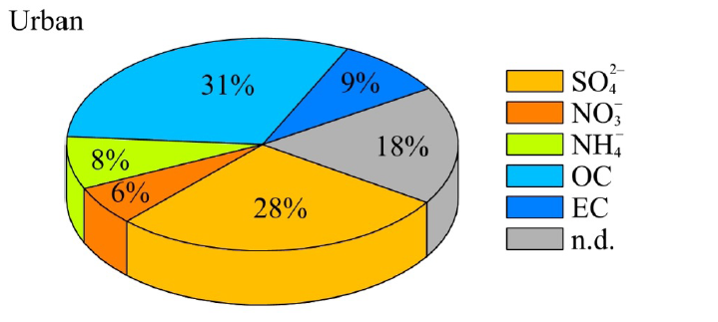
Typical chemical composition of aerosols can vary at different locations, times, weather conditions and particle size fractions. Figure 9.10, Figure 9.11 and Figure 9.12 show the relative abundance of different chemical components of fine particles in different locations, in urban area, in rural region and in a remote site, respectively.
Figure 9.10: Average fine particle composition of aerosol types in urban area. Data correspond to mass fraction in % of the total fine particle mass concentration. OC = organic carbon, EC = elementary carbon. Source of data:

Slide 29
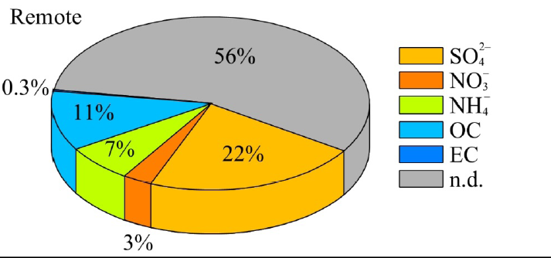
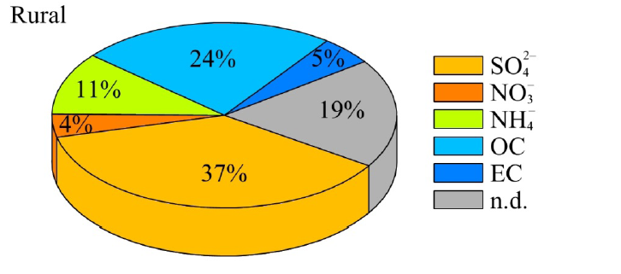
Figure 9.12:
Average fine particle composition of aerosol types in remote region. Data correspond to mass fraction in % of the total fine particle mass concentration. OC = organic carbon, EC = elementary carbon.
Source of data: Heitzenberg, 1994.
Figure 9.11:
Average fine particle composition of aerosol types in rural continental region. Data correspond to mass fraction in % of the total fine particle mass concentration. OC = organic carbon, EC = elementary carbon.
Source of data: Heitzenberg, 1994.

Slide 30
2.4. Water solubility
Atmospheric particles can also be categorized by their water solubility, that is, how well they dissolve in water. In continental regions, about 80% of smaller particles are water-soluble. However, some types of coarse particles are also water soluble, like sea salt particles over oceans.
If aerosol particles consisting of water-soluble material, the uptake of atmospheric water vapour can results an aqueous solution droplet. During this process, the size of particle increases by hygroscopic growth, even when relative humidity is lower than 100%.
Highly soluble particles are for example ammonium sulphate, ammonium nitrate and sodium chloride. These particles are efficient cloud condensation nuclei (CCN). example of Insoluble aerosols particles derived from soil dust or volcanoes (e.g. metal oxides, silicates, clay minerals).

Slide 31
2.5. Atmospheric lifetime
The lifetime of atmospheric aerosol particles depends on their properties (size, chemical composition, etc.) and on altitude range, too (Figure 9.13).
In the atmospheric boundary layer (lower troposphere), the residence time of aerosol particles is usually less than a week, often on the order of a day, depending on aerosol properties and meteorological conditions.
In the free troposphere, the typical particle lifetime is 3–10 days on average. During this time, particle can easily be transported to a long distance. Therefore, there is a large variability in particle concentration, reflecting the geographical distribution of sources and sinks.
Smaller particles are efficiently removed by coagulation with other particles. Therefore, their lifetime is very short (in a range of ten minutes to day). Similarly, the large particles spend only a short time in the atmosphere due to the sedimentation. Particles in the accumulation mode have the longest lifetime (7–10 days on average), as in this range, both the Brownian diffusion and sedimentation are less important. These particles removed from the atmosphere predominantly by wet deposition.

Slide 32
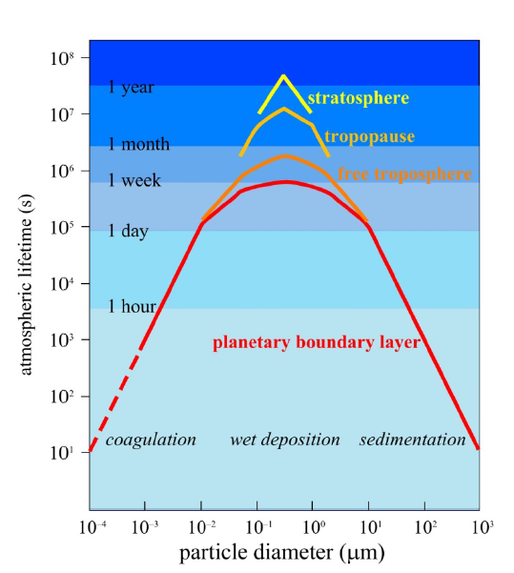
Figure 9.13: Atmospheric lifetime of different size particles at different levels of the atmosphere (after Jaenicke, 1980)

Slide 33
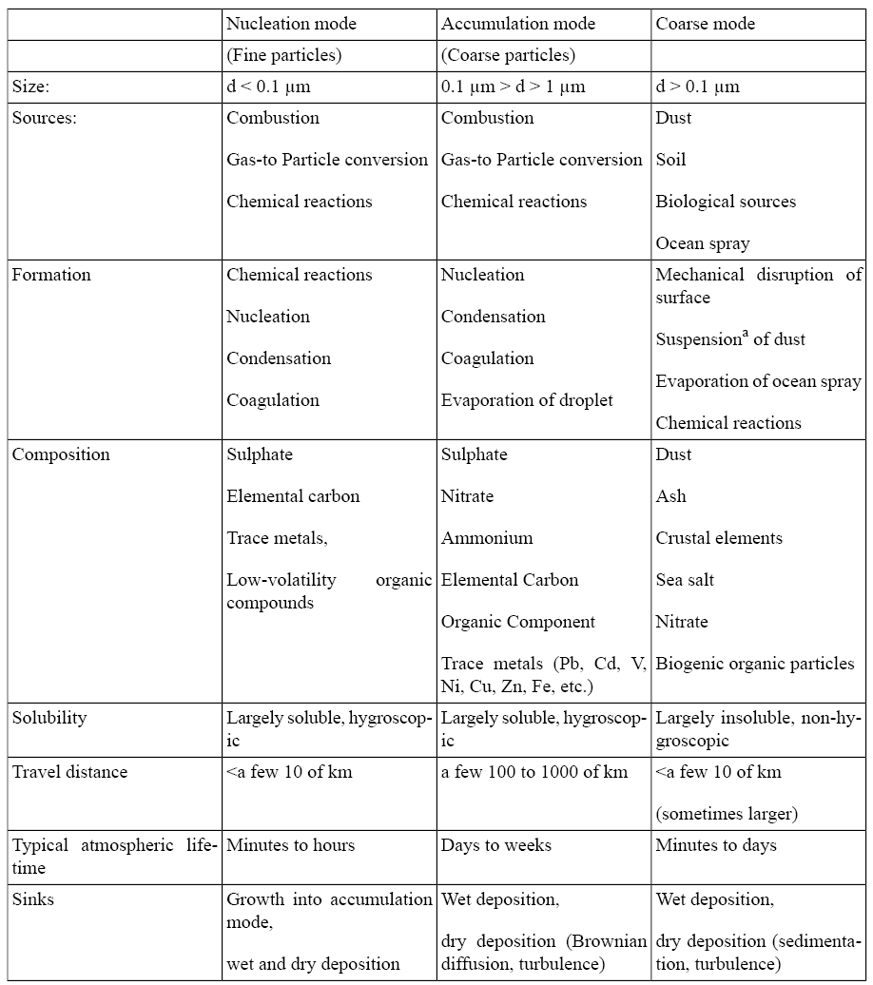
Table 9.5: Main properties of different aerosol particles (Adapted from Wilson and Suh, 1997):

Slide 34
third lecture
3. Effects of atmospheric aerosols
3.1. Direct effects: direct radiative forcing due the scattering radiation.
3.2. Indirect effects: indirect radiative forcing through cloud formation effects

Slide 35
3. Effects of atmospheric aerosols
Atmospheric aerosol particles play important role in radiation budget of the Earth’s as they scatter and absorb both shortwave solar radiation and longwave terrestrial radiation. aerosol particles involved in the formation of clouds and precipitation since they operate as cloud condensation and ice nuclei . Additionally, particles are major elements of lower tropospheric air quality, and can influence harmfully the environment and human health. Aerosols play important role in the balance of the Earth’s climate. Due to the increasing anthropogenic emission of aerosols since the industrial revolution, they can also effect the global climate change. The climate forcing by aerosols can be realized in two ways, basically: in direct and indirect radiative forcing.

Slide 36
3.1. Direct radiative forcing due the scattering radiation (Direct effects).
Aerosol particles reflected a part of shortwave solar radiation back into the space, cooling the Earth’s atmosphere. This cooling effect of aerosols, especially by sulphate components may be compensated by the absorption of longwave terreastrial radiation primarily by elemental (black) carbon aerosols and dust particles.
The global, annual mean radiative forcing is estimated to (–0.4 ± 0.2 W ${\text{m}}^{–2}$ for sulphate) , (–0.05 ± 0.05 W ${\text{m}}^{–2}$ for fossil fuel organic carbon), (+0.2 ± 0.15 W ${\text{m}}^{–2}$ for fossil fuel black carbon), (+0.03 ± 0.12 W ${\text{m}}^{–2}$ for biomass burning), (–0.1 ± 0.1 W ${\text{m}}^{–2}$ for nitrate) and (–0.1 ± 0.2 W ${\text{m}}^{–2}$ for mineral dust) .
A large volcanic eruption can greatly increase the concentration of stratospheric sulphate aerosols, thereby increasing the negative radiative forcing. However, a single, large eruption can cool our atmosphere only for a few years.

Slide 37
3.2. Indirect radiative forcing through cloud formation effects
Aerosol particles can also affect the radiation balance by formation of cloud droplets. Cloud droplets are formed in the troposphere by condensation of water vapour onto aerosol particles (cloud condensation nuclei, or ice nuclei) when the relative humidity exceeds the saturation level. Without these particles, a very large supersaturation (about 400%) would be necessary for the homogeneous condensation of water vapour.
The properties and the number of particles can affect the formation and the characteristic of clouds and precipitation in many ways. The increased number of aerosol particles, and therefore the increased cloud optical thickness decrease the net surface solar radiation.
The more numerous smaller cloud particles reflect more solar radiation (called albedo effect or Twomey effect). Smaller particles decrease the precipitation efficiency, thereby prolonging cloud lifetime.

Slide 38
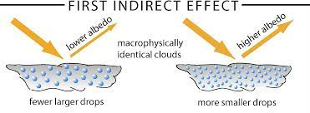
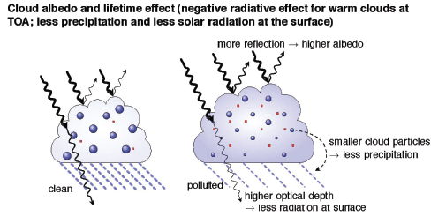

Slide 39
Aerosol particles in the upper atmosphere, where the major part of atmospheric ozone forms, can modify the ozone removal.
Aerosols can form the abundance and distribution of atmospheric trace gases by complex chemical reactions, and can affect significantly the cycles of nitrogen, sulphur, and atmospheric oxidants.
Anthropogenic aerosols effects on water clouds through the cloud albedo effect cause a negative radiative forcing of –0.3 to –1.8 W/ ${\text{m}}^{2}$. ( TOMMY EFFECT)

Slide 40
4. Aerosols interaction with atmospheric gases
five lecture
5. Atmospheric particulate
5.1 PM10
5.2 sources of PM10
5.3 PM2.5
5.4 atmospheric level of PM2.5
5.5 particulate smaller than PM2.5um

Slide 42
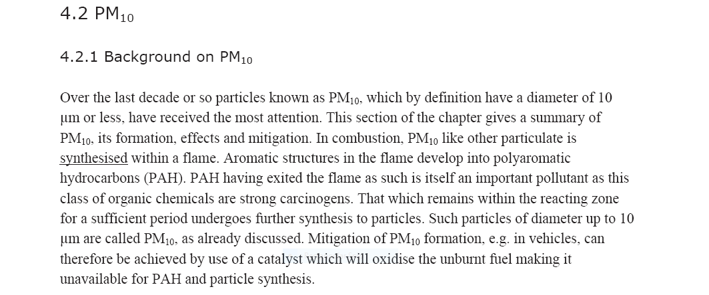

Slide 43
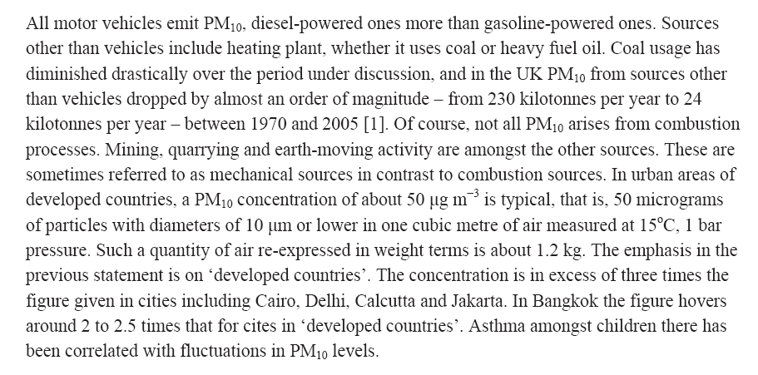

Slide 44
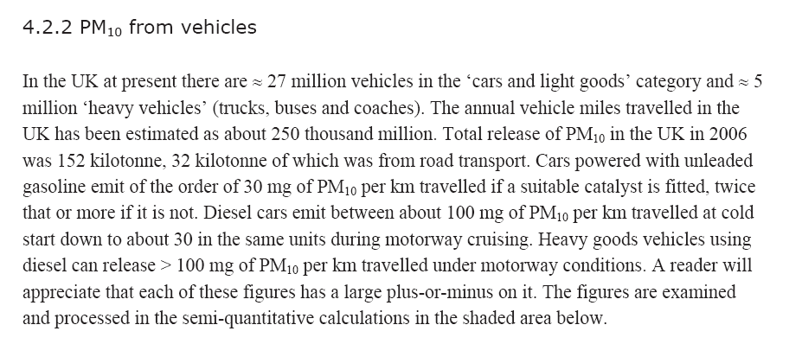

Slide 45
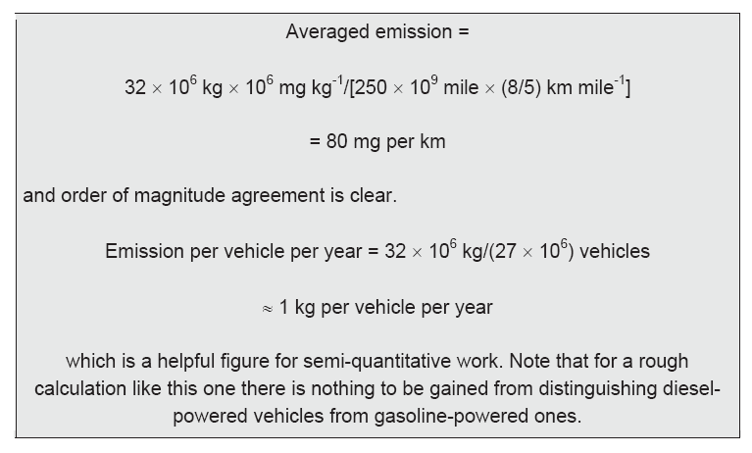

Slide 47
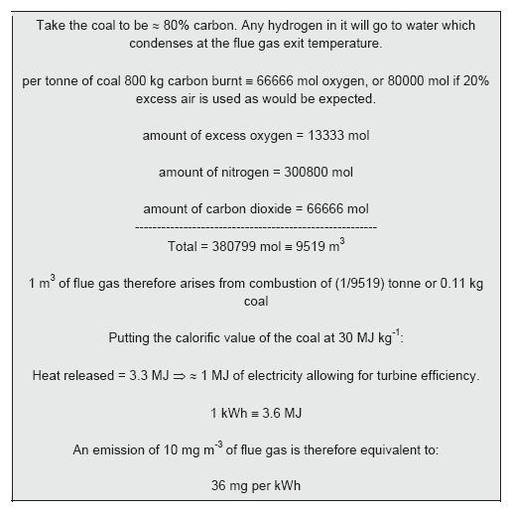

Slide 48
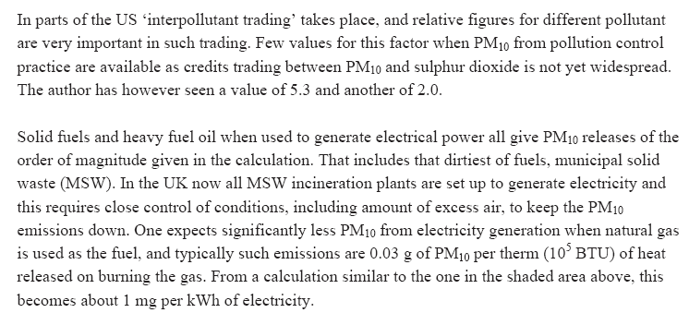

Slide 49
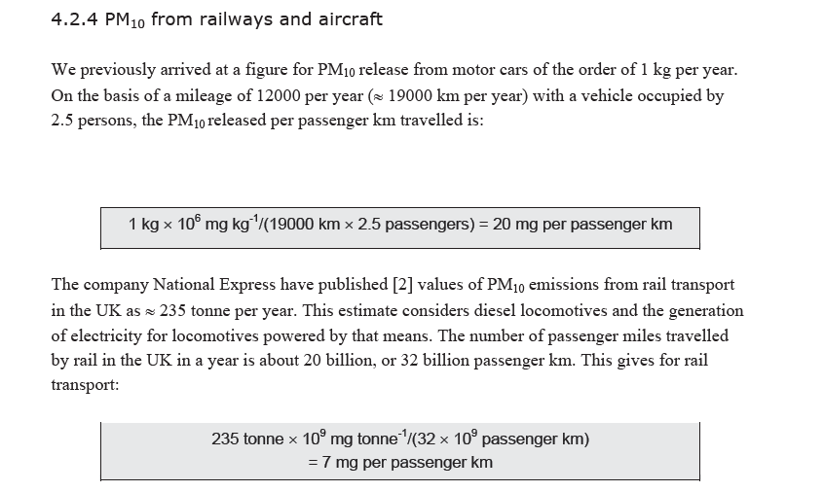

Slide 51
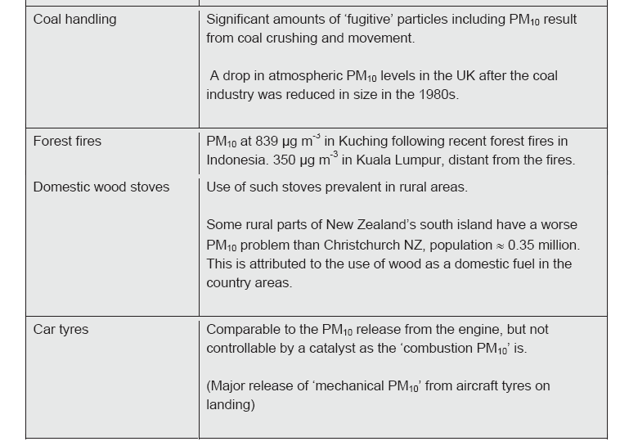

Slide 52
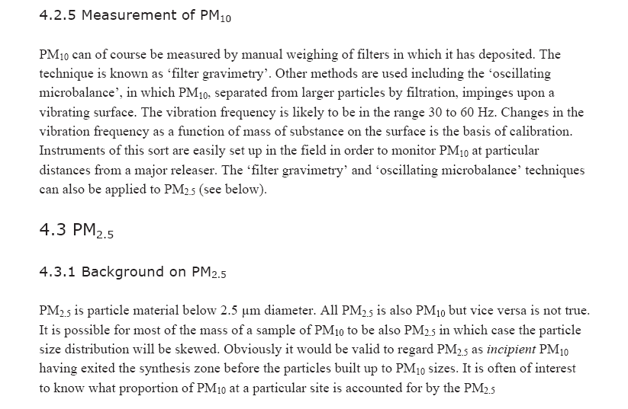

Slide 53
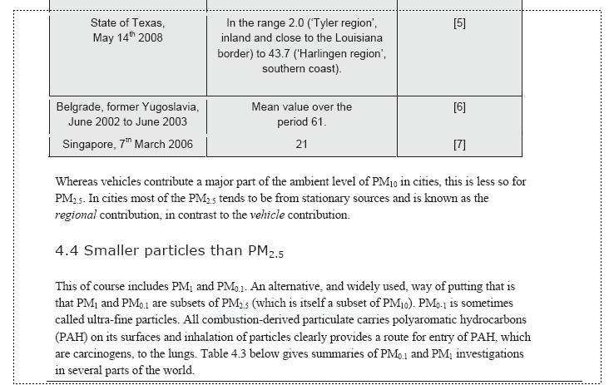

Slide 54
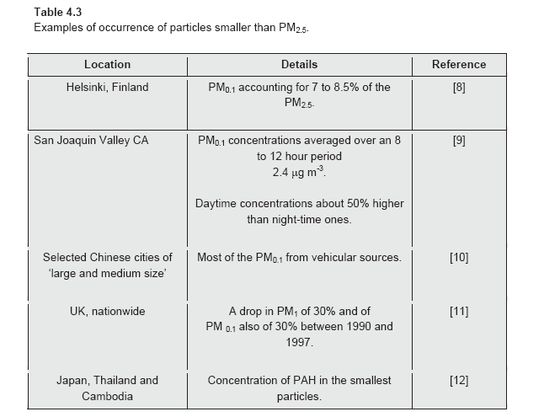

Slide 55
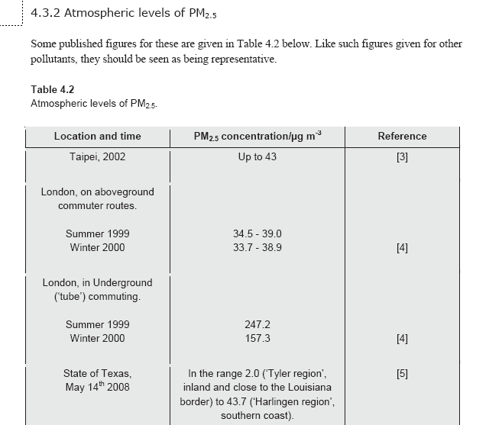

Slide 56
