Slide 1
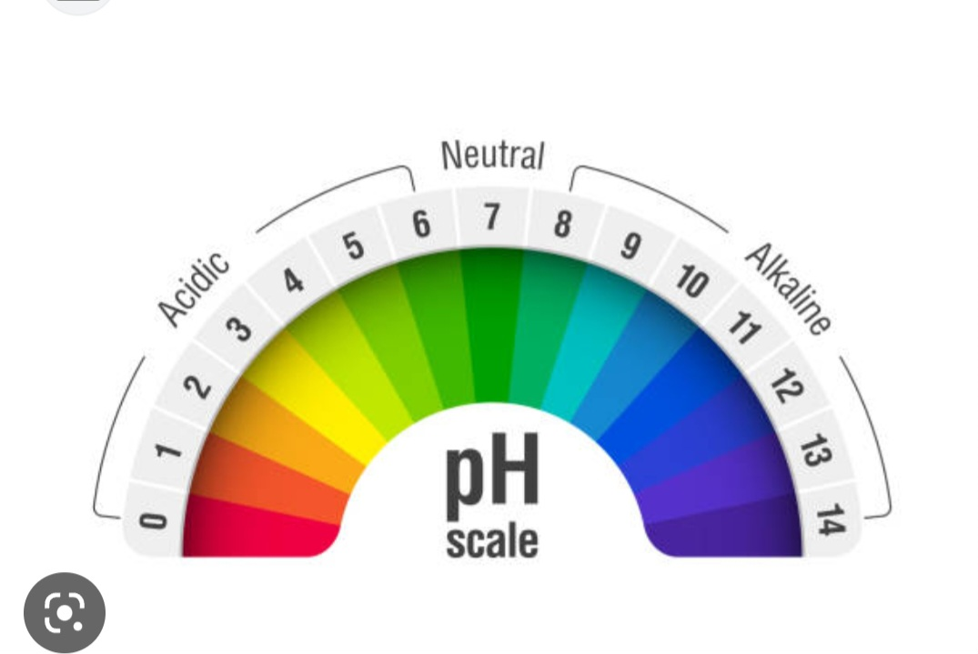

Slide 3
Acid
Any substance that can release a hydrogen ion (H⁺) or hydronium ion when dissolved in water
Release of proton or H⁺
Base
Substance that can release hydroxyl ions (OH⁻)
Accept protons or H⁺

Slide 4
pH
The H⁺ concentration of a solution is usually indicated in pH units on a pH scale that runs from 0 to 14.
The pH value is equal to the logarithm of 1 over the H+ concentration:
pH= log 1/[H⁺]

Slide 6
Buffers
A buffer is a system of molecules and ions that acts to prevent changes in H⁺ concentration and thus serves to stabilize the pH of a solution.
blood plasma, for example, the pH is stabilized by the following reversible reaction involving the bicarbonate ion (HCO3) and carbonic acid (H2CO3):
HCO3 ⁻ + H⁺ ⇔ H₂CO₃

Slide 7
Acid - Base Balance
Blood - normal pH of 7.2 – 7.45
< 7.2 = acidosis > 7.45 = alkalosis
3 buffer systems to maintain normal blood pH
Buffers
Removal of CO² by lungs
Removal of H⁺ ions by kidneys

Slide 8
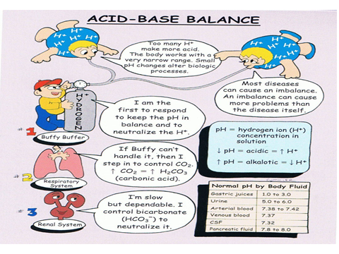

Slide 9
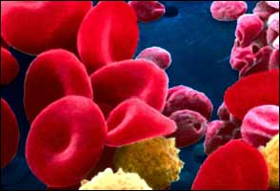
Buffers
Protein Buffer Systems
Amino Acid buffers
Hemoglobin buffers
Plasma Protein buffers
Phosphate Buffer Systems
Carbonic Acid – Bicarbonate Buffer System

Slide 10
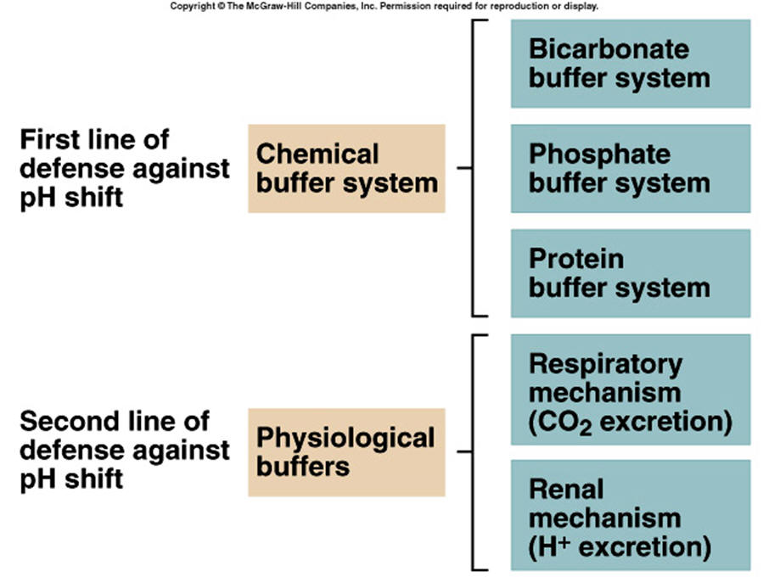

Slide 11
Buffers system.
Why do we need them?
If the acids produced in the body from the catabolism of food and other cellular processes are not removed or buffered, the body’s pH would drop
Significant drops in pH interferes with cell enzyme systems.

