Slide 1
An Argumentative Essay: its Outline and Types 16th Lecture

Slide 2
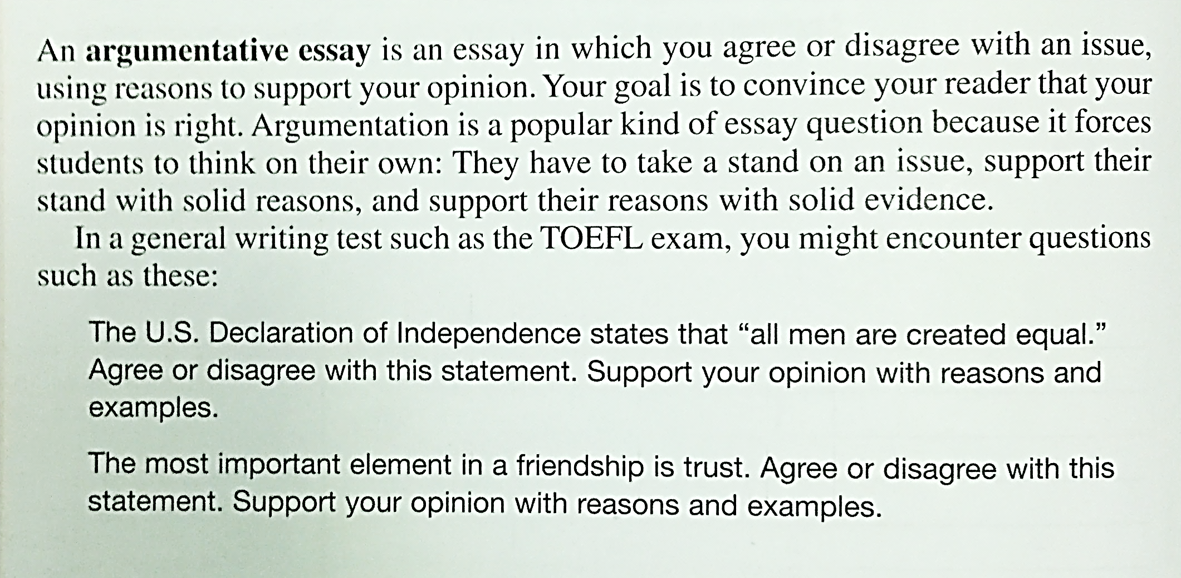

Slide 4
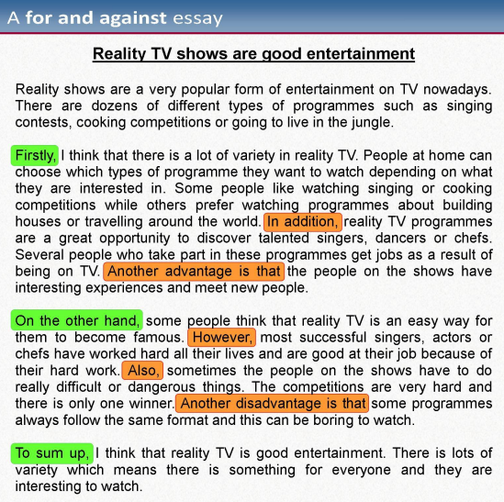

Slide 5
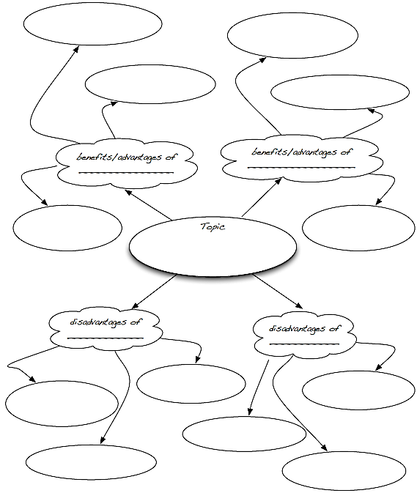

Slide 6
Organization of Argumentative Essays

Slide 7
Write an argumentative essay concerning the topic below:
The Plastic Surgeries

Slide 8
