Slide 1
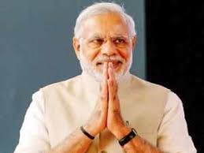
Modi is to blame for India’s failure on Pakistan policy

Slide 2
A striking feature of the Indian government headed by Prime Minister Narendra Modi, which assumed office in New Delhi in May 2014, was its abandonment of the flexible Pakistan policy pursued by previous Prime Ministers Atal Behari Vajpayee (1998-2004) and his successor Manmohan Singh (2004-2014).

Slide 3
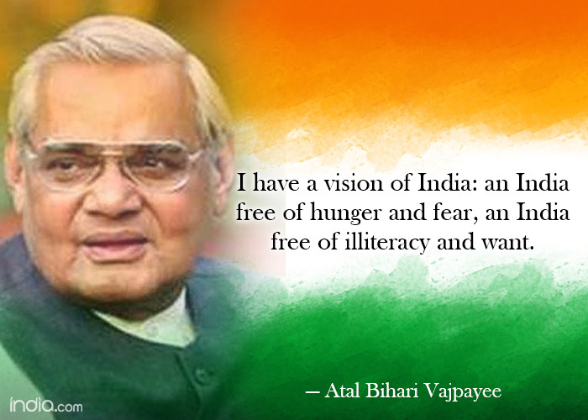

Slide 4
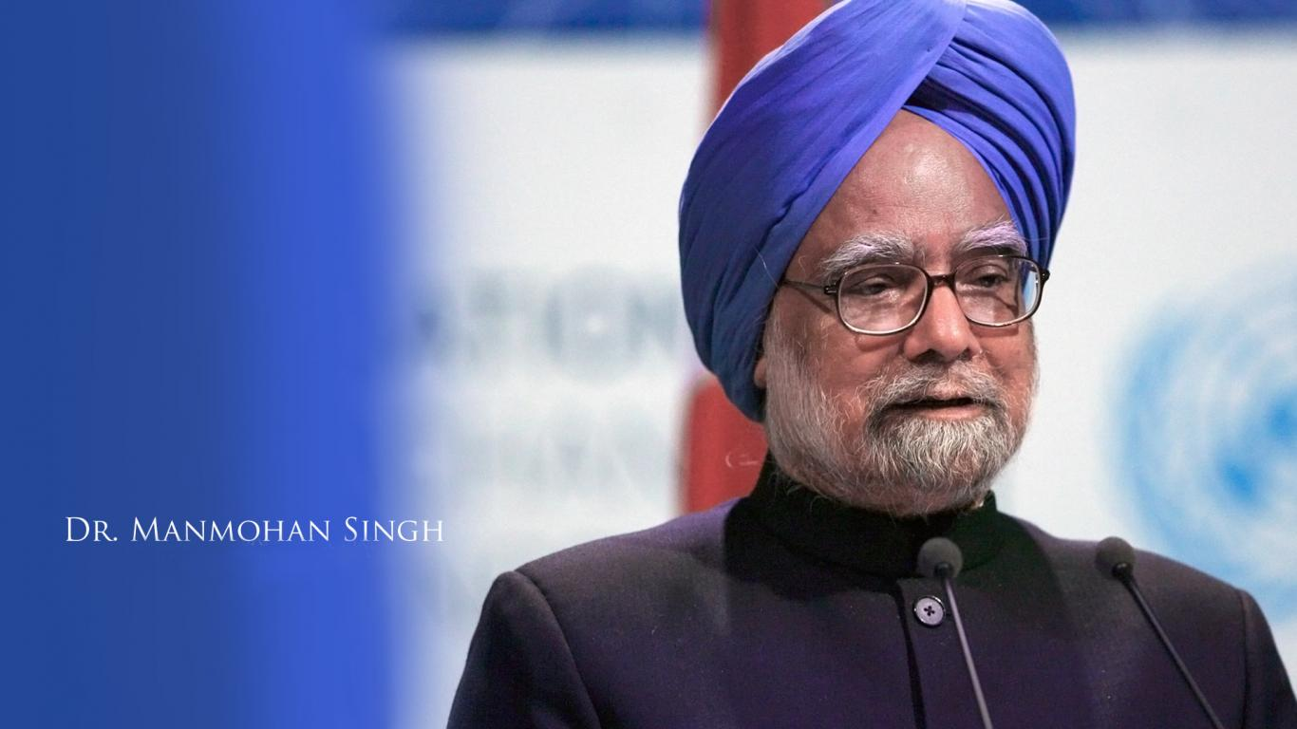

Slide 5
Kashmir has been at the heart of the dispute between India and Pakistan over decades and Vajpayee attempted to resolve the issue by initiating dialogue with Pakistan Prime Minister Nawaz Sharif and later with President Parvez Musharraf.

Slide 6
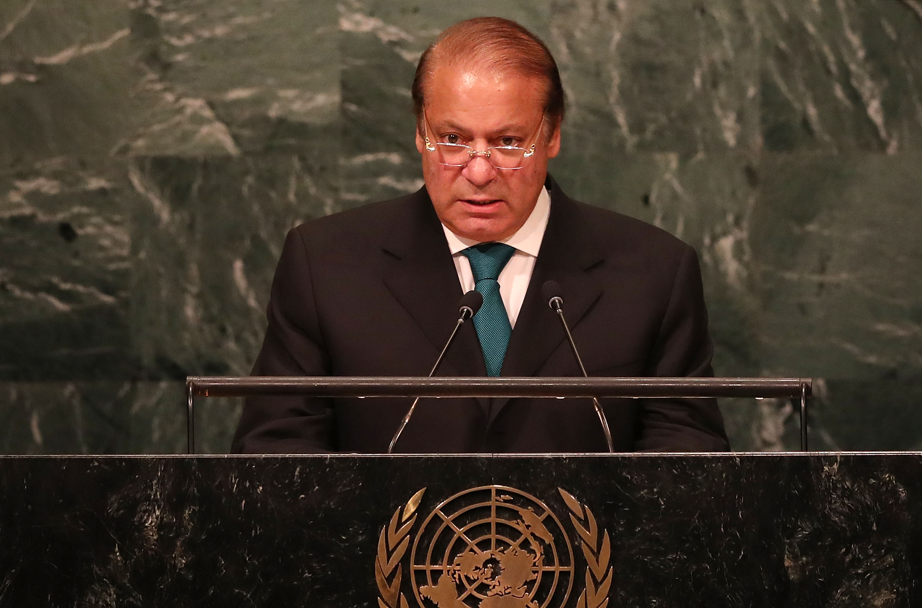

Slide 7
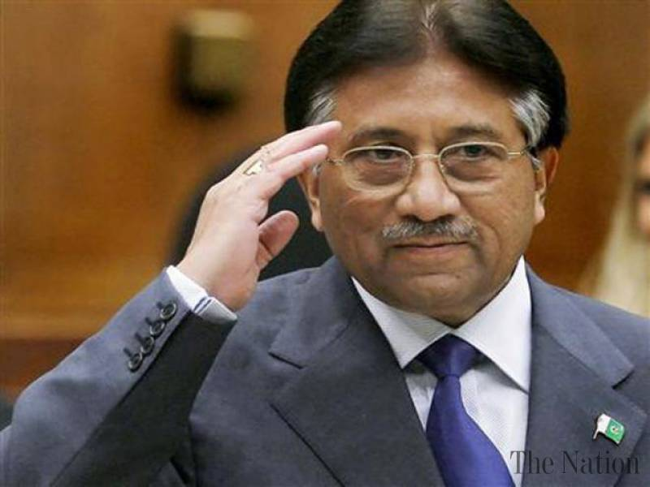

Slide 8
Unlike Vajpayee, Modi was rigid and hawkish. According to him, Pakistan is illegally occupying parts of India in Jammu and Kashmir and they should vacate those areas for better relations to prevail between the two countries. For him, Kashmir is an integral and inseparable part of India, not subject to bilateral discussions.

Slide 9
Pakistan, on the other hand, views Kashmir as a disputed territory and insists that its future should dominate bilateral talks.

Slide 10
After becoming prime minister, Modi met with Nawaz Sharif in May 2014. However, the foreign secretary-level talks scheduled for August 2014 was called off after Pakistan High Commissioner to India Abdul Basit met with separatist Hurriyat leaders whom India does not regard as stakeholders in the Kashmir dispute.

Slide 11
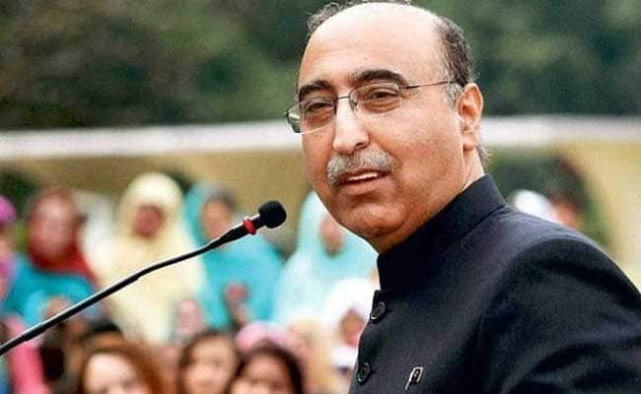

Slide 12
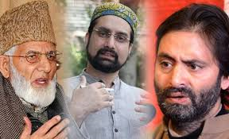

Slide 13
Prime Minister Narendra Modi must revise his Pakistan policy linked to Kashmir. Together with his advisors, he needs to restore optimal relations with Pakistan besides reviving the peace process in the Kashmir Valley.

Slide 14
Related Terms
(APHC) All Parties Hurriyat Conference: مؤتمر جميع احزاب الحرية (اول بارتي حريات كونغرس)
(منظمة تضم تحت مظلتها العديد من الجماعات الانفصالية)
exchanging artillery fireتبادل نيران المدفعية:
call the shots: to be in charge, to be the boss: يدير الدفة / تكون السلطة بيده / يتخذ القرارات
lasting peaceسلام دائم:

