Slide 1
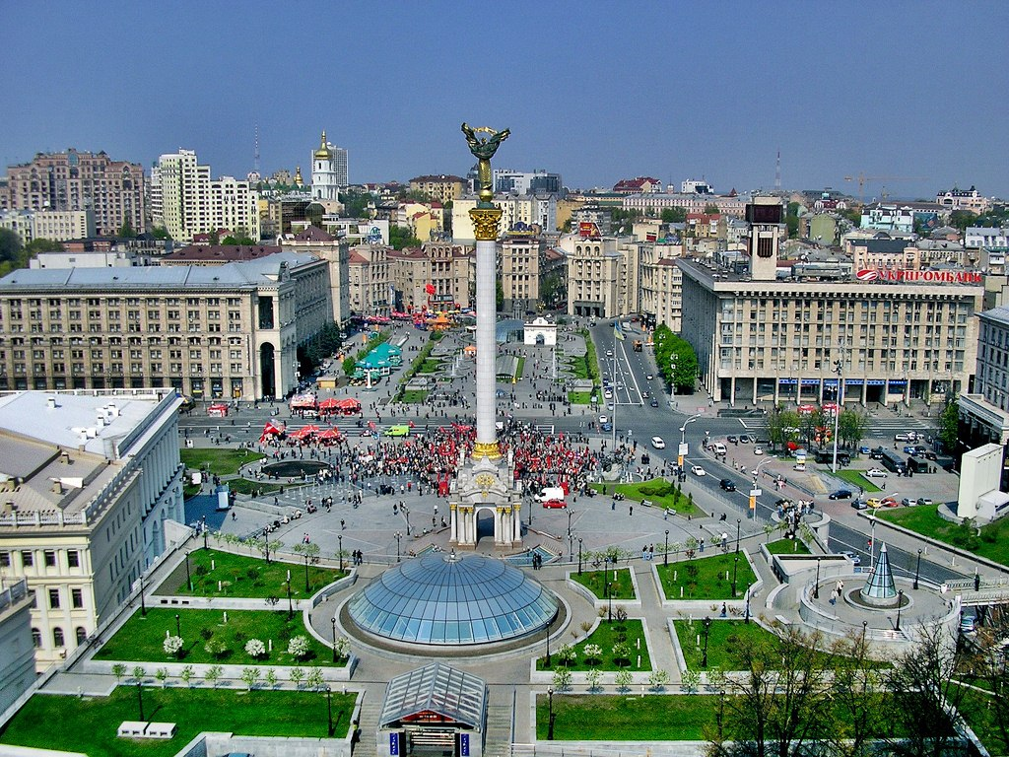
What's Ahead for Ukraine’s Reform Movement

Slide 2
Ukraine’s future as an independent and sovereign state will depend as much on winning its internal war on corruption and fixing its broken government as on keeping Russia contained in the east.

Slide 3
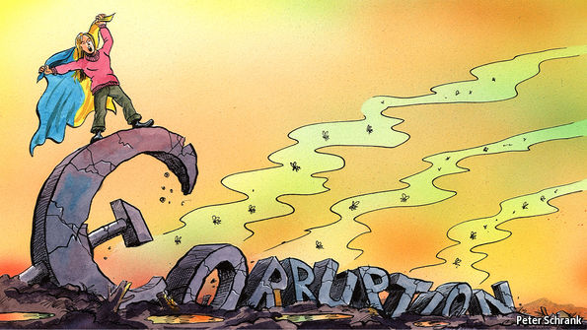

Slide 4
If Kiev fails to emerge as a reformist success story, the EU-border state may collapse, creating a major security threat for Europe and beyond.

Slide 5
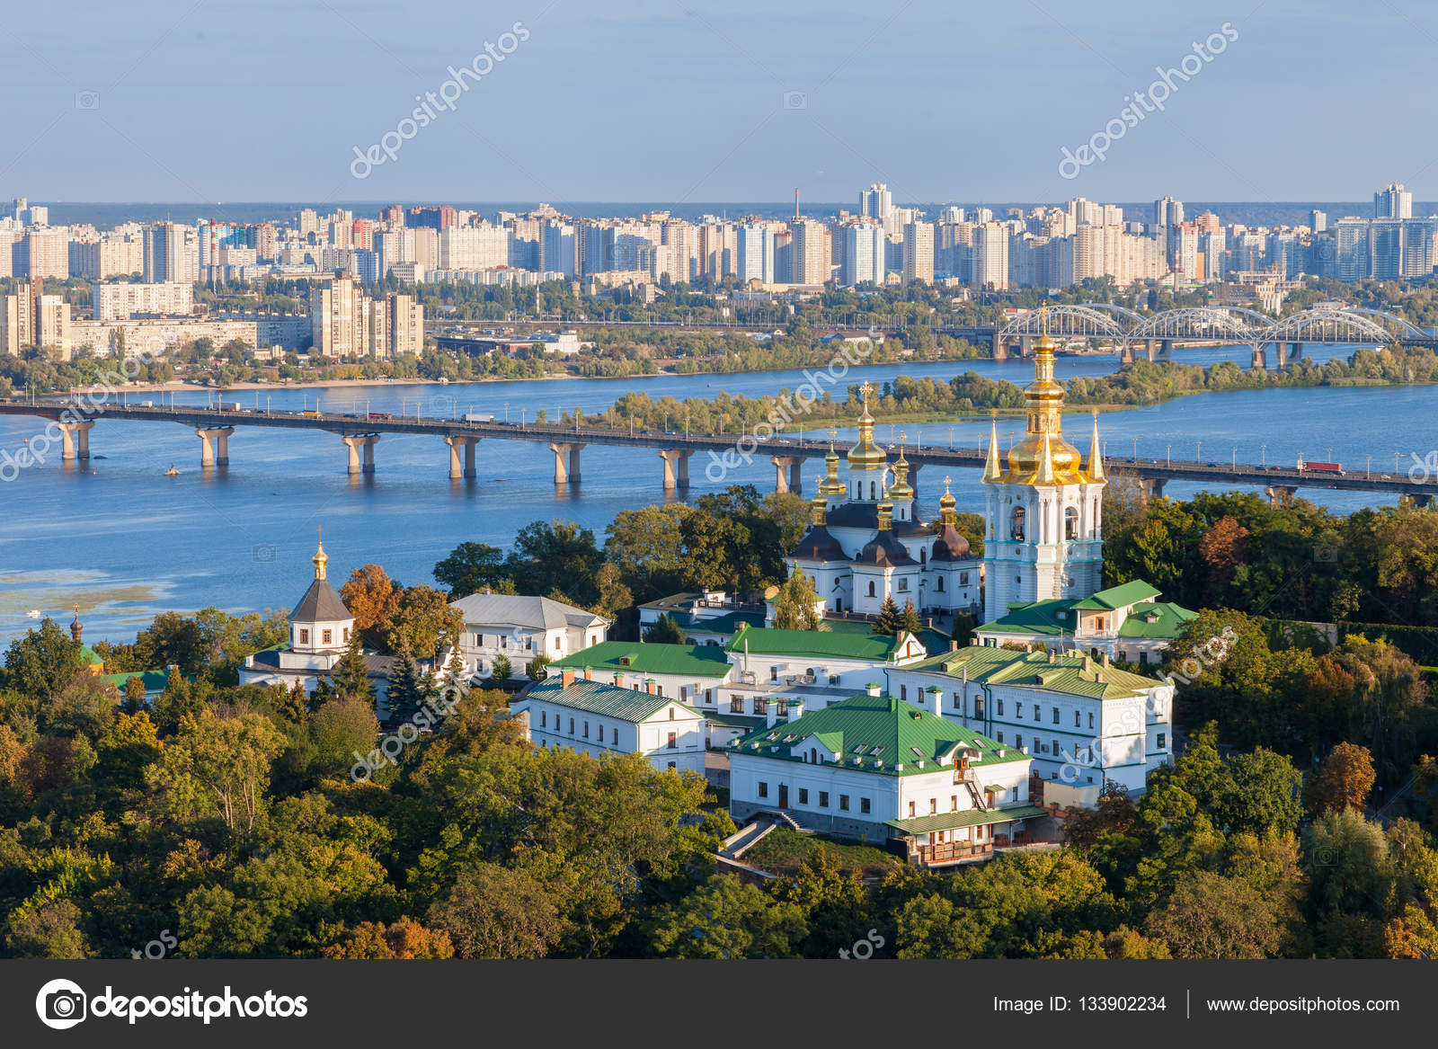

Slide 6
Not surprisingly, efforts to root out widespread corruption have been a long-standing priority since independence in 1991.

Slide 7
Progress in this area was negligible until 2014, when the Euromaidan revolution toppled then President Viktor Yanukovych and brought to power pro-Western and pro-reformist elites.

Slide 8
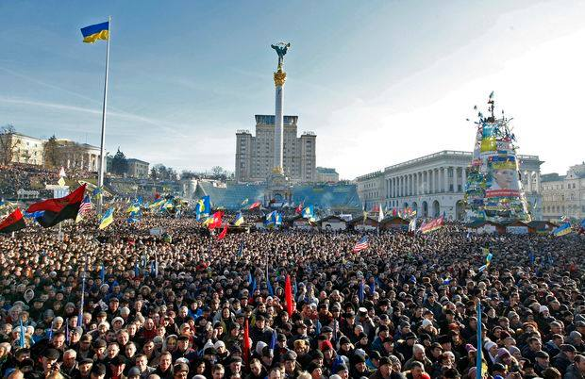

Slide 9
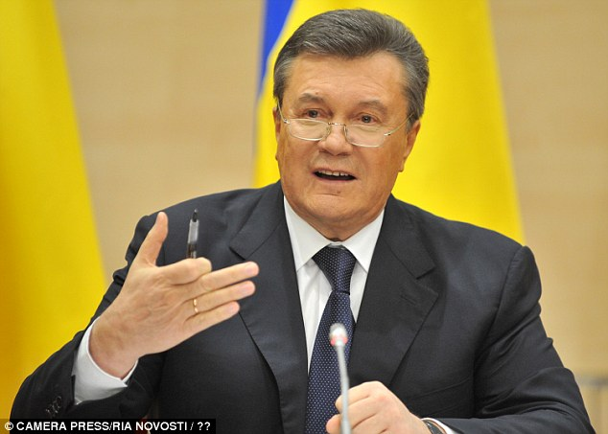
Viktor Yanukovych

Slide 10
That same year, businessman Petro Poroshenko, one of the principal financial backers of the protests, was elected president and created a largely reformist coalition government. He is without doubt the best president that independent Ukraine has had.

Slide 11
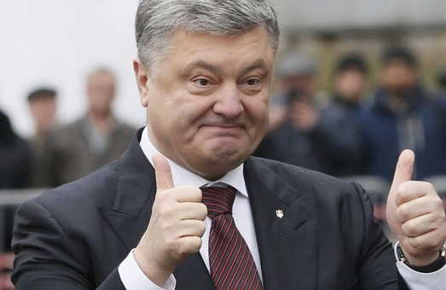
Petro Poroshenko

Slide 12
The government has fixed the banking sector and—together with a burgeoning number of Chinese investors—is spending huge amounts to fix roads and railroads, modernize airports and ports, build new highways and tunnels to the West, and invest in renewable energy.

Slide 13
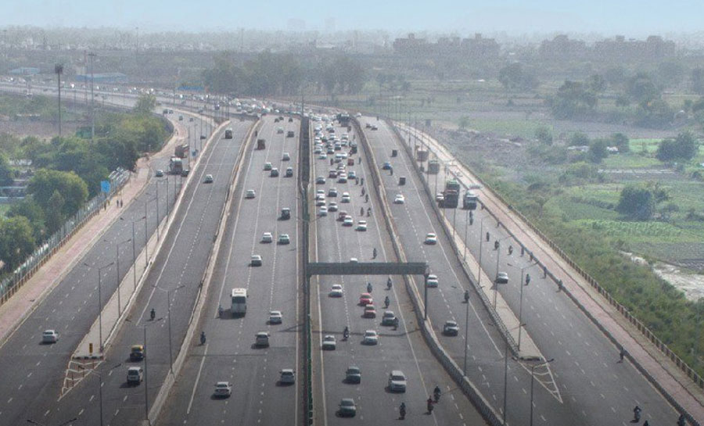

Slide 14
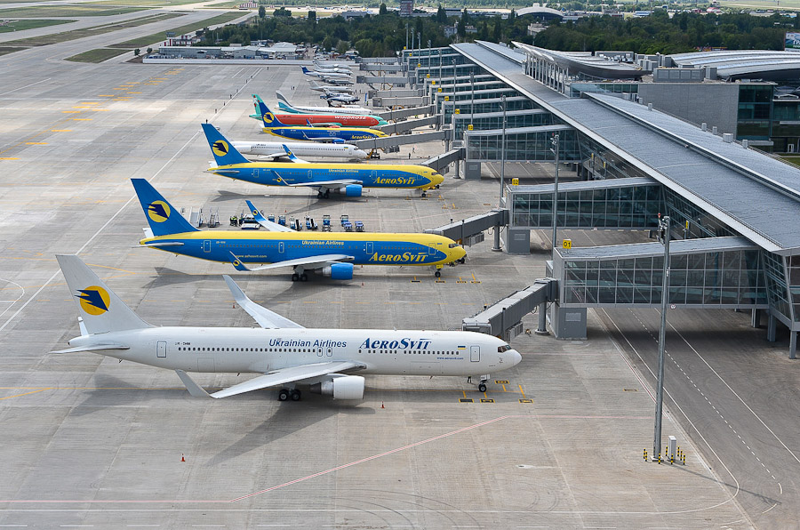

Slide 15
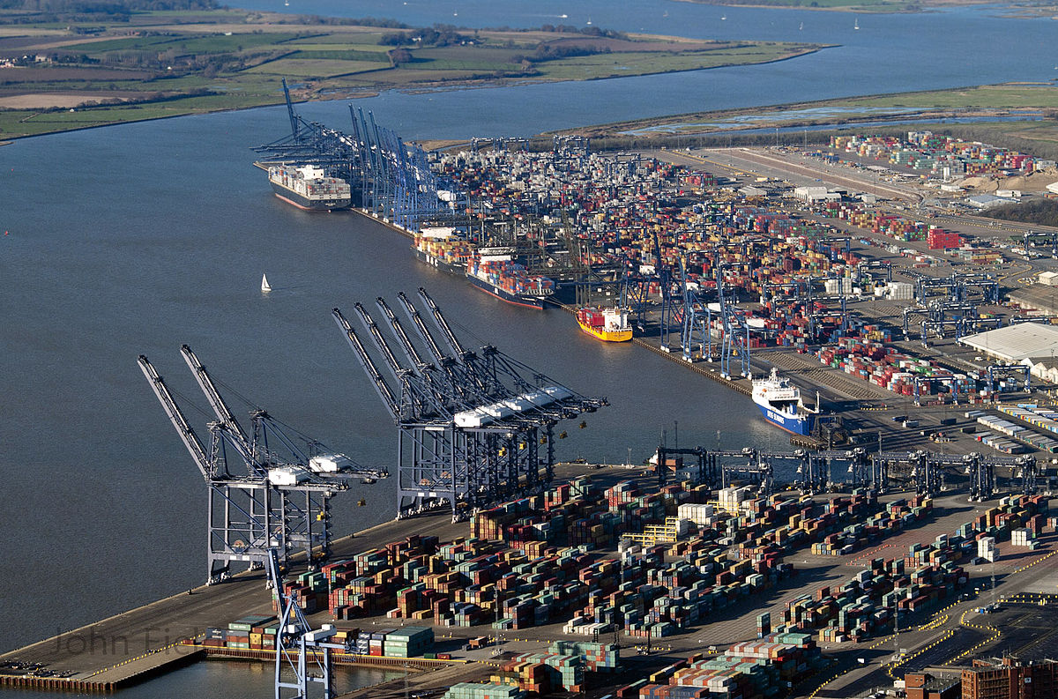

Slide 16
Ukraine’s IT sector is booming and has become one of the largest and most dynamic in the world. Of course, there is still work for Ukraine to do.

Slide 18
One problem is that ordinary Ukrainians do not yet feel many of the changes in their daily lives. They have been hit hard by the slump in the economy and the national currency after the pro-democracy revolution and subsequent conflict in 2014.

Slide 19
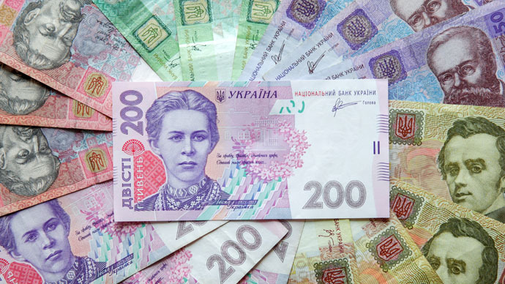

Slide 20
هريفنا أوكرانية
The hryvnia, sometimes hryvnya, has been the national currency of Ukraine since 2 September 1996

Slide 21
The economy, which contracted by more than 20 percent in 2014–15, is finally improving. Ukraine needs to catch up with its neighbors to the west, but the important thing is that it has finally lifted itself up from the depression that followed the Russian invasion.

Slide 22
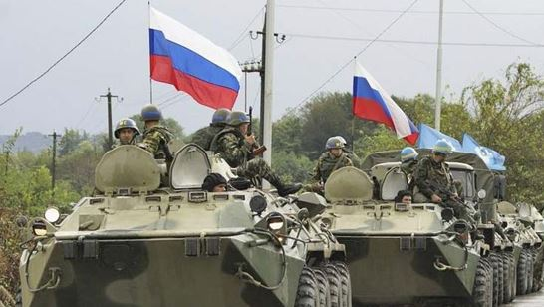

Slide 23
The West needs to continue to support Ukraine economically, diplomatically, and militarily. This is so not only because Ukraine is the only thing standing between Europe and Putin’s Russia but because, as a rapidly Westernizing country that has made remarkable progress over the past four years, Ukraine simply deserves it.

Slide 24
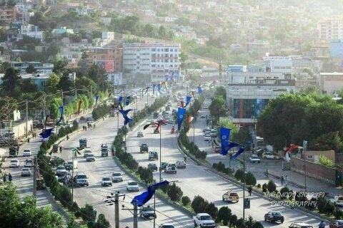
A new elite for Afghanistan - made in Germany

Slide 25
Since 2008, a number of young Afghans have been coming to study at the Willy Brandt School of Public Policy at the University of Erfurt in central Germany. They learn how to govern countries effectively.

Slide 26
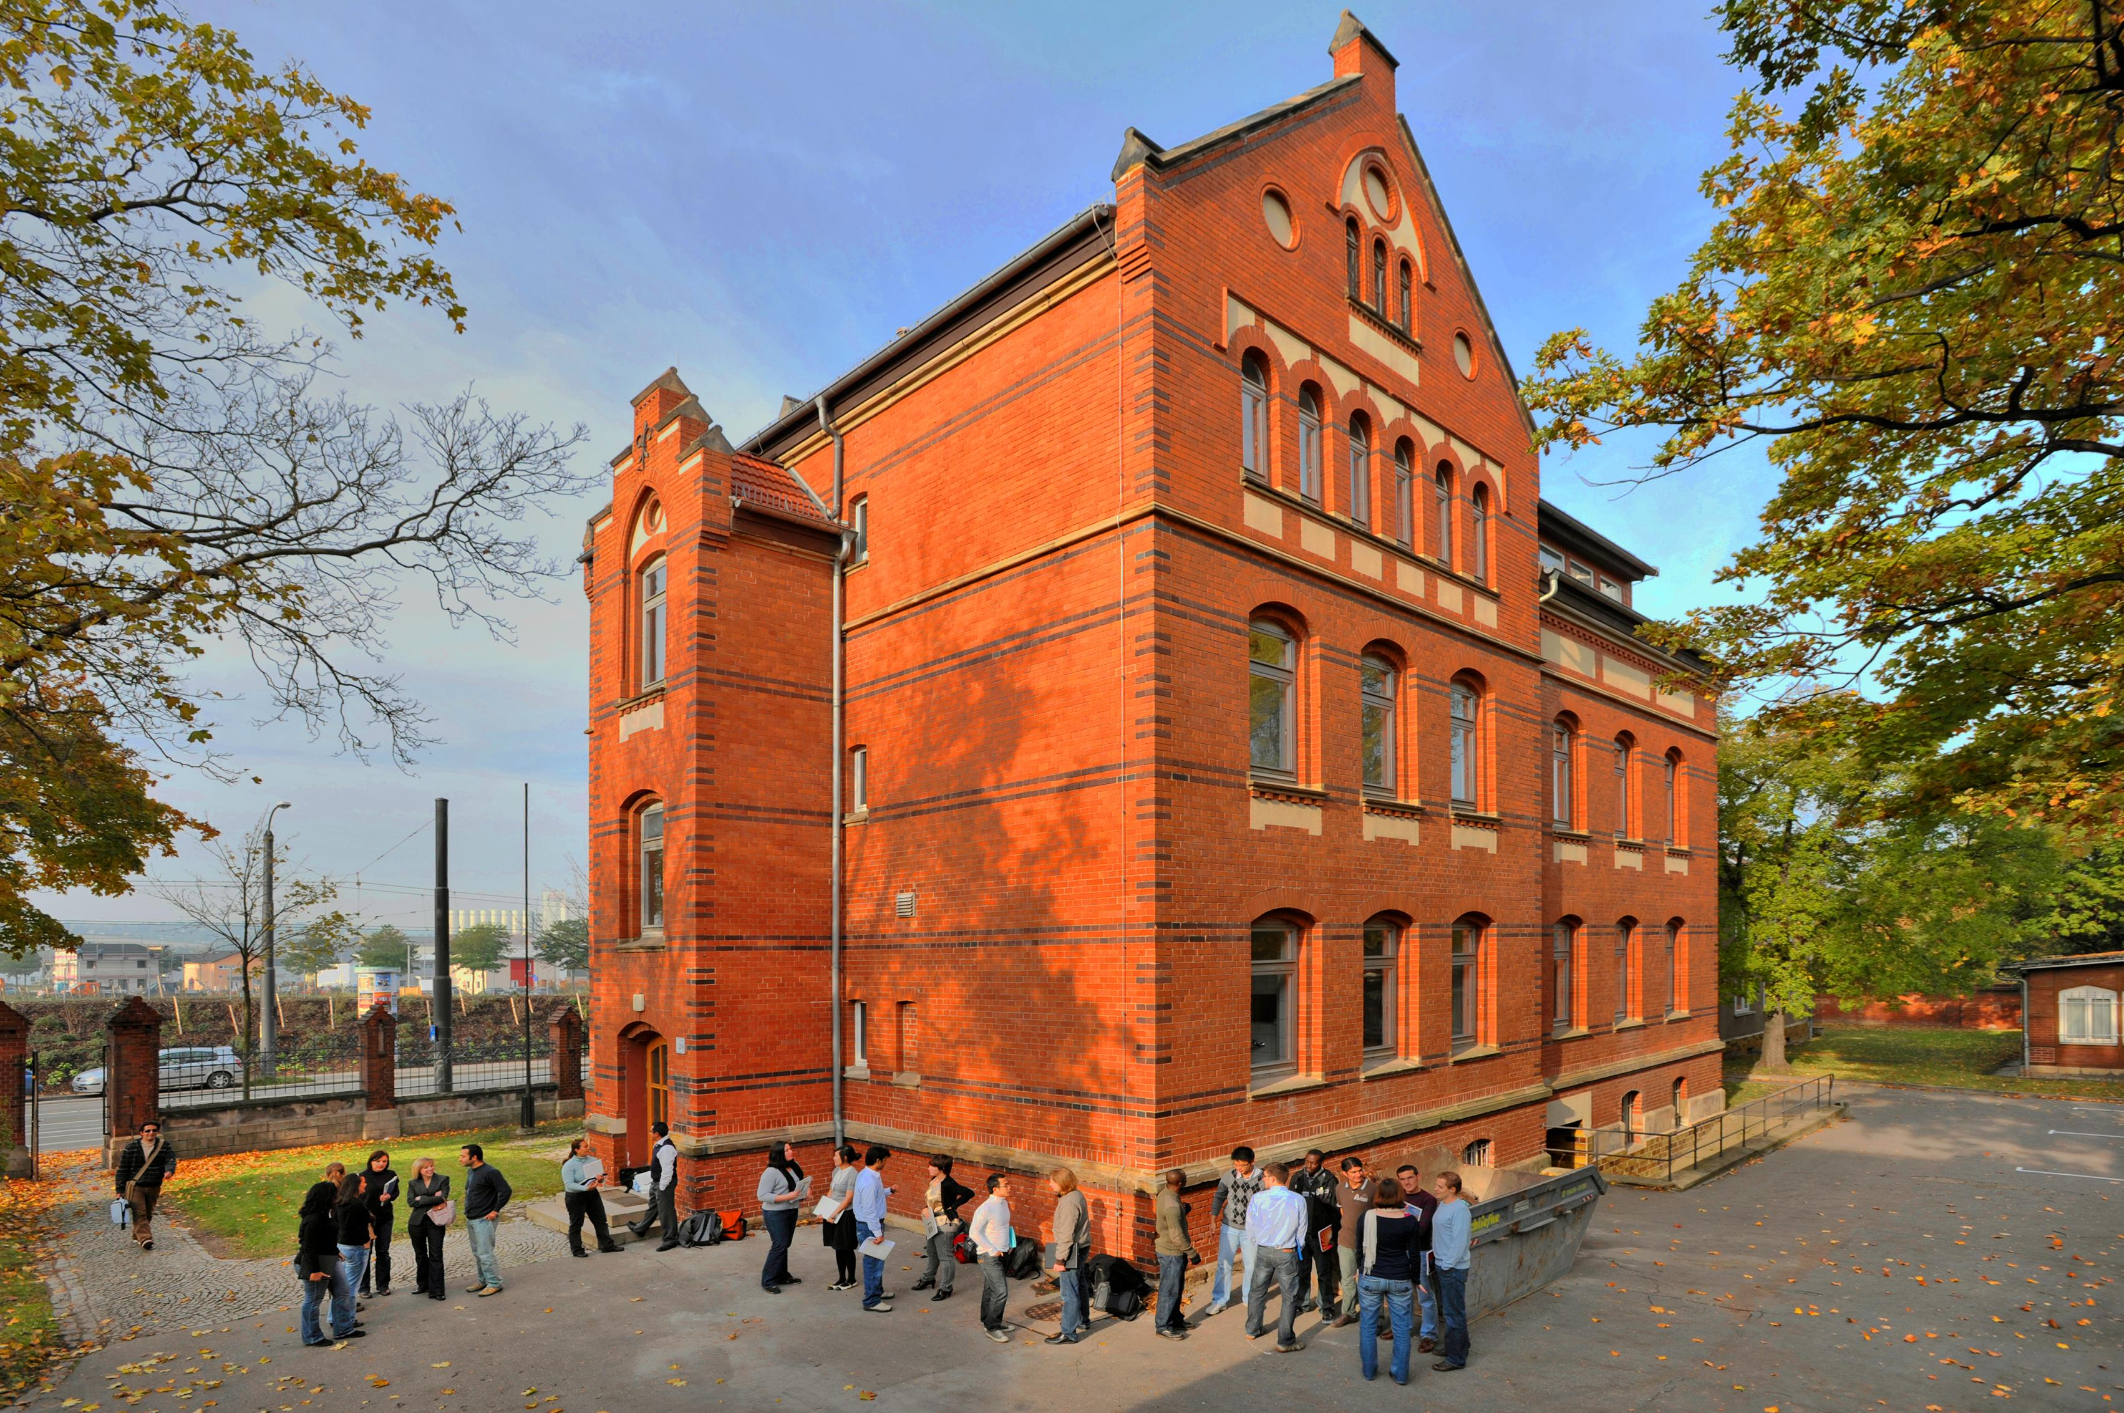

Slide 27
The students have an ambitious goal: to build a peaceful, democratic state in Afghanistan, and to rid the country of terror and violence.

Slide 28
In the future, these students hope to form the Afghan elite, to find jobs in government ministries or NGOs. After a six-month preparatory program entitled "Good Governance in Afghanistan," the students are ready to begin a Masters course in public policy.

Slide 29
Moheb Jarbakhail is one of 27 young Afghans at the Willy Brandt School. The 25-year-old says he wants to return to Kabul at the end of his course, armed with skills he has learned.

Slide 30
"People like myself can make a significant difference to Afghanistan for two reasons," Moheb said. "One, we get all the academic knowledge of how to govern a society, and the second is: We are from that country, we understand the internal politics. So, I see my future in helping the Afghan public."

Slide 31
Moheb has been studying in Erfurt for almost a year. Before that, he completed a degree in economics at the University of Kabul, studied in the US and also worked for an aid organization in Afghanistan.

Slide 32
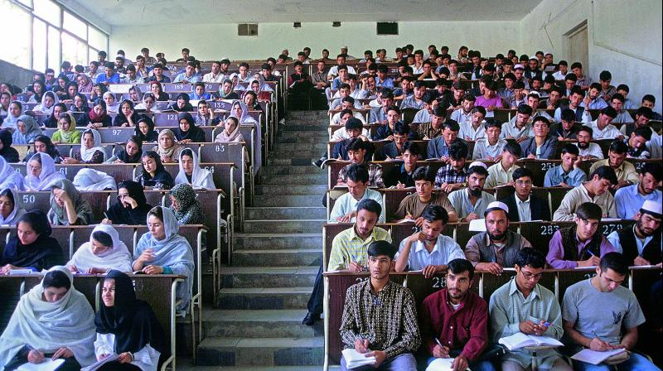

Slide 33
One of only five women on the course is 23-year-old Hajar Mobarez. She already knows what women can achieve in Afghanistan. Her mother is a member of parliament in Kabul.

Slide 34
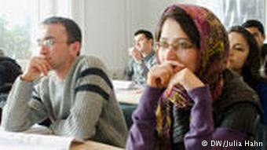

Slide 35
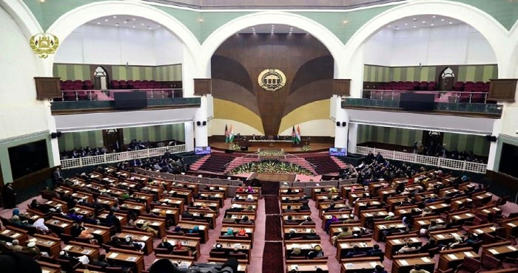

Slide 36
Over the summer holidays, Hajar helped her with the election campaign. The women drove round remote villages, distributing campaign leaflets.

Slide 37
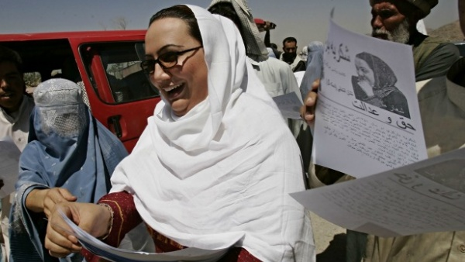

Slide 38
"I want to work for the government, especially in the area of economic development," Hajar said. "I also want to work for empowering women through providing more educational opportunities."

