Slide 1
IMPLICATURES PRESENTED BY: JASMIN KANAAN

Slide 2
IMPLICATURES
CONVERSTIONAL GRICE’S
IMPLICATURES CONVERSATIONAL
MAXIMS
HOW TO THE CO-OPREATIVE HOW IMPLICATURES
RECOGNIZE PRINCIPLE MAXIMS’ ARISE
CNOVERSATIONAL NATURE
IMPLICATURES
QUALITY QUANTITY STANDARD FLOUTING
IMLICATURES THE
RELATION MANNAR MAXIMS
CONTEXT CANCELLABILATY
DEPENDENCE the relation of conversational
and propositions
NON-DATACHTABILITY
CALCULABILITY

Slide 3
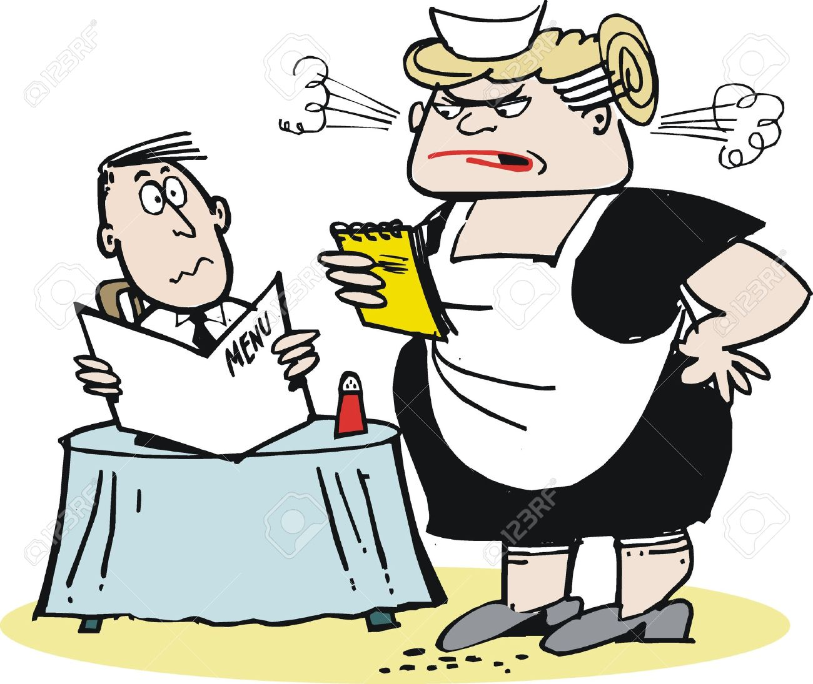
1.CONERSATIONAL IMPLICATURES :PROPOSITIONS OR ASSUMPTIONS NOT ENCODED
B:I’ve cleared the table
A:Am I in time for supper
What does B’s proposition?

Slide 4
HOW TO RECOGNIZE CONVERSATIONAL IMPLICATURES:
CONTEXT-DEPENDENCY
NON-DATECHABILITY
CALCULABILITY
DEFEASIBILITY/CANELLABILITY

Slide 5
CONTEXT DEPENDENCE
CONVERSATIONAL IMPLICATURES
ENTAILMENTS
CONVENTIONAL IMLICATURES
-JOHN KILLED THE WASP.
-THE WASP DIED.
A:HAVE YOU CLEARED THE TABLE AND WASHED THE DISHES?
B:I’VE CLEARED THE TABLE.
-haven't cleared the table.
–I haven't cleared the table yet.

Slide 6
DEFEASIBILITY/CANCELLABILITY: additional material
Conversational Implicatures: WITHOUT CONTRADICTION OR ANOMALY.
A-did the minister attend the meeting and sign the agreement?
b(1)-the minister attended the meeting.
B(2)the minister attended the meeting; a statement will be issued later with
regard to the agreement.
CONVENTIONAL IMPLICATURES
anomaly and contradiction
-John hasn’t arrived yet: I know for a fact he is not coming.

Slide 7
Non-detachability:
-Conversational Implicatures:
is tied to meaning, and not to form.
Conventional Implicatures:
it I tied to lexical items
1-john didn't manage to walk as far as the cross road.
2-john attempted to walk as far as the cross road.
3- John didn’t walk as far as the crossroads.
Have you cleared the table and washed the dishes?
I’ve taken all the things off the table.
I’ve cleared the table
1=2,2=1
3 = 2,1

Slide 8
Calculability: using statable general principles on the basis of conventional meaning together with contextual information.
-Have you seen anything of Clive recently ?
“Lets leave in fifteen minutes”

Slide 9
The relation of conversational implicatures to propositions
Propositions : the information conveyed by the overt linguistic form the of the utterance needs to be supplemented by processes of completion and/or enrichment.
1. A: What time is your train?
B: 10.30.(completion)
2.My train leaves at 10.30.(enrichment)
Implicatures are assumptions and proposition which cannot be directly derived from overt linguistic form by completion or enrichment
1.A: Did I get invited to the conference?
B: Your paper was too long.
2.Speaker A did not get invited to the conference.

Slide 10
Grice’s conversational maxims
Co-operative princple
“Make yoiur conversational contribution such as is required ,at the stage which it occurs, by the accepted purpose or direction of the talk exchange in which you are engaged “

Slide 11
The maxim of quality :concerned with truth telling
Don’t say what you belive to be false
Do not say that for which you lack adequate evidence
Oh ,I like its red cover
Jenny, how do you like this novel?

Slide 12
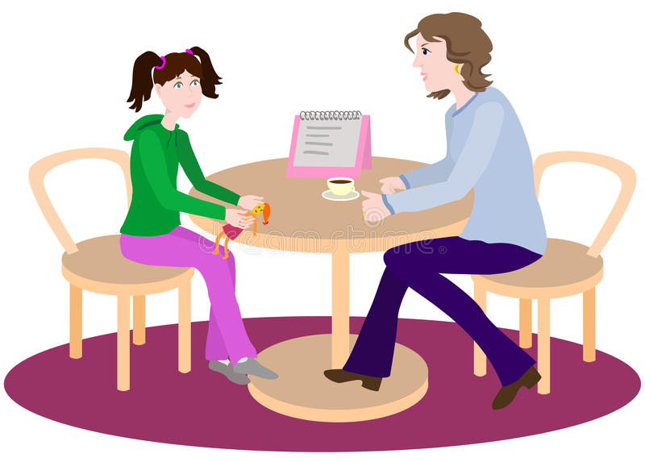
The maxim of quantity :the amount of information
Make your contribution as informative as is required for the current purposes of the exchange in which you are engaged
Do not make your contribution more informative than is required
Baked beans on toast
What did you have for lunch today?
food
I had 87 warmed-up baked beans (although eight of them were slightly crushed) served on a slice of toast 12.7 cm. by 10.3 cm. which had been unevenly toasted...

Slide 13
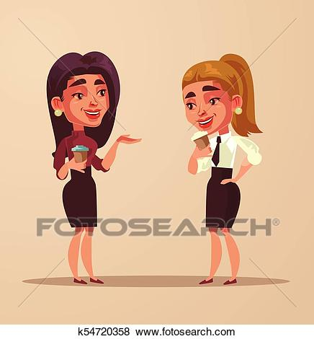
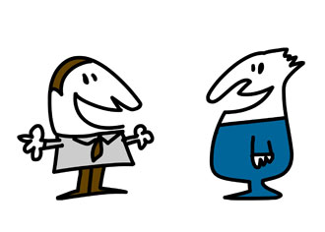
The manner of relation:👉be relevent
A-Have you seen Mary today?
B-I'm breathing
He is a polite man and works sometimes on time.
Daniel, is Morgan good as a finance manager?

Slide 14
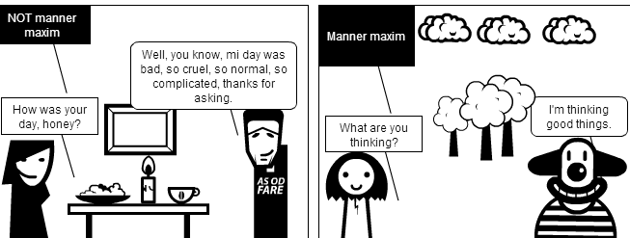
The maxim of manner:
Avoid obscurity
Avoid unnecessary prolixity
Avoid ambiguity
Be orderly
A-The lone ranger rode off into the sunset and jumped on his horse.
B-The lone ranger rode off into the sunset after jumping on his horse

Slide 15
How Implicatures arise? Two mechanisms
standard Implicatures flouting the maxim
scalar Implicatures quality relation manner
quantity

Slide 16
1.standard Implicatures
requires the assumption that the speaker is doing their best to follow the co-operative principle, even though the result may not be the best, from the point of view of the hearer
-(standard motorist)I’ve run out of petrol
-(passer -by)there is a garage just round the corner.

Slide 17
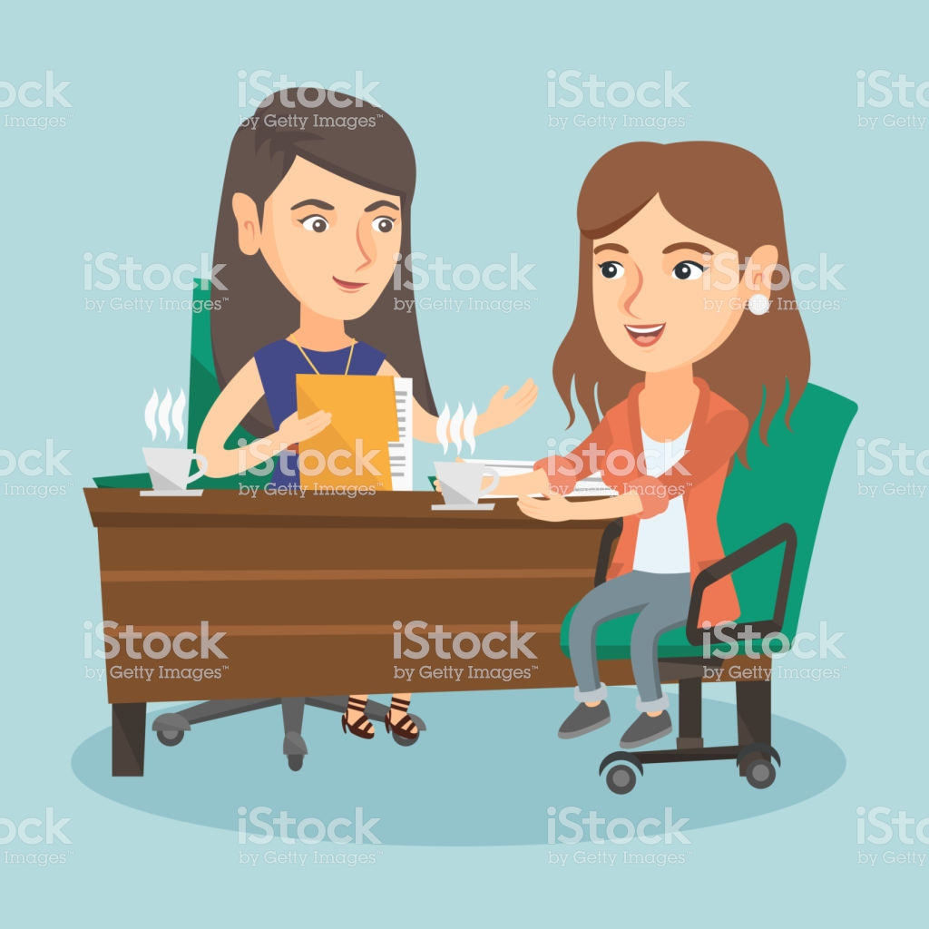
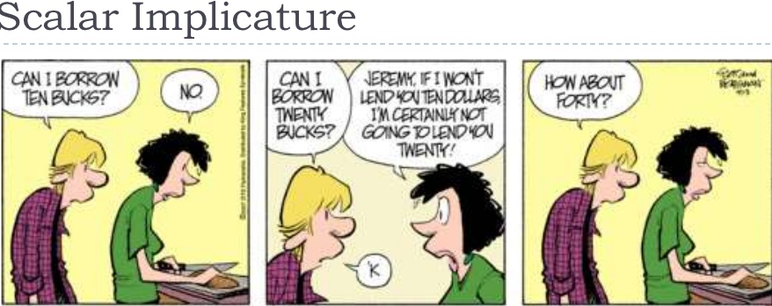
1.1.scalar imlicatures :the use of certain scales of value, one cancels the others .
have you read any of Hardy’s novels?
I’ve read some of them
Few some most all

Slide 18
2. Flouting the maxim:
flouting of the maxims in circumstances in which:
it is obvious to the hearer that the maxims are being flouted,
it is obvious to the hearer that the speaker intends the hearer to be aware that the maxims are being flouted,
there are no signs that the speaker is opting out of the co-operative principle.
The maxim of quality:
-the mushroom Omelette wants his coffee with.
The maxim of quantity:
-Mother: What did you do?
-Daughter: (with exaggerated patience, elaborates a long list of totally uninteresting
details
(The Implicature is that the mother is too damn curious, and overworried about her daughter's doings.
the maxim of relation :
A: I say, did you hear about Mary's...
B: Yes, well, it rained nearly the whole time we were there.
The maxim of manner:
Consider : Lura jumped and ran to the pier when she heared that
Lauren’s boat has arrived
-What did Lura did when she heard that Lauren's boat has arrived ?
- Lura ran to the pier and jumped.

Slide 19
Thanks!
Any questions?

Slide 20
SlidesCarnival icons are editable shapes.
This means that you can:
Resize them without losing quality.
Change fill color and opacity.
Isn’t that nice? :)

Slide 21
😉
Now you can use any emoji as an icon!
And of course it resizes without losing quality and you can change the color.
How? Follow Google instructions https://twitter.com/googledocs/status/730087240156643328
✋👆👉👍👤👦👧👨👩👪💃🏃💑❤😂😉😋😒😭👶😸🐟🍒🍔💣📌📖🔨🎃🎈🎨🏈🏰🌏🔌🔑 and many more...

