Slide 1
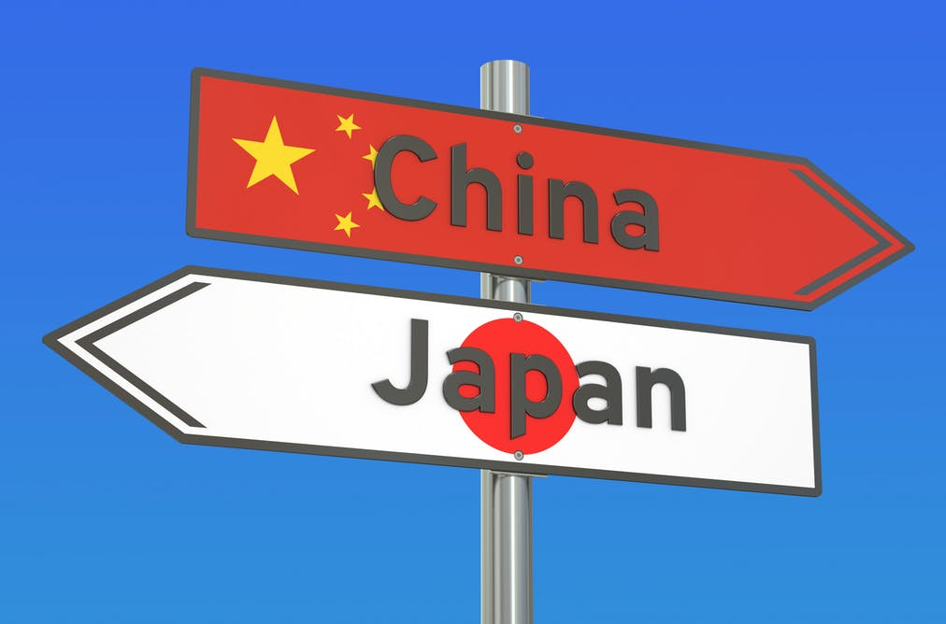
Why do Japan and China have such a frosty relationship?

Slide 2
Japan’s Shinzo Abe and China’s Xi Jinping have met face-to-face for the first time, but why do the neighbours have such an uneasy relationship?

Slide 3
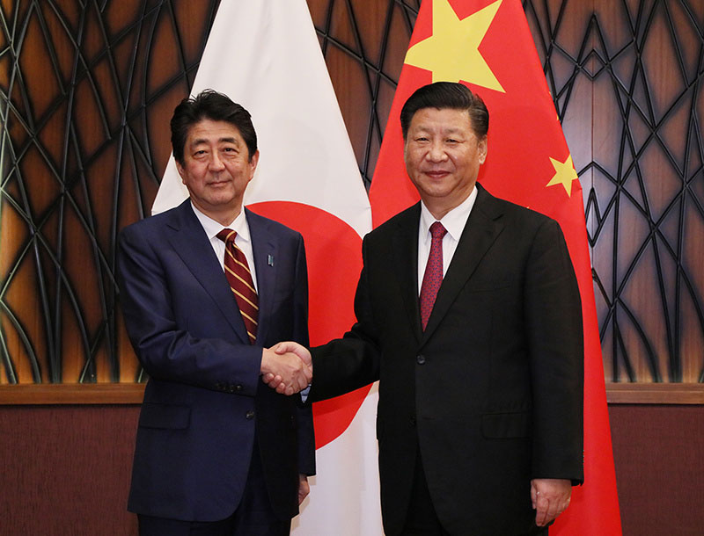

Slide 4
The recent tensions have centred on uninhabited islands and rocks in the East China Sea that both countries say belongs to them.

Slide 5
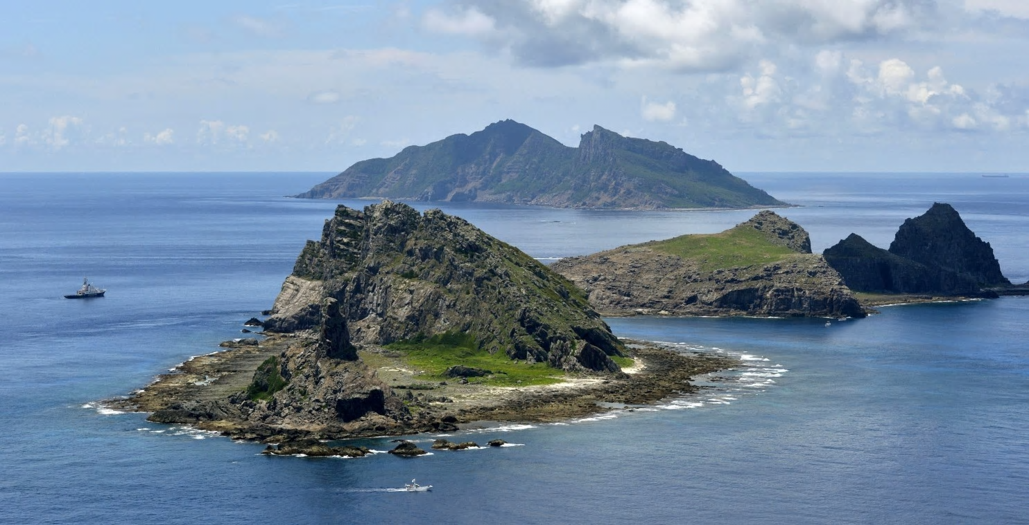

Slide 6
The Japanese, who have claimed the islands since the 19th century, call them the Senkaku Islands and that is how they are generally referred to internationally. In China they are known as the Diaoyu Islands.

Slide 7
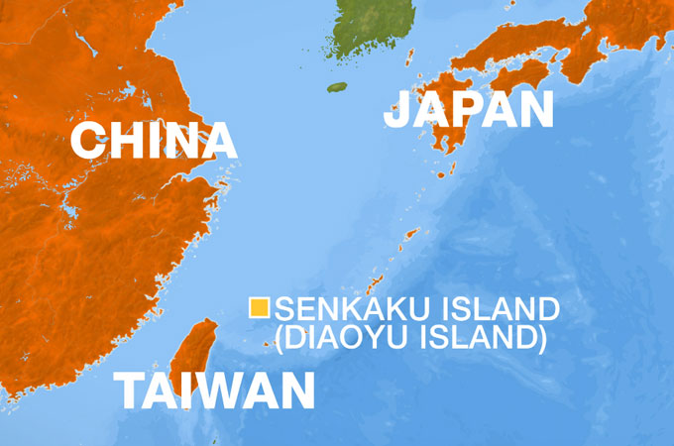

Slide 8
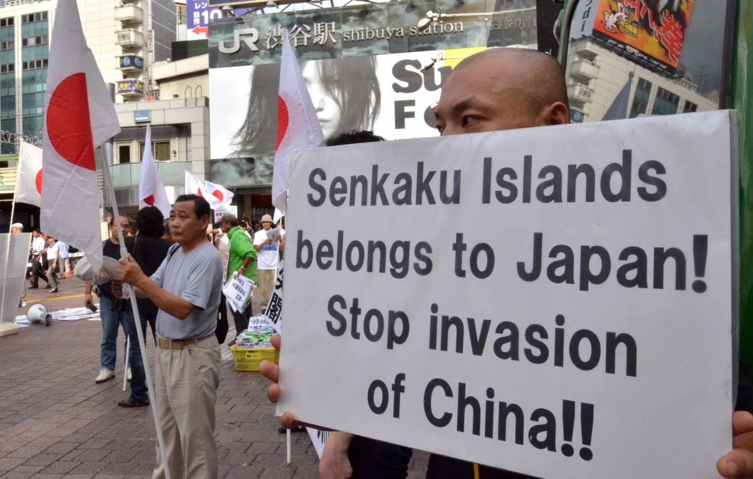

Slide 9
Crucially, in 1968, potential undersea oil reserves were discovered. The territory is close to important shipping lanes and has rich fishing areas.

Slide 10
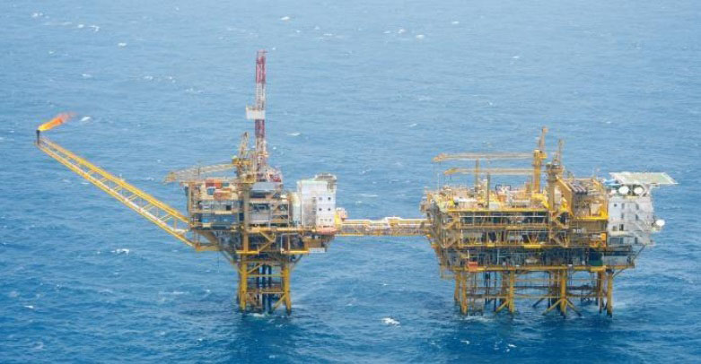

Slide 11
The islands were returned to Japan with a 1972 treaty, but at the same time, the Chinese and Taiwanese both declared ownership.

Slide 12
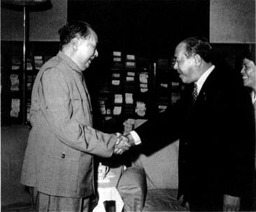

Slide 13
Recently, Beijing has pushed its claim on the islands, coupled with its growing militarisation of the East China Sea.

Slide 14
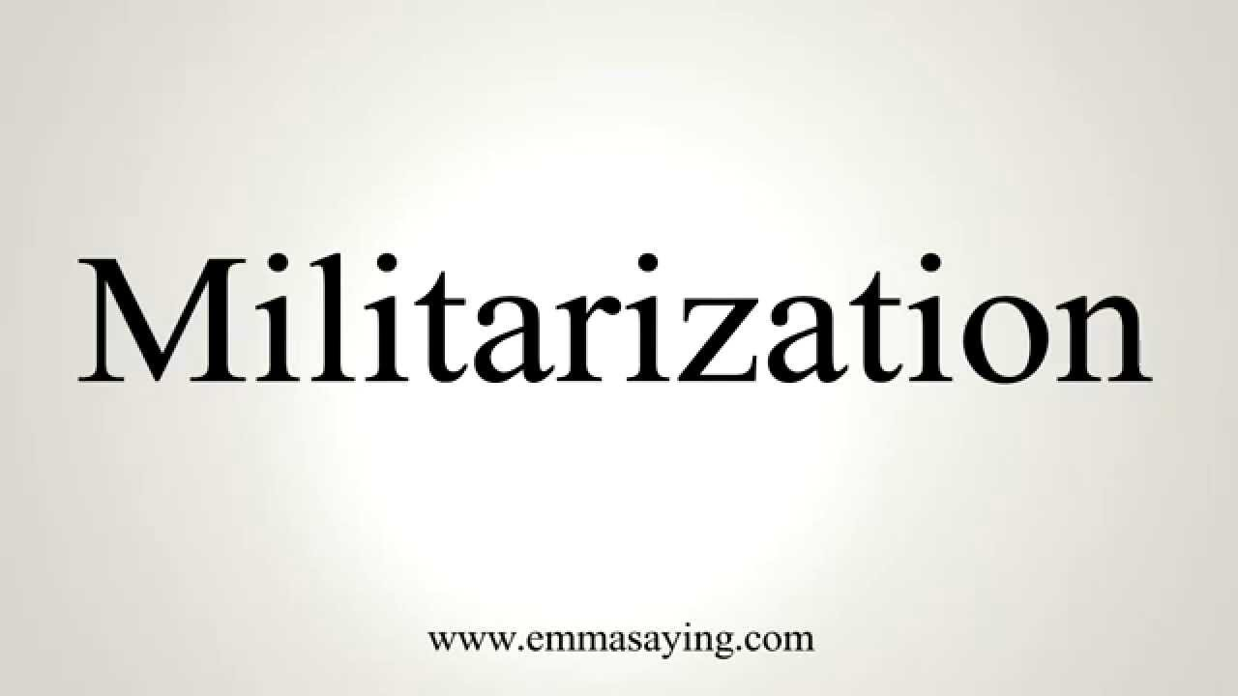
Militarization, or militarisation, is the process by which a society organizes itself for military conflict and violence. It is related to militarism, which is an ideology that reflects the level of militarization of a state, and which is associated with the glorification of the military, armed forces and weapons and of military power, including through symbolic displays (e.g., parades of tanks and soldiers) and actual use of force, such as through warfare.

Slide 15
In an eight-month period in 2012, there were 40 maritime incursions and 160 aerial incursions by Chinese military ships and planes into the disputed waters, leading Japan to state that its neighbours were jeopardising peace.

Slide 17
a sudden attack on or act of going into a place, especially across a border:
incursions into enemy territory
​
formal an occasion when people suddenly involve themselves in another person's private situation

Slide 18
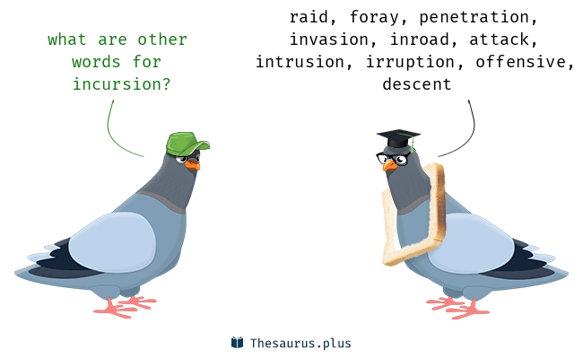

Slide 19
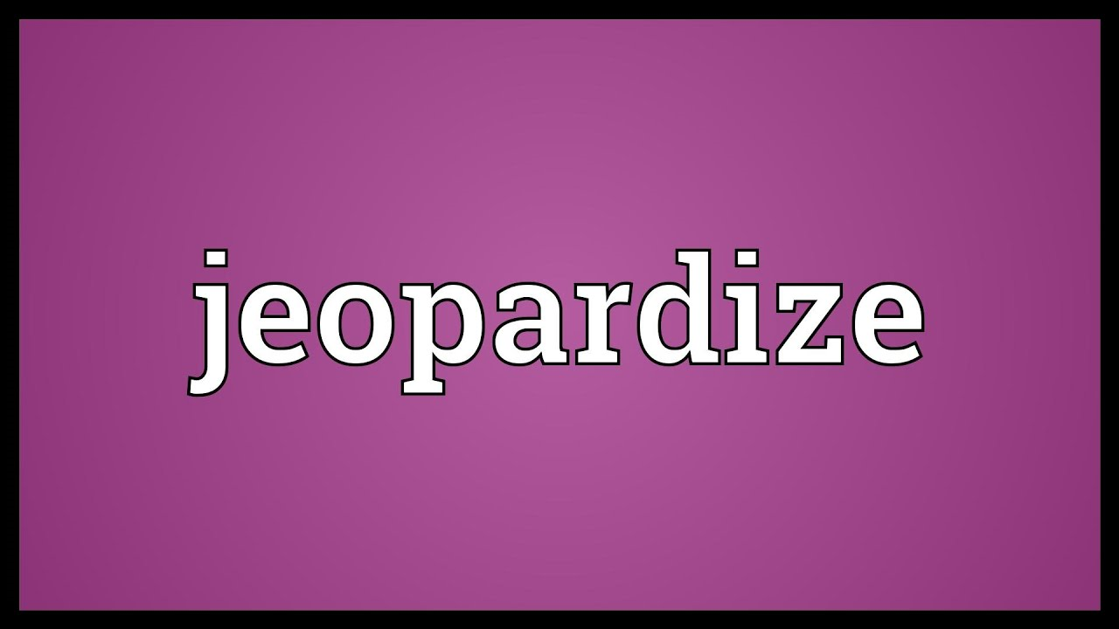
to put something such as a plan or system in danger of being harmed or damaged

Slide 21
The fear is that, with so much military and coastguard activity in the area, an “accidental” collision could lead to an escalation – and conflict.

Slide 25
Even a seemingly shallow exchange between the top leaders of the world’s second and third biggest economies can make a considerable difference.

Slide 27
This is particularly true for military cooperation, with the hope that tensions over the Senkaku islands can finally be reduced.

Slide 28
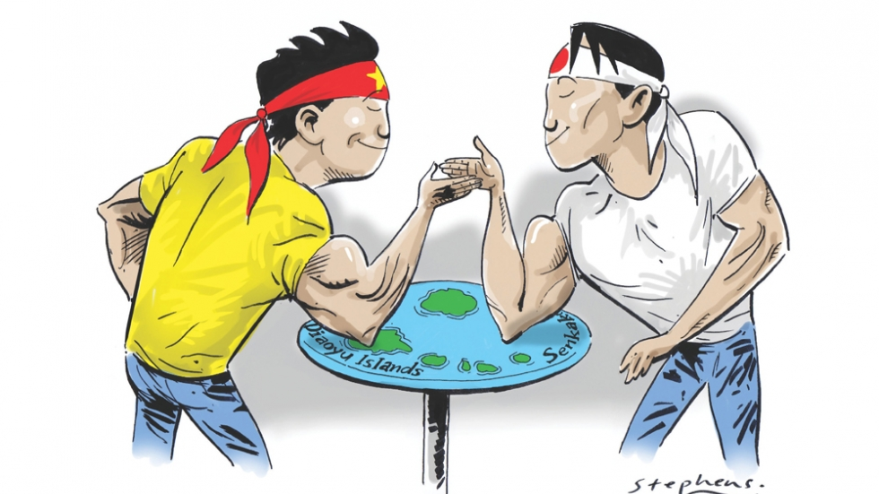

Slide 29
A starting point would be the establishment of a military hotline between Beijing and Tokyo.

Slide 31
A hotline is a special, direct phone line between the heads of government in different countries. They have discussed setting up a military hotline between the two countries.

Slide 32
Japan and China could help stabilize not just Asia but the whole world. China’s foreign minister and premier have both visited Japan this year, and the number of Chinese tourists following suit is expected to reach a record 8 million this year.

Slide 34
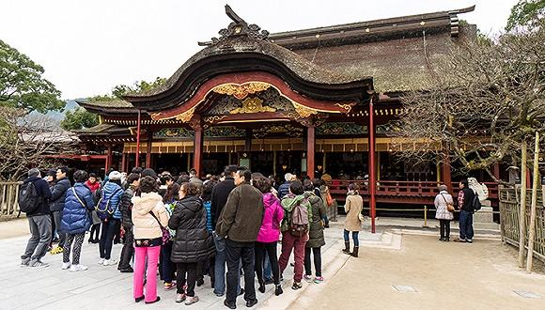
Japan Tourism adopt new strategy to increase the tourist’s number

Slide 35
Japan is still an ally of the U.S., and it will avoid adopting any policies that could undermine U.S. policies. Therefore, we could expect ties to improve but the steps will not be huge.

Slide 36
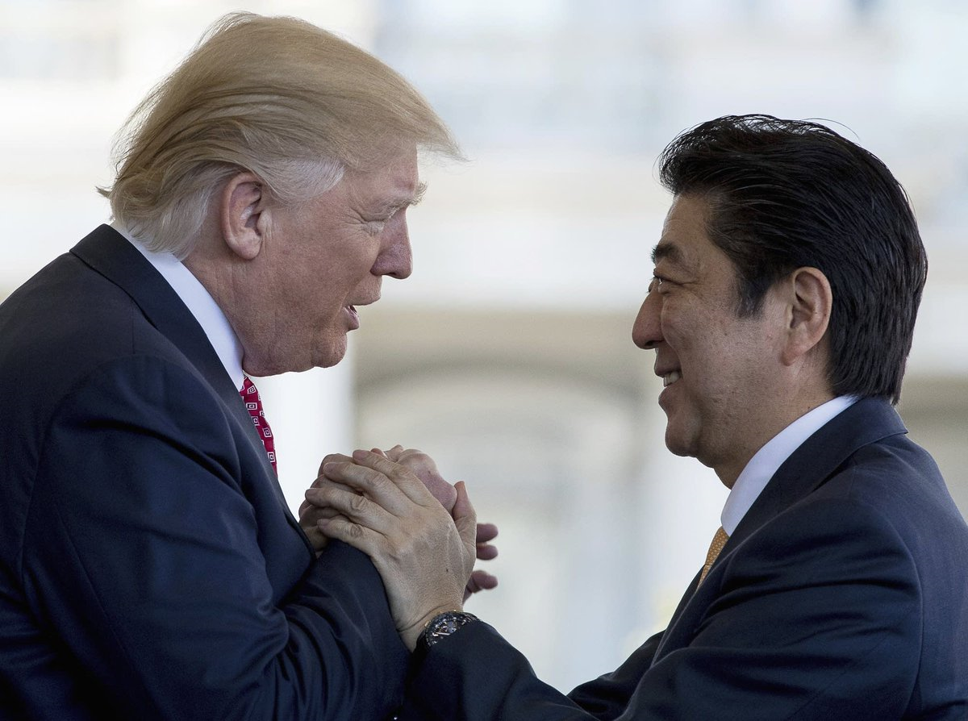

Slide 38
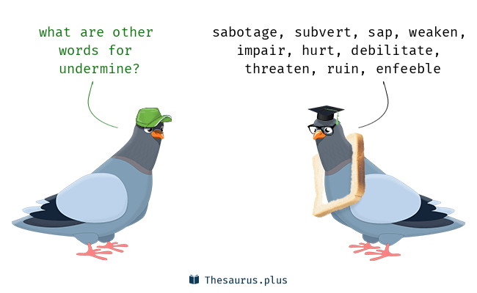

Slide 39
