Slide 1
Skills of work ethics

Slide 2
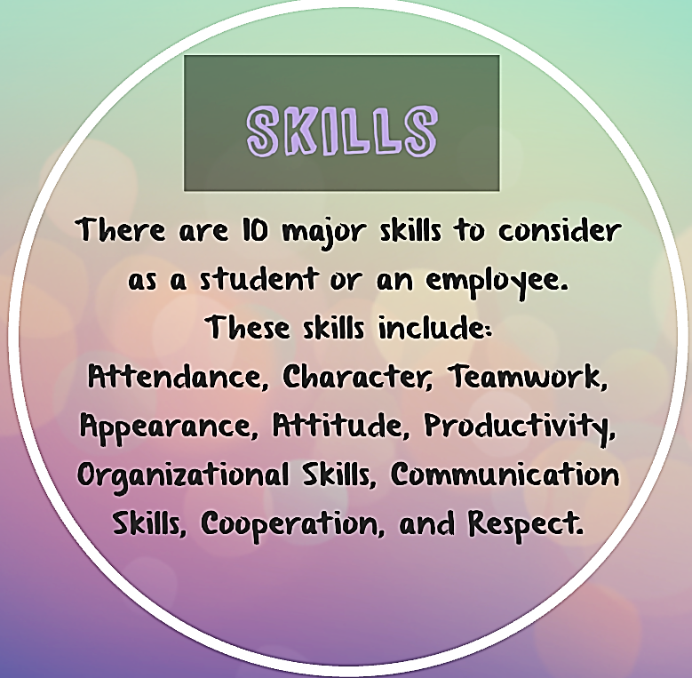

Slide 10
