Slide 1
Characterization of Nanoparticles
م د نيران علي ثامر

Slide 2
Ultraviolet-Visible (UV-Vis) Spectroscopy
nanoparticles present distinct optical and physical properties, which are dependent upon their size (diameter), shape, surface structure and
agglomeration state.
optical feature commonly referred to as localized surface plasmon resonance (LSPR), that is, the collective oscillation of electrons in the conduction band of nanoparticles in resonance with a specific wavelength of incident light

Slide 3
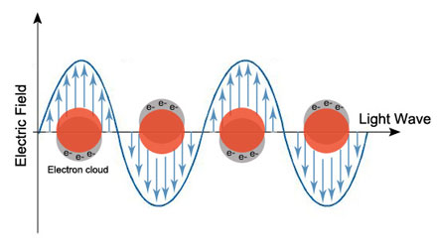
Basics of localized surface plasmon resonance (LSPR) of gold nanoparticles due to collective oscillation of surface electrons with incident light at a specific wavelength.

Slide 4
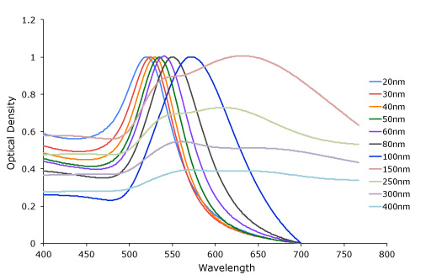
Figure 1. Gold nanoparticle size dependant surface plasmon resonance. Note the red-shift of the absorption maximum as the gold nanoparticle size increases.

Slide 5
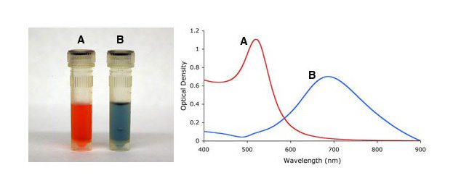
Gold nanoparticle shape dependant localized surface plasmon resonance as indicated by the visual appearance and UV-VIS spectra of spherical (A), and urchin-shaped (B) gold nanoparticles ("spiky gold").

Slide 6
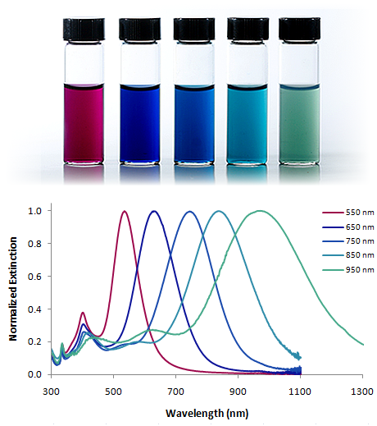

Slide 7
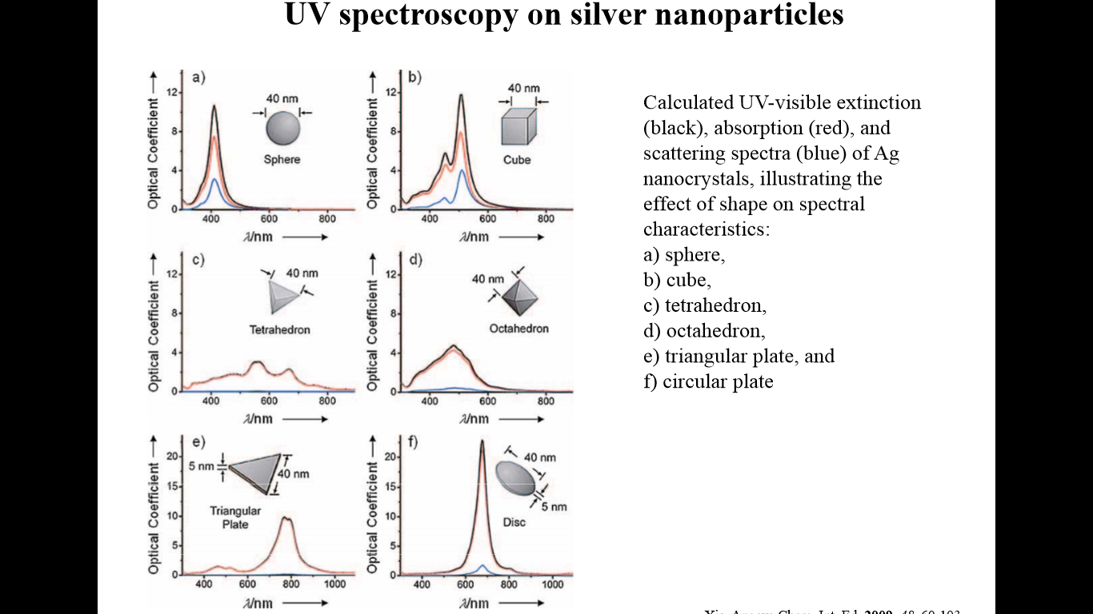

Slide 8
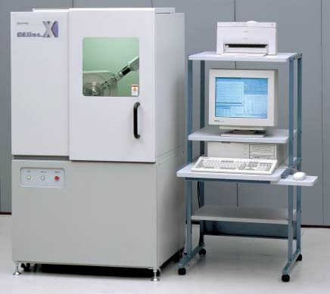
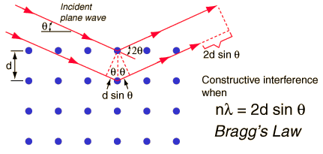

Slide 9
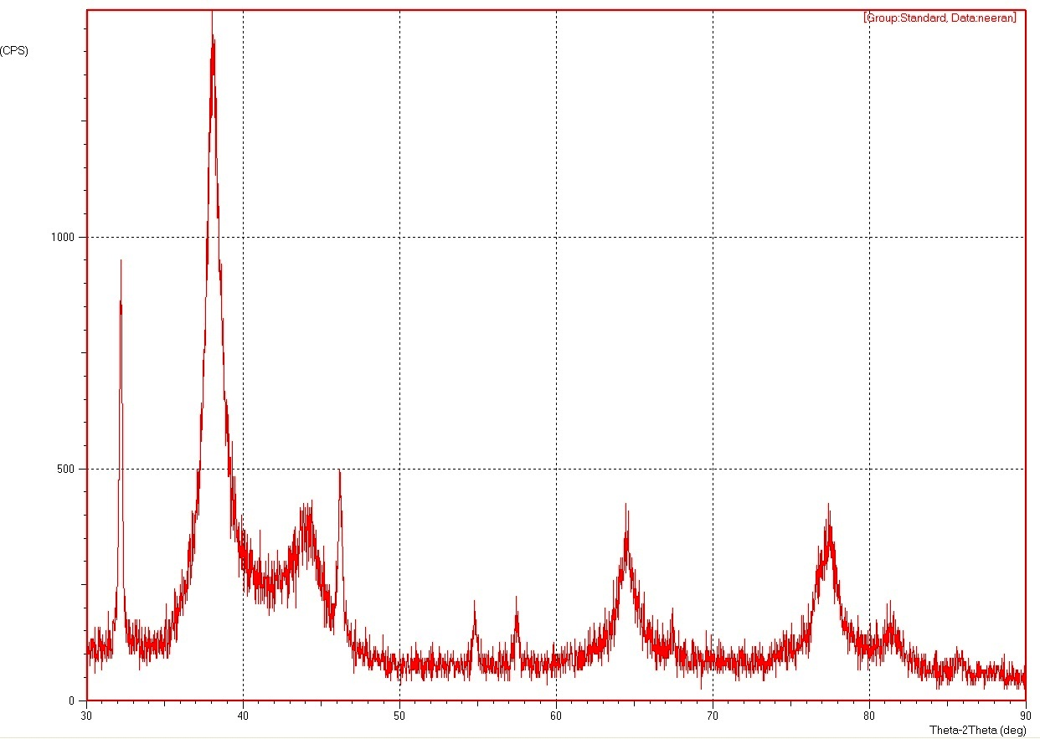
Debye–Scherrer formula, D = kλ/βcosθ,

Slide 10
Debye–Scherrer formula, D = kλ/βcosθ,
where D is particle diameter size,
k is a constant equals 1,
λ is wavelength of X-ray source (0.1541 nm),
β is the full width at half maximum (FWHM)=0.23,
θ is the diffraction angle corresponding to the lattice plane (111).

Slide 11
Dynamic Light Scattering (DLS)
Dynamic light scattering (DLS) is an analytical technique used for measuring the size and size distribution of submicron-sized particles. In the measurement, a particle suspension is illuminated by a laser beam, and the fluctuation of scattered light is monitored and analyzed, to acquire the velocity of the particles’ Brownian motion and thereby inferring their size.

Slide 12
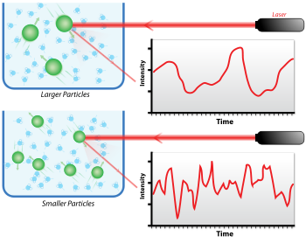

Slide 13
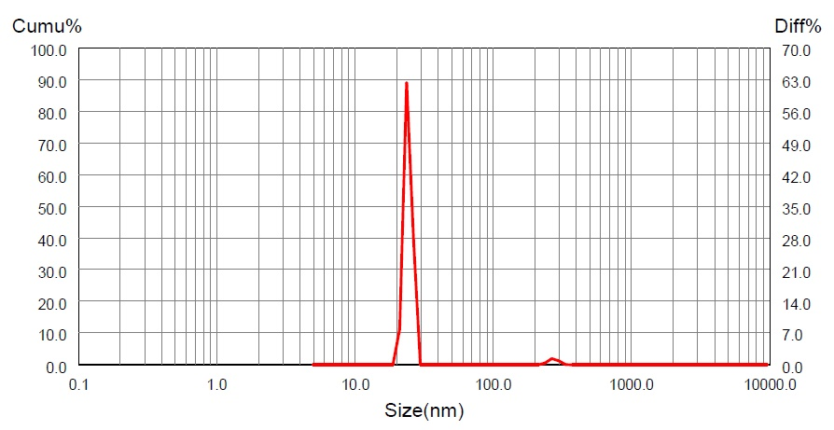
22.3-25 62.38

Slide 14
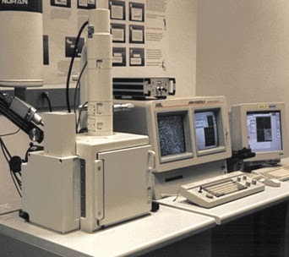
Scanning Electron Microscope SEM

Slide 15
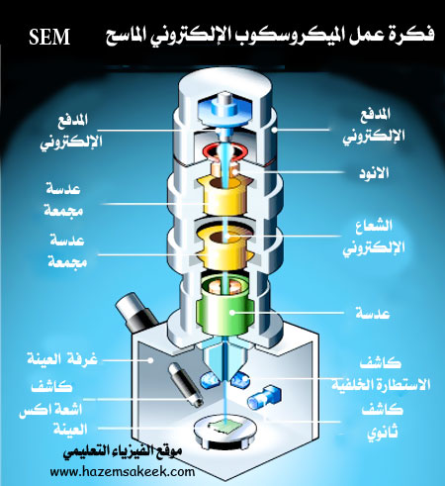

Slide 16
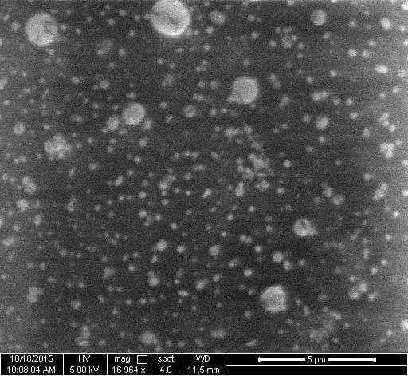

Slide 17
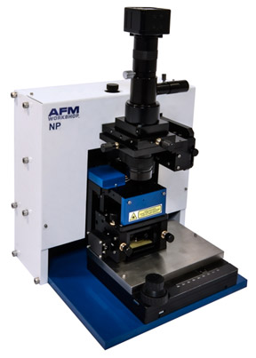
Atomic Force Microscope AFM

Slide 18
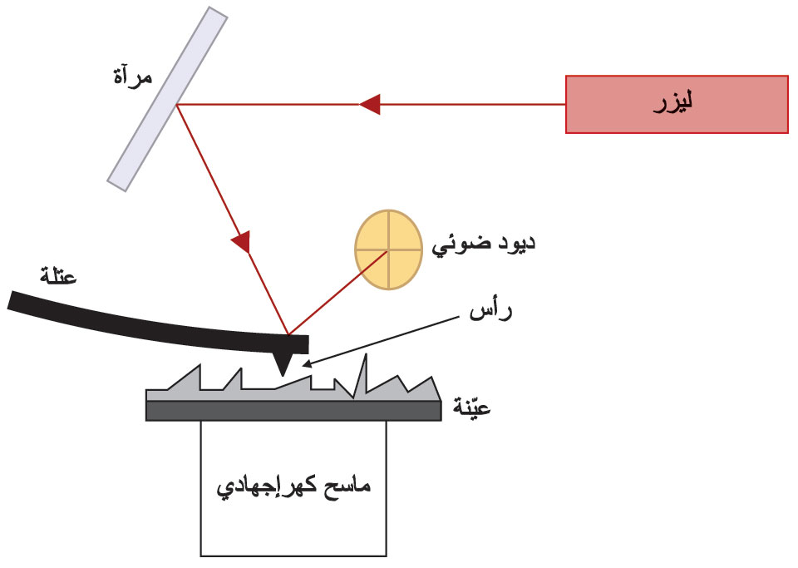
يتم إسقاط شعاع ليزري على الحامل والذي يرتفع وينخفض مع ارتفاع وانخفاض الابرة وبالتالي مع تنوع تضاريس السطح من ارتفاع وانخفاض, ويتم التقاط منعكس الشعاع الليزري على الحامل على مستقبل وبالتالي يتم تحديد ورسم تضاريس السطح الممسوح تبعا لحركة منعكس الشعاع الليزري.

Slide 19
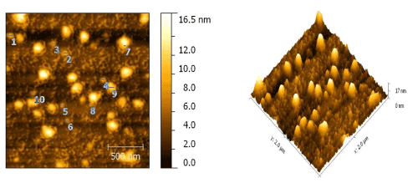

Slide 20
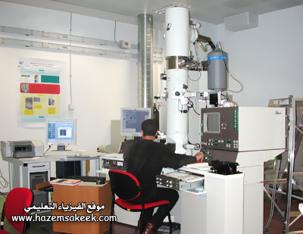
Transmission Electron Microscope TEM

Slide 21
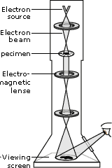
It is a microscopy technique whereby a beam of electrons is transmitted through an ultra thin specimen, interacting with the specimen as it passes through. An image is formed from the interaction of electrons transmitted through the specimen; the image is magnified and focuses onto an imaging device, such as a fluorescent screen, on a layer of photographic film, or to be detected by a sensor such as a CCD camera.

Slide 22
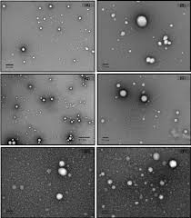

Slide 23
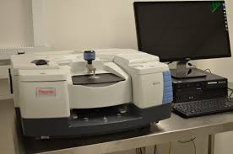
Fourier Transform Infrared Spectroscopy FTIR

Slide 24
