Slide 1
Declaration of Helsinki

Slide 2
المركز العراقي لبحوث السرطان والوراثة الطبية / الجامعة المستنصرية
Helsinki scientific research law ethics
م. د. زينب سعد عبد الغني
رئيس قسم الاحياء الجزيئي

Slide 3
The Nuremberg code 1947
The first international instrument on the ethics of medical research on human subjects
Designed to protect the integrity of the research subjects
Set out conditions for the conduct of ethical research on human subjects
Emphasized the need for voluntary consent for research

Slide 16
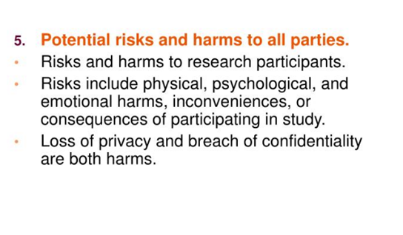

Slide 19
The Belmont Report 1979
National commission for the protection of human subjects of biomedical and behavioral research
Focuses on informed consent
Favourable risk-benefit ratio
Need to ensure that vulnerable population are not targeted for risky research

Slide 20
CIOMS guidelines 1982
International ethical guidelines for biomedical research involving human subjects
Geneva, council for international organizations of medical sciences (CIOMS) in collaboration withWHO 2002
CIOMS guidelines are designed to be pf use to countries in defining national policies on the ethics of biomedical research involving human subjects, applying ethical standards in local circumstances and establishing or improving ethical review mechanisms

Slide 21
Sri Lanka guidelines:
Draft act to provide for the establishment and development of a national center for ethics in research involving human subjects (NCERHS) 1995 (unpublished)
SLMA ethical review committee guidelines 1998
A guidebook on research ethics NASTEC 2004

Slide 28
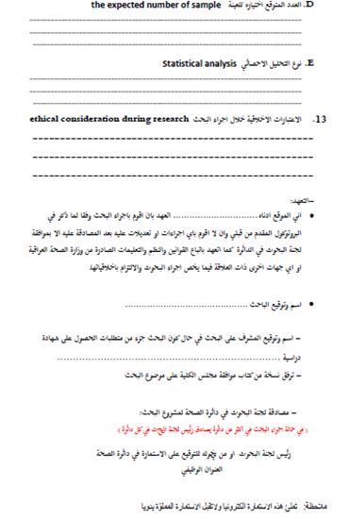

Slide 30
Hope it will be easy for you
You can fell free to contact me
zaynab.saad@iccmgr.org
Thank you for attending this workshop

