Slide 1
How to Read or Write Chromosomal Analysis report !
Asmaa A. Almukhtar .PHD
Lecturer
Medical Genetic Department
ICCMGR
2021

Slide 2
How to read karyotype?
Need to know chromosomal structure and composition
What is the karyotype?(photograph)
What is the karyotyping?(process)
What are the normal chromosomes vs chromosomal changes?
The variable features of normal chromosomes
Complex karyotype.
How to write the chromosomal analysis report?
The symbols and abbreviates
The order for writing the diagnostic chromosomes

Slide 3
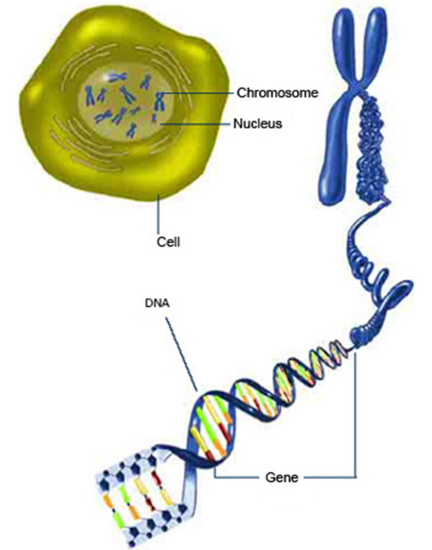
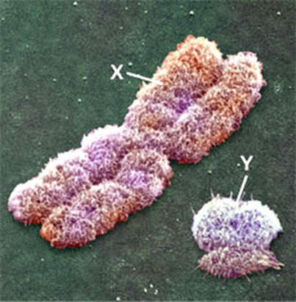
Chromosomes are DNA Molecule and Histone Proteins

Slide 4
Chromosomal Parts

Slide 5
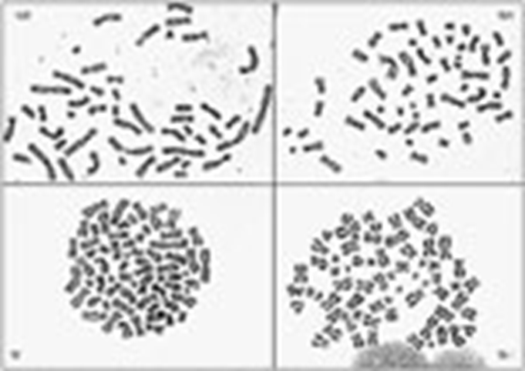
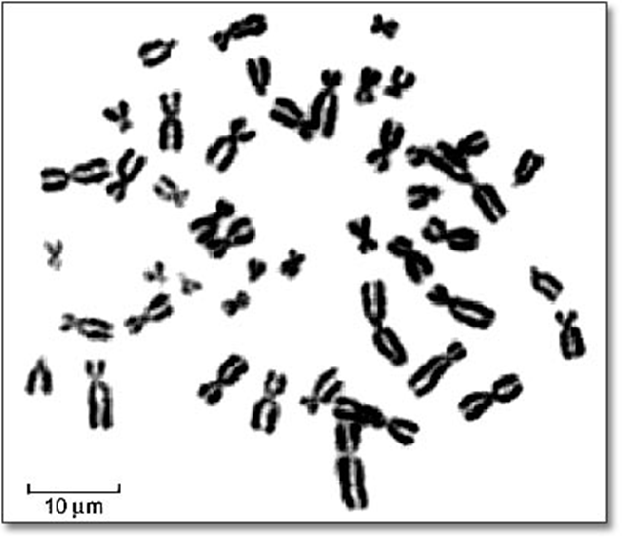
Metaphases with solid chromosomes

Slide 6
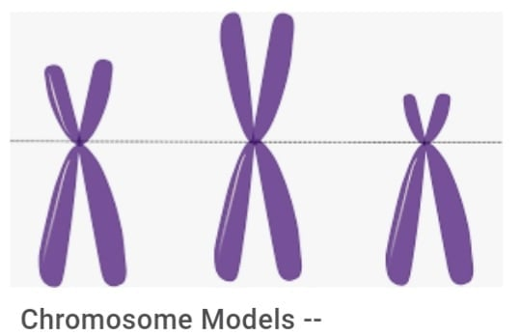
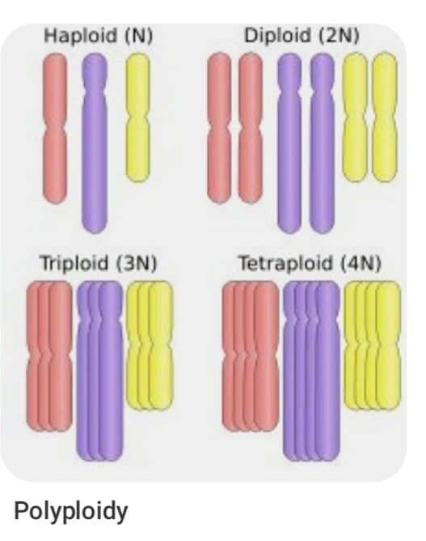
Numecaluture without banding
Submetacentric, Metacentric, Acrocentric

Slide 7
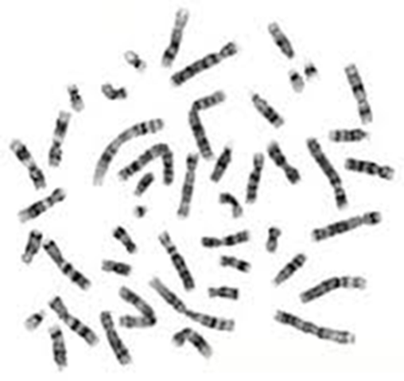
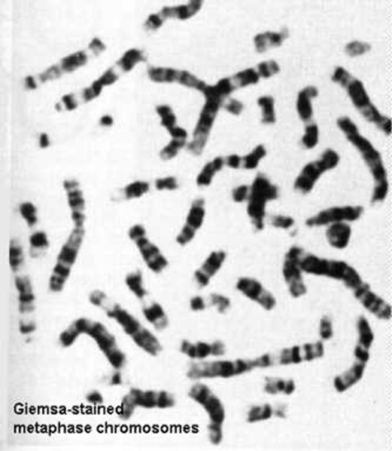
Metaphases were treated with Trypsin and Giemsa Stain for Banding

Slide 9
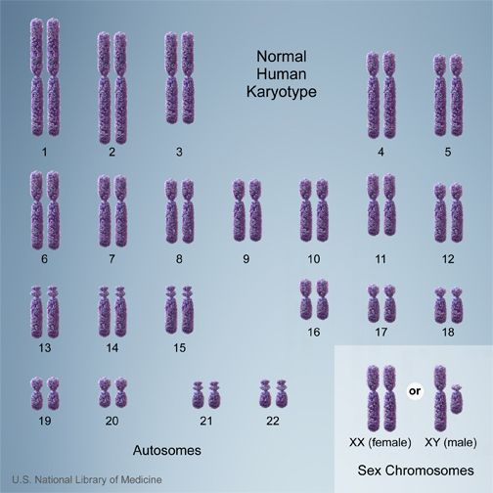
Numecaluture without banding
A group:1,2,3
B group:4,5
C group:6,7,8,9,10,11,12,X
D group:13,14,15
E group :16,17,18
F group:19,20
G group: 21,22,Y

Slide 10
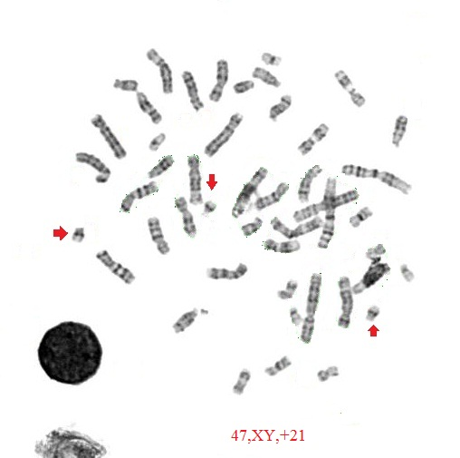
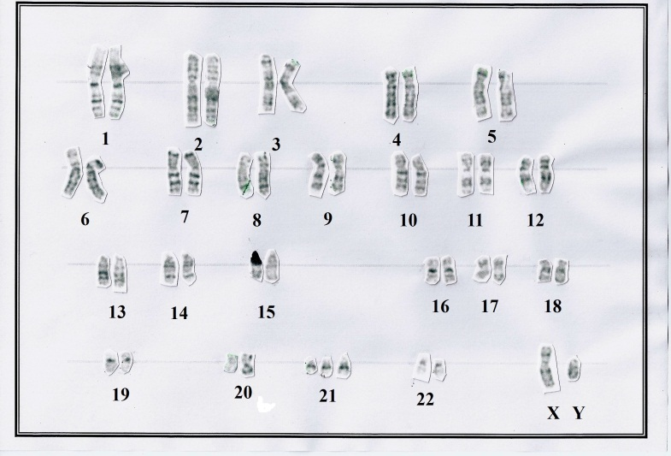
Numerical Abnormalities
47,XY,+21
Ploidy level ,sex chromosome,(+) or (-) befor a chromosome is indicate to gain or loss of particular chromosome
e.g 26,X,+4,+6,+21
A near haploid karyotype with 2 copies of chromosomes,4,6,21 and single copy of rest chromosomes
e.g 71,XXX,+8,+10
A near triploid karyotype with four copies of chromosome8, and 10and three copies of rest chromosomes
Quiz: 48,XX,+X,+14…..?

Slide 11
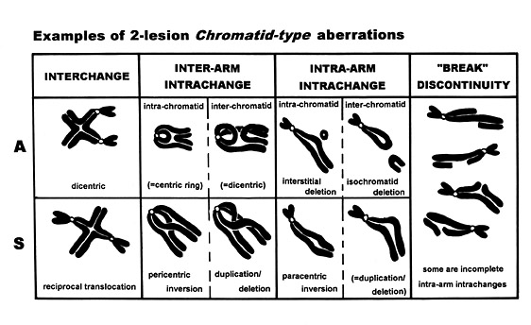
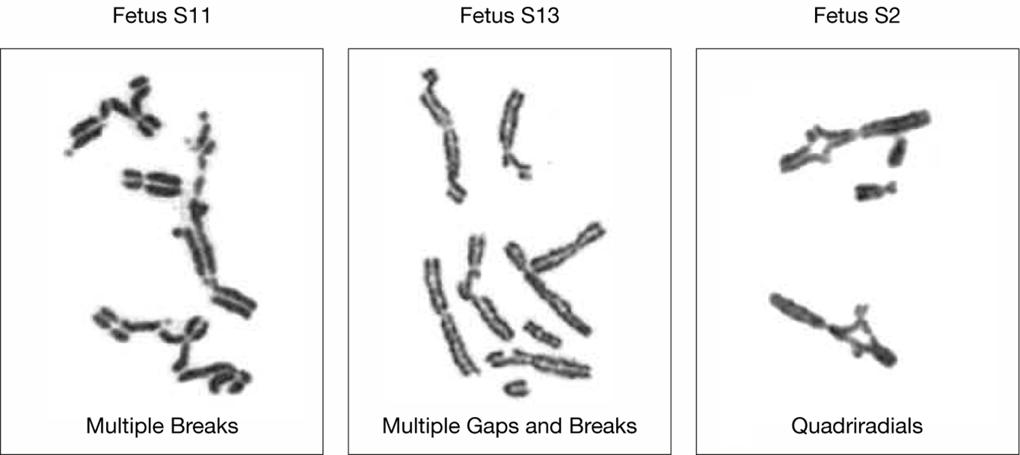
Structural Abnormalities

Slide 12
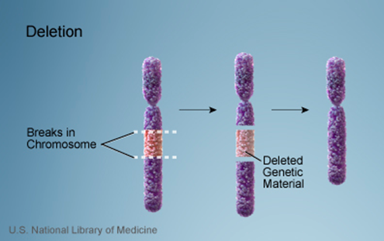
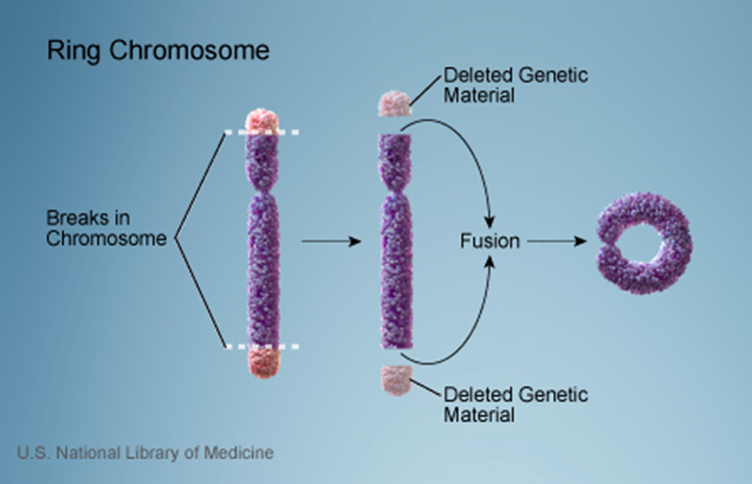
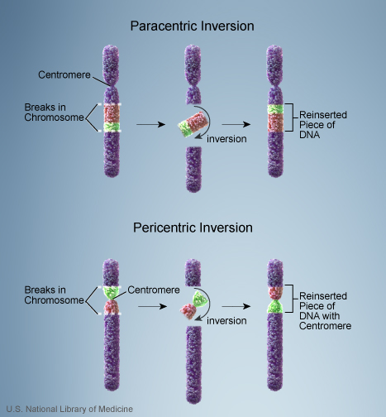
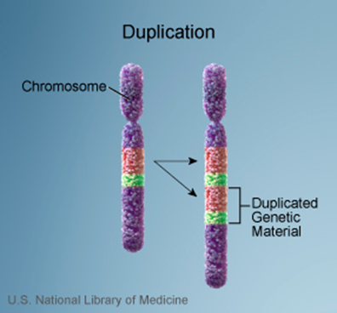
Types of Structural Changes
2 breaks at one side
2 breaks at different side

Slide 13
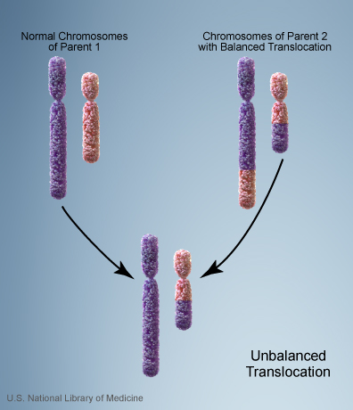
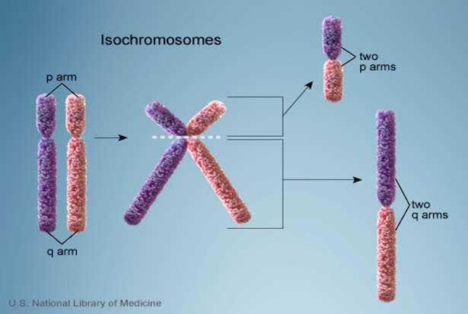
One break in centromere

Slide 14
Symbols and abbreviated terms
del = deletion
der = derivative
dup = duplication
inv = inversion
ins = insertion
t = translocation
add = additional material of unknown origin
mar = marker chromosome of unknown origin
dmin = double minute
i = isochromosome
*when there are more than defect at the same chromosome then write the defect according alphabetical order within the complex karyotype

Slide 15
Normal karyotype and normal variable chromosome features.
Karyotype with one or two changes.
Karyotype with more than two changes.
Complex karyotype.

Slide 16
Normal karyotype and normal variable chromosome features.
Variation in Heterochromoatic segment ,Satellites Stalks and Satellites.
Heterochromatin(1,3,6,9,16,22,X,Y).
Satellites (13,14,15,21,22,Y)
16qh+ (increase in length of the heterochromatin on the long arm of chromosome 16).
21ps+( increase in length of satellite on the short arm of chromosome 21)
Yqh- (decrease in length of long arm of chromosome y).

Slide 17
Karyotype with one or two changes
69,XXX,del(7)(p11.2)
Two normal chromosomes 7 and one with a deletion of a short arm
45,XX,dic(13;15)(q22;q24)
A one dicentric chromosome replaces two normal chromosomes 13,15
46,XX,inv(3)(q21q26.2)
the karyotype should be written as 46,XX,-3,+inv(3)(q21q26.2)
An inversion in one copy of chromosome 3

Slide 18
Complex karyotype karyotype with more than two changes
46,XX,der(1)t(1;3)(p32;q21)t(1;11)(q25;q13)
45,XX,der(5,7)t(3;5)(q21;q22)t(3;7)(q29:p13)

Slide 19
Mosaic:
46,XX [20]+46,XX,del 6p[5].
Means 80% of cells were normal, while 25% of the cells with structural defect in short arm of ch 6.
47,XX,+21 [30]+46,XX [2].
Means 93% of cells gain additional copy of ch 21(Down syndrome),while 7% of the cells were normal.

