Slide 1
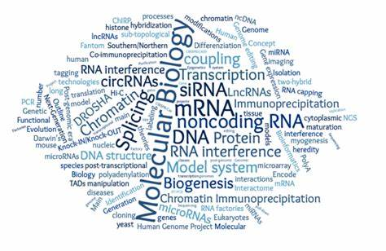
Principles of Molecular Biology
Mustansiriyah University
National Diabetes Center
Presented By
Assistant lecturer: Safaa Ehssan Atta

Slide 2
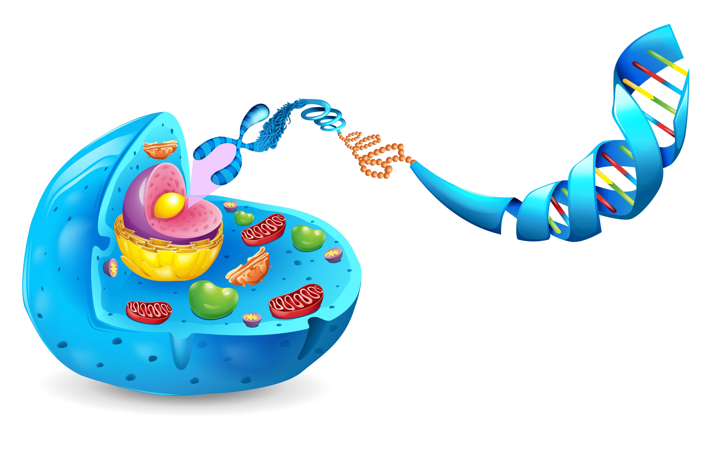
Introduction
Genetics: Genetics is the branch of biology that studies genes, heredity, and genetic variation in living organisms.
Molecular Biology: the branch of biology that deals with the formation, structure, and function of macromolecules essential to life, such as nucleic acids and proteins, and especially with their role in cell replication and the transmission of genetic information

Slide 3
Molecular biology of genes
Refers to the study of the molecular mechanisms that regulate gene function, expression, and inheritance.
It involves understanding how genetic information encoded in DNA is transcribed into RNA, which is then translated into proteins, and how these processes are regulated at a molecular level.

Slide 4
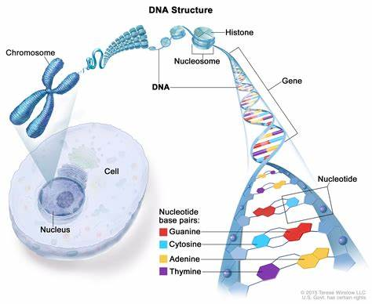

Slide 5
Gene: A gene is a specific segment of DNA that contains instructions for making a protein or performing a function in the body. Example: The gene for eye color.
Allele: An allele is a variant or version of a gene. A single gene can have multiple alleles. For example, the eye color gene can have different alleles, such as blue, brown, or green.
Locus (Loci): The locus is the specific physical location of a gene on a chromosome. Example: The gene for eye color is found at a specific locus on chromosome 15.

Slide 6
Nucleic Acids
Structure of Nucleic Acids:
- In most organisms, the hereditary material is DNA.
- DNA and RNA are polymeric molecules made up of linear chains of subunits called nucleotides.
Each nucleotide has three parts:
nitrogenous base
five-carbon-atom sugar (Ribose)
phosphate group
-The combination of base and sugar is termed a nucleoside, while the base-sugar-phosphate is called a nucleotide.

Slide 7
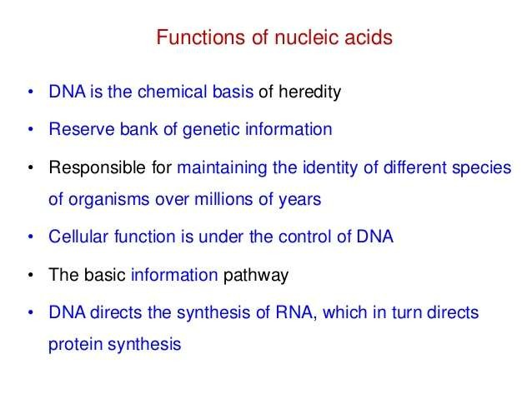

Slide 8
Nucleic Acids
Different types of nucleic acid are used to form organisms’ genomes, depending on the organism itself.
Viruses have a genome composed of either double-stranded DNA, single-stranded DNA, or RNA, depending on the virus type.
The chromosomes of most eukaryotes are composed of single linear double-stranded DNA molecules.
The genomes of prokaryotic organisms are generally composed of a circular DNA molecule.

Slide 9
The sequence of nitrogen bases (A, T, C, G) in DNA forms an organism’s traits.
The nitrogen bases A and T (or U in RNA) always go together, and C with G always go together
molecules (Molecular Basis of the Genetic Code).
The nucleotide bases can be either a double-ringed purine or a single-ringed pyrimidine.
Nucleic acids are made of nucleotides that join together through phosphodiester linkages between the 5' and 3' carbon atoms of the sugar.
The bonds between the sugar and the phosphate are called ester bonds. The bonds between the sugar and the nitrogenous base are called glycosidic bonds

Slide 10
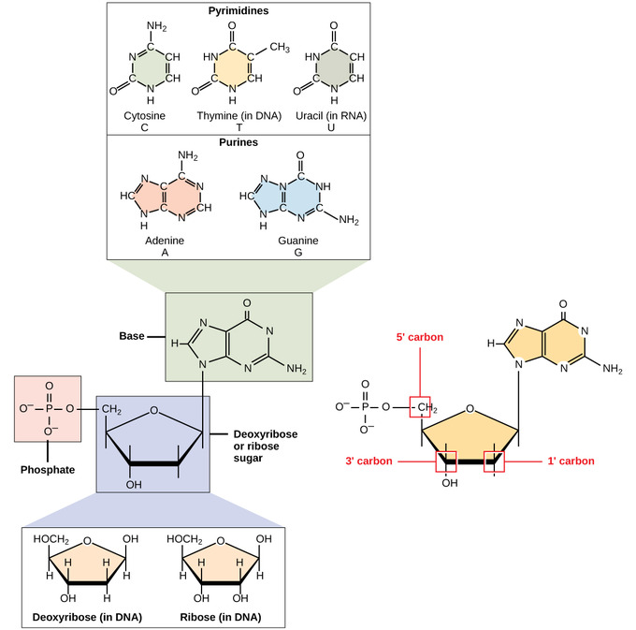

Slide 11
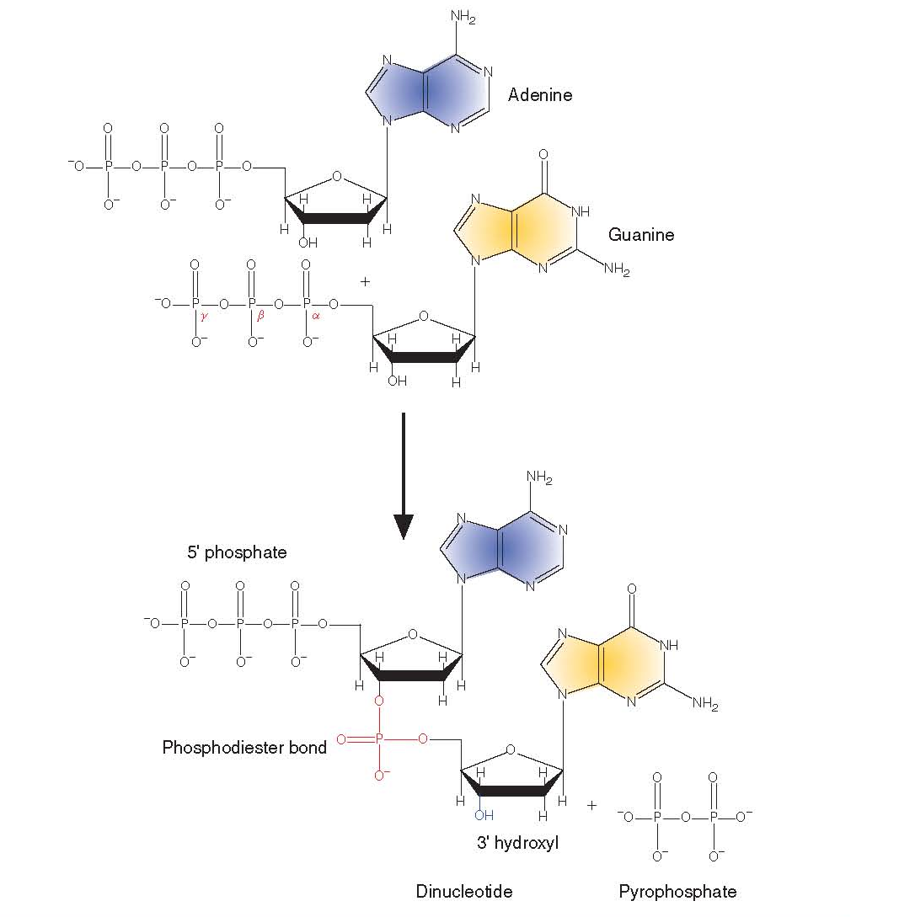
Two nucleotides connected to each other are called a dinucleotide, three are called a trinucleotide, and numerous nucleotides connected in a long chain are termed polynucleotides.

Slide 12
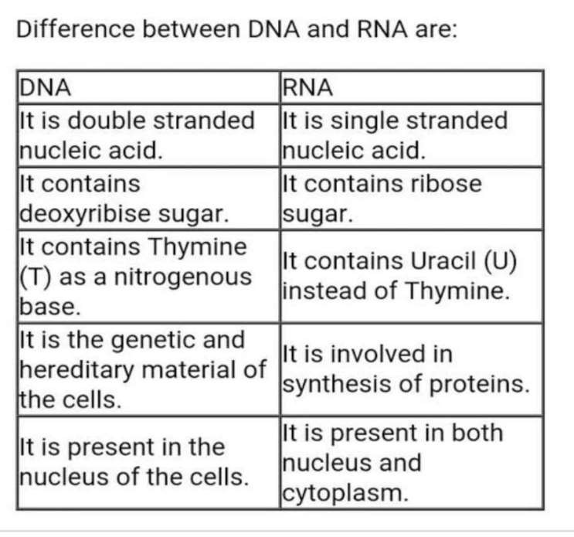

Slide 13
Hydrogen Bonding
The two strands of DNA are held together by hydrogen bonds.
The Base pairing of a purine (A or G) with a pyrimidine (T or C) within the helix is important for the integrity of the helix.
Base pairing (A to T and G to C) holds the two strands of the helix together.

Slide 14
The Antiparallel Helix
The antiparallel nature of the two polynucleotide chains is a key part of the double helix.
One chain of the helix runs in the 5ˉ to 3ˉ orientation, and the other chain runs in the 3ˉ to 5ˉ orientation.
A single DNA chain begins with a free phosphate group on the 5ˉ carbon of a deoxyribose ring.
While the chain terminates in a free hydroxyl group on the 3ˉ carbon atom of the last sugar.

Slide 15
Plasmids: A number of extra-chromosomal DNA molecules found in prokaryotic cells.
Plasmid DNA molecules are usually closed circles of either single-stranded or double-stranded DNA.
Inside a eukaryotic cell, DNA is associated with a vast array of proteins, many of which wrap DNA around themselves.
DNA is highly compacted and associated with a number of proteins that wrap DNA into nucleosomes.
a substantial amount of protein is associated with the DNA to form chromatin. Chromatin fibers are composed of linear arrays of spherical particles called nucleosomes (ν-bodies)

Slide 16
The proteins (histones) associated with DNA in chromatin are divided into basic, positively charged histones and less positively charged non-histones.
Histones contain large amounts of the positively charged amino acids lysine and arginine, making it possible for them to bind through electrostatic interactions to the negatively charged phosphate groups of the DNA nucleotides.
Non-histone proteins are involved in various essential processes such as DNA replication, transcription, repair, and chromatin remodeling.
A nucleosome core particle consists of two copies
Each of histones H2A, H2B, H3, and H4 forms a histone octamer around which ~150 base pairs of DNA are wrapped in a left-handed superhelix, which completes about 1.7 turns per nucleosome. Linker histone refers to a special type of histone protein, mainly histone H1, that helps organize and stabilize DNA in the cell nucleus.

Slide 17
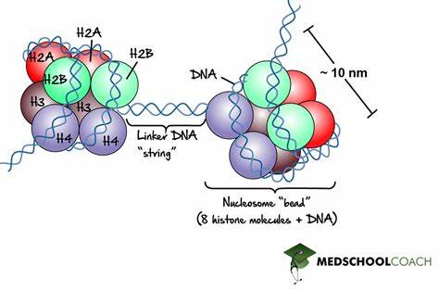

Slide 18
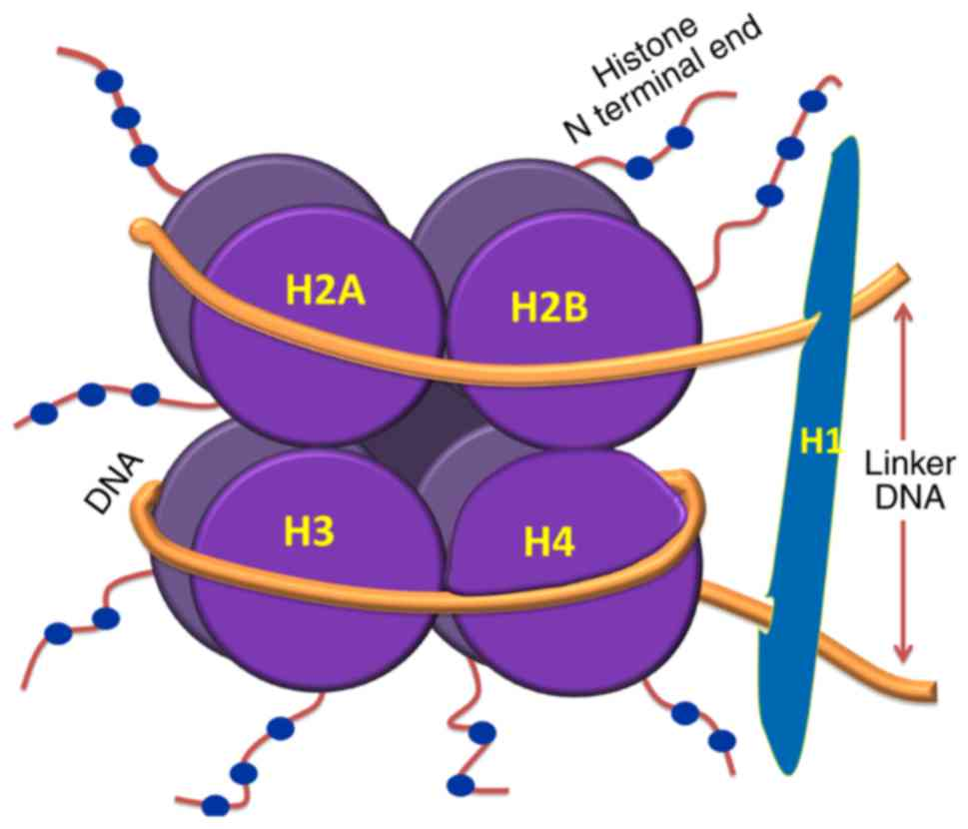

Slide 19
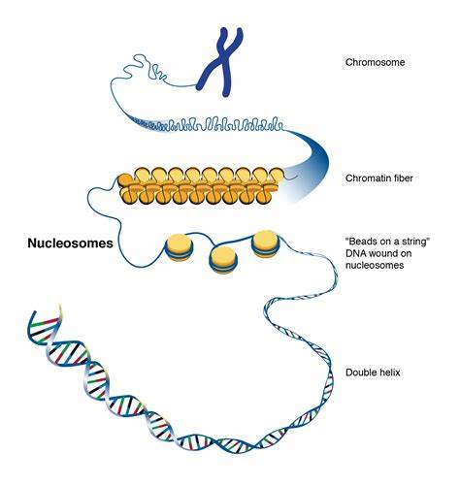

Slide 20
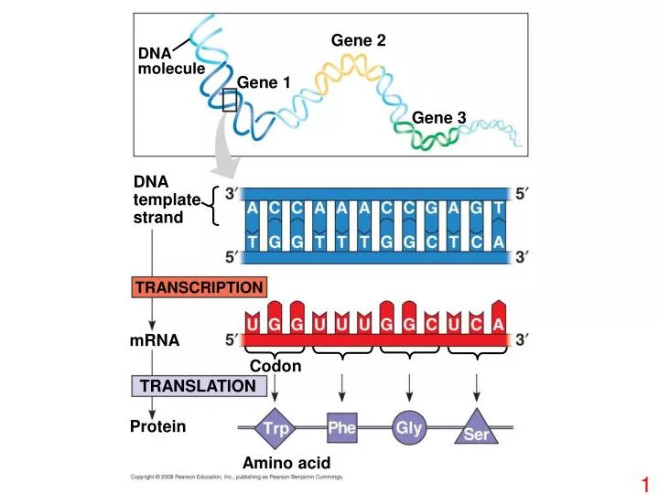

Slide 21
Genetic code
The genetic code is the set of rules used by living cells to translate information encoded within genetic material (DNA or RNA sequences of nucleotide triplets or codons) into proteins.

Slide 22
Genetic code
The following list summarizes the code’s main features:
1- The code consists of triplet codons
AAA TTT CTA GAC, each of which specifies an amino acid. The code shows the 5’-to-3’ sequence of the three nucleotides in each mRNA codon.

Slide 23
Genetic code
2- The codons are non-overlapping.
In the mRNA sequence 5’ GAA-GUU-GAA 3’, for example, the first three nucleotides (GAA) form one codon; nucleotides 4 through 6 (GUU) form the second, and nucleotides 7 through 9 (GAA), the third. Each nucleotide is part of only one codon.

Slide 24
Genetic code
3- The code includes three stops or nonsense codons.
These codons do not encode an amino acid and thus terminate translation (UAA, UAG, and UGA).
4- The code is degenerate.
This means that, in many cases, more than one codon specifies the same amino acid.

Slide 25
5- In reading the transcript of a gene, the cellular machinery scans a single strand of mRNA from a fixed starting point that establishes a reading frame. The nucleotide triplet AUG, which specifies the amino acid methionine, serves in certain contexts as the initiation codon.
6- Moving from the 5’ to the 3’ end of an mRNA.
-Each successive codon is sequentially interpreted into an amino acid
-Starting at the N terminus and moving toward the C terminus of the resulting polypeptide.
Genetic code

Slide 26
7-Mutations may modify the message encoded in a sequence of nucleotides in three ways. Frameshift mutations are nucleotide insertions of deletions that alter the genetic instructions for polypeptide construction by changing the reading frame. Missense mutations change a codon for one amino acid to a codon for a different amino acid, and nonsense mutations change a codon for an amino acid to a stop codon.

Slide 27
Codons
The main problem was that while there were only 4 nitrogen bases (nucleotides), those nucleotides had to code for 20 amino acids.
If adenine, thymine, guanine, and cytosine each coded for a particular amino acid, then the DNA/mRNA information system could only code for 4 amino acids.
If, however, groups of two nucleotides are coded for a single amino acid, the story is somewhat different. Given four nucleotides looked at in groups of two, there are sixteen possible combinations(4²=16) (AA, AT, AG, AC, TA, TT, TG, TC, GA, GT, GG, GC, CA, CT, CG, CC); that sixteen is still not enough to code for twenty amino acids.
But if the nucleotides code for amino acids in groups of three, then there are sixty-four possible combinations (4*4*4=64).

Slide 28
Degeneracy of the Genetic Code
The degeneracy of the genetic code refers to the fact that multiple codons (three nucleotide sequences of mRNA) can code for the same amino acid.
In other words, there are more codons (64 in total) than there are amino acids (20 in total), which allows for redundancy in the genetic code.
Examples of Degeneracy:
Alanine (Ala): Codons — GCU, GCC, GCA, GCG

Slide 29
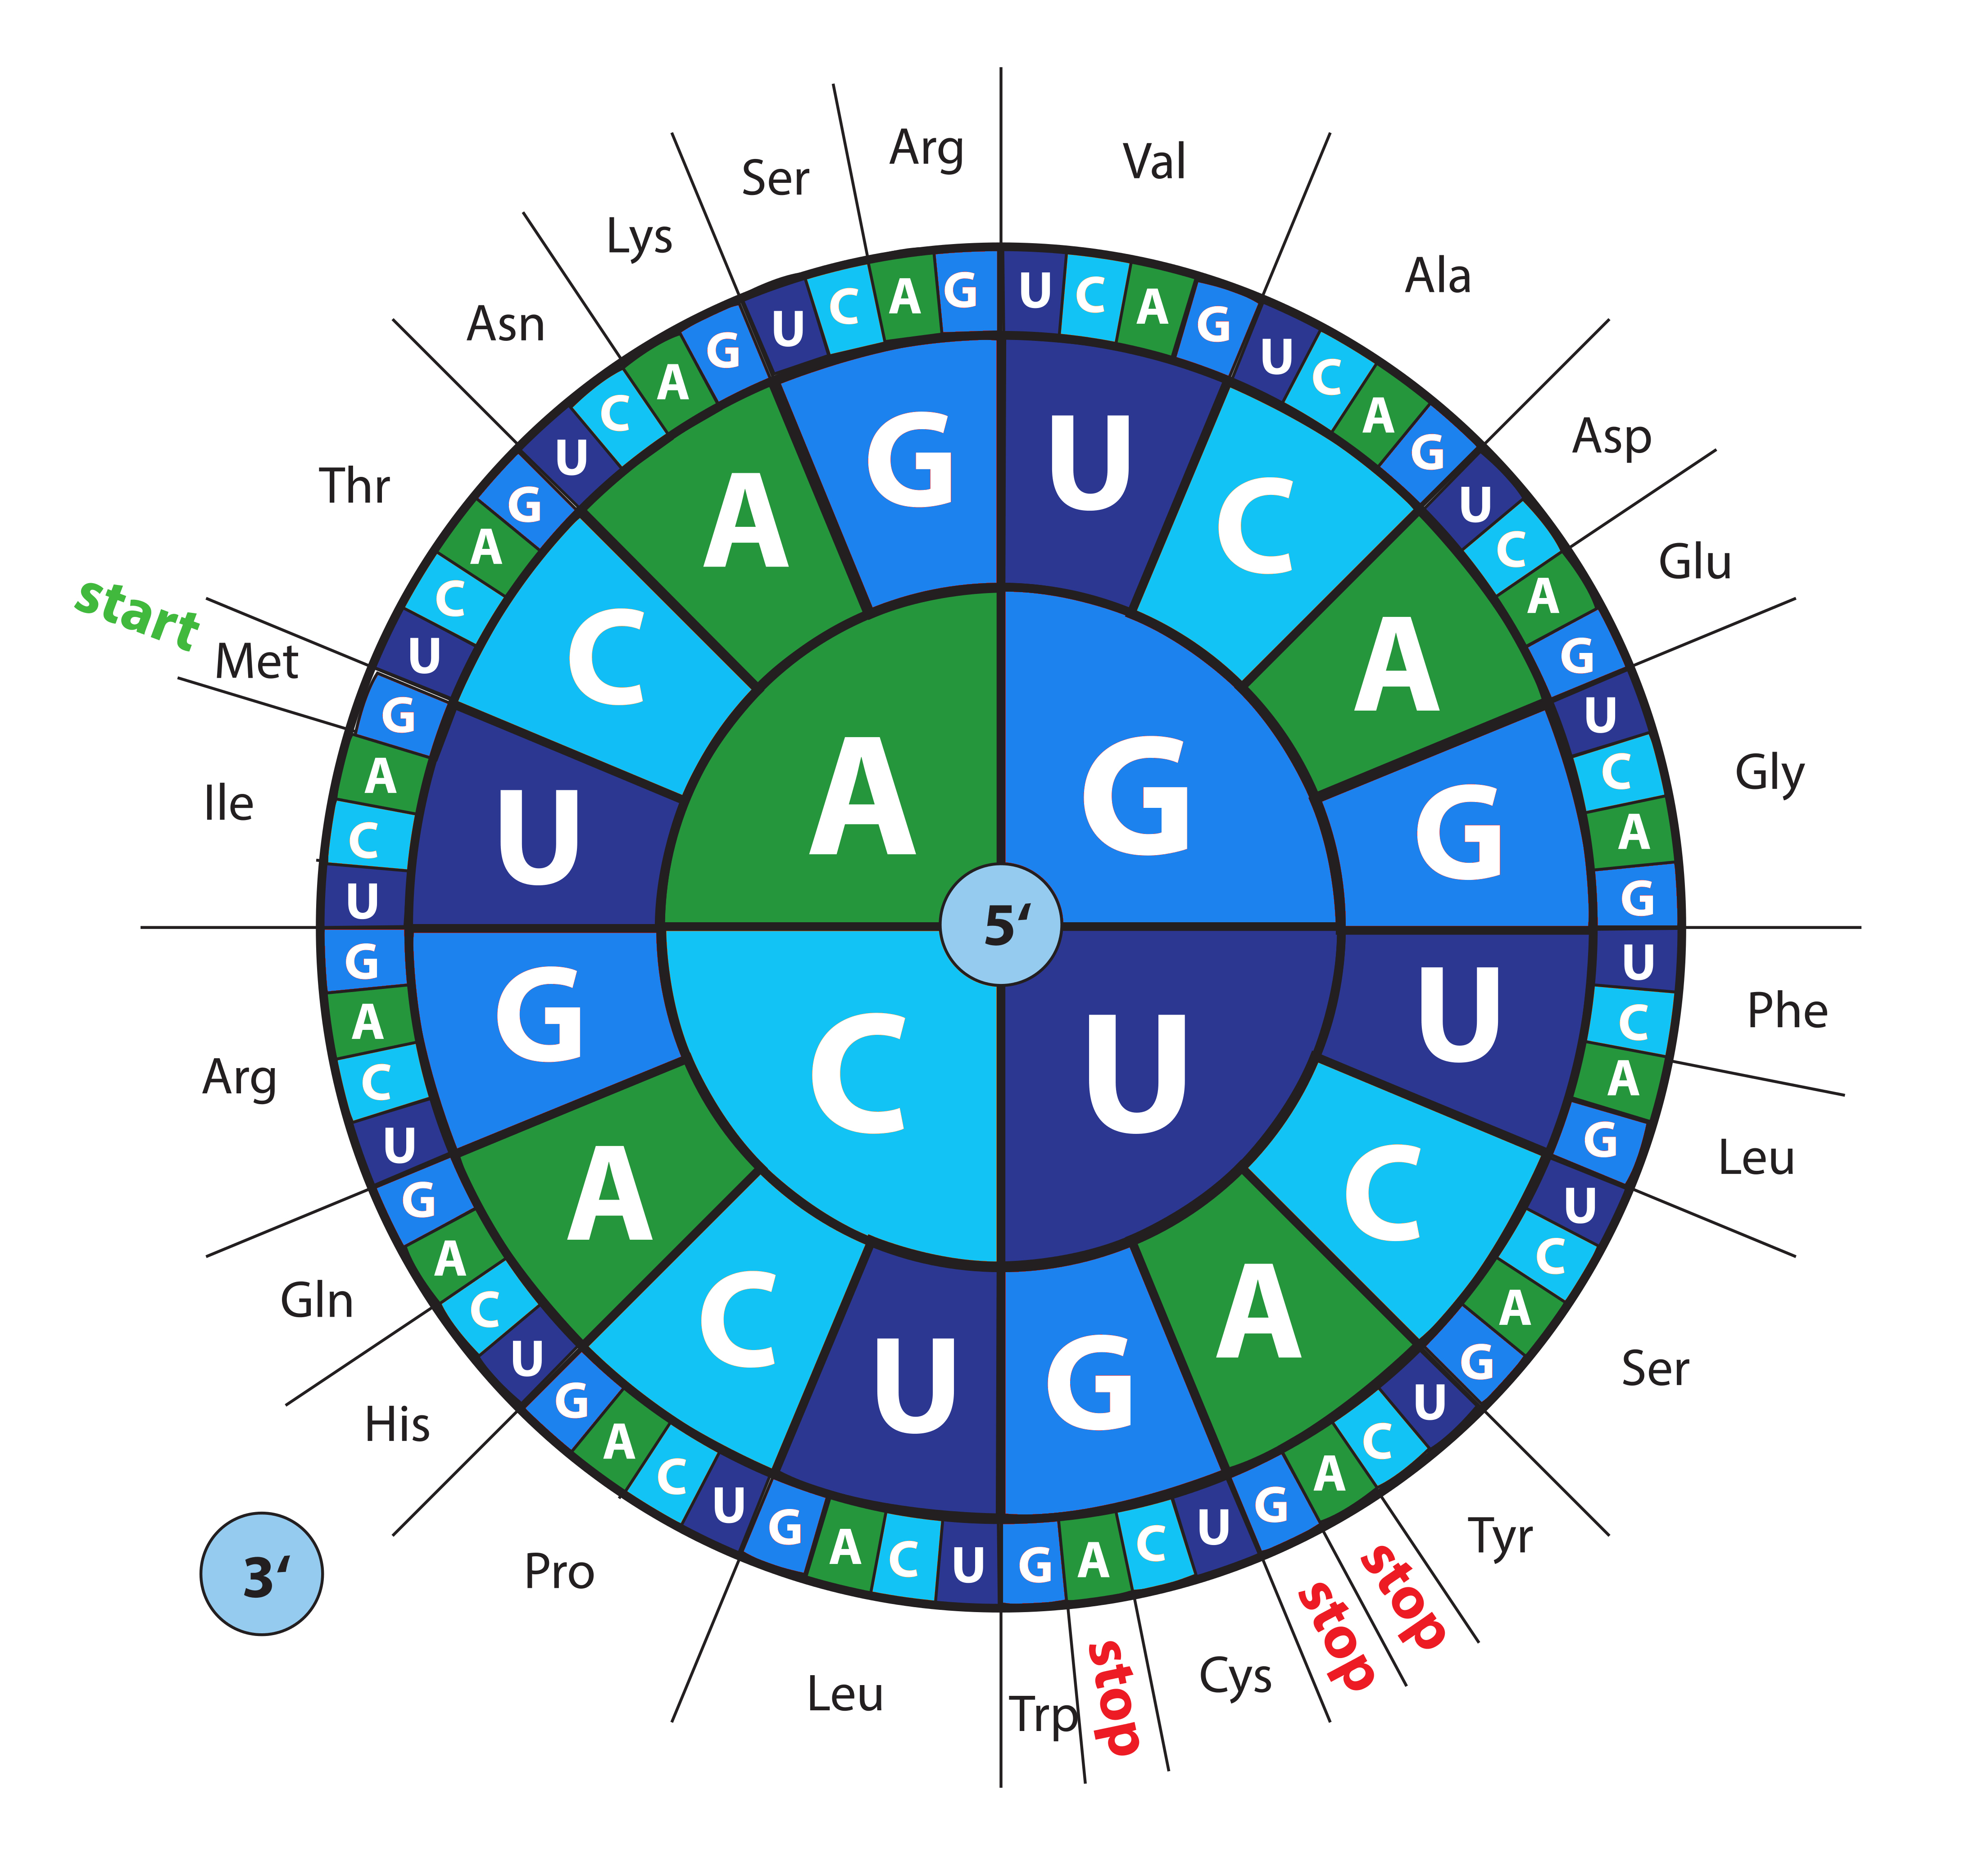

Slide 30
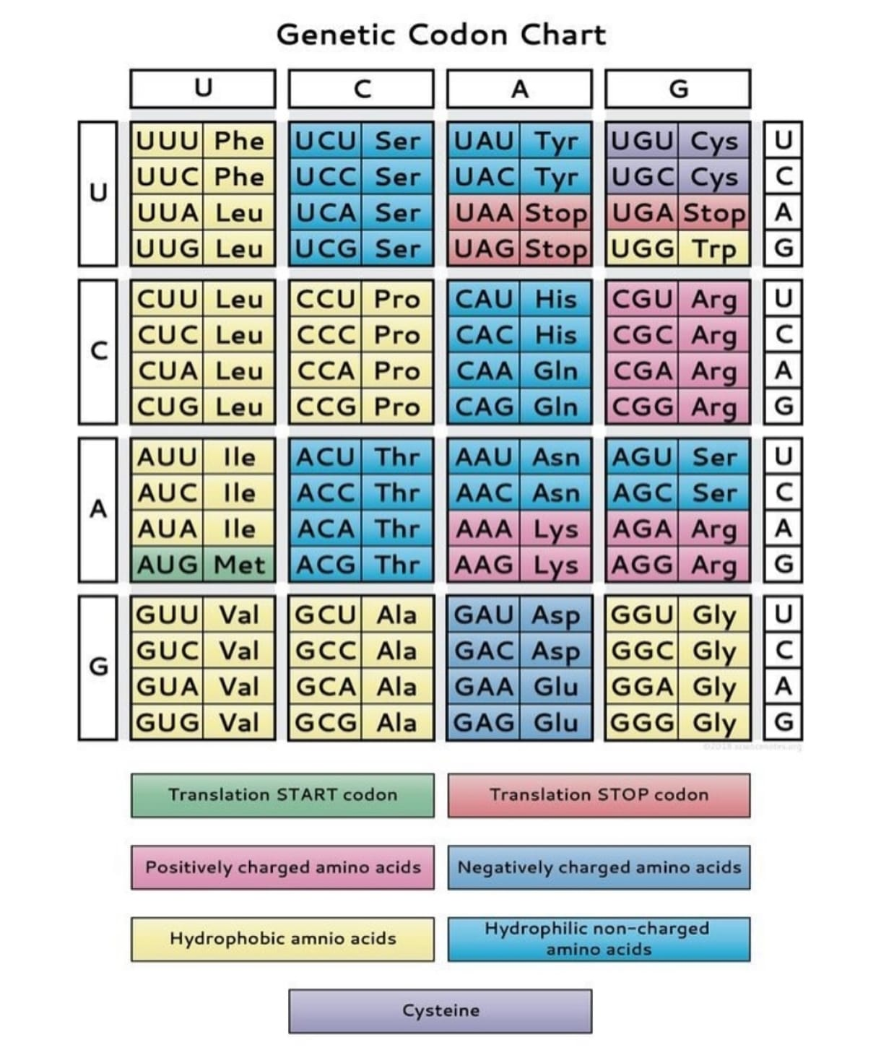

Slide 31
Determining Codon Length
In 1961, Francis Crick and coworkers gave the first evidence for a triplet code by way of experiments using the T4 bacteriophage.
They designed a clever experiment that included a special kind of mutation known as a frameshift mutation.
At first, Francis Crick and coworkers introduced a single frameshift mutation into the T4 bacteriophage gene coding for a protein involved in the infection of E. coli.
Bacterial infection was stopped because the frameshift shifted the protein to an inactive form.
After that, the researchers introduced additional frame-shift mutations in the hope that doing so would restore the correct reading frame (and, in turn, allow the protein to once again play a role in the infection of E. coli).

Slide 32
Marshall Nierenberg and Heinrich Matthaei designed an experiment to determine which three nucleotide sequences specify which amino acids.
They used a cell-free system to translate a poly-uracil RNA sequence (i.e., UUUUU...) and discovered that the polypeptide that they had synthesized consisted of only the amino acid phenylalanine.
They concluded that the codon UUU specified the amino acid phenylalanine.
This was followed by experiments in Severo Ochoa's laboratory that demonstrated that the poly-adenine RNA sequence (AAAAA...) coded for the polypeptide poly-lysine and that the poly-cytosine RNA sequence (CCCCC...) coded for the polypeptide poly-proline.

Slide 33
The genetic is not universal
Many slight variants have also been discovered since then, including various alternative mitochondrial codes and small variants such as the translation of the codon UGA as tryptophan in Mycoplasma species.
The translation of CUG as a serine rather than leucine in some members of the genus Candida.
In bacteria and archaea, GUG and UUG are common start codons. Thus, the standard genetic code is not universal.

Slide 34
Central Dogma of Molecular Biology
Fundamental principle in molecular biology based on extensive experimental evidence.
The flow of genetic information from DNA to RNA to protein.
Replication
Transcription
Translation

Slide 35
Gene
A gene is a molecular unit of heredity of a living organism.
A hereditary unit consisting of a sequence of DNA that takes a specific location on a chromosome and determines a particular characteristic in an organism.
corresponding to a unit of inheritance associated with regulatory regions, transcribed regions, and other functional sequence regions.
Gene expression is the process by which the information encoded in a gene (DNA) is used to synthesize a functional product, typically a protein or a functional RNA (such as rRNA, tRNA, or microRNA).

Slide 36
Principles of Molecular Biology
Mustansiriyah University
National Diabetes Center
Presented By
Assistant lecturer: Safaa Ehssan Atta

Slide 37
Others define a gene as "the complete sequence region necessary for generating a functional product."
This encompasses promoters and control regions necessary for the transcription, processing, and, if applicable, translation of a gene.
Hence, we include not only protein-coding genes (genes that encode polypeptides) but also non-coding RNA genes (ribosomal RNA, transfer RNA, microRNA, and small nuclear RNA genes).

Slide 38
Genes can be classified into two main types based on their final functional product:
1. RNA-coding genes: These produce functional RNA molecules, such as tRNA, rRNA, or regulatory RNAs (e.g., miRNA, snRNA), that are not translated into protein but play essential roles in gene regulation and protein synthesis.
2. Protein-coding genes: These are transcribed into mRNA, which is then translated into a functional protein, the final product responsible for carrying out most biological processes in the cell.

Slide 39
Gene Type | Description
Monocistronic | One gene → one protein (eukaryotes)
Polycistronic | One gene or a cluster of genes like an operon A single bacterial mRNA molecule may encode several proteins (prokaryotes)
Structural | Codes for functional proteins or RNAs
Housekeeping | Always active, maintain basic functions
Regulatory | Control gene expression (e.g., transcription factors)
Conserved open reading frame | Essential genes found in many organisms any sequence of bases (in DNA or RNA) that could, in theory, encode a protein.
Inducible | Only expressed in response to stimuli

Slide 40
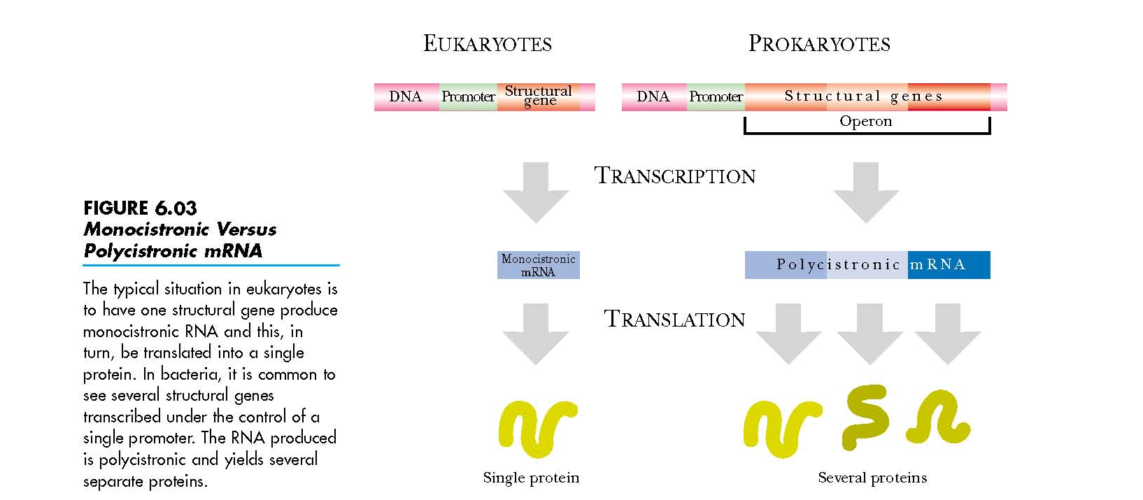

Slide 41
All genes have regulatory regions in addition to regions that code for a protein or RNA product.
A regulatory region shared by almost all genes is known as the promoter. It provides a position recognized by the transcription machinery when a gene is about to be transcribed and expressed. A gene can have more than one promoter.
Promoter regions have a consensus sequence that is the most common sequence at this position
Most regulatory regions are "upstream“ before or toward the 5' end of the transcription initiation site.

Slide 42
A promoter is a region of DNA that initiates transcription of a particular gene. Promoters are located near the genes they transcribe.
RNA polymerase is an essential enzyme that synthesizes RNA from a DNA template during the process of transcription. It reads the DNA strand in the 3′ to 5′ direction and builds a complementary RNA strand in the 5′ to 3′ direction by joining ribonucleotides (A, U, C, G).
RNA polymerase must attach to the DNA near a gene.
Promoters contain specific DNA sequences and response elements that provide a secure initial binding site for RNA polymerase and for proteins called transcription factors.
These transcription factors have specific activator or repressor sequences of corresponding nucleotides that attach to specific promoters and regulate gene expression.

Slide 43
Bacterial RNA polymerase consists of two major components, the core enzyme (itself made of four subunits) and the sigma subunit.
The core enzyme is responsible for RNA synthesis, whereas the sigma subunit is largely responsible for recognizing the promoter.
The sigma subunit recognizes two special sequences of bases in the promoter region of the coding (non-template) strand of the DNA.
These are known as the -10 sequence and the -35 sequence.
✅ Core Enzyme = α₂ββ′ω → Can elongate RNA but needs σ to start
✅ Holoenzyme = α₂ββ′ω + σ → Capable of initiating transcription

Slide 44
RNA Polymerase | Function | Transcribes
RNA Polymerase I | Synthesizes rRNA | Most ribosomal RNAs
RNA Polymerase II | Synthesizes mRNA | All protein-coding genes (mRNA), and some small nuclear RNAs (snRNAs)
RNA Polymerase III | Synthesizes tRNA and small RNAs | tRNA, 5S rRNA, and other small RNAs

Slide 45
Types of promoters
Proximal promoter - the proximal sequence upstream of the gene that tends to contain primary regulatory elements.
Distal promoter - the distal sequence upstream of the gene that may contain additional regulatory elements, often with a weaker influence than the proximal promoter.
Anything further upstream (but not an enhancer), Specific transcription factor binding sites.
The strength of a promoter depends partly on how closely it matches the ideal consensus sequence.

Slide 46
Prokaryotic promoters
In bacteria, the promoter contains two short sequence elements, approximately -10 and -35 nucleotides upstream from the transcription start site.
The sequence at -10 (the -10 element) has the consensus sequence TATAAT.
The sequence at -35 (the -35 element) has the consensus sequence TTGACA.

Slide 47
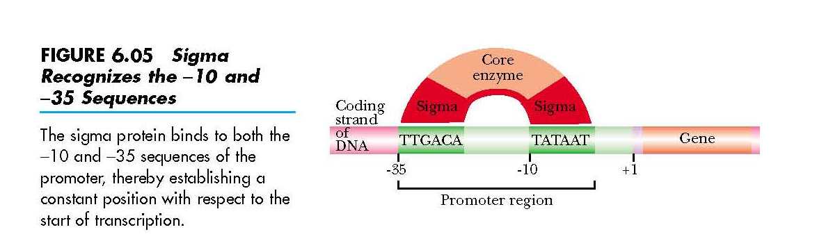

Slide 48
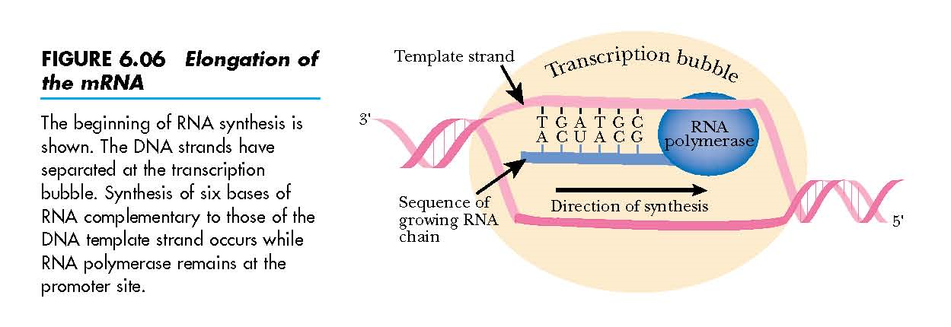

Slide 49
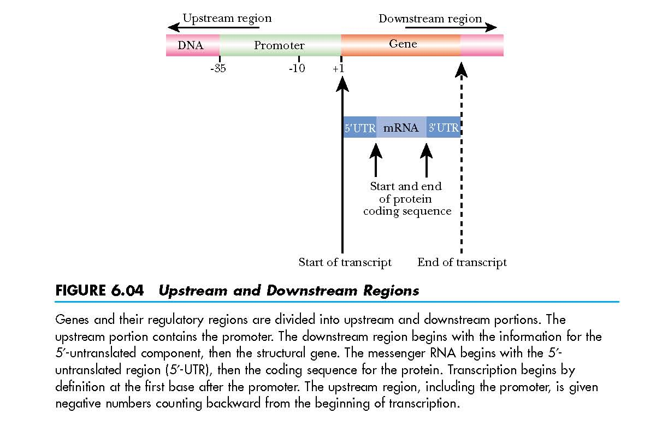

Slide 50
Eukaryotic promoters
They are typically located upstream of the gene and can have regulatory elements several kilobases away from the transcriptional start site.
Eukaryotic RNA-polymerase-II-dependent promoters can contain a TATA element (consensus sequence TATAAA), which is recognized by the general transcription factor TATA-binding protein (TBP), and a B recognition element (BRE), which is recognized by the general transcription factor TFIIB.
The TATA element and BRE are typically located close to the transcriptional start site (typically within 30 to 40 base pairs).

Slide 51
TATA box
The TATA box (also called the Goldberg-Hogness box) is a DNA sequence (cis-regulatory element) found in the promoter region of genes in archaea and eukaryotes. Approximately 24% of human genes contain a TATA box within the core promoter.
Considered to be the core promoter sequence, it is the binding site of either general transcription factors or histones.
It is involved in the process of transcription by RNA polymerase.

Slide 52
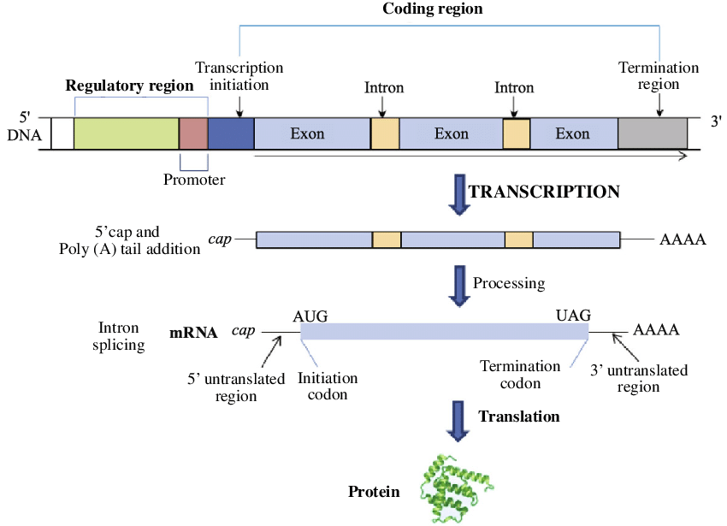

Slide 53
Cis-regulatory element
A cis-regulatory element or cis-element is a region of DNA or RNA that regulates the expression of genes located on that same molecule of DNA (often a chromosome) (binding sites for one or more trans-acting factors).
This term is constructed from the Latin word cis, which means "on the same side as".
A cis-element may be located upstream of the coding sequence of the gene (in the promoter region or in an intron or downstream of the gene's coding sequence.

Slide 54
Trans-regulatory elements
It means genes that may modify (or regulate) the expression of distant genes. More specifically, trans-regulatory elements are DNA sequences that encode transcription factors.
For example, a transcription factor that regulates a gene on chromosome 6 might itself have been transcribed from a gene on chromosome 11.
(Regulate genes distant from the gene from which they were transcribed).

Slide 55
Transcription factor
A transcription factor is a protein that binds to specific DNA sequences, thereby controlling the flow (or transcription) of genetic information from DNA to mRNA.
Transcription factors perform this function alone or with other proteins in a complex, by promoting (as an activator), or blocking (as a repressor).
A defining feature of transcription factors is that they contain one or more DNA-binding domains (DBDs), which attach to specific sequences of DNA adjacent to the genes that they regulate.
Additional proteins, such as coactivators, chromatin, histone, acetylases, deacetylases, kinases, and methylases, while also playing crucial roles in gene regulation, lack DNA-binding domains and, therefore, are not classified as transcription factors

Slide 56
Enhancer
It is a short region of DNA that can be bound with proteins (namely, the trans-acting factors) to enhance transcription levels of genes.
Enhancers are usually cis-acting,
Enhancer DNA sequences bind transcription factors called enhancer-binding proteins, which increase the rate of transcription. Enhancer sequences may be located thousands of base pairs away from the gene they influence.
Silencer DNA sequences are the opposite to enhancer sequences. They decrease or suppress the rate of transcription.
Insulator DNA sequences are located between enhancer and silencer sequences and, as their name suggests, they prevent a gene from being transcribed non-specifically by another gene's enhancer.

Slide 57
Operator
An operator is a segment of DNA to which a transcription factor protein binds. It is classically defined in the lac operon as a segment between the promoter and the genes of the operon.
Inducer
An inducer is a molecule that assists in starting gene expression. An inducer can bind to repressors or activators.
The gene is expressed because an inducer binds to the repressor.
The binding of the inducer to the repressor prevents the repressor from binding to the operator, and RNA polymerase can then begin to transcribe the operon genes.

Slide 58
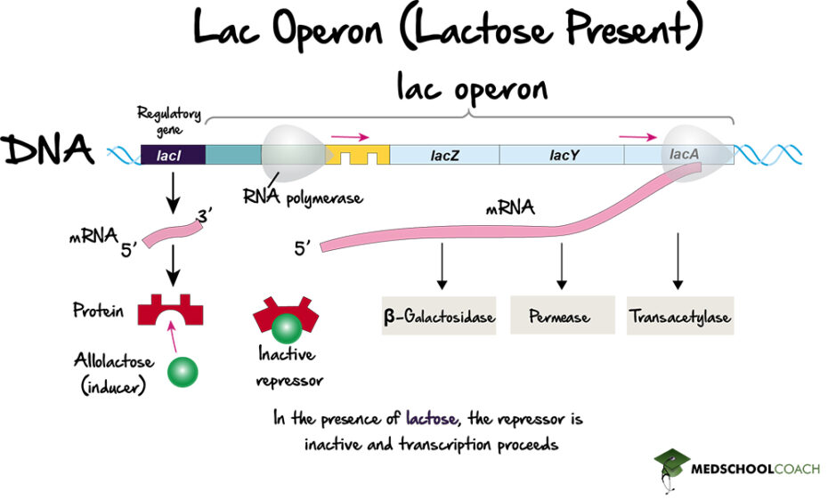

Slide 59
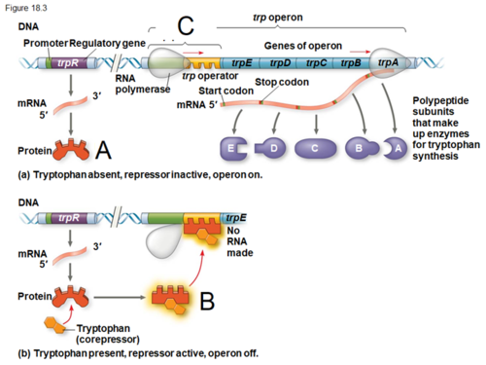

Slide 60
Exon
An exon is any nucleotide sequence encoded by a gene that remains present within the final mature RNA product of that gene after introns have been removed by RNA splicing.
In RNA splicing, introns are removed and exons are covalently joined to one another as part of generating the mature messenger RNA
The definition was originally made for protein-coding transcripts that are spliced before being translated.
In many genes, each of the exons contains part of the open reading frame (ORF) that codes for a specific portion of the complete protein.
However, the term exon is often misused to refer only to coding sequences for the final protein. This is incorrect, since many noncoding exons are known in human genes
Some of the exons will be wholly or part of the 5' untranslated region (5' UTR) or the 3' untranslated region (3' UTR) of each transcript. The untranslated regions are important for efficient translation of the transcript and for controlling the rate of translation and half-life of the transcript. Furthermore, transcripts made from the same gene may not have the same exon structure, since parts of the mRNA could be removed by the process of alternative splicing.

Slide 61
Intron
An intron is any nucleotide sequence within a gene that is removed by RNA splicing while the final mature RNA product of a gene is being generated.
The term "intervening sequence" can refer to any of several internal nucleic acid sequences that are not present in the final gene product, including untranslated sequences (UTR), and nucleotides removed by RNA editing, in addition to introns.
They can influence transcription speed or mRNA stability.
Introns are found in the genes of most organisms and many viruses and can be located in a wide range of genes, including those that generate proteins, ribosomal RNA (rRNA), and transfer RNA(tRNA).
Introns were first discovered in protein-coding genes of adenovirus and were subsequently identified in genes encoding transfer RNA and ribosomal RNA genes

Slide 62
Precursor mRNA
Precursor mRNA (pre-mRNA) is the initial transcript produced by RNA polymerase II during gene expression in eukaryotic cells.
It contains both coding regions (exons) and non-coding regions (introns) copied from the DNA template strand. Pre-mRNA is not yet ready for translation and must undergo several processing steps to become mature mRNA.
These include the addition of a 5′ cap, splicing to remove introns and join exons, and the addition of a poly-A tail at the 3′ end.
These modifications protect the mRNA from degradation, assist in its export from the nucleus, and ensure it can be efficiently translated into a protein in the cytoplasm.

Slide 63
Untranslated region
The 5′ UTR (untranslated region) and 3′ UTR are important non-coding sections of eukaryotic mRNA that play key roles in regulating gene expression.
The 5′ UTR is located at the beginning of the mRNA, upstream of the start codon (AUG), and is not translated into protein.
It contains regulatory elements that help control the initiation of translation by guiding ribosome binding and can influence how efficiently a protein is produced.
On the other end, the 3′ UTR lies downstream of the stop codon and also remains untranslated.
It contains sequences that affect mRNA stability, cellular localization, and interactions with microRNAs (miRNAs), which can suppress or regulate gene expression.
Although neither region codes for protein, both the 5′ and 3′ UTRs are essential for post-transcriptional control of gene expression and overall mRNA function.

Slide 64
Terminator: Terminator is a specific DNA sequence that signals the end of transcription. When RNA polymerase reaches the terminator, it stops transcription and releases the newly synthesized RNA molecule.
5' cap: The 5' cap is a modified guanine nucleotide added to the 5' end of the mRNA molecule. It consists of a methylated guanine nucleotide linked to the mRNA via a 5'-5' triphosphate bond. The 5' cap protects the mRNA from degradation, enhances mRNA stability, and is involved in the initiation of translation. It also helps in the splicing of introns from pre-mRNA during mRNA processing.
Poly(A) tail: The poly(A) tail is a sequence of adenine nucleotides added to the 3' end of the mRNA molecule after transcription. It helps protect the mRNA from degradation by exonucleases, increasing the mRNA's stability. The poly(A) tail also plays a role in mRNA export from the nucleus to the cytoplasm and in the initiation of translation.

Slide 65
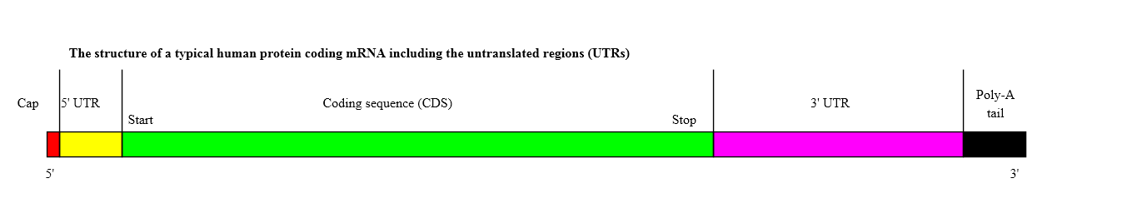

Slide 66
Messenger RNA (mRNA) is a type of RNA molecule that carries genetic information from the DNA in the cell nucleus to the ribosomes in the cytoplasm.
Ribosomal RNA (rRNA): rRNA is a component of ribosomes, the cellular machinery responsible for protein synthesis. It helps in the binding of mRNA and tRNA during translation.
Transfer RNA (tRNA): tRNA is responsible for bringing amino acids to the ribosome during protein synthesis.

Slide 67
MicroRNA (miRNA): miRNAs are small non-coding RNA molecules that regulate gene expression by binding to mRNA and either degrading it or inhibiting its translation. They play important roles in various cellular processes, including development, differentiation, and apoptosis.
Small nuclear RNA (snRNA): SnRNAs are involved in the splicing of pre-mRNA molecules during the process of mRNA maturation. They are components of the spliceosome, a complex that removes introns from pre-mRNA molecules to produce mature mRNA.
Genes encoding these types of RNA are transcribed from DNA by RNA polymerase. The resulting RNA molecules then undergo further processing to become functional in the cell.

Slide 68


