Slide 1
Short Answers
Maribel Moreno
CEIP SALVADOR DALÍ (Villalbilla)

Slide 2
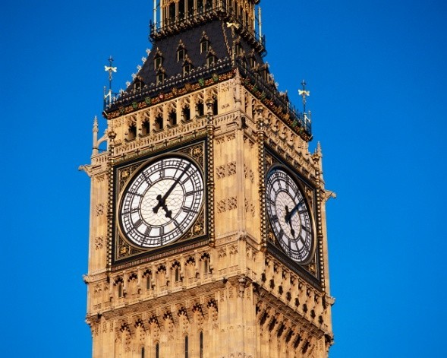
When we want to answer a question using a short answer we have to say “Yes” or “no” followed by the subject (I, you…) and the auxiliary verb you find a the beginning of the question
Ex. Do you like dancing?
Yes, I do No, I don’t

Slide 3
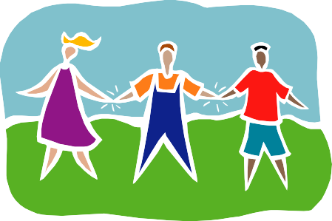
Short answers with the Verb To Be
•
•
•
•
•
•
Are you a student? Yes, I am / No, I’m not Is he my friend? Yes, he is / No, he isn’t
Is your mother here? Yes, she is / No, she isn’t Are we in the kitchen? Yes, we are / No, we aren’t Are they studying? Yes, they are / No, they aren’t
Are Mary and John here? Yes, they are, No, they aren’t

Slide 4
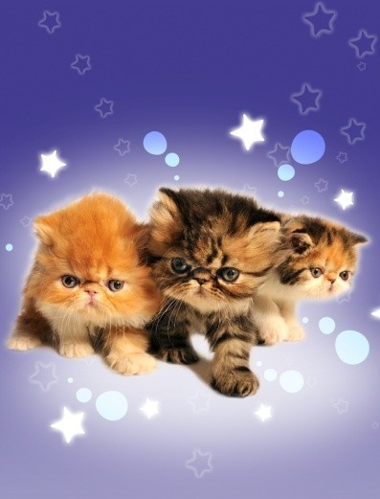
Short answers with “have got”
Have you got a cat? Yes, I have / No, I haven´t
Has he got a pencil? Yes, he has / No, he hasn’t
Have the boys got a ball? Yes, they have
No, they haven’t

Slide 5
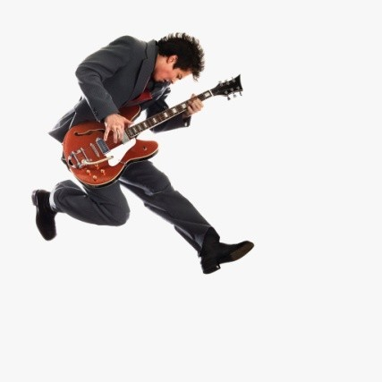
Short answers with Can
Can you open the window? Yes, I can
No, I can’t
Can she dance? Yes, she can / No, she can’t
Can they jump? Yes, they can / No, they can’t
Can Alex play the guitar? Yes, he can
No, he can’t

Slide 6
Short answers with auxiliary do /does
Do you like reading? Yes, I do / No, I don’t
Does he have breakfast everyday? Yes, he does
No, he doesn’t
Does Jenny drink milk? Yes, she does
No, she doesn’t
Do they go to school? Yes, they do
No, they don’t

Slide 7
Short answers with “Is there”
“are there”
Is there a book on the table? Yes, there is
No, there isn’t
Are there two apples on the plate?
Yes, there are No, there aren’t

Slide 8
Answer the following questions using a short answer:
Do you like dancing?
Does your father go to bed at 9:00 o’clock?
Can you ride a bike?
Can you speak Italian?
Is there a cat in the classroom?
Have you got a computer?
Are there 28 students in this classroom?
Is your uncle a policeman?
Are your teachers from France?
Has your sister got a cat?

Slide 9
Write a question for the following answers:
1.
2.
3.
4.
5.
6.
? Yes, I do
? No, I can’t
? No, there isn’t
? Yes, we have
? No, I’m not
? Yes, she is

