Slide 1
Management of HF with Depressed Ejection Fraction (<40%)
General Measures
Clinicians should aim to screen for and treat comorbidities such as hypertension, CAD, diabetes mellitus, anemia, and sleep-disordered breathing, as these conditions tend to exacerbate HF.
HF patients should be advised to stop smoking and to limit alcohol consumption to two standard drinks per day in men or one per day in women.
  Patients suspected of having an alcohol-induced cardiomyopathy should be urged to abstain from alcohol consumption indefinitely.
Extremes of temperature and heavy physical exertion should be avoided.
Certain drugs are known to make HF worse and should be avoided .For example, nonsteroidal anti-inflammatory drugs, including cyclooxygenase 2 inhibitors, are not recommended in patients with chronic HF because the risk of renal failure and fluid retention is markedly increased in the presence of reduced renal function or ACE inhibitor therapy.
Patients should receive immunization with influenza and pneumococcal vaccines to prevent respiratory infections.
It is equally important to educate the patient and family about HF, the importance of proper diet, and the importance of compliance with the medical regimen.

Slide 2
Diuretics
Many of the clinical manifestations of moderate to severe HF result from excessive salt and water retention that leads to volume expansion and congestive symptoms.
Diuretics are the only pharmacologic agents that can adequately control fluid retention in advanced HF, and they should be used to restore and maintain normal volume status in patients with congestive symptoms (dyspnea, orthopnea, edema) or signs of elevated filling pressures (rales, jugular venous distention, peripheral edema).
Furosemide, torsemide, and bumetanide act at the loop of Henle (loop diuretics) by reversibly inhibiting the reabsorption of Na⁺, K⁺, and Cl– in the thick ascending limb of Henle's loop;
thiazides and metolazone reduce the reabsorption of Na⁺ and Cl– in the first half of the distal convoluted tubule;
and potassium-sparing diuretics such as spironolactone act at the level of the collecting duct.

Slide 3
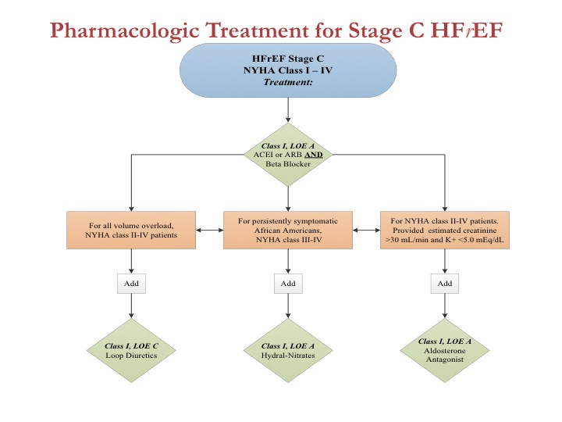

Slide 5
Preventing Disease Progression
Drugs that interfere with excessive activation of the RAA system and the adrenergic nervous system can relieve the symptoms of HF with a depressed EF by stabilizing and/or reversing cardiac remodeling.
In this regard, ACE inhibitors and beta blockers have emerged as the cornerstones of modern therapy for HF with a depressed EF.

Slide 6
ACE Inhibitors
There is overwhelming evidence that ACE inhibitors should be used in symptomatic and asymptomatic patients with a depressed EF (<40%).
ACE inhibitors interfere with the renin-angiotensin system by inhibiting the enzyme that is responsible for the conversion of angiotensin I to angiotensin II.
ACE inhibitors stabilize LV remodeling, improve symptoms, reduce hospitalization, and prolong life.
Because fluid retention can attenuate the effects of ACE inhibitors, it is preferable to optimize the dose of diuretic before starting the ACE inhibitor.
ACE inhibitors should be initiated in low doses, followed by gradual increments if the lower doses have been well tolerated.
Higher doses are more effective than lower doses in preventing hospitalization.

Slide 7
Angiotensin Receptor Blockers
These drugs are well tolerated in patients who are intolerant of ACE inhibitors because of cough, skin rash, and angioedema.
ARBs should be used in symptomatic and asymptomatic patients with an EF <40% who are ACE-intolerant for reasons other than hyperkalemia or renal insufficiency .
Although ACE inhibitors and ARBs inhibit the renin-angiotensin system, they do so by different mechanisms. Whereas ACE inhibitors block the enzyme responsible for converting angiotensin I to angiotensin II, ARBs block the effects of angiotensin II on the angiotensin type 1 receptor.
When given in concert with beta blockers, ARBs reverse the process of LV remodeling, improve patient symptoms, prevent hospitalization, and prolong life.

Slide 8
B-Adrenergic Receptor Blockers
Beta-blocker therapy represents a major advance in the treatment of patients with a depressed EF.
These drugs interfere with the harmful effects of sustained activation of the adrenergic nervous system by competitively antagonizing one or more adrenergic receptors (a₁, B₁, and B₂).
When given in concert with ACE inhibitors, beta blockers reverse the process of LV remodeling, improve patient symptoms, prevent hospitalization, and prolong life.
Therefore, beta blockers are indicated for patients with symptomatic or asymptomatic HF and a depressed EF <40%.

Slide 9
Analogous to the use of ACE inhibitors, beta blockers should be initiated in low doses , followed by gradual increments in the dose if lower doses have been well tolerated.
However, unlike ACE inhibitors, which may be titrated upward relatively rapidly, the titration of beta blockers should proceed no more rapidly than at 2-week intervals, because the initiation and/or increased dosing of these agents may lead to worsening fluid retention consequent to the withdrawal of adrenergic support to the heart and the circulation.

Slide 10
Aldosterone Antagonists
Although classified as potassium-sparing diuretics, drugs that block the effects of aldosterone (spironolactone or eplerenone) have beneficial effects that are independent of the effects of these agents on sodium balance.
Accordingly, the administration of an aldosterone antagonist is recommended for patients with NYHA class II-IV HF who have a depressed EF (<35%) and are receiving standard therapy, including diuretics, ACE inhibitors, and beta blockers.

Slide 11
Angiotensin receptor neprilysin inhibitor (ARNI)
Sacubitril/valsartan is recommended as a replacement for an ACEI to further reduce the risk of HF hospitalization& death in ambulatory patients with HFrEF who remain symptomatic despite optimal treatment with ACEI, BB and aldosterone antagonism

Slide 12
Cardiac glycosides
Digoxin is a cardiac glycoside that is indicated in:
Patients in atrial fibrillation with heart failure.
It is used as add-on therapy in symptomatic heart failure patients (in sinus rhythm) already receiving ACEI and beta-blockers as it is demonstrated that digoxin result in reduction of hospital admissions in those patients .

Slide 13
Vasodilators and nitrates
The combination of hydralazine and nitrates reduces afterload and pre-load and is used in patients intolerant of ACEI or ARB.
this combination improved survival in patients with chronic heart failure.

Slide 14
Inotropic and vasopressor agents
Intravenous inotropes and vasopressor agents are used in patients with chronic heart failure who are not responding to oral medication.
Although they produce haemodynamic improvements they have not been shown to improve long-term mortality when compared with placebo.

Slide 15
Anticoagulation and Antiplatelet Therapy
Treatment with warfarin [goal international normalized ratio (INR) 2–3] is recommended for patients with:
HF and chronic or paroxysmal atrial fibrillation
or with a history of systemic or pulmonary emboli, including stroke or transient ischemic attack.
Patients with recent MI & documented LV thrombus
  should be treated with warfarin (goal INR 2–3) for the initial 3 months after the MI unless there are contraindications to its use.

Slide 16
Aspirin is recommended in HF patients with ischemic heart disease for the prevention of MI and death.
However, lower doses of aspirin (100mg) may be preferable because of the concern of worsening of HF at higher doses.

Slide 17
Management of Cardiac Arrhythmias
Atrial fibrillation occurs in 15–30% of patients with HF and is a common cause of cardiac decompensation.
Most antiarrhythmic agents, with the exception of amiodarone and dofetilide, have negative inotropic effects and are proarrhythmic.
Amiodarone is a class III antiarrhythmic that has few or no negative inotropic and/or proarrhythmic effects and is effective against most supraventricular arrhythmias.
Amiodarone is the preferred drug for restoring and maintaining sinus rhythm, and it may improve the success of electrical cardioversion in patients with HF.
Amiodarone increases the level of phenytoin and digoxin and prolongs the INR in patients taking warfarin.
  Therefore, it is often necessary to reduce the dose of these drugs by as much as 50% when initiating therapy with amiodarone.
The risk of adverse events such as hyperthyroidism, hypothyroidism, pulmonary fibrosis, and hepatitis is relatively low, particularly when lower doses of amiodarone are used (100–200 mg/d).

Slide 18
Implantable cardiac defibrillators (ICDs) are highly effective in treating recurrences of sustained ventricular tachycardia and/or ventricular fibrillation in HF patients with recurrent arrhythmias and/or cardiac syncope, and they may be used as stand-alone therapy or in combination with amiodarone and/or a beta blocker .
There is no role for treating ventricular arrhythmias with an antiarrhythmic agent without an ICD.

Slide 19
Non-pharmacological treatment of heart failure
Revascularization
Coronary artery bypass surgery or percutaneous coronary intervention may improve function in areas of the myocardium that are ‘hibernating’ because of inadequate blood supply,

Slide 20
Cardiac Resynchronization
Approximately one-third of patients with a depressed EF and symptomatic HF (NYHA class III–IV) manifest a QRS duration >120 ms. (Bundle Branch Block, BBB)
This ECG finding of abnormal inter- or intraventricular conduction has been used to identify patients with dyssynchronous ventricular contraction.
The mechanical consequences of ventricular dyssynchrony include suboptimal ventricular filling, a reduction in LV contractility, prolonged duration (and therefore greater severity) of mitral regurgitation, and paradoxical septal wall motion.
Biventricular pacing, also termed cardiac resynchronization therapy (CRT), stimulates both ventricles nearly simultaneously, thereby improving the coordination of ventricular contraction and reducing the severity of mitral regurgitation.
When CRT is added to optimal medical therapy in patients in sinus rhythm, there is a significant decrease in patient mortality rates and hospitalization and a reversal of LV remodeling, as well as improved quality of life and exercise capacity.
Accordingly, CRT is recommended for patients in sinus rhythm with an
  EF <35%
  a QRS >150 ms (with LBBB configuration)
  those who remain symptomatic (NYHA II–IV) despite optimal medical therapy.

Slide 21
Implantable Cardiac Defibrillators
The prophylactic implantation of ICDs in patients with mild to moderate HF (NYHA class II–III) has been shown to reduce the incidence of sudden cardiac death in patients with ischemic or nonischemic cardiomyopathy.
Accordingly, implantation of an ICD should be considered for patients in NYHA class II–III HF with a depressed EF of <35% who are already on optimal background therapy, including an ACE inhibitor (or ARB), a beta blocker, and an aldosterone antagonist.

Slide 22
Cardiac transplantation
Cardiac transplantation has become the treatment of choice for younger patients with severe intractable heart failure, whose life-expectancy is less than 6 months.
With careful recipient selection, the expected 1-year survival for patients following transplantation is over 90%, and is 75% at 5 years.
Irrespective of survival, quality of life is dramatically improved for the majority of patients.
The availability of heart transplantation is limited.

Slide 23
Ventricular assist devices
Because of the limited supply of donor organs, ventricular assist devices (VADs) have been employed as:
a bridge to cardiac transplantation
potential long-term ‘destination’ therapy
short-term restoration therapy following a potentially reversible insult such as viral myocarditis.

Slide 24
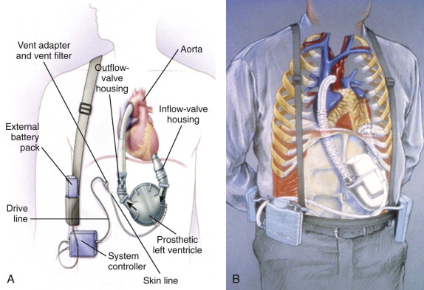

Slide 25
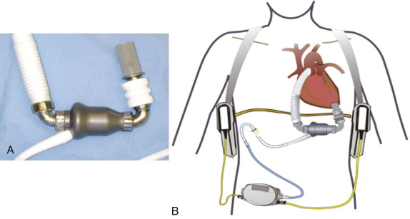

Slide 26
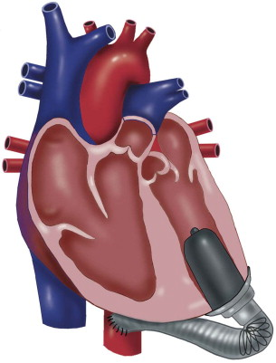

Slide 28
Management of HF with a Preserved Ejection Fractionm(>50%)
Despite the wealth of information with respect to the evaluation and management of HF with a depressed EF, there are no proven and/or approved pharmacologic or device therapies for the management of patients with HF and a preserved EF.
Therefore, it is recommended that :
  Control systolic and diastolic hypertension
  Control ventricular rate in patients with atrial fibrillation
  Diuretics to control pulmonary congestion and peripheral edema

