Slide 1
Management of HT
BY
Dr.Arshad Fuad
بورد عراقي (دكتوراه) في الطب الباطني
بورد عربي (دكتوراه) في الطب الباطني
بورد عراقي (دكتوراه) تخصص دقيق في أمراض وقسطرة القلب والشرايين
MBChB, FIBMS (Medicine), CABM (Medicine), FIBMS(Cardiology)

Slide 2
Treatment
Overview
Goals of therapy
Lifestyle modification
Pharmacologic treatment
  Algorithm for treatment of hypertension

Slide 3
"The Goal is to Get to Goal!”
Hypertension | -PLUS- Diabetes or Renal Disease
< 140/90 mmHg | < 130/80 mmHg
Measurements and goals should be provided to the patient verbally and in writing at each office visit

Slide 4
Lifestyle Interventions
Implementation of lifestyles that favorably affect blood pressure has implications for both the prevention and the treatment of hypertension.
Health-promoting lifestyle modifications are recommended for individuals with prehypertension and as an adjunct to drug therapy in hypertensive individuals.

Slide 6
Lifestyle Modification
Modification | Approximate SBP reduction (range)
Weight reduction | 5–20 mmHg/10 kg weight loss
Adopt DASH eating plan | 8–14 mmHg
Dietary sodium reduction | 2–8 mmHg
Physical activity | 4–9 mmHg
Moderation of alcohol consumption | 2–4 mmHg

Slide 7
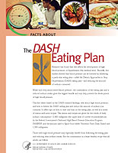
Dietary
Approaches to
Stop
Hypertension
Lowers systolic BP
  in normotensive patients by an average of 3.5 mm Hg
  In hypertensive patients by 11.4 mm Hg
Copies available from NHLBI website
http://www.nhlbi.nih.gov/health/public/heart/hbp/dash/

Slide 8
DASH Eating Plan
Low in saturated fat, cholesterol, and total fat
Emphasizes fruits, vegetables, and low fat diary products
Reduced red meat, sweets, and sugar containing beverages
Rich in magnesium, potassium, calcium, protein, and fiber
3 -1.5 g sodium per day
Can reduce BP in 2 weeks
Sacks FM. NEJM. 2001; 344:3-10.

Slide 9
Sample Menu
Breakfast
  1 whole-wheat bagel
  2 tablespoons peanut butter
  1 medium orange
  1 cup fat-free milk
  Decaffeinated coffee
Lunch
  Spinach salad made with 4 cups of fresh spinach leaves, 1 sliced pear, 1/2 cup mandarin orange sections, 1/3 cup unsalted peanuts and 2 tablespoons reduced-fat red wine vinaigrette
  12 reduced-sodium wheat crackers
  1 cup fat-free milk
Dinner
  Herb crusted baked cod
  1 cup bulgur
  1/2 cup fresh green beans, steamed
  1 sourdough roll with 1 teaspoon trans-free margarine
  1 cup fresh berries with chopped mint
  Herbal iced tea

Slide 10
Algorithm for Treatment of Hypertension
Lifestyle Modifications
Not at Goal Blood Pressure (<140/90 mmHg)
(<130/80 mmHg for those with diabetes or chronic kidney disease)
Initial Drug Choices
Without Compelling
Indications
With Compelling
Indications
Stage 1 Hypertension
(SBP 140–159 or DBP 90–99 mmHg)
Thiazide-type diuretics, ACEI, ARB, BB, CCB,
Stage 2 Hypertension
(SBP >160 or DBP >100 mmHg)
2-drug combination for most ( thiazide-type diuretic,
ACEI, or ARB, or BB, or CCB)
Drug(s) for the compelling indications
Other antihypertensive drugs (diuretics, ACEI, ARB, BB, CCB)
as needed.
Not at Goal
Blood Pressure
Optimize dosages or add additional drugs
until goal blood pressure is achieved.
Consider consultation with hypertension specialist.

Slide 12
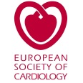

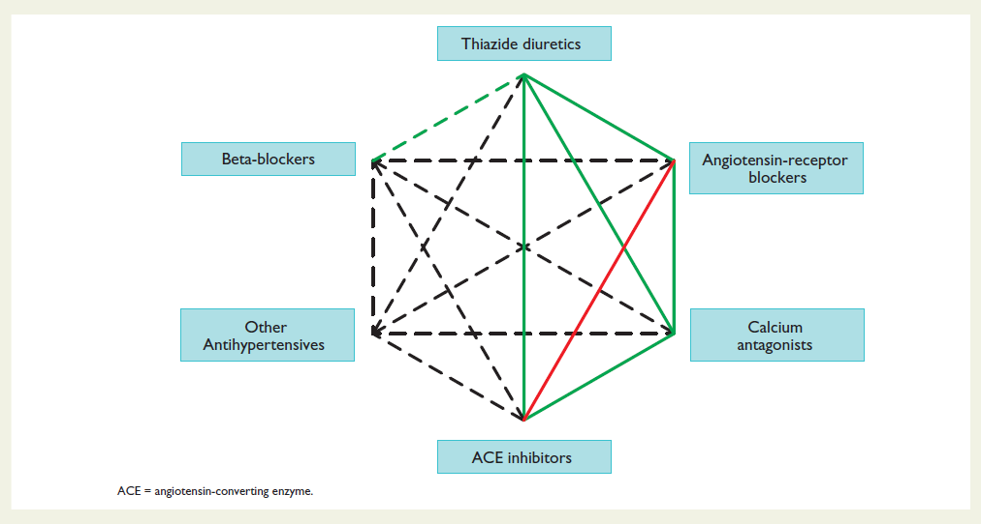
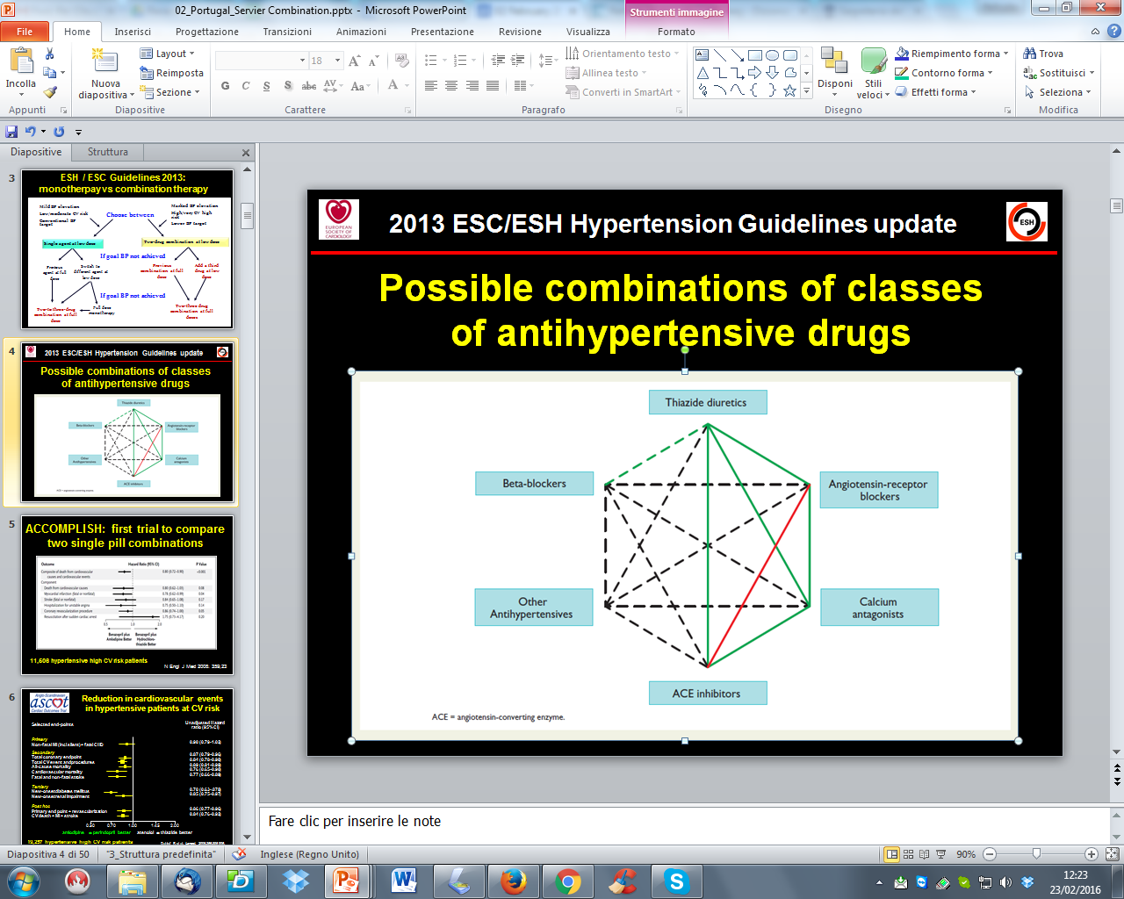
2013 ESC/ESH Hypertension Guidelines update
Possible combinations of classes
of antihypertensive drugs

Slide 13
Classification and Management of BP for adults
BP classification | SBP* mmHg | DBP* mmHg | Lifestyle modification | Initial drug therapy
 |  |  |  | Without compelling indication | With compelling indications
Normal | <120 | and <80 | Encourage
Prehypertension | 120–139 | or 80–89 | Yes | No antihypertensive drug indicated. | Drug(s) for compelling indications. ‡
Stage 1 Hypertension | 140–159 | or 90–99 | Yes | Thiazide-type diuretics, ACEI, ARB, BB, CCB, or combination. | Drug(s) for the compelling indications.‡ Other antihypertensive drugs (diuretics, ACEI, ARB, BB, CCB) as needed.
Stage 2 Hypertension | >160 | or >100 | Yes | Two-drug combination for most† (thiazide-type diuretic, ACEI or ARB or BB or CCB).
*Treatment determined by highest BP category.
†Initial combined therapy should be used cautiously in those at risk for orthostatic hypotension.
‡Treat patients with chronic kidney disease or diabetes to BP goal of <130/80 mmHg.

Slide 16
Pharmacologic Therapy
Drug therapy is recommended for individuals with blood pressures 140/90 mmHg. The degree of benefit derived from antihypertensive agents is related to the magnitude of the blood pressure reduction.

Slide 17
Benefits of Lowering BP
Lowering systolic blood pressure by 10–12 mmHg and diastolic blood pressure by 5–6 mmHg
Average Percent Reduction
Stroke incidence 35–40%
Myocardial infarction 20–25%
Heart failure 50%

Slide 18
Diuretics
Low-dose thiazide diuretics often are used previously as first-line agents alone or in combination with other antihypertensive drugs.
Thiazides inhibit the Na⁺/Cl– pump in the distal convoluted tubule and hence increase sodium excretion.
In the long term, they also may act as vasodilators.
Thiazides are safe, efficacious, inexpensive, and reduce clinical events.
They provide additive blood pressure–lowering effects when combined with beta blockers, angiotensin-converting enzyme inhibitors (ACEIs), or angiotensin receptor blockers (ARBs).
In contrast, addition of a diuretic to a calcium channel blocker is less effective.
Usual doses of hydrochlorothiazide range from 6.25–50 mg/d.
The preferred are Chlorthalidone 6.25-50 mg/dl & indapamide 1.5 mg
Owing to an increased incidence of metabolic side effects (hypokalemia, insulin resistance, increased cholesterol), higher doses generally are not recommended.

Slide 19
Indications:
  HF
  Stroke

Slide 20
Loop diuretics generally are reserved for hypertensive patients with
  reduced glomerular filtration rates [reflected in serum creatinine >220 mol/L (>2.5 mg/dL)],
  CHF,
  or sodium retention and edema
Low-dose eplerenone (6.25 to 25 mg/day) or spironolactone (6.25 to 12.5 mg/day) can be effective in treatment of primary hypertension, particularly low-renin hypertension in African Americans.

Slide 21
Angiotensin-Converting Enzyme Inhibitors
These inhibit the conversion of angiotensin I to angiotensin II and are usually well tolerated.
They are particularly useful in diabetics with nephropathy, where they have been shown to slow disease progression, and in those patients with symptomatic or asymptomatic left ventricular dysfunction, where they have been shown to improve survival.
Electrolytes and creatinine should be checked before and 1-2 weeks after commencing therapy.

Slide 22
Side-effects include first-dose hypotension, cough, rash, hyperkalaemia and renal dysfunction.
  The most common side effect of ACE inhibitors is a dry cough. Patients may complain not of a cough but rather of having to clear the throat or loss of voice later in the day. These symptoms occur in 3 to 39% of patients, resolve in a few days after the drug is discontinued, and can be eliminated by switching the patient to an ARB. The incidence is higher in African Americans than in whites and is highest in Asians.

Slide 23
Angiotensin II receptor antagonists
This group of agents selectively block the receptors for angiotensin II. They share many of the actions of ACE inhibitors but, since they do not have any effect on bradykinin, do not cause a cough. They are currently used for patients who cannot tolerate ACE inhibitors because of persistent cough.
Angioneurotic oedema and renal dysfunction are encountered less with these drugs than with ACE inhibitors.

Slide 24
Indications of both:
  HF
  MI
  Diabetes
  CKD
  Stroke

Slide 25
Beta-adrenoceptor blockers
B-Adrenergic receptor blockers lower blood pressure by decreasing cardiac output, due to a reduction of heart rate and contractility.
They are no longer a preferred initial therapy for hypertension.
Indications:
  Angina
  MI
  HF
  Tachycardia

Slide 26
The major side-effects of this class of agents are bradycardia, bronchospasm, cold extremities, fatigue, bad dreams and hallucinations.
Atenolol has been shown to reduce brachial arterial pressure but not aortic pressure, which is more significant in causing strokes and heart attacks. Atenolol is now not a preferred drug for hypertension.

Slide 27
Calcium-channel blockers
These agents effectively reduce blood pressure by causing arteriolar dilatation, and some also reduce the force of cardiac contraction. Like the beta-blockers, they are especially useful in patients with concomitant ischaemic heart disease.
The major side-effects are particularly seen with the short-acting agents and include headache, sweating, swelling of the ankles, palpitations and flushing.
Indications:
  Angina

Slide 28
Alpha-blockers
By blocking the interaction of norepinephrine on vascular α-adrenergic receptors, these drugs cause peripheral vasodilation, thereby lowering blood pressure.
they are effective third- or fourth-line therapy for difficult hypertension and are particularly useful in older men with prostatism.
Indications:
  Prostatism
  Phenoxybenzamine remains the drug of choice for preoperative management of pheochromocytoma

Slide 29
Renin inhibitors
Aliskerin is the first orally active renin inhibitor which directly inhibits plasma renin activity: it reduces the negative feedback by which angiotensin II inhibits renin release.
It has been used in combination with ACE inhibitors and angiotensin receptor blockers with a significant reduction in blood pressure. Side-effects are few but hypokalaemia occurs.

Slide 30
Centrally acting drugs
Reserpine is used in a low dose of 0.05 mg/day, which provides almost all its antihypertensive action with fewer sideeffects than higher doses. It has a slow onset of action (measured in weeks).
Methyldopa is still widely used despite central and potentially serious hepatic and blood side-effects. It acts on central á2-receptors, usually without slowing the heart.
Clonidine provide all the benefits of methyldopa with none of the rare (but serious) autoimmune reactions.

Slide 31
vasodilators
These include hydralazine (up to 100 mg daily) and minoxidil (up to 50 mg daily). Both are extremely potent vasodilators that are reserved for patients resistant to other forms of treatment.
Hydralazine can be associated with tachycardia, fluid retention and a systemic lupus erythematosus-like syndrome.
Minoxidil can cause severe oedema, excessive hair growth and coarse facial features.
If these agents are used, it is usually in combination with a beta-blocker.

Slide 33
Acute Severe Hypertension
Twenty-five percent of all emergency department patients present with an elevated blood pressure .
Hypertensive emergencies are acute, often severe, elevations in blood pressure, accompanied by acute (or rapidly progressive) target organ dysfunction, such as myocardial or cerebral ischemia or infarction, pulmonary edema, or renal failure.
Hypertensive urgencies are severe elevations in blood pressure without severe symptoms and without evidence of acute or progressive target organ dysfunction. The key distinction depends on the state of the patient and the assessment of target organ damage, not just the absolute level of blood pressure.

Slide 34
The full-blown clinical picture of a hypertensive emergency is a critically ill patient who presents with a blood pressure above 220/140 mm Hg, headaches, confusion, blurred vision, nausea and vomiting, seizures, pulmonary edema, oliguria, and grade 3 or grade 4 hypertensive retinopathy .
Hypertensive emergencies require immediate intensive care unit (ICU) admission for intravenous therapy and continuous blood pressure monitoring;

Slide 35
In most other hypertensive emergencies, the goal of parenteral therapy is to achieve a controlled and gradual lowering of blood pressure.
A good rule of thumb is to lower the initially elevated arterial pressure by 10% in the first hour and by an additional 15% during the next 3 to 12 hours to a blood pressure of no less than 150/90mm Hg. Blood pressure can be reduced further during the next 48 hours.

Slide 37
hypertensive urgencies often can be managed with oral medications and appropriate outpatient follow-up in 24 to 72 hours.
Most patients who present to the emergency department with hypertensive urgencies either are nonadherent with their medical regimen or are being treated with an inadequate regimen.
To expedite the necessary changes in medications, outpatient follow-up should be arranged within 72 hours

Slide 38
Resistant Hypertension
(Refractory hypertension)
Defined as persistence of usual blood pressure above 140/90 mm Hg despite treatment with full doses of three or more different classes of medications including a diuretic in rational combination, resistant hypertension is the most common reason for referral to a hypertension specialist. In practice, the problem usually falls into one of four categories: (1) pseudoresistance, (2) an inadequate medical regimen, (3) nonadherence or ingestion of pressor substances, or (4) secondary hypertension.
  Pseudoresistant hypertension is caused by white coat aggravation

Slide 39
Adjuvant drug therapy
Aspirin. Antiplatelet therapy is a powerful means of reducing cardiovascular risk but may cause bleeding, particularly intracerebral haemorrhage, in a small number of patients. The benefits are thought to outweigh the risks in hypertensive patients aged 50 or over who have well-controlled BP and either target organ damage, diabetes or a 10-year coronary heart disease risk of ≥ 15% (or 10-year cardiovascular disease risk of ≥ 20%).
Statins. Treating hyperlipidaemia can produce a substantial reduction in cardiovascular risk. These drugs are strongly indicated in patients who have established vascular disease, or hypertension with a high (≥ 20% in 10 years) risk of developing cardiovascular disease

