Slide 1
Inst. Abdulridha Sholi

Slide 2
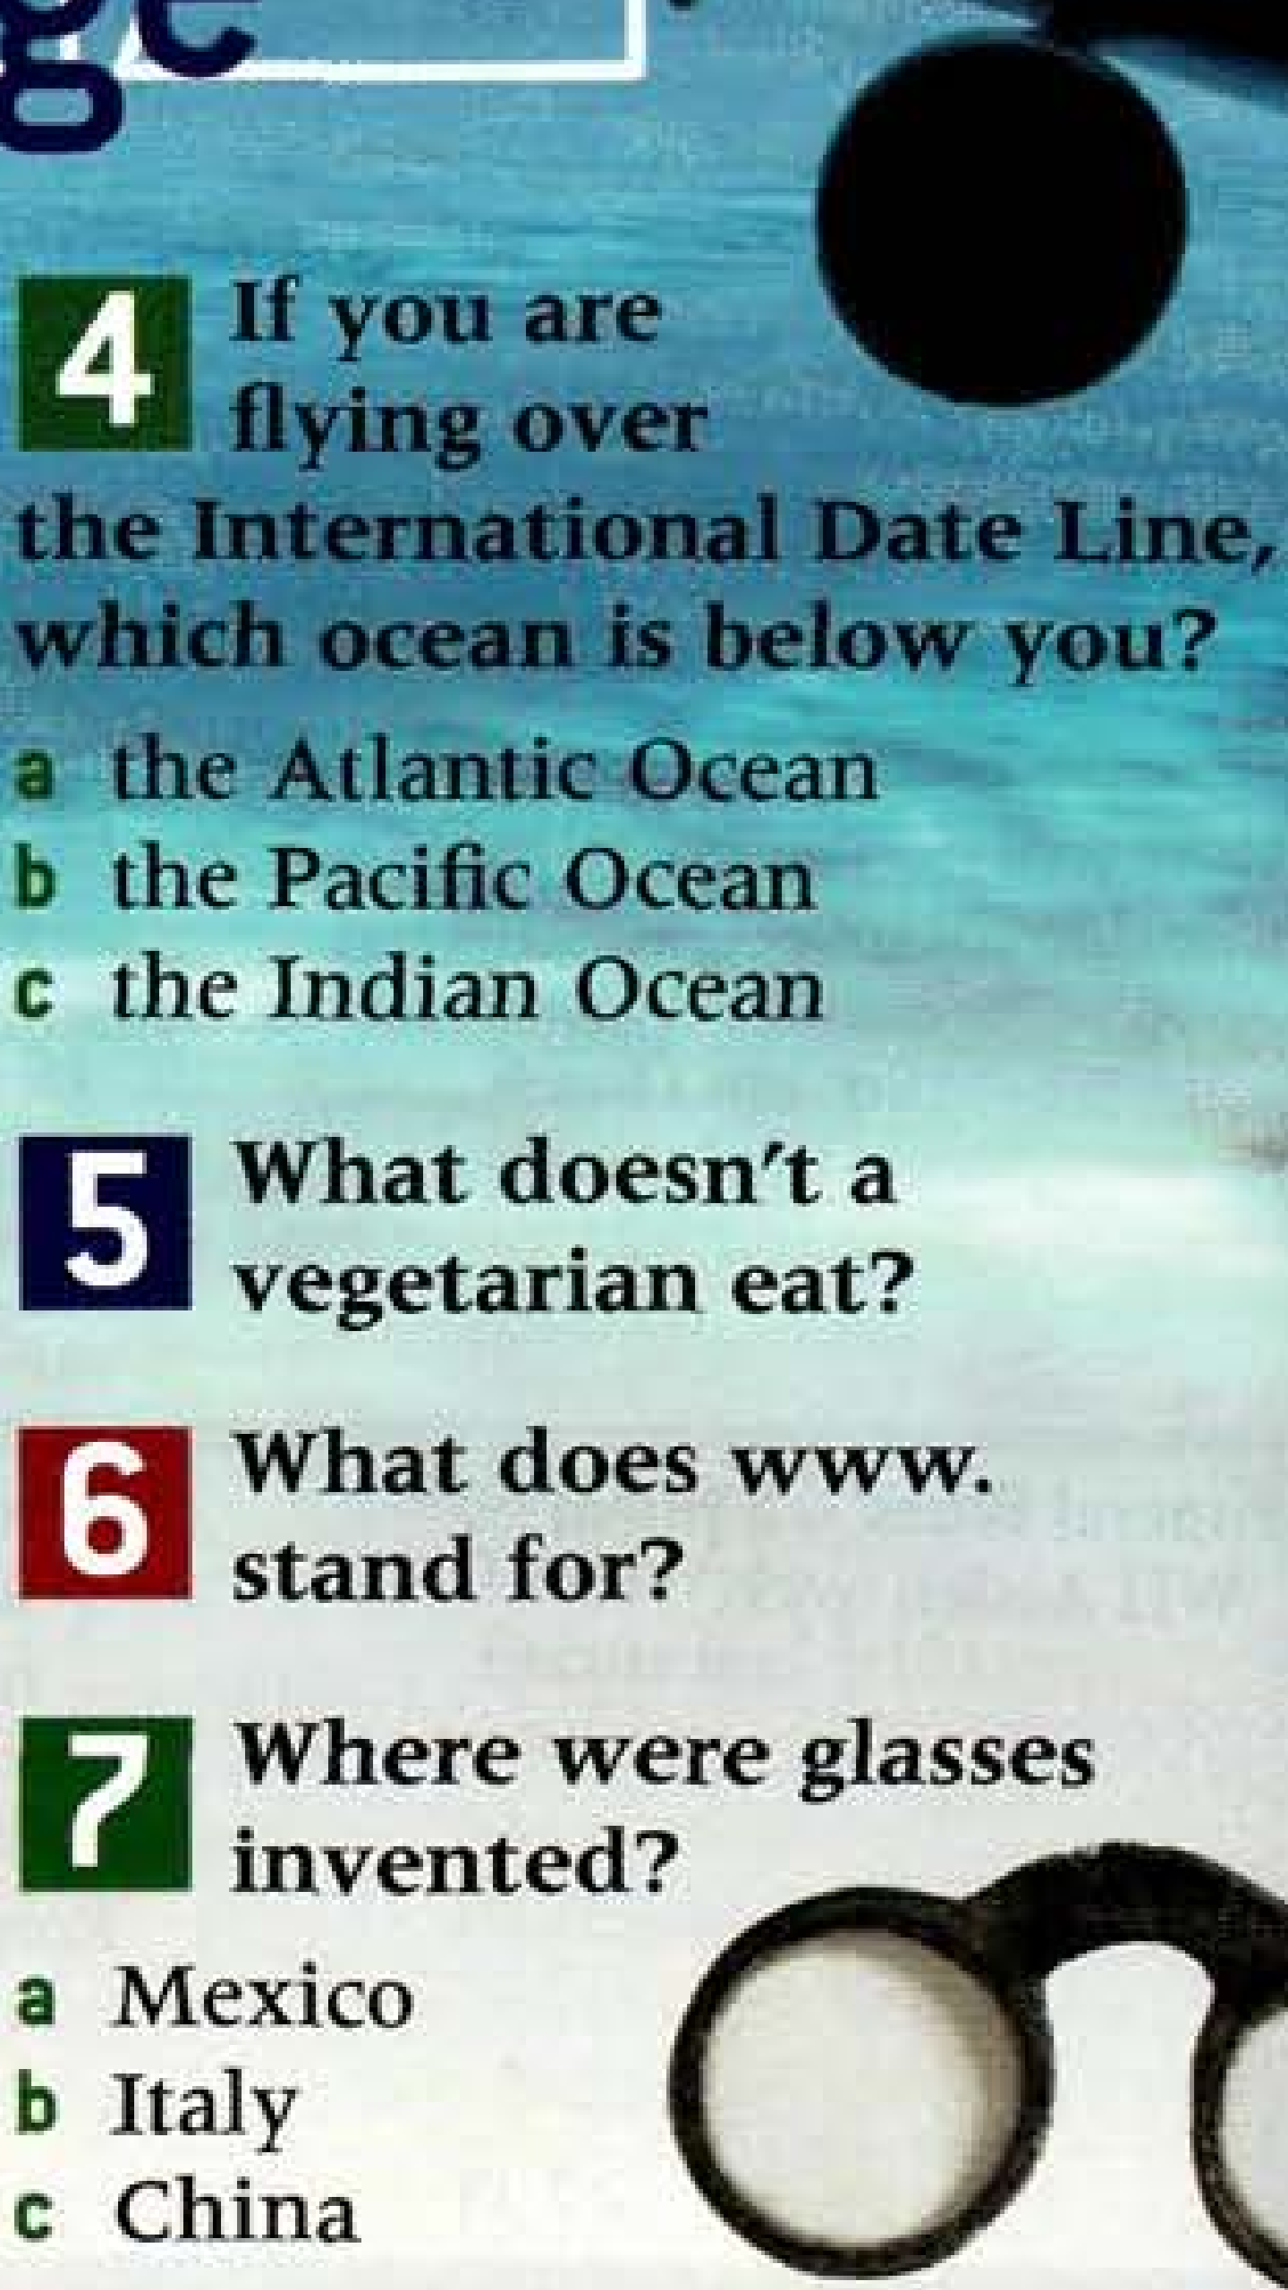
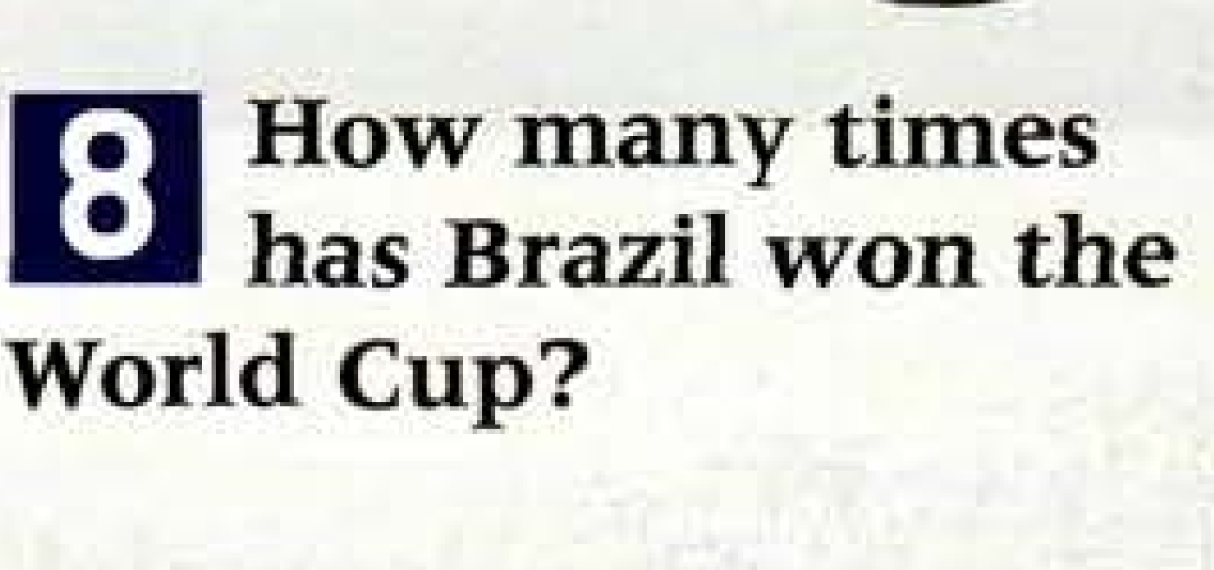
Inst. Abdulridha Sholi

Slide 4
1. The modern Olympic Games started in 1896. 2. It takes eight minutes for the sun’s rays to reach the Earth. 3. He was walking on the moon. 4. If you are flying over the International Date Line, the Pacific Ocean is below you. 5. A vegetarian doesn't eat meat. 6. www. stands for World Wide Web.
Inst. Abdulridha Sholi

Slide 5
7. Glasses were invented in Italy around 1300 AD. 8. Brazil has won the World Cup five times. 9. John Lennon was returning to his apartment when he was assassinated. 10. Chinese is spoken by the most people in the world.
Inst. Abdulridha Sholi

Slide 6
11. Nelson Mandela didn’t become President of South Africa until he was 76 years old because he was in prison for 27 years. 12. People have been sending emails since the 1970s.
Inst. Abdulridha Sholi

