Slide 1
Repair of DNA Damage and Replication Errors

Slide 2
One of the benefits of the double stranded DNA structure is that it lends itself to repair, when structural damage or replication errors occur. Several kinds of chemical change may cause damage to DNA:
• Spontaneous hydrolysis of a nucleoside removes the heterocyclic base component. • Spontaneous hydrolysis of cytosine changes it to a uracil. • Various toxic metabolites may oxidize or methylate heterocyclic base components. • Ultraviolet light may dimerize adjacent cytosine or thymine bases.

Slide 3
All these transformations disrupt base pairing at the site of the change, and this produces a structural deformation in the double helix.. Inspection-repair enzymes detect such deformations, and use the undamaged nucleotide at that site as a template for replacing the damaged unit. These repairs reduce errors in DNA structure from about one in ten million to one per trillion

Slide 4
RNA and Protein Synthesis
The genetic information stored in DNA molecules is used as a blueprint for making proteins. Why proteins? Because these macromolecules have diverse primary, secondary and tertiary structures that equip them to carry out the numerous functions necessary to maintain a living organism , these functions include:
• Structural integrity (hair, horn, eye lenses etc.). • Molecular recognition and signaling (antibodies and hormones). • Catalysis of reactions (enzymes).. • Molecular transport (hemoglobin transports oxygen). • Movement (pumps and motors).

Slide 5
The critical importance of proteins in life processes is demonstrated by numerous genetic diseases, in which small modifications in primary structure produce debilitating and often disastrous consequences. Such genetic diseases include Tay-Sachs, phenylketonuria (PKU), sickel cell anemia, achondroplasia, and Parkinson disease.

Slide 6
anemia, achondroplasia, and Parkinson disease.
The unavoidable conclusion is that proteins are of central importance in living cells, and that proteins must therefore be continuously prepared with high structural fidelity by appropriate cellular chemistry. Early geneticists identified genes as hereditary units that determined the appearance and / or function of an organism (i.e. its phenotype). Now define genes as sequences of DNA that occupy specific locations on a chromosome. The original proposal that each gene controlled the formation of a single enzyme has since been modified as: one gene = one polypeptide. The intriguing question of how the information encoded in DNA is converted to the actual construction of a specific polypeptide has been the subject of numerous studies, which have created the modern field of Molecular Biology.

Slide 7
1. The Central Dogma and Transcription
Francis Crick proposed that information flows from DNA to RNA in a process called transcription, and is then used to synthesize polypeptides by a process called translation. Transcription takes place in a manner similar to DNA replication. A characteristic sequence of nucleotides marks the beginning of a gene on the DNA strand, and this region binds to a promoter protein that initiates RNA synthesis. The double stranded structure unwinds at the promoter site., and one of the strands serves as a template for RNA formation, as depicted in the following diagram. The RNA molecule thus formed is single stranded, and serves to carry information from DNA to the protein synthesis machinery called ribosomes. These RNA molecules are therefore called messenger-RNA (mRNA).

Slide 8
To summarize: a gene is a stretch of DNA that contains a pattern for the amino acid sequence of a protein. In order to actually make this protein, the relevant DNA segment is first copied into messenger-RNA. The cell then synthesizes the protein, using the mRNA as a template.

Slide 9
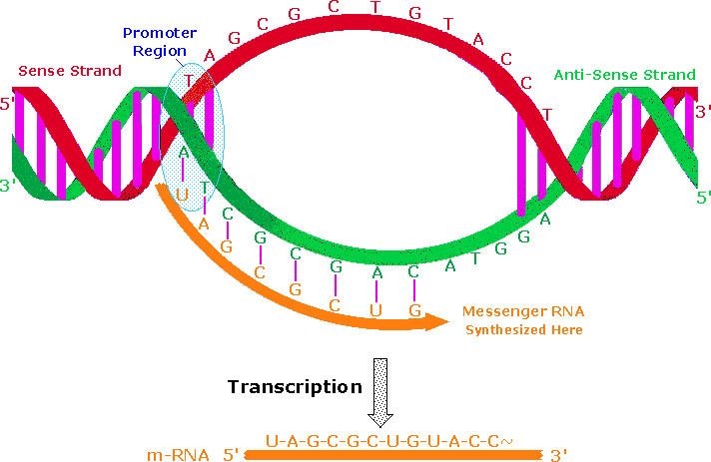

Slide 10
An important distinction must be made here. One of the DNA strands in the double helix holds the genetic information used for protein synthesis. This is called the sense strand, or information strand (colored red above). The complementary strand that binds to the sense strand is called the anti-sense strand (colored green), and it serves as a template for generating a mRNA molecule that delivers a copy of the sense strand information to a ribosome.
The promoter protein binds to a specific nucleotide sequence that identifies the sense strand, relative to the anti-sense strand. RNA synthesis is then initiated in the 3' direction, as nucleotide triphosphates bind to complementary bases on the template strand, and are joined by phosphate diester linkages.
An animation of this process for DNA replication was presented earlier. A characteristic "stop sequence" of nucleotides terminates the RNA synthesis.

Slide 11
The messenger molecule (colored orange above) is released into the cytoplasm to find a ribosome, and the DNA then rewinds to its double helix structure. In eucaryotic cells the initially transcribed m-RNA molecule is usually modified and shortened by an "editing" process that removes irrelevant material.
The DNA of such organisms is often thousands of times larger and more complex than that composing the single chromosome of a procaryotic bacterial cell. This difference is due in part to repetitive nucleotide sequences (ca. 25% in the human genome).
Furthermore, over 95% of human DNA is found in intervening sequences that separate genes and parts of genes. The informational DNA segments that make up genes are called exons, and the noncoding segments are called introns. Before the mRNA molecule leaves the nucleus, the nonsense bases that make up the introns are cut out, and the informationally useful exons are joined together in a step known as RNA splicing

Slide 12
In this fashion shorter mRNA molecules carrying the blueprint for a specific protein are sent on their way to the ribosome factories.
The Central Dogma of molecular biology, which at first was formulated as a simple linear progression of information from DNA to RNA to Protein, is summarized in the following illustration. The replication process on the left consists of passing information from a parent DNA molecule to daughter molecules.
The middle transcription process copies this information to a mRNA molecule. Finally, this information is used by the chemical machinery of the ribosome to make polypeptides.

Slide 13
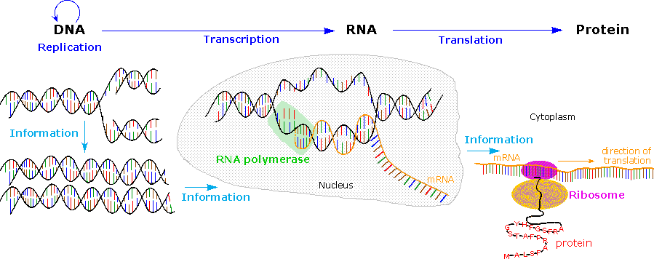

Slide 14
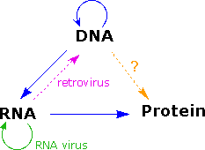
As more has been learned about these relationships, the central dogma has been refined to the representation displayed on the right. The dark blue arrows show the general, well demonstrated, information transfers noted above. It is now known that an RNA-dependent DNA polymerase enzyme, known as a reverse transcriptase, is able to transcribe a single-stranded RNA sequence into double-stranded DNA (magenta arrow).

Slide 15
Such enzymes are found in all cells and are an essential component of retroviruses (e.g. HIV), which require RNA replication of their genomes (green arrow). Direct translation of DNA information into protein synthesis (orange arrow) has not yet been observed in a living organism. Finally, proteins appear to be an informational dead end, and do not provide a structural blueprint for either RNA or DNA. In the following section the last fundamental relationship, that of structural information translation from mRNA to protein, will be described.

