Slide 1
OPIOIDS TOXICITY
Asst.Prof. Dr. Ghaith Ali Jasim
PhD Pharmacology

Slide 2
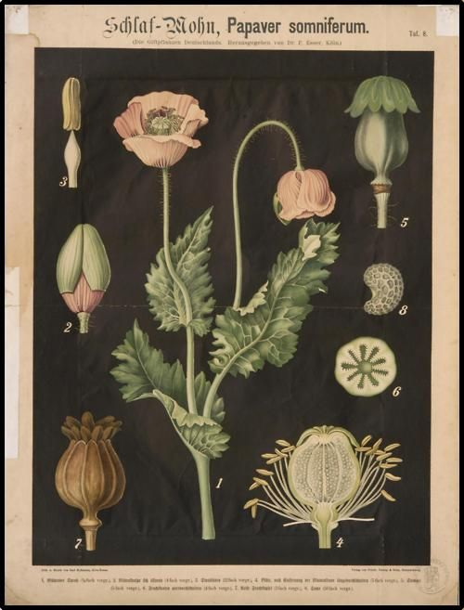
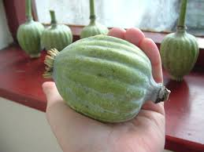
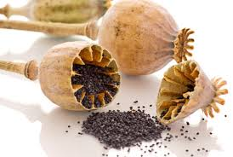
OPIATES: Alkaloid found as a natural product in Papaver somniferum (Poppy), un-ripened seed pods.

Slide 3
NARCOTIC: Broader group of agents and is predominantly used by law enforcement to designate a variety of controlled substances with abuse or addictive effect, It also induces sleep.
OPIOIDS: Medications that relieve pain. It applies to all natural, semi-synthetic and synthetic agents.

Slide 4
Natural (opiates): Heroin, Codeine, Morphine
Semi-synthetic: Buprenorphine, Hydrocodone Hydromorphone, Oxycodone, Oxymorphone
Synthetic: Diphenoxylate, Fentanyl Meperidine, Methadone, Pentazocine, Propoxyphene, Tramadol

Slide 5
Pharmacological Action
• Actions of opioids involve many organ systems, incl. the central nervous system (CNS), Peripheral nervous system (PNS), CVS, Respiratory system, and gastrointestinal system, and cause characteristic clinical effects.
• Goals: Sedation and analgesia.

Slide 6
Opioid receptors
μ-receptors: Analgesia, Sedation, Miosis, Respiratory depression, Cough suppression, Euphoria, Decreased GI motility.
κ-receptors: Analgesia, Sedation, Miosis, Decreased intestinal motility, Dysphoria, Hallucinations.
δ-receptors: Analgesia, some antidepressant effect, Dysphoria, Supraspinal and spinal analgesia.

Slide 7
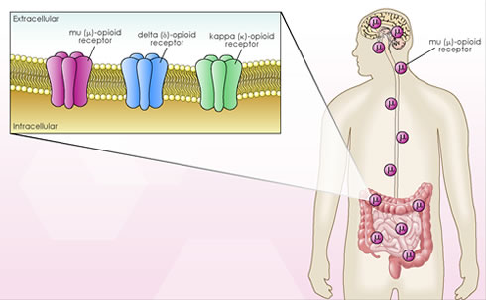

Slide 10
Route of Administration
Oral, parenteral, nasal, rectal, transdermal depending upon the lipid solubility.
Heroin is usually abused through IV and S/C routes, but also absorbed after nasal administration because it is lipid soluble.

Slide 11
Opioid toxicity is less pronounced but more prolonged with ingestion than with parenteral administration.
Absorption of opioids after ingestion occurs in the small intestine. However, because of delayed gastric emptying, absorption and clinical effects of toxicity may be prolonged after overdose.

Slide 12
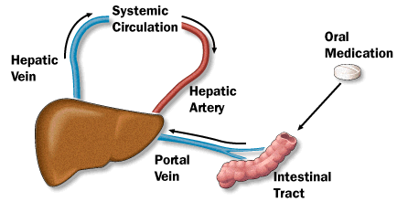
All opioids undergo hepatic metabolism (first-pass hepatic metabolism) and renal elimination, and variations in hepatic and renal function are important because metabolite activity may contribute to clinical effects and toxicity.

Slide 13
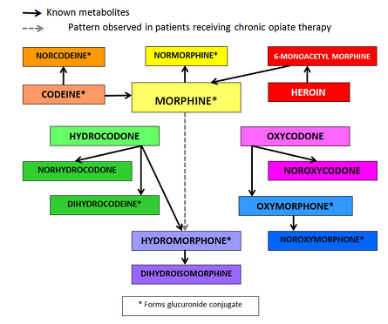

Slide 14
Opioid Toxicity
Nervous System:
-Direct CNS depression
-Respiratory depression – hypoxia
-Seizures
-Hypertonicity Mepiridine & propoxyphene
-Myoclonus
-Dysphoria
-Psychosis

Slide 15
Opioid Toxicity
- Spongiform leuko-encephalopathy
- Heroin preparation on aluminium foil – ‘chasing the dragon’
-Serotonin syndrome - Meperidine, methadone, tramadol - clinical triad of mental status changes, autonomic instability, and neuromuscular changes

Slide 16
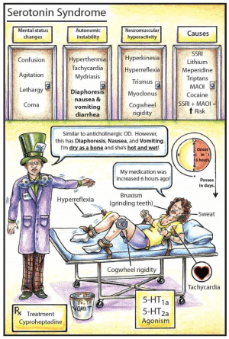

Slide 17
Opioid Toxicity
Respiratory System -Decrease respiratory rate and tidal volume -Bronchospasm (rare but severe)
Ophthalmologic -Stimulation of μ- receptors in the Edinger-Westphal nuclei of the third nerve usually results in miosis.

Slide 18
Opioid Toxicity
Otologic -Sensorineural hearing loss
Cardiovascular system -Hypotension and bradycardia -Propoxyphene – Na+ channel blocker – acts as Class A antiarrhythmic agent – prolong QRS complex -Methadone – QT prolongation

Slide 19
Opioid Toxicity
Gastrointestinal system -Nausea and vomiting -Delayed gastric emptying – may lead to Ileus
Other systems:
-Urinary retention from urethral sphincter spasm and decreased detrusor tone
-Pruritus, flushing, and urticarial
-Hypoglycemia
-Hypothermia

Slide 20
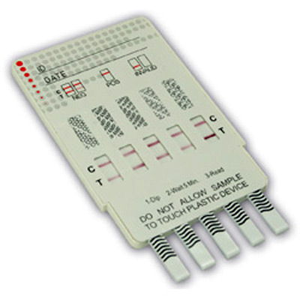
Diagnosis
Diagnosis History and physical examination , ECG ,Chest X-ray ,Urine tox screen

Slide 22
Treatment
IV Fluids
Single-dose activated charcoal, 1 gram/kg PO, should be administered if the opioid ingestion occurred within the hour.
Naloxone is a pure competitive antagonist at all opioid receptors, with particular affinity for μ-receptors, therefore fully reverses all the effects of opioid. Onset – 1-2 min, duration – 30-90 min.
Nalmefene - opioid antagonist with a long half-life (8-11 hours) and duration of clinical effect

Slide 23
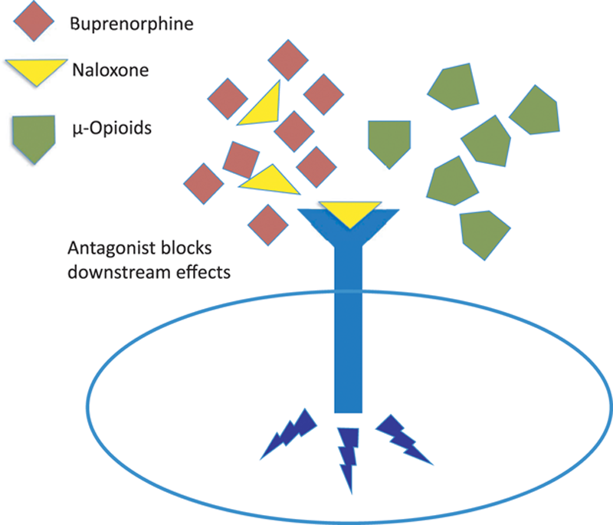

Slide 24
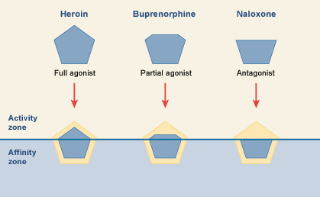

Slide 25
Opioid Withdrawal
Down-regulation of opioid receptors occurs with long-term use of opioids. Abrupt cessation of opioid use does not allow time for up-regulation of receptors and results in increased neuronal firing and the opioid withdrawal syndrome.

Slide 26
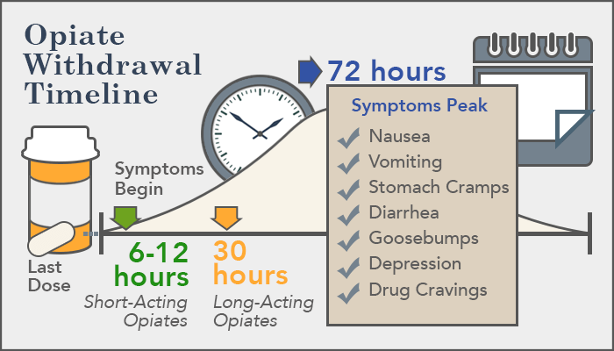

Slide 27
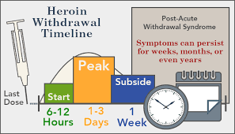

Slide 29
Methadone - a long-acting opioid, provides opioid replacement to treat or to prevent withdrawal - 20 mg orally or 10 mg IM, onset – 30-60 min
Clonidine (central alpha2-agonist) - 0.1 mg orally, repeated every 30-60min
Buprenorphine (partial agonist)

Slide 30
Management
The consequential effects of acute opioid poisoning are CNS and respiratory depression.
Early support of ventilation and oxygenation is generally sufficient to prevent death, prolonged use of bag-valve-mask ventilation and endotracheal intubation may be avoided by cautious administration of an opioid antagonist.

Slide 31
Management
Opioid antagonists, such as naloxone, competitively inhibit binding of opioid agonists to opioid receptors, allowing the patient to resume spontaneous respiration.
Naloxone competes at all receptor subtypes, although Not equally, and is effective at reversing almost all adverse effects Mediated through opioid receptors.

Slide 32
The goal of naloxone therapy is not necessarily complete arousal; rather, the goal is reinstitution of adequate spontaneous ventilation.
Because precipitation of withdrawal is potentially detrimental and often unpredictable, the lowest practical naloxone dose should be administered initially, with rapid escalation as by the clinical situation.

Slide 33
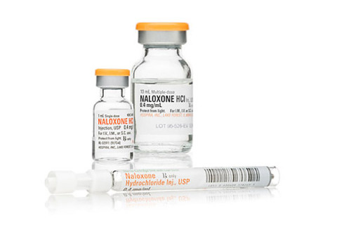
Most patients respond to 0.04 to 0.05 mg of naloxone administered IV, although the requirement for ventilatory assistance may be Slightly prolonged because the onset may be slower than with larger doses.

Slide 34
If a naloxone bolus (start with 0.04 mg IV and titrate) is successful, administer two-thirds of the effective bolus dose per hour by IV infusion; frequently re-assess the patient’s respiratory status.
If respiratory depression is not reversed after the bolus dose: Intubate the patient, as clinically indicated. Administer up to 10 mg of naloxone as an IV bolus. If the patient does not respond, do not initiate an infusion.

Slide 35
If the patient develops withdrawal after the bolus dose: Allow the effects of the bolus to abate (become less). If respiratory depression recurs, administer half of this new bolus dose and begin an IV infusion at two-thirds of the initial bolus dose per hour. Frequently re-assess the patient’s respiratory status.
If the patient develops withdrawal signs or symptoms during the infusion: Stop the infusion until the withdrawal symptoms abate. Restart the infusion at half the initial rate; frequently re-assess the patient’s respiratory status.

Slide 36
If the patient develops respiratory depression during the infusion: Readminister half of the initial bolus and repeat until reversal occurs. Increase the infusion by half of the initial rate; frequently reassess the patient’s respiratory status.
Exclude continued absorption, re-administration of opioid, and other etiologies as the cause of the respiratory depression.

Slide 37
Thank you

