Slide 1
THE AUTONOMIC NERVOUS SYSTEM

Slide 3
TWO MAJOR DIVISIONS
PARASYMPATHETIC
-ganglia close to organ innervated
-preganglionic fibers are myelinated and long
-postganglionic fibers short and unmyelinated
SYMPATHETIC
-ganglia mostly near the spinal cord (paravertebral chain) except for some which are prevertebral and some lie near organs innervated
-preganglionic fibers are myelinated but shorter
-postganglionic fibers are long and unmyelinated

Slide 4
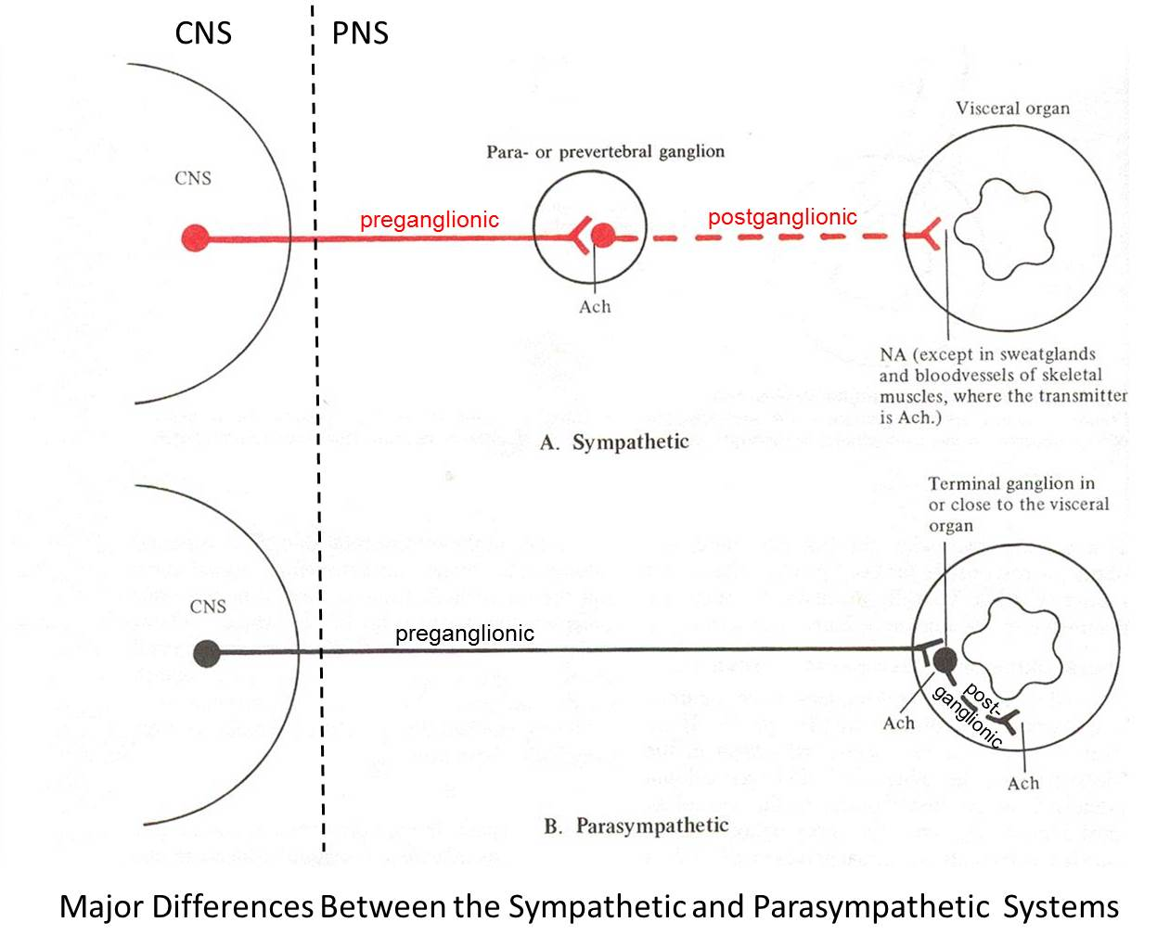

Slide 5
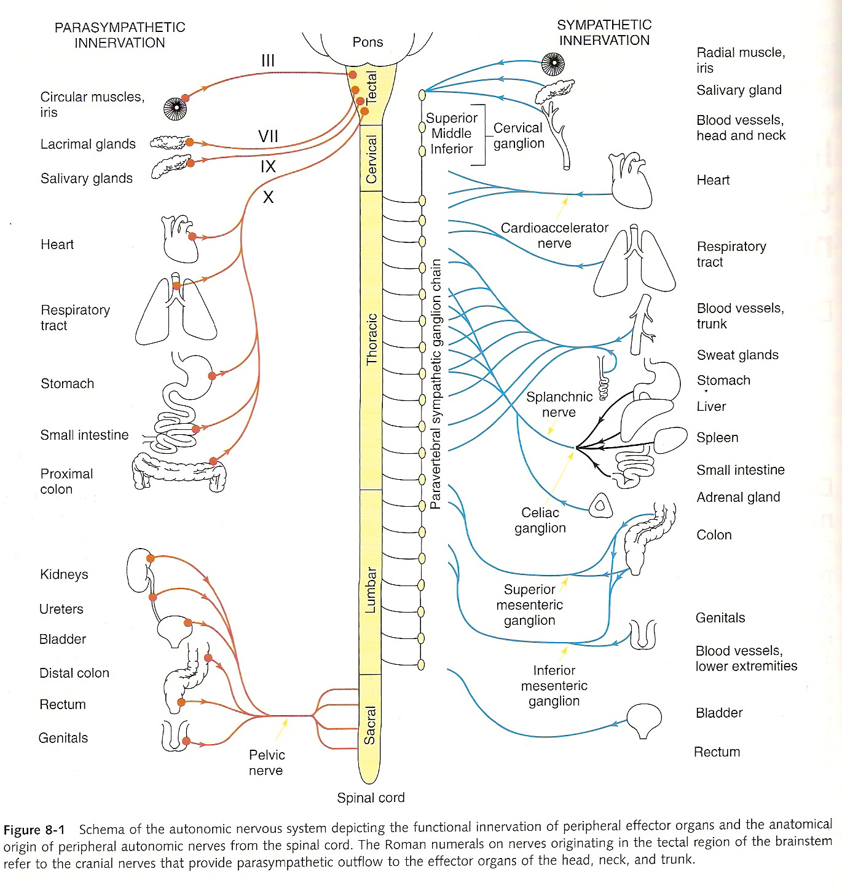

Slide 6
PARASYMPATHETIC
-cell bodies of preganglionic nerons exit spinal cord at cranial and sacral levels
SYMPATHETIC
-cell bodies of preganglionic fibers exit at thoracic and lumbar levels

Slide 8
PARASYMPATHETIC
-Neurotransmitter:
preg.neuron→Ach
postg.neuron→Ach
SYMPATHETIC
-Neurotransmitter:
preg.neuron→Ach
postg.neuron→NE
-Adrenal Medulla→ chromaffin cells→Epinephrine

Slide 11
Autonomic Regulation of peripheral organs
Generally the two branches stimulate opposing responses in effector organs but there are some EXCEPTIONS when similar responses are produced
Balance exists between the two so that inhibition of one leads to increases in response mediated by the other
Some organs have only one type of innervation such as spleen and vasculature (sympathetic)

Slide 12
A sympathetic preganglionic neuron may synapse with many postganglionic neurons→diffuse responses
Parasympathetic preganglionic neurons usually only have single synapses with postganglionic neurons→ discrete, localized responses

Slide 13
Activation of outflow
Parasympathetic-
conservation of energy, maintenance of function during periods of lesser activity
essential for life
Sympathetic
“fight, flight or fright”
response
response to stress conditions

Slide 15
Parasympathetic
-Reduces heart rate and BP
-Activates GIT
-Emptying of bladder and rectum
-Activation of lacrimal, mucus and salivary cells
-Constriction of bronchial tree
-Pupillary constriction
Sympathetic
-Elevation of heart rate and BP
-Redirection of blood flow to skeletal muscles from skin
-Dilation of pupils and bronchioles
-Piloerection

Slide 17
Neurotransmission Neurotransmitters in the ANS

Slide 19
After release: NTS→ synaptic cleft→ specific receptors of postganglionic cells or cells of the effector organ→ message delivery→ response
Nerve terminals then have mechanisms to degrade and reuse (reuptake) NTS for rapid termination of message

Slide 22
Neurotransmitter Receptors in the ANS

Slide 24
CHOLINERGIC RECEPTORS
Acetycholine (Ach) action differs depending on the type of receptor it interacts with
Ach action is mimicked by nicotine in some organs and mimicked by muscarine in others →
nicotinic cholinergic receptors
muscarinic cholinergic receptors

Slide 25
Nicotinic:
Ligand-gated ion channels→ (+)→ allows entry of sodium and calcium ions
Muscarinic:
G protein-coupled receptors→ (+) →activate G proteins to induce downstream effects

Slide 26
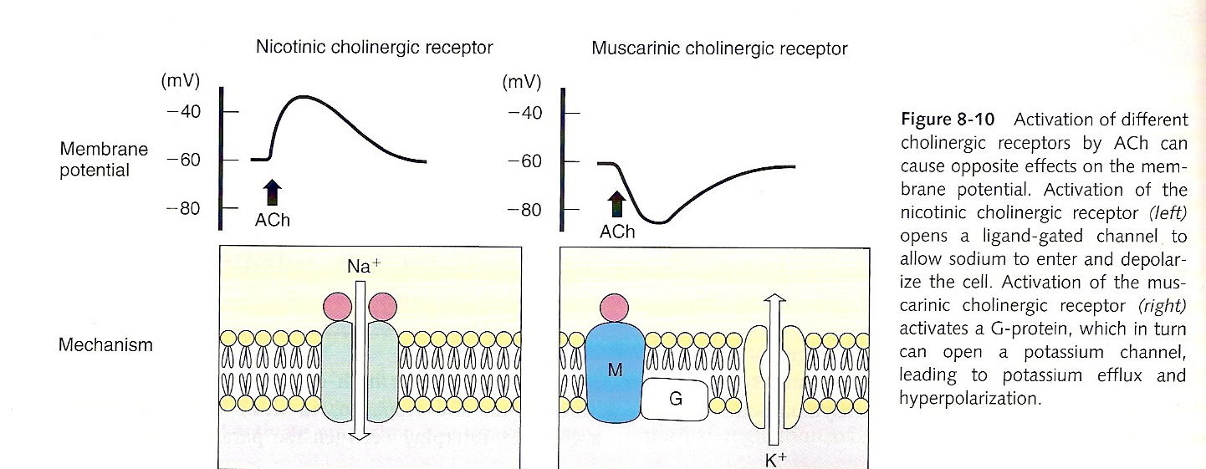
Insert Brody Fig 8-10 p.98

Slide 28
*Nicotinic Cholinergic Receptors
Primary action of Ach at Para- and Symp- ganglia are mediated by activation of ganglionic NICOTINIC receptors (similar to that in the CNS and immune cells but different from that in the skeletal muscle at the NMJ)
These different types of nicotinic receptors allow for selective action (+ or -) of different agonist and antagonist

Slide 29
*Muscarinic Cholinergic Receptors
Mediates responses to Ach at the parasympathetic neuroeffector junction
Subtypes M1 to M5:
M1→autonomic ganglia- modulates effects of nicotinic receptor activation
M2→ heart
M3→ glands, smooth muscles
M4, M5→?
All types → CNS

Slide 30
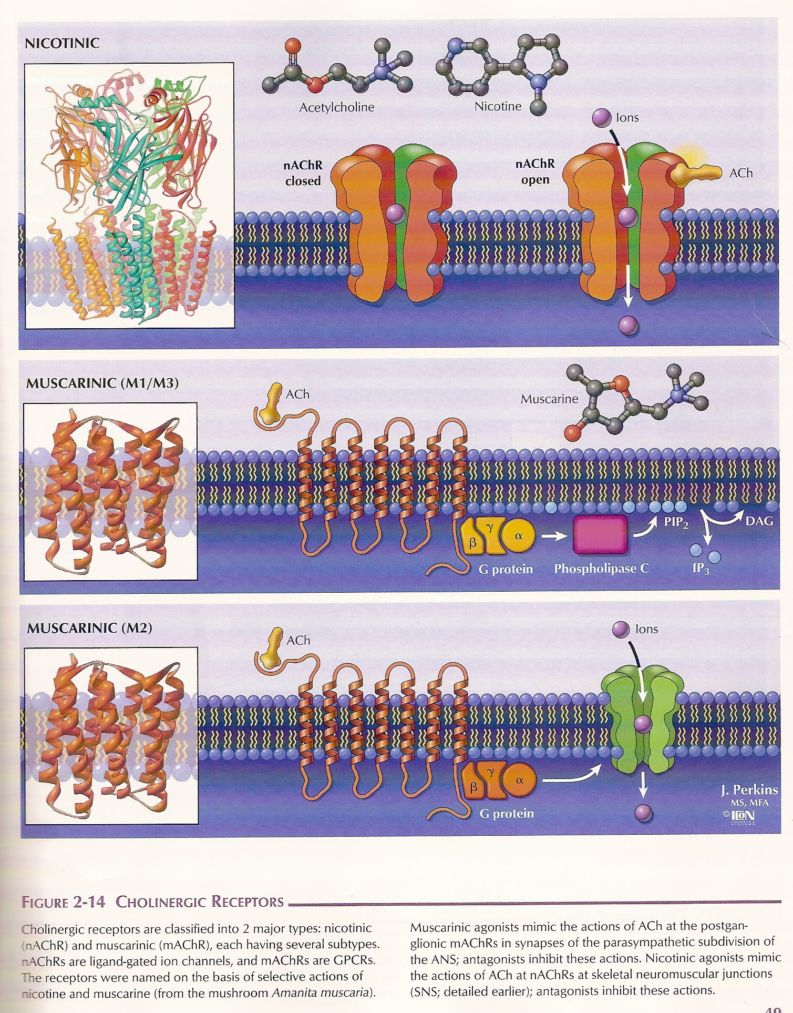

Slide 31
ADRENERGIC RECEPTORS
NE and Epi can activate more than one type of adrenergic receptor
β receptors (1,2, and 3 subtypes)
α1 (3 subtypes) and α2 (3 subtypes)

Slide 32
Somatic
Parasympathetic
Sympathetic
ACh
N
ACh
N
ACh
ACh
NE
N
M
αβ

Slide 33
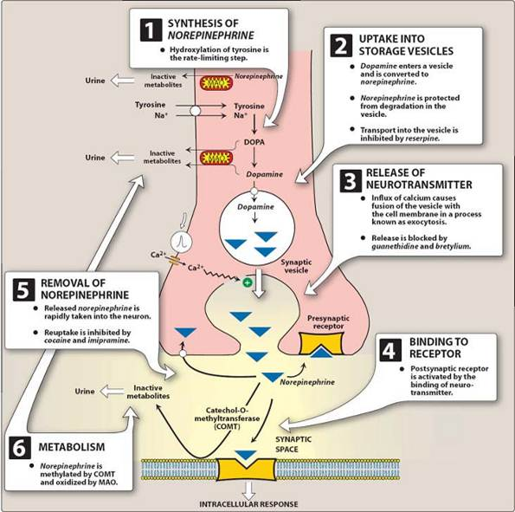

Slide 34
Functional Responses mediated by the ANS

Slide 35
Functional Reponses
Most organs are innervated by both cholinergic and adrenergic systems therefore responses of organs are due to interplay between these two
HOWEVER, an organ is usually under the PREDOMINANT control of one division

Slide 36
Functional Responses
Organs innervated by both systems:
Heart
Eye
Bronchial tree
GIT
Urinary Bladder
Reproductive organs
Organs innervated only by sympathetic branch:
Blood vessels
Spleen
Piloerector muscles

Slide 37
Functional Responses
The responses in each organ are mediated by the particular muscarinic cholinergic OR adrenergic receptors present

Slide 38
Functional Responses
Usually, the two divisions mediate physiologically opposing responses such that if one inhibits an effect, the other enhances it.

Slide 39
Sites of Drug Action in Neurotransmission Process
synthesis
storage
release
reuptake
degradation

Slide 41
Drugs Acting on Autonomic Nerves and Receptors

Slide 42
GANGLIONIC BLOCKERS
Interferes with transmission from preganglionic to postganglionic neurons
Inhibits BOTH divisions of the ANS

Slide 43
Parasympathetic
Sympathetic
ACh
Ganglionic
Blocker
(-)
N
ACh
Ganglionic Blocker
(-)
N
ACh
NE
M
αβ

Slide 44
INHIBITORS OF NEUROTRANSMITTER RELEASE
Inhibitors of biosynthesis of Norepinephrine (NE) and Epinephrine (Epi)
Inhibitors of biosynthesis of Acetylcholine (Ach)
Inhibitors of exocytotic release of NE from postganglionic sympathetic nerve terminals
Inhibitors of exocytotic release of Ach from all types of cholinergic nerve fibers:

Slide 45
PROMOTERS OF NEUROTRANSMITTER RELEASE

Slide 46
Sympathetic
ACh
Nicotine
+
N
Tyramine, Ephedrine
amphetamine
NE
+
αβ

Slide 47
Parasympathetic
ACh
Nicotine
N
+
Black widow
Spider venom
ACh
+
M

Slide 48
DRUGS THAT INTERFERE WITH NEUROTRANSMITTER STORAGE
The neurotransmitters are taken up into storage vesicles by specific energy-dependent pumps in the vesicle membrane
→ inhibits uptake of NE into vesicles
→prevents packing of Ach into storage vesicles

Slide 49
DRUGS THAT AFFECT THE DURATION OF ACTION OF NEUROTRANSMITTER
NE
imipramine, cocaine- block NE reuptake in the nerve terminal→ increases synaptic concentration of NE→enhancement of adrenergic transmission
2. Paragyline (inhibits MAO) and
tolcapone (inhibits COMT) → higher amounts of NE in peripheral tissue

Slide 50
Acethylcholine
inhibited by physostigmine, edrophonium, and other drugs →enhances magnitude and duration of effects of cholinergic stimulation

Slide 51
Thank you

Slide 52
Questions??

Slide 53
DRUGS THAT STIMULATE AUTONOMIC RECEPTORS
Adrenergic receptor stimulators
1.NE
2.Epi
3.Phenylephrine
4.Clonidine
5.Isoproterenol
6.Dobutamine
7.Terbutaline

Slide 54
Cholinergic receptor stimulators
1.Alkaloid muscarine, betanechol→(+) muscarinic receptors
2.Alkaloid nicotine→(+) micotinic receptors

Slide 55
DRUGS THAT BLOCK AUTONOMIC RECEPTORS
Adrenergic receptor blockers
1.Phentolamine
2.Prazosin
3.Yohimbine
4.Propranolol
5.Metoprolol

Slide 56
Cholinergic receptor blocker
1.Atropine→ competitive blocker at muscarine receptors
2.trimetaphan→inhibits nicotinic cholinergic receptors in ganglia

