Slide 1
The Nervous System
Asst. Prof. Dr. Ghaith Ali Jasim

Slide 2
The Nervous System : (NS)
Include all the neural tissue in the body.
The basic functional units of the NS are the neurons. The neurons are supported by supporting cells or neuroglia or glial cells, these separate & protect the neurons.

Slide 4
Neural tissue with supporting blood vessels & connective tissue forms the organs of the NS: the brain, the spinal cord & the receptors in complex sense organs & the nerves that interconnect those organs & link the NS with other organs.
NS CNS (Central NS)
PNS (Peripheral NS)

Slide 5
CNS : consists of the Brain & Spinal cord, these are complex organs that include neural tissue & blood vessels & various connective tissue that provide physical protection & support.
The CNS is responsible for integrating, processing & coordinating sensory data & motor commands
The CNS specifically the brain is also the center of higher functions e.g. intelligence, memory, learning & emotion.

Slide 6
Sensory data convey information about conditions inside or outside the body.
Motor commands control or adjust the activities of peripheral organs e.g. skeletal muscles.

Slide 8
PNS : include all the neural tissue outside the CNS. The PNS delivers sensory information to the CNS & carries motor commands to the peripheral tissue & systems.
Afferent division of PNS brings sensory information to CNS from receptors in peripheral tissue & organs.
Efferent division of PNS carries motor commands from the CNS to muscles & glands (effectors).

Slide 9
Efferent division…
*The somatic nervous system (SNS) controls skeletal muscles contractions (voluntary or involuntary).
* The autonomic nervous system (ANS) or visceral motor system, provides automatic involuntary regulation of smooth muscle, cardiac muscle, glandular activity or secretion, include:
-sympathetic division.
-parasympathetic division.

Slide 12
Functional classification of the neuron:
1. Sensory neurons: from the afferent division of the PNS, the cell bodies of the sensory neurons are found in peripheral sensory ganglia (a ganglion is a collection of neuron cell bodies in the PNS).
-somatic sensory neurons ( monitor the outside world & our position within it).
-visceral sensory neurons ( monitor internal conditions & the status of other organ system).
2. Motor neurons: or efferent neurons, which carries instructions from the CNS to peripheral effectors (the motor neuron stimulates a peripheral tissue or organ).

Slide 13
The Transmembrane Potential:
The intracellular fluid (ICF) & extracellular (ECF) fluid differ markedly in ionic composition.
The ECF contains high concentrations of sodium ions (Na+) & chloride ions (Cl-),
while the ICF contains high concentrations of potassium ions (K+) & negatively charged proteins (Pr-).

Slide 15
Because living cells have selectively permeable membranes the ions are not distributed evenly.
Ions cannot freely cross the lipid protein of the cell membrane so they can enter or leave the cell only through membrane channels & there are also active transport mechanisms that move specific ions into or out of cell.

Slide 16
The passive & active factors do not ensure the equal distribution of +ve & -ve charges across the cell membrane.

Slide 18
** The transmembrane potential results from combination of passive & active forces:
Chemical gradients → because the ICF concentration of K+ is high, K+ tends to move out of the cell & Na+ ions tend to move into the cell.
Electrical gradients → because the membrane is much more permeable to K+ than it is to Na+, so K+ leave the cell more rapidly than Na+ enter. As a result the ICF losses +ve charges & the ECF gains +ve charge.

Slide 20
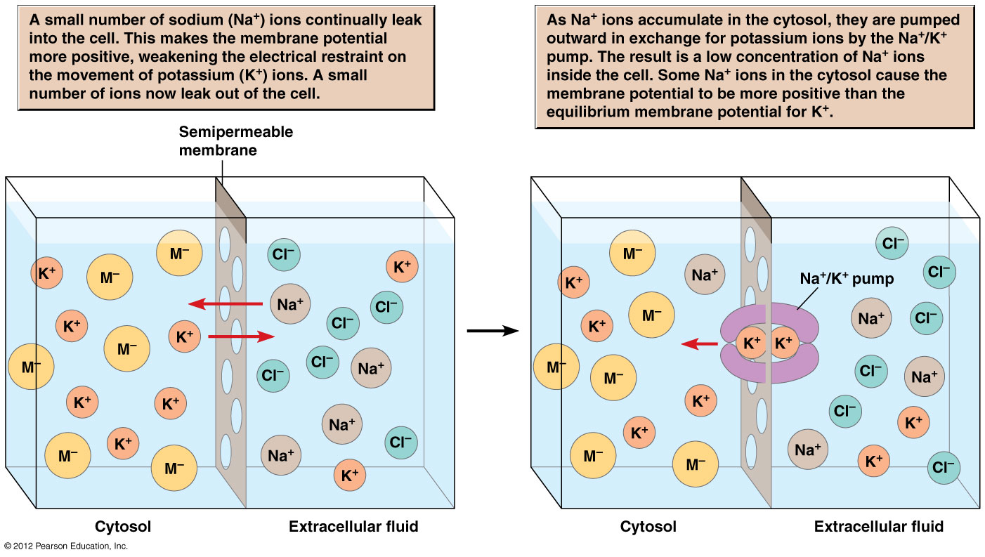

Slide 21
*** the +ve & -ve charges are separated by the cell membrane which constitutes a resistance because it resists the free movement of ions.
So whenever +ve & -ve ions are separated by a resistance (cell membrane) a potential difference exists. The potential difference is measured in volts or mV (the resting potential or transmembrane potential is -0.07V for a neuron cell membrane)

Slide 23
The electro-chemical gradient → the electrical gradients can help or oppose the chemical gradient.
- Na+ in ECF are attracted by the –ve charge in the ICF, so both electrical & chemical forces push Na+ into the cell.
Chemical gradient for K+ tends to drive them out of the cell but the movement is opposed by:
a. attraction between K+ &-ve charge inside cell.
b. repulsion between K+ &+ve charge outside.

Slide 24
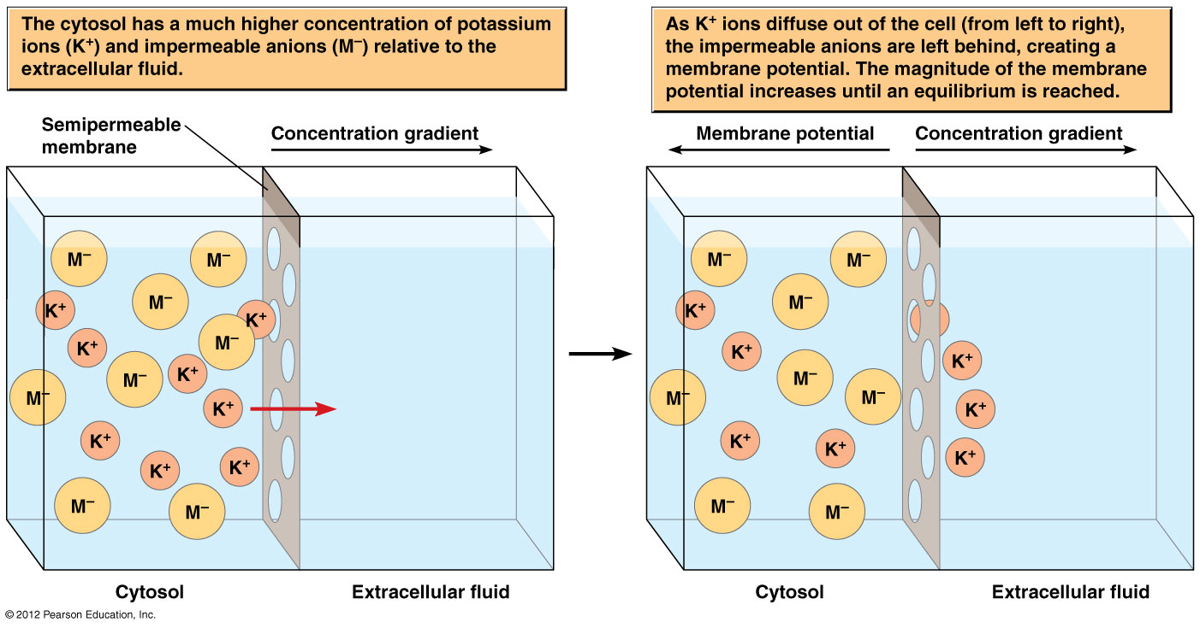

Slide 25
Sodium – Potassium ATPase → at the normal resting potential, there is a slow leakage of Na+ into cell & diffusion of K+ out of the cell. So the cell must use ATP to eject Na+ & take K+.
**The sodium-potassium ATPase exchange 3 intracellular Na+ for 2 extracellular K+ in this way the pump contributes to the negativity of the transmembrane potential.

Slide 27
Ion Channels: ions cross the cell membrane through membrane channels.
-there are several Na & K ion channels called passive channels or leak channels ( because they are always open) but can change permeability in response to local conditions.
-cell membrane also contain active channels or gated channels, these are ion channels that open or close in response to specific stimuli & can be in one of 3 states:
1. closed but capable of opening.
2. open (activated).
3. closed & incapable of opening.

Slide 29
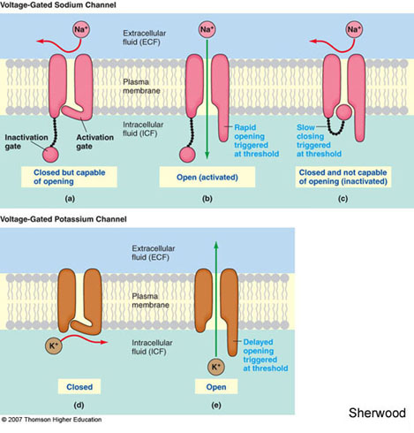

Slide 30
Classes of Gated channels:
Chemically regulated channels: open or close when they bind to specific chemicals. e.g. receptors that bind to Ach at neuromuscular junction.
Chemically regulated channels are the most on the dendrite & soma of neurons in synapses.

Slide 31
Voltage regulated channels: are in areas of excitable tissue (a membrane capable of generating & conducting an action potential).
Voltage regulated channels open & close in response to changes in trans-membrane potential. ((the opening of the voltage regulated Na-channels is the key step in the generation of an action potential)).

Slide 32
Mechanically regulated channels: these open & close in response to physical distortion of the membrane surface. e.g. sensory receptors that respond to touch, pressure & vibration.

Slide 34
Graded Potentials: (Local Potential)
Is the changes in the trans-membrane potential that cannot spread far from the area surrounding the site of stimulus.
In this case the membrane is exposed to a chemical that opens chemically regulated Na+ channels. Na+ ions inter the cell & an additional positive charge shifts the trans-membrane potential toward 0mV.
So any shift in the trans-membrane potential away from the resting levels toward 0mV or above is called Depolarization.

Slide 36
The movement of Na+ ions across the cell membrane at one location causes the depolarization of the surrounding membrane. (Na ions entering the cell spread along the inner surface attracted by the excess of –ve charges).
(( The ion movement in the inner & outer surface of membrane is called Local Current)).

Slide 37
**the change in the trans-membrane potential & the area affected by the local current are directly related to the number of Na+ channels opened by the chemical stimulus.
* the more channels open → ↑es Na+ spread → ↑es depolarization.

Slide 38
Opening of K+ ion channels will have the opposite effect, so the K+ will outflow & the inner surface of cell will lose positive ions & produce hyperpolarization (a shift of resting potential to -80mV).
And also a local current will distribute the effect to adjacent cell membrane.

Slide 40
Characteristics of Graded Potential:
The trans membrane potential is most affected at the site of stimulation & the effect ↓es with distance.
the effect spreads passively due to local currents.
the graded potential change may involve depolarization or hyperpolarization. Depending on the membrane channels involve.
the stronger the stimulus, the greater the change in transmembrane potential & the larger the area affected.

Slide 41
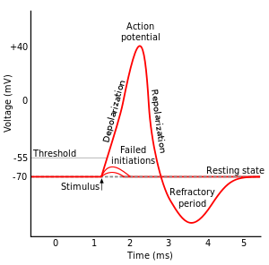
Action Potentials (AP):
APs are propagated changes in the transmembrane potential that once initiated, spread across the entire excitable membrane. An AP generally begins at the initial segment of the axon, the AP is then propagated along the length of the axon reaching the synaptic knobs.

Slide 43
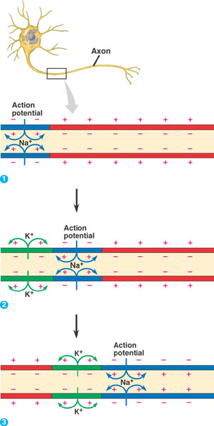

Slide 45
(the stimulus that initiate an AP is a depolarization large enough to open voltage-regulated Na+ channels), and the opening occur at the transmembrane potential called the Threshold (-60mV or -55mV).

Slide 46
**all stimuli that bring the membrane to threshold will generate an AP, so the properties of the AP dose not depend on the strength of depolarizing stimulus (graded-depolarization) as long as the stimulus exceeds threshold.
--this is called the all or non principle (because a stimulus either triggers a typical AP or dose not at all).

Slide 48
Action Potential Generation:
Depolarization to threshold:
before an AP can begin, an area of excitable membrane must be depolarized to threshold by local current.
Activation of Na+ channels and rapid depolarization:
at threshold the activation gates open & the cell become much more permeable to Na+ (by the effect of the electro-chemical gradients. Na+ rush into the cytoplasm and rapid depolarization occur).

Slide 50
Na+ channel inactivation & K+ channel activation:
at trans membrane potential of +30mV the inactivated gates of the voltage-regulated Na+ channels begin closing (this step is called Na+ channel inactivation). At the same time K+ channels are opened

Slide 52
Return to normal permeability:
voltage regulated Na+ channels remain inactivated until the membrane repolarize to threshold (about -60mV) then they remain closed but capable opening. Voltage regulated K+ channel begin closing as membrane reaches normal resting potential (about -70mV).

Slide 54
Action Potential Propagation
AP will begin in the initial segment. The membrane is a series of adjacent segments ((axon hillock cannot respond to an AP)), at peak of AP the transmembrane potential will become +ve & a Local Current develops.
Na+ ions move in the cytoplasm & in extra- cellular fluid, & the local current spreads in all directions depolarizing adjacent portions of cell membranes ( the process continue in a chain reaction or as tiny steps).

Slide 56
Each time a local current develops the AP moves forward because the previous segment of the axon is still in the absolute refractory period, so AP always proceeds away from site of generation & cannot reverse direction.

Slide 58
…In a Myelinated axon
The lipid content of the myelin blocks the flow of ions across the membrane. So ions cross the cell membrane only at the nodes (that respond to the depolarization).
The AP in the myelinated axon is propagated 5-7 times more rapidly then in the non myelinated axon.

Slide 59
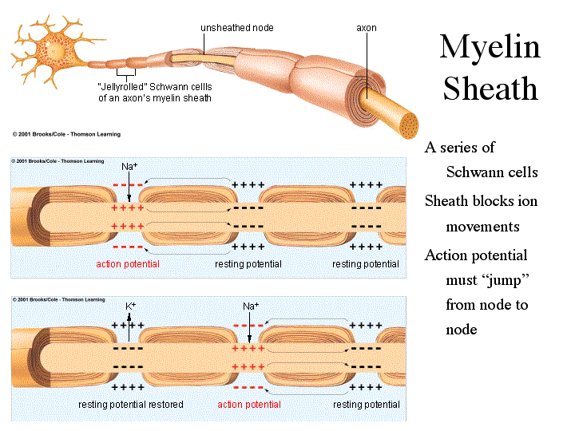

Slide 61
The Synaptic Transmission
In the nervous system, messages move from one location to another in the form of APs along the axons. These electrical events are also called nerve impulses. A message must be transferred in some way to another cell.
At a synapse involving two neurons the impulse passes from the presynaptic neuron to the postsynaptic neuron, a synapse may involve other types of postsynaptic cells e.g. the neuromuscular junction.

Slide 62
A synapse may be electrical (with direct physical contact between the cells). Or chemical (involving a neurotransmitter).

Slide 64
**Events that occur at a cholinergic synapse following the arrival of an AP at the synaptic knob may be summarized by four steps:
*Step I:
-arriving AP depolarized the synaptic knob & the presynaptic membrane.
*Step II:
-Ca+ ions enter the cytoplasm of the synaptic knob.
-acetylcholine (Ach) release occurs by exocytosis of neurotransmitter vesicles.

Slide 66
*Step III:
-Ach binds to receptor on postsynaptic membrane.
-chemically regulated Na+ channels activated (graded depolarization).
-Ach release stops because Ca+ ions are removed from the cytoplasm.
*Step IV:
-depolarization ends as Ach is broken down into acetate & choline by AchE.
-the synaptic knob reabsorbs choline from synaptic cleft & resynthesize Ach.

Slide 67
Cellular Information Processing:
At each synapse, an action potential arriving at a synaptic knob triggers a chemical or electrical event that affect another cell.
Some of the neurotransmitters arriving at the postsynaptic cell may be Excitatory, while others from different presynaptic neuron may be Inhibitory.

Slide 69
The result may be depolarizing or hyperpolarizing changes to the transmembrane potential at the initial segment, so the transmembrane potential at the initial segment is an integration of all the excitatory & inhibitory stimuli.
*The excitatory & inhibitory stimuli are integrated through inter-actions between postsynaptic potentials ((the inter-actions are the simplest level of information processing)).

Slide 70
Postsynaptic Potential: is a graded potential that develop in the postsynaptic membrane in response to a neurotransmitter.
EPSP: is a graded depolarization caused by an arrival of a neurotransmitter at the postsynaptic membrane. EPSP is caused by opening of chemically regulated Na+ ion channels, EPSP affects the area immediately surrounding the synapse. e.g.: Ach

Slide 71
IPSP: is a transient hyperpolarization of the postsynaptic membrane. IPSP may result from the opening chemically regulated K+ ion channels (while the hyperpolarization continue the neuron is inhibited).
((in transmembrane potential where resting at -85mV because of an IPSP the stimulus will depolarize it only to -75mV which is still below threshold)).

Slide 73
Summation:
Is the mechanism responsible for the integration of EPSP, IPSP or some combination of the two in the postsynaptic neuron.
There are two forms of summation
Temporal summation. Spatial summation.

Slide 74
= Temporal summation: is addition of stimuli occurring rapidly at a single synapse. every time an action potential arrives at the synapse another group of vesicles discharges Ach into the cleft.
every time more Ach arrives at the postsynaptic membrane → more chemically regulated channels open → degree of depolarization ↑es → so series of small steps can bring the initial segment to threshold → AP.

Slide 76
= Spatial summation: occur when simultaneous (at the same time) stimuli at different location have accumulative effect on transmembrane potential (involves multiple synapses).
More than one synapse is active at the same time → all will "pour" Na+ ions across postsynaptic membrane → as an effect on the initial segment is accumulative → degree of depolarization depend on number of synapses active → threshold → AP.

Slide 78
Summation of EPSP & IPSP:
IPSP is like EPSP stimulate spatially & temporally (but IPSP is activation of deferent type of ion channels) so the antagonism of IPSP & EPSP is important for cellular information processing

Slide 82
Facilitation:
Spatial or temporal summation of EPSPs will not necessary depolarize the initial segment to threshold. But every step closer to threshold makes it easier for the next stimulus to trigger an AP. So a neuron that has been brought closer to threshold is facilitated.
*The larger degree of facilitation → the smaller the additional stimulus needed to trigger an AP. ((in a highly facilitated neuron → even a small depolarizing stimulus will produce an AP)).

Slide 84
e.g.: nicotine → stimulates postsynaptic synaptic Ach receptors → producing prolonged EPSPs → that facilitate CNS neurons.
e.g.: active ingredients of coffee, colas, cocoa & tea (caffeine, theobromine, theophylline) cause facilitation.
- They lower the threshold at the initial segment → so a smaller than usual depolarization will cause an AP.
- They also ↑es the amount of Ach released.

Slide 85
Chloride (Cl-) channels & EPSP & IPSP summation:
The chemicals that inhibit EPSP formation open chemically regulated Cl- channels rather than K+ channels.
- the equilibrium potential for Cl- ions is -70mV. With the Cl- channel open, any shift in transmembrane potential to -65mV (above -70mV) → Cl- ions start rushing into the cell. So it will acquire much larger –than –normal stimulus to depolarize the membrane to threshold.

Slide 88
Presynaptic Inhibition & Facilitation
* the axoaxonal synapse that occur on the synaptic knob can alter of modify the rate of neurotransmitter released from the presynaptic membrane.
.

Slide 89
Presynaptic Facilitation → activity at axoaxonal synapse ↑es amount of neurotransmitter release when AP arrives at the synaptic knob, e.g. Serotonin → voltage regulated Ca+ channel remain open.
AP arrives.
prolong opening of Ca+ channels.
more Ca+ enters.
more neurotransmitter released.
↑es effect on post synaptic membrane

Slide 92
Presynaptic Inhibition → GABA inhibit the opening of voltage regulated Ca+ channels in the synaptic knob → ↓es amount of neurotransmitter release when AP arrives at the synaptic knob.
AP arrive.
fewer Ca+ channels open.
less Ca+ inters.
less neurotransmitter relese.
↓es effect on postsynaptic membrane.

Slide 95
The Spinal Cord
Every spinal segment is associated with a pair of dorsal root ganglia (that contain the cell bodies of sensory neurons). The dorsal roots which contain the axons of these neurons they bring sensory information into the spinal cord.
A pair of ventral roots that contains the axons of motor neurons which extend to the periphery controlling somatic & visceral effectors.

Slide 97
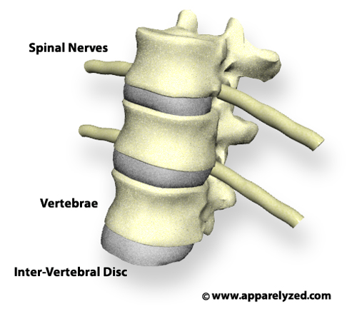
On either sides the dorsal & ventral roots of each segment pass through the inter-ventral foramen.

Slide 98
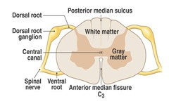
Distal to each dorsal ganglion, the sensory & motor roots are bound together into a single spinal nerve, spinal nerves are mixed nerves because they contain both afferent (sensory) & efferent (motor) fibers, there are 31 pairs of spinal nerves.

Slide 99
The spinal nerves takes the name of the segment of the vertebrae, e.g. T1, T2, C1, L3, S2……… .

Slide 100
Cervical spinal nerves: C1 – C8
Thoracic spinal nerves: T1 – T12
Lumber spinal nerves: L1 – L5
Sacral spinal nerves: S1 – S5

Slide 102
Spinal Meninges “or membranes”
These provide the physical stability & shock absorption & blood vessels branching within these layers also deliver oxygen & nutrients to the spinal cord, there are 3 meningeal layers (1- the dura mater 2- the arachnoid 3- the pia mater). These are continuous with the cranial meninges of brain.

Slide 104
Sectional organization of spinal cord
The anterior median fissure & the posterior median sulcus mark the division between left & right sides of the spinal cord.

Slide 105
Superficial white matter contain large number of myelinated & non myelinated axons.
The gray matter contain the cell bodies of neurons & the projections of gray matter toward the outer surface of the spinal cord are called horns.

Slide 106
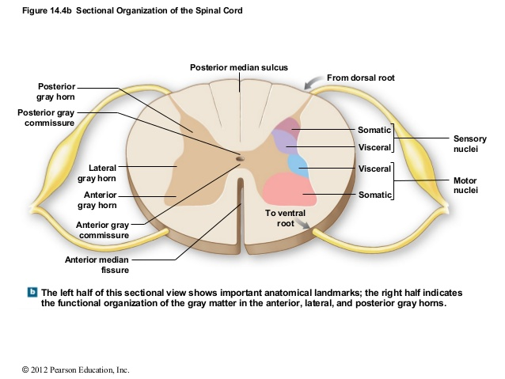

Slide 107
Gray Matter: the cell bodies of neurons in the gray matter of the spinal cord are organized into functional groups called nuclei.
Sensory nuclei: receive & rely sensory information from peripheral receptors.
Motor nuclei: issue motor commands to peripheral effectors.
= the posterior or dorsal gray horns contain somatic & visceral sensory nuclei.
= the anterior or ventral gray horns contain somatic motor nuclei.
= the lateral gray horns ((located only in the thoracic & lumber segments)) these contain visceral motor nuclei.

Slide 109
White Matter: can be divided into three regions called columns:
Posterior white column.
Anterior white column.
Lateral white column

Slide 110
Reflexes
Reflexes: they are rapid automatic responses to specific stimuli.
-neural reflexes: in which sensory fibers delivers information to the CNS & motor fibers commands to peripheral effectors.

Slide 112
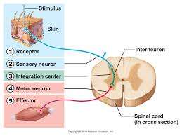
The Reflex Arc: a reflex arc begins at a receptor & ends at a peripheral effecter such as a muscle fiber or gland cell. There are five steps involved in a neural reflex:

Slide 113
Step I: arrival of stimulus & activation of a receptor: receptors are specialized cells or dendrites of a sensory neuron. The receptors are sensitive to physical or chemical changes in the body or to the external environment. If there is a pain stimulus there will be activation to the pain receptor.
Step II: activation of a sensory neuron: stimulation of pain receptor leads to the formation & propagation of AP along the axon of sensory neurons.
Information reaches the spinal cord with one of the dorsal roots, step I & II involve the same neuron or a different neuron e.g. : in laud sound a reflex is triggered when receptor release a neurotransmitter that stimulate a second neuron.

Slide 115
Step III: information processing: it begins when a neurotransmitter is released by the synaptic knob & affect the post synaptic membrane of an interneuron producing an EPSP. Some times the sensory neuron innervates a motor nerve directly.
Step IV: activation of a motor neuron: the axons of the stimulated motor neurons carry APs in to the periphery over the ventral root of the spinal cord.
Step V: respond of a peripheral effecter: release of neurotransmitter by the motor neurons at the synaptic knobs → response by peripheral effecter, skeletal muscle → contraction.

Slide 118
Classification of Reflexes:
According to their development.
Site where information processing occur.
Nature of the resulting motor response.
Complexity of neural circuit involved.

Slide 119
According to Development of reflexes:
Innate reflexes: result from the connections that form between neurons during development. e.g. removing your hand from a hot plate & blinking when your eye lashes are touched.
Acquired reflex: learned motor patterns. These motor responses are rapid & automatic but they where learned rather than pre-established e.g. a driver steps on the break when trouble appears on the road.

Slide 120
The Processing sites:
Spinal reflex: the important interconnections & processing occur inside the spinal cord
Cranial reflex: the reflex processed in the brain e.g. movements in response to a loud noise, or bright light.

Slide 121
The Nature of the response:
Somatic reflex: mechanism of involuntary control of muscular system.
Visceral reflex: or autonomic reflex, control activities of other systems.

Slide 122
The Complexity of the circuit:
Monosynaptic reflexes: it is the simplest reflex arc, the sensory neuron synapse directly on a motor neuron which it self serves as the processing center.
e.g. the starch reflex: Knee jerk reflex or patellar reflex, because of the presence of muscle spindles (sensory receptors).
Polysynaptic reflexes: it have at least one interneuron between the sensory & motor neurons.
e.g. the tendon reflex: presence of the sensory receptors on the tendon called (Golgi tendon organs) → these stimulate inhibition of interneuron that innervate motor neuron of skeletal muscle.

Slide 123
The Brain
1. Cerebrum : responsible for
- conscious thought processes, intellectual functions.
- memory storage & processing.
- conscious & subconscious regulation of skeletal muscle contractions.
2. Cerebellum: responsible for
- coordinating complex somatic motor patterns.
- adjust out put of other somatic motor centers in brain & spinal cord.

Slide 124
3. Diencephalone:
- thalamus:- relay & processing centers for sensory information.
- Hypothalamus:- centers controlling emotions, autonomic functions &
- hormone productions.
4. Mesencephalon:
- processing of visual & auditory data.
- generation of reflexive somatic motor responses.
- maintenance of consciousness.

Slide 125
5. Pons :
- relays sensory information to cerebellum & thalamus.
- subconscious somatic & visceral motor centers.
6. Medulla Oblongata: -relays sensory information to thalamus & to other portions of the Brain stem.
- autonomic centers for regulation of visceral functions (cardio-vascular, respiratory & digestive systems activities.

Slide 126
The Cranial Meninges: the layers that make up the cranial meninges are the dura mater, arachnoid & pia mater these are continuous with those of the spinal cord

Slide 127
CSF
The CSF completely surrounds & bathes the exposed surfaces of the CNS. The CSF has several functions:
Cushioning delicate structures.
Supporting the brain. The brain floats in the CSF, human brain weight 1400g in air but only about 50g when supported by the CSF.
Transporting nutrients, chemical messengers & waste products.

Slide 128
The Cranial Nerves:
1. The Olfactory Nerves (N I)
Primary function: special sensory (smell).
Origin: receptors of olfactory epithelium.
Destination: olfactory bulbs.
2. The optic Nerves (NII)
Primary function: special sensory (vision).
Origin: retina of eye.
Destination: diencephalons via the optic chiasm.

Slide 129
3. The oculomotor Nerves (NIII)
Primary function: motor (eye movements).
Origin: mesencephalon.
Destination: Somatic motor=superior, inferior & medial rectus muscles, inferior oblique muscle, levator palpebrae superioris muscles.
Visceral motor=intrinsic eye muscle.
4. The Trochlear Nerves (NIV)
Primary function: motor (eye movement).
Origin: mesencephalon.
Destination: superior oblique muscle.

Slide 130
5. The Trigeminal Nerves (NV)
Primary function: mixed (sensory & motor) to face.
Origin:
- ophthalmic branch (sensory)= orbital structure, nasal cavity, skin of the forehead, upper eyelids nose.
- maxillary branch (sensory)= lower eye-lid, upper lip, guns & teeth, cheek, nose, palate & pharynx.
- mandibular branch (mixed)= Sensory from lower gum, teeth & lips, palate & tongue.
Motor from motor nuclei of pons.
Destination: ophthalmic & maxillary branches to sensory nuclei in pons, mandibular branch inervate muscles of mastication.
6. The Abducens Nerves (VI)
Primary function: motor (eye movement).
Origin: pons.
Destination: lateral rectus muscle.

Slide 131
7. The facial Nerves (VII)
Primary function: mixed (sensory & motor) to face.
Origin: sensory from taste receptors on the tongue.
motor from motor nuclei of pons.
Destination: sensory to sensory nuclei of pons.
Somatic motor= muscles of the facial expression.
Visceral motor= lacrimal (tear) glands, nasal mucous glands, submandibular & sublingual salivary glands.
8. The Vestibular Nerves (NVIII)
Primary function: special sensory = balance & equilibrium(vestibular branch) & hearing(cochlear branch).
Origin: monitor receptors of the inner ear(vestibule & cochlea).
Destination: vestibular & cochlear nuclei of pons & medulla oblongata.

Slide 132
9. The Glossopharyngeal Nerves (NIX)
Primary function: mixed (sensory & motor) to head & neck.
Origin: Sensory= from posterior one-third of the tongue, part of the pharynx & palate,
carotid arteries of the neck.
Motor= from the motor nuclei of medulla oblongata.
Destination: Sensory= to sensory nuclei in medulla oblongata.
Motor= somatic: pharyngeal muscles(involve in swallowing).
visceral: parotid salivary gland.
10. The Vagus Nerves (NX)
Primary function: mixed (sensory & motor) widely distributed in thorax & abdomen.
Origin: sensory= from pharynx(part), pinna & external auditory canal, diaphragm &
visceral organ in thoracic & abdominopelvic cavities.
motor= from nuclei in medulla oblongata.
Destination:
sensory= fibers to sensory nuclei & autonomic centers of medulla oblongata.
motor (visceral )= fibers to muscles of the palate, pharynx, diagestive, respiratory & cardiovascular system in thoracic & abdominal cavities.

Slide 133
11. The Accessory Nerves (NXI)
Primary function: motor to muscles of the neck & upper back.
Origin: motor nuclei of spinal cord & medulla oblongata.
Destination: medullary branches innervate, spinal branches control sternodeidomastoid.
12. The Hypoglossal Nerves (NXII)
Primary function: motor (tongue movement).
Origin: motor medulla oblongata.
Destination: muscles of the tongue.

Slide 134
The Autonomic Nervous System (ANS)
* In the ANS there is always a second visceral motor neuron interposed between the CNS & the peripheral effectors.
The visceral motor neurons in the CNS are known as preganglionic neurons, the axons of these neurons are called preganglionic fibers.
The pregangilionic fibers leave the CNS and synapse on neurons in autonomic ganglia (these are called ganglionic neuron). The ganglionic neurons control peripheral effectors such as cardiac muscles, smooth muscles, glands. The axon of the ganglionic neurons are called post ganglionic fibers.
ANS is subdivided to: Sympathetic division Parasympathetic division

Slide 135
The two divisions have opposing effects, if the sympathetic division causes excitation, the parasympathetic causes inhibition.
Sympathetic Division:- (fight or flight) response
heightened mental alertness.
↑es metabolism (metabolic rate).
reduced digestive & urinary functions.
activation of energy reserves.
↑es respiratory rate & dilation of respiratory passageways.
↑es heart rate & blood pressure.
activation of sweat glands.
Parasympathetic Division:- stimulate visceral activity, (rest & repose) state that fallow a big dinner.
↓ed metabolic rate.
↓ed heart rate & blood pressure.
↑ed secretion by salivary & digestive glands.
↑ed motility and blood flow in the digestive gland.
stimulation of urination & defecation.

