Slide 1
beta-Thalassaemia syndromes

Slide 2
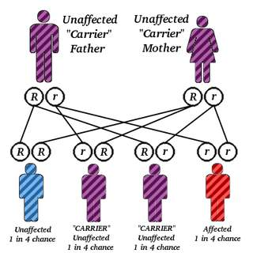
β-Thalassaemia major
This condition occurs on average in one in four offspring if both parents are carriers of the β thalassaemia rait.
Either no β chain (β 0)
or small amounts (β +) are synthesized

Slide 3
Excess α chains precipitate in erythroblasts and in mature red cells causing
*the severe ineffective erythropoiesis and
*haemolysis that are typical of this disease.
The greater the α-chain excess, the more severe the
anaemia.
Production of ɣchains helps to 'mop up'
excess α chains and to ameliorate the condition

Slide 4
Over 200 different genetic defects have now been
detected
Unlike α-thalassaemia, the majority of genetic
lesions are point mutations rather than gene deletions.
These mutations may be within the gene
complex itself or
in promoter or enhancer regions.
Certain mutations are particularly frequent in some
Communities and this may simplify antenatal
diagnosis aimed at detecting the mutations in
fetal DNA.

Slide 6
Thalassaemia major is often a result of inheritance of two different mutations, each affecting
β-globin synthesis (compoud heterozygotes).
In some cases, deletion of the β gene, δand β genes
or even δ, β and ɣ genes occurs.
In others, unequal crossing-over has produced δ, β fusion genes (so called Lepore syndrome named after the first family in which this was diagnosed

Slide 7
Clinical features
1 Severe anaemia becomes apparent at 3-6 months
after birth when the switch from ɣ to β-chain production should take place.
2 Enlargement of the liver and spleen occurs as a
result of excessive red cell destruction,extramedullary
haemopoiesis and later because of iron overload.
The large spleen increases blood requirements by increasing red cell destruction and pooling, and by
causing expansion of the plasma volume

Slide 8
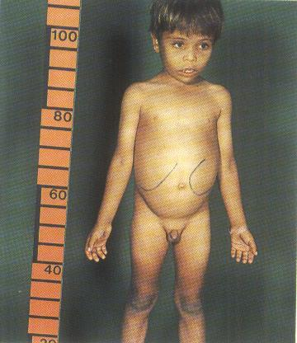

Slide 9
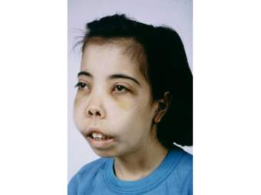
3 Expansion of bones caused by intense marrow
hyperplasia leads to a thalassaemic facies
and to thinning of the cortex of many bones with a
tendency to fractures and bossing of the skull with a
'hair-on-end' appearance on X-ray

Slide 10
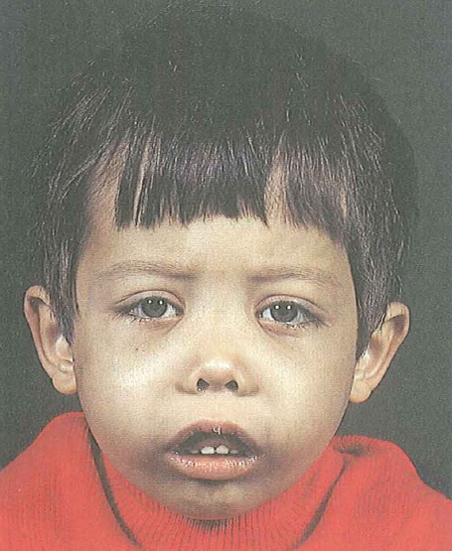
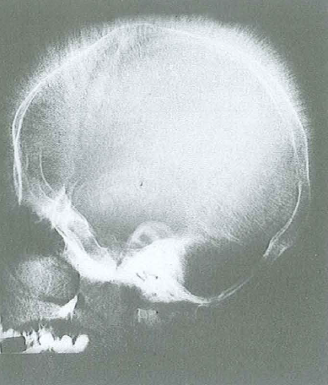

Slide 11
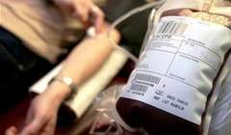
4 The patient can be sustained by blood transfusions
but iron overload caused by repeated
transfusions is inevitable unless chelation therapy
is given .
Each 500 mL of transfused
blood contains approximately 250 mg iron.
To make matters worse, iron absorption from food is
increased in β-thalassaemia??

Slide 12
Iron damages the liver and the endocrine organs with failure
of growth, delayed or absent puberty, diabetes mellitus,
hypothyroidism and hypoparathyroidism.
Skin pigmentation as a result of excess melanin and haemosiderin gives a slately grey appearance at
an early stage of iron overload.
Most importantly, iron damages the heart. In the
absence of intensive iron chelation, death occurs in
the second or third decade, usually from congestive
heart failure or cardiac arrhythmias.

Slide 13
T2* magnetic resonance imaging (MRI) is a valuable measure
of cardiac (or liver) iron
It can detect increased cardiac iron before sensitive tests detect impaired cardiac function. Serum ferritin and liver
iron show poor correlation with cardiac iron estimated
by T2*MRI

Slide 15
5- Infections can occur for a variety of reasons.
In infancy, without adequate transfusion, the anaemic
child is prone to bacterial infections. Pneumococcal,
Haemophilus and meningococcal infections are likely
if splenectomy has been carried out and prophylactic
penicillin is not taken. Yersinin enterocolitica occurs, particularly in iron-loaded patients being treated with deferoxamine; it may cause severe gastroenteritis.
Transfusion of viruses by blood transfusion may occur. Liver disease in thalassaemia ismost frequently a result of hepatitis C but hepatitis Bis also common where the virus is endemic. Human immunodeficiency virus (HIV) has been transmitted
to some patients by blood transfusion.

Slide 16
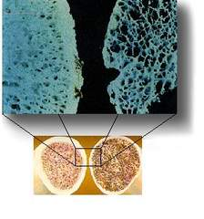
6 -Osteoporosis may occur in well-transfused patients.
It is more common in diabetic patients with
endocrine abnormalities and with marrow expansion
resulting from ineffective erythopoiesis.

Slide 17
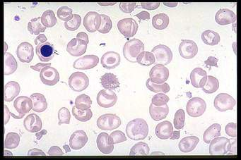
Laboratory diagnosis
1 -There is a severe hypochromic, microcytic
anaemia, raised reticulocyte percentage with normoblasts,target cells' and basophilic stippling in the blood film

Slide 18
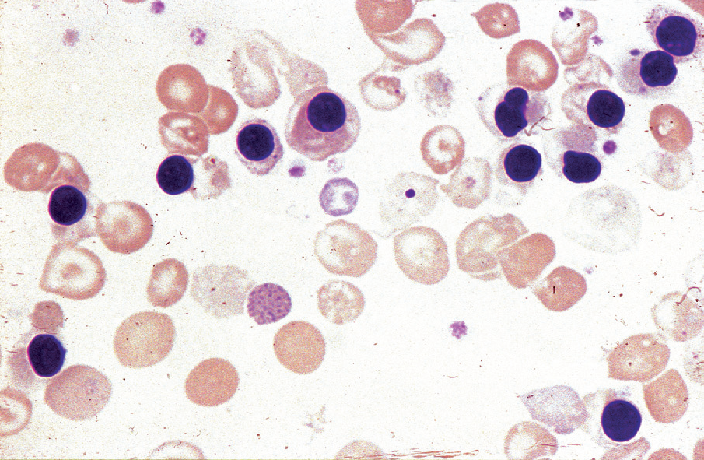

Slide 19
2 Haemoglobin electrophoresis reveals absence
or almost complete absence of Hb A, with almost
all the circulating haemoglobin being Hb F. The
Hb A2 percentage is normal, low or slightly raised
High performance liquid chromatography is now usually used as first-line method to diagnose haemoglobin disorders
α/β-Globin chain synthesis studies on reticulocytes
show an increased α:β ratio with reduced or
absent β -chain synthesis.
DNA analysis is used to identify the defect on each allele.

Slide 20
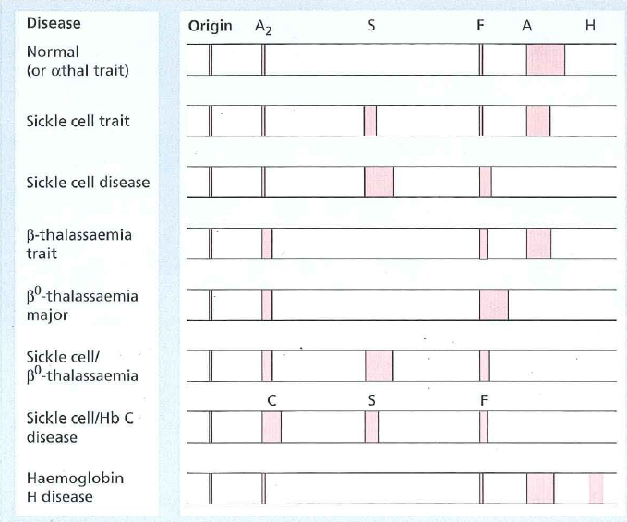

Slide 21
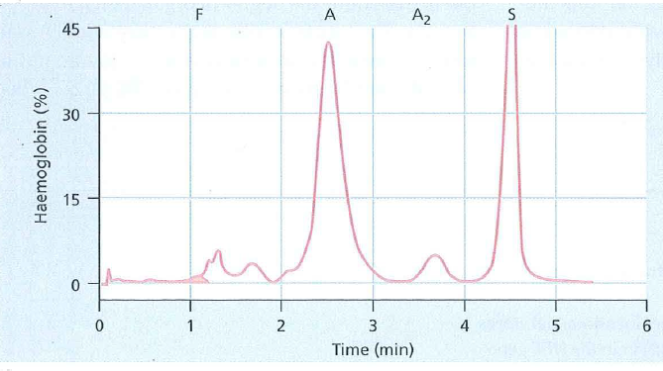

Slide 22
Lab. findings

Slide 23
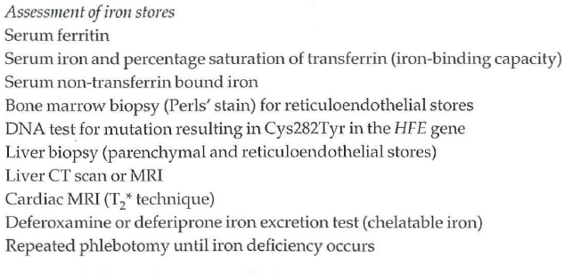

Slide 24
