Slide 1
Immunopathology
Dr. Maysem M. Alwash

Slide 2
The Normal Immune Response
Immunity: is defense against infectious pathogens,.

Slide 3
The mechanisms of protection against infections fall into two broad categories:

Slide 4
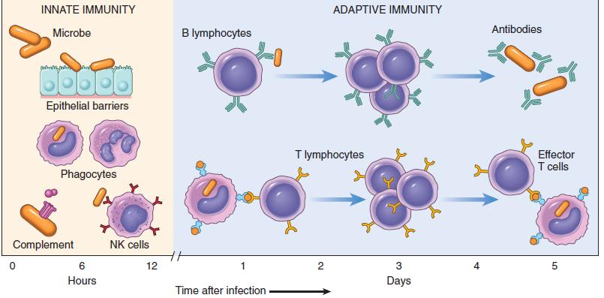

Slide 5
1.Innate immunity (also called natural, or native, immunity)
-
refers to defense mechanisms that are present even before infection.

Slide 6
Innate immunity is the first line of defense.
- -The major components of innate immunity are :epithelial barriers, phagocytic cells (mainly neutrophils and macrophages), dendritic cells, natural killer (NK) cells, and several plasma proteins, including the proteins of the complement system..

Slide 7
2.Adaptive immunity (also called acquired, or specific, immunity)
- It consists of mechanisms that are stimulated by (“adapt to”) microbes and are capable of recognizing microbial and nonmicrobial substances.

Slide 8
-Adaptive immunity develops later, after exposure to microbes, and is even more powerful than innate immunity in combating infections.
-It consists of lymphocytes and their products, including antibodies.

Slide 9
There are two types of adaptive immunity:
1-Humoral immunity, which protects against extracellular microbes and their toxins, and is mediated by B (bone marrow–derived) lymphocytes and their secreted products, antibodies (also called immunoglobulins, Ig),

Slide 10
2-Cell-mediated (or cellular) immunity, which is responsible for defense against intracellular microbes. and is mediated by T (thymus-derived) lymphocytes..

Slide 11
Tissues of the Immune System:
1.Generative (also called primary, or central) lymphoid organs:
in which T and B lymphocytes mature and become competent to respond to antigens. It consists of bone marrow and thymus

Slide 12
2. The peripheral (or secondary) lymphoid organs:
in which adaptive immune responses to microbes are initiated.It consist of the lymph nodes, spleen, and the mucosal and cutaneous lymphoid tissues.

Slide 13
Cells of the Immune System:
.

Slide 14
1.T Lymphocytes :
-Thymus-derived, or T, lymphocytes are the effector cells of cellular immunity and the “helper cells” for antibody responses to protein antigens.
-

Slide 15
T cells constitute 60% to 70% of the lymphocytes in peripheral blood and are the major lymphocyte population in splenic periarteriolar sheaths and lymph node interfollicular zones

Slide 16
Each T cell recognizes a specific cell-bound antigen by means of an antigen-specific T-cell receptor (TCR).
In approximately 95% of T cells the TCR are αβ TCR .
-The αβ TCR recognizes peptide antigens that are displayed by major histocompatibility complex (MHC) molecules on the surfaces of antigen-presenting cells (APCs)..

Slide 17
CD4 is expressed on approximately 50- 60% of mature T cells, which function as cytokine-secreting helper cells that help macrophages and B lymphocytes to combat infections.
-.

Slide 18
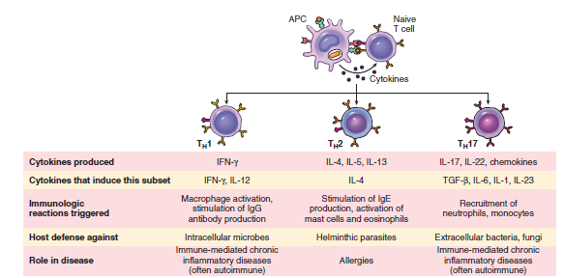

Slide 19
CD8 is expressed on about 40% of T cells, which function as cytotoxic (killer) T lymphocytes (CTLs) directly killing virus-infected or tumor cells.,
-

Slide 20
CD4+ helper T cells can recognize and respond to antigen displayed only by class II MHC molecules , whereas CD8+ cytotoxic T cells recognize cell-bound antigens only in association with class I MHC molecules

Slide 21
2. B Lymphocytes :
-Bone marrow–derived B lymphocytes are the cells that produce antibodies and are thus the effector cells of humoral immunity.
-

Slide 22
They make up 10% to 20% of the circulating peripheral lymphocyte population.
They also are present in bone marrow and in the follicles of peripheral lymphoid tissues (lymph nodes, spleen, tonsils, and other mucosal tissues).

Slide 23
-B cells recognize antigen by means of membrane-bound antibody of the immunoglobulin M (IgM) class, expressed on the surface .
-

Slide 24
B cells can recognize and respond to many more chemical structures, including soluble or cell-associated proteins, lipids, polysaccharides, nucleic acids, and small chemicals..

Slide 25
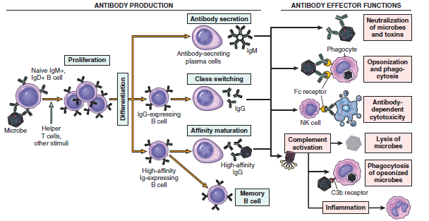

Slide 26
3.Natural Killer Cells:
-NK cells kill cells that are infected by some microbes or are stressed and damaged beyond repair.
- NK cells express inhibitory receptors that recognize MHC molecules that are normally expressed on healthy cells, and are thus
prevented from killing normal cells.

Slide 27
4. Antigen-Presenting Cells(APCs)
-APCs capture microbes and other antigens, transport them to lymphoid organs, and display them for recognition by lymphocytes. The most efficient APCs are Dendritic Cells DCs, which are located in epithelia and most tissues.
- Macrophages are other Antigen-Presenting Cells.

Slide 28
Major Histocompatibility Complex Molecules( MHC):
-.

Slide 29
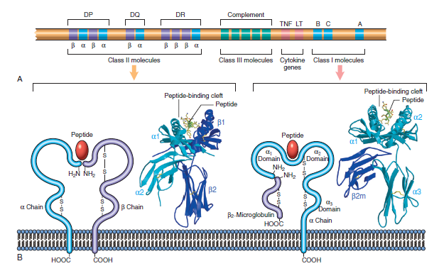
MHC

Slide 30
The human MHC, known as the human leukocyte antigen (HLA) complex, consists of a cluster of genes on chromosome 6.
-The HLA system is highly polymorphic; that is, there are several alternative forms (alleles) of a gene at each locus

Slide 31
On the basis of their chemical structure, tissue distribution, and function, MHC gene products fall into two main categories:
1. Class I MHC molecules are encoded by three closely linked loci, designated HLA-A, HLA-B, and HLA-C.

Slide 32
-Class I MHC molecules are present on all nucleated cells of the body.
-CD8+ T cells can respond to peptides displayed by class I molecules.
-In general, class I MHC molecules bind and display peptides derived from proteins synthesized in the cytoplasmof the cell (e.g., viral antigens).

Slide 33
2.Class II MHC molecules : are encoded by genes in the HLA-D region, which contains at least three subregions: DP, DQ, and DR.
-CD4+ T cells can respond to peptides displayed by class II molecules.
-Class II MHC expression is restricted to a few types of cells, mainly APCs (notably, dendritic cells [DCs]), macrophages, and B cells.
-

Slide 34
In general, class II MHC molecules bind to peptides derived from proteins synthesized outside the cell (e.g., those derived from extracellular bacteria) and ingested into the cell.

Slide 35
Each individual expresses maternal and paternal alleles of the class I
MHC and class II MHC loci.
-Each person expresses a unique MHC antigenic profile on his or her cells.

Slide 36
The combination of HLA alleles for each person is called the HLA haplotype.
-.

Slide 37
The implications of HLA polymorphism are obvious in the context of transplantation—because each person has HLA alleles that differ to some extent from every other person’s, grafts from virtually any donor will evoke immune responses in the recipient and be rejected (except, of course, for identical twins)

Slide 38
- Many autoimmune diseases are associated with particular HLA alleles.

Slide 39
- MHC class III molecules:
These include complement components (C2, C3, and Bf) and the cytokines tumor necrosis factor and lymphotoxin

Slide 40
HYPERSENSITIVITY REACTIONS:
-Individuals who have been previously exposed to an antigen are said to be sensitized.
-Sometimes, repeat exposures to the same antigen trigger an excessive response to antigen,a pathologic reaction; described as hypersensitivity.

Slide 41
Causes of Hypersensitivity Reactions
1.Autoimmunity: reactions against self antigens.
2.Reactions against microbes.
3.Reactions against environmental antigens.
almost 20% of the population are “allergic” to common environmental substances (e.g., pollens, animal danders, or dust mites).

Slide 42
Types of Hypersensitivity Reactions
:
Hypersensitivity reactions are traditionally subdivided into four types based on the principal immune mechanism responsible for injury:

Slide 43
1 -Immediate (Type I) Hypersensitivity:
Immediate (type I) hypersensitivity results from the activation of the T_{H}2 subset of CD4+ helper T cells by environmental antigens (introduced by inhalation, ingestion, or Injection),

Slide 44
which is induced to secrete several cytokines, including IL-4, IL-5, and IL-13, which are responsible for essentially all the reactions of immediate hypersensitivity. IL-4 stimulates B cells leading to the production of IgE antibodies.

Slide 45
IgE antibodies become attached to mast cells (Mast cells are widely distributed in tissues, often near blood vessels and nerves and in subepithelial locations) by a high-affinity receptor for the Fc portion of the ε heavy chain of IgE, called FcεRI..

Slide 46
On re-exposure, allergen binds to and cross-links the IgE FcER1 and results in activation of mast cells and degranulation with secretion of various mediators .

Slide 47
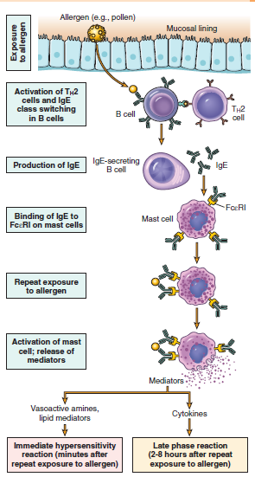
TYPE I HYPERSENSITIVITY

Slide 48
Often, the IgE-triggered reaction has two well-defined phases :
(1) the immediate response,: mediated by vasoactive amines released from granules of mast cells (e.g. Histamine , Proteases) and lipid mediators,

Slide 49
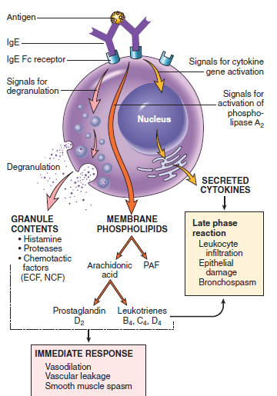
Mast cell mediators.

Slide 50
characterized by vasodilation, vascular leakage, and smooth muscle spasm, which usually evident within 5 to 30 minutes after exposure to an allergen and subsiding by 60 minutes

Slide 51
(2) late-phase reaction that usually sets in 2 to 8 hours later and may last for several days and is characterized by inflammation as well as tissue destruction, such as mucosal epithelial cell damage..

Slide 52
The dominant inflammatory cells are neutrophils, eosinophils, and lymphocytes, especially TH2 cells,the mediaters are cytokines

Slide 53
An immediate hypersensitivity reaction may occur as a systemic disorder or as a local reaction , is often determined by the route of antigen exposure.

Slide 54
Systemic exposure to protein antigens (e.g., in bee venom) or drugs (e.g., penicillin) may result in systemic anaphylaxis. Within minutes of the exposure in a sensitized host, itching, urticaria (hives), and skin erythema appear, followed in short order by pulmonary bronchoconstriction and hypersecretion of mucus. Laryngeal edema causing upper airway obstruction.

Slide 55
Sometimes involvement of the gastrointestinal tract with resultant vomiting, abdominal cramps, and diarrhea. Without immediate
intervention, there may be anaphylactic shock and death within minutes.

Slide 56
Local reactions generally occur when the antigen is confined to a particular site, such as skin (contact, causing urticaria), gastrointestinal tract (ingestion, causing diarrhea), or lung (inhalation, causing bronchoconstriction), hay fever, and certain forms of asthma

Slide 57
The term atopy is used to imply familial predisposition to such Susceptibility to localized type I reactions ,it has a strong
genetic component reactions.

Slide 59
In IgE mediated hypersensitivity, all of the following are needed except
A) antigen presenting cell
B) B cell
C) IgE antibody
D) mast cell
E) neutrophil

Slide 60
THANK YOU

