Slide 1
Orthopaedic operations
The art and skill of orthopaedic surgery is directed not simply to reshaping or constructing a particular arrangement of parts but to restoring function to the whole.
(LIFE IS MOVEMENT AND MOVEMENT IS LIFE)

Slide 2
A-OPERATIONS ON BONES
OSTEOTOMY.
BONE FIXATION (internal or external fixation).
BONE GRAFT.
B-OPERATIONS ON JOINTS
ARTHROTOMY
ARTHRODESIS
ARTHROPLASTY

Slide 3
AMPUTATIONS
INDICATIONS: -
‘Three Ds’:
(1) Dead.
(2) Dangerous .
(3) Damned nuisance.

Slide 4
1-Dead (or dying) Peripheral vascular disease accounts for almost 90 per cent of all amputations. Other causes of limb death are severe trauma, burns and frostbite.
2-Dangerous ‘Dangerous’ disorders are malignant tumours, potentially lethal sepsis and crush injury. In crush injury, releasing the compression may result in renal failure (the crush syndrome).
3-Damned nuisance Retaining the limb may be worse than having no limb at all. This may be because of: (1)
pain; (2) gross malformation; (3) recurrent sepsis or (4) severe loss of function. The combination of deformity and loss of sensation is particularly trying, and in the lower limb is likely to result in pressure ulceration.

Slide 5
AMPUTATIONS AT SITES OF ELECTION
Most lower limb amputations are for ischaemic disease and are performed through the site of election below the most distal palpable pulse. The selection of amputation level can be aided by Doppler US.
The sites of election are determined also by the demands of prosthetic design and local function. Too short a stump may tend to slip out of the prosthesis.
Too long a stump may have inadequate circulation and can become painful, or ulcerate; moreover, it complicates the incorporation of a joint in the prosthesis

Slide 6
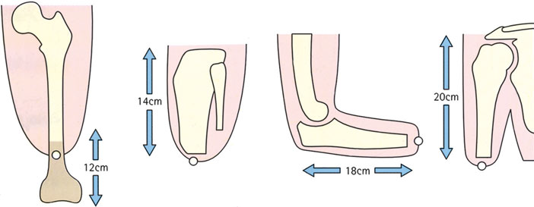
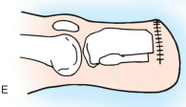
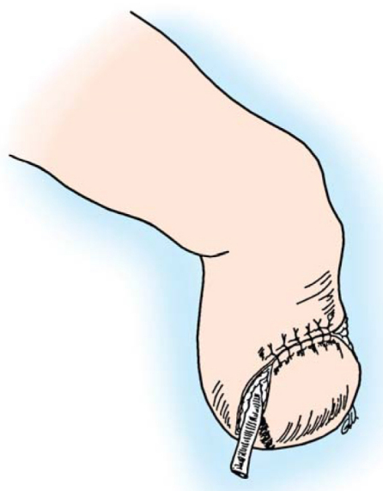
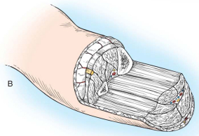
The traditional sites of election;the scar is made terminalbecause these are not endbearing stumps.

Slide 7
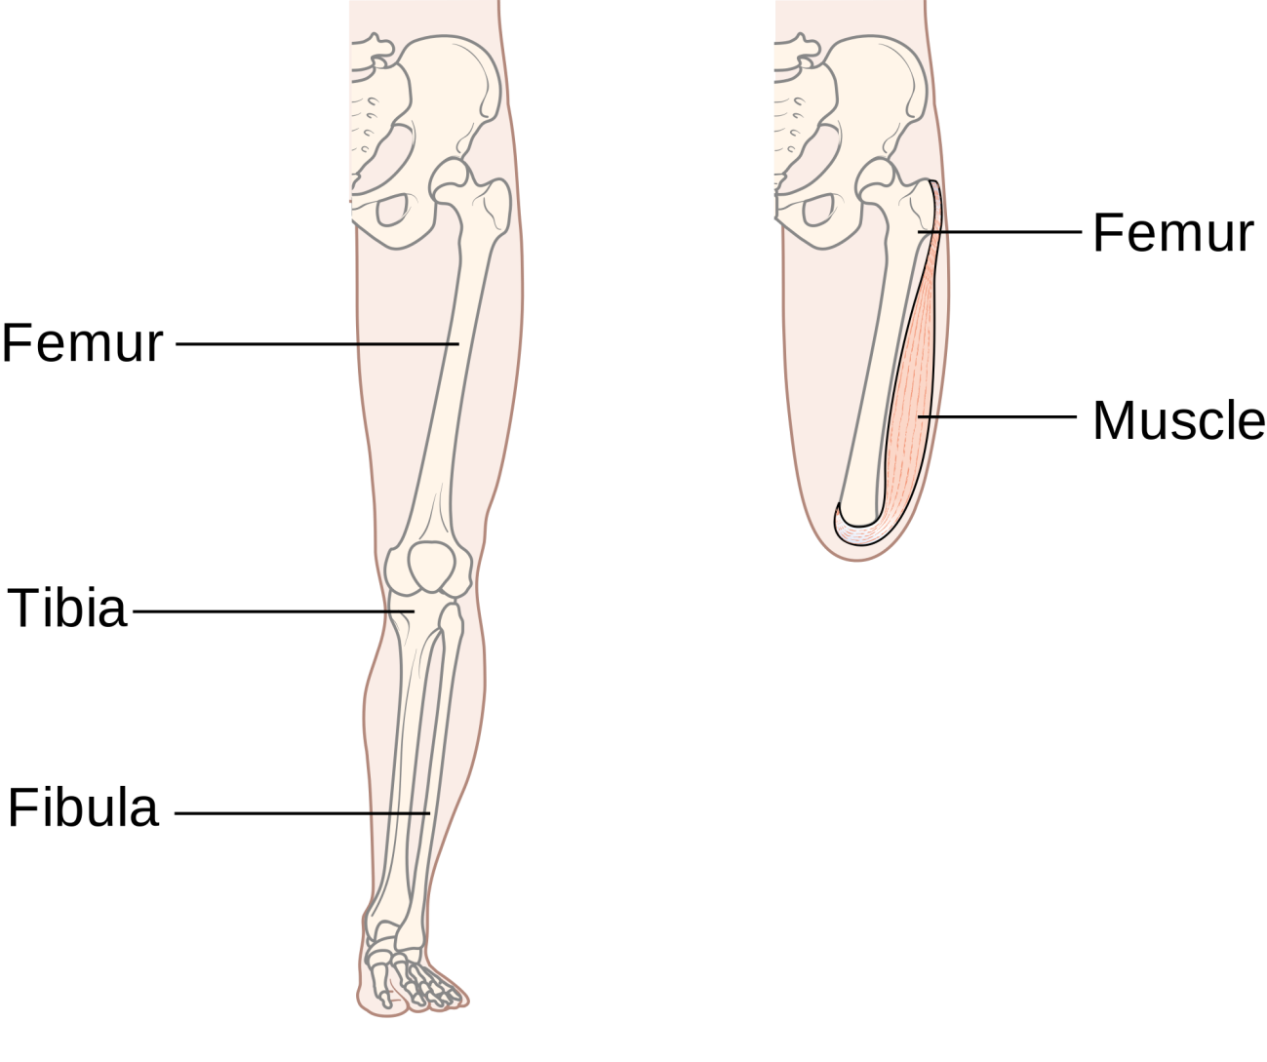
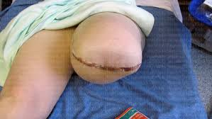

Slide 8
PRINCIPLES OF TECHNIQUE
A tourniquet is used unless there is arteria insufficiency. Skin flaps are cut so that their combined length equals 1.5 times the width of the limb at the site of amputation. As a rule anterior and posterior flaps of equal length are used for the upper limb and for transfemoral
(above-knee) amputations; below the knee a
long posterior flap is usual. Muscles are divided distal to the proposed site of bone section.
It is also helpful to pass the sutures that anchor the opposing muscle groups through drill-holes in the bone end, creating an osteomyodesis. Nerves are divided proximal to the bone cut to ensure a cut nerve end will not bear weight

Slide 9
The bone is sawn across at the proposed level. In trans-tibial amputations the front of the tibia is usually bevelled and filed to create a smoothly rounded contour; the fibula is cut 3 cm shorter.
The main vessels are tied, the tourniquet is removed and every bleeding point meticulously ligated.The skin is sutured carefully without tension. Suction drainage is advised and the stump covered without constricting passes of bandage; figure-of eight passes are better suited and prevent the creation of a venous tourniquet proximal to the stump.

Slide 10
AFTERCARE
If a haematoma forms, it is evacuated as soon as possible. After satisfactory wound healing, gradualcompression stump socks are used to help shrink the stump and produce a conical limb-end. The muscles must be exercised, the joints kept mobile and the patient taught to use his prosthesis.

Slide 11
AMPUTATIONS OTHER THAN AT SITES OF ELECTION
1-Interscapulo-thoracic (forequarter amputation)
2-Disarticulation at the shoulder
3-Amputation in the forearm
4-Amputations in the hand
5-Hemipelvectomy (hindquarter amputation)
6-Disarticulation through the hip
7-Transfemoral amputations (Above KneeAmputation)
8-Around the knee
9-Transtibial (below-knee) amputations
10-Above the ankle Syme’s amputation
11-Partial foot amputation

Slide 12
COMPLICATIONS OF AMPUTATION STUMPS
A-EARLY COMPLICATIONS
1-Breakdown of skin flaps This may be due to ischaemia,suturing under excess tension or (in below-knee amputations) an unduly long tibia pressing against the flap.
2-Gas gangrene Clostridia and spores from the perineum may infect a high above-knee amputation (or reamputation), especially if performed through ischaemic tissue.
3-secondary haemorrhage.

Slide 13
LATE COMPLICATIONS
1-Skin Eczema is common, and tender purulent lumps may develop in the groin. A rest from the prosthesis is indicated.
2-Muscle If too much muscle is left at the end of the stump, the resulting unstable ‘cushion’ induces a feeling of insecurity that may prevent proper use of a prosthesis; if so, the excess soft tissue must be excised.
3-Blood supply Poor circulation gives a cold, blue stump
that is liable to ulcerate. This problem chiefly arises
with below-knee amputations and often re-amputation
is necessary.

Slide 14
4-Nerve A cut nerve always forms a neuroma and
occasionally this is painful and tender. Excising 3 cm of
the nerve above the neuroma sometimes succeeds.
Phantom limb’ This term is used to describe the
feeling that the amputated limb is still present.
5-Joint The joint above an amputation may be stiff or
deformed. A common deformity is fixed flexion and
fixed abduction at the hip in above-knee stumps
(because the adductors and hamstring muscles have
been divided). It should be prevented by exercises.
Fixed flexion at the knee makes it difficult to walk properly and should also be prevented.
6-Bone a spur often forms at the end of the bone, but
is usually painless. If there has been infection, however,
the spur may be large and painful and it may be
necessary to excise the end of the bone with the spur.

