Slide 1
Liver Disease
Dr. Abdulwahhab S. Abdullah
CABM, FICMS-G&H

Slide 2
Topics to be discussed today:
Hepatocellular carcinoma
Hereditary hemochromatosis
Wilson’s disease
Hepatic vein obstruction (Budd-Chiari syndrome)
Drug-induced liver disease

Slide 3
Hepatocellular carcinoma (HCC)
HCC is the commonest primary liver cancer.
Cirrhosis is the strongest risk factor (75-90% of cases).
Chronic hepatitis B can cause “de novo” HCC.
Clinical features: weight loss, anorexia, fever, ascites, and abdominal pain. New or rapid deterioration in a known stable cirrhotic patient is a common scenario.
Surveillance is by serum AFP and liver US every 6/12.
Confirmation is mainly radiological (CT or MRI).
Prognosis is poor & treatment (resection, transplant, or palliative) depends on tumor stage and liver function.

Slide 4
Hereditary hemochromatosis (HH)
HH is the commonest autosomal recessive disorder in Caucasians & is usually caused by a low penetrance HFE gene (C282Y) mutation on chromosome 6 that results in excess dietary iron absorption which is deposited in various organs resulting in fibrosis and organ failure.
Clinical features:
middle aged men or postmenopausal women
chronic liver disease (& HCC), skin pigmentation, diabetes, heart failure, arthropathy, impotence.
Screening: % transferrin saturation, s.ferritin.
Confirmation of Dx: genetic testing, liver biopsy.

Slide 5
Hereditary hemochromatosis (HH)
Differential Diagnosis:
Other causes of cirrhosis, heart failure, hypopituitarism
Other causes of iron overload, especially multiple transfusions as in β-thalassemia or sickle cell disease.
Treatment:
Weekly venesection for 1-2 years followed by maintenance venesection (keep s.ferritin low).
Low-iron diet.
Genetic screening of 1st degree relatives.
Transplantation for decompensated cirrhosis.

Slide 6
Wilson disease (WD)
WD is rare autosomal recessive disorder of copper metabolism caused by a variety of mutations in the ATP7B gene on chromosome 13 that result in reduced biliary excretion of copper which is deposited in, and causes damage to, several organs particularly the liver and brain.
The ATP7B gene mutation results in:
↓biliary copper excretion
↓incorporation of copper into ceruloplasmin

Slide 7
Wilson disease (WD)
Clinical features:
Onset of symptoms at age of 5-45 years.
Hepatic disease (child/adolescent) include:
—acute (or fulminant) hepatitis with hemolysis
—chronic hepatitis, cirrhosis, portal hypertension
Neurological disease (adolescent/adult) include:
—behavioral change, parkinsonism/tremor, cognitive impairment, dysarthria
Kayser–Fleischer rings (60%-100% of cases)

Slide 9
Wilson disease (WD)
Diagnosis:
↓ serum ceruloplasmin
↓ serum copper (but ↑“free” serum copper)
↑ 24-hour urinary copper (± D-penicillamine)
↑ tissue copper in liver biopsy
NB: genetic testing is usually not useful.

Slide 10
Wilson disease (WD)
Treatment:
Acute liver failure:
supportive care & urgent liver transplantation.
Chronic liver disease:
Avoid foods with high copper-content.
D-Penicillamine (usual) or Trientine (alternative).
Zinc (less S/E, can be used for maintenance).
Liver transplantation (decompensated cirrhosis)
Family members (esp siblings) require screening.

Slide 11
Budd-Chiari syndrome (BCS)
BCS refers to hepatic venous outflow obstruction which results in venous stasis and congestion within the liver leading to hypoxic damage and necrosis of hepatocytes, fibrosis, and cirrhosis.
Causes include:
Thrombophilia (myeloproliferative disorders, antithrombin III, protein C or protein S deficiencies)
Pregnancy and oral contraceptive use
Obstruction due to tumours (e.g., HCC)
Congenital venous webs

Slide 12
Budd-Chiari syndrome (BCS)
Clinical features:
Presentation depends on whether the venous obstruction is acute or chronic.
Acute BCS has features of acute hepatic ischemia & necrosis (fulminant hepatic failure).
Chronic BCS has features of complications of cirrhosis and portal hypertension.
Peripheral edema occurs with IVC obstruction.

Slide 13
Budd-Chiari syndrome (BCS)
Diagnosis:
LFTs: acute presentation mimics acute hepatitis.
Ascitic fluid analysis: protein >25 g/L (exudate)
Doppler US: obliterated hepatic veins and reversed flow or associated portal vein thrombosis.
CT/MRI: enlarged caudate lobe & obstructed hepatic v. or IVC.
Liver biopsy (not needed): centrilobular congestion ± fibrosis.
Venography: usually not needed unless intervention planned.
Thrombophilia screen.

Slide 14
Budd-Chiari syndrome (BCS)
Treatment:
Restore hepatic venous drainage: only feasible in acute phase and includes thrombolysis, angioplasty & stenting, or TIPS.
Treatment of complications related to ascites and portal hypertension.
Treatment of underlying thrombophilia: long term anticoagulation usually required.
Liver transplantation: for fulminant hepatic failure in acute BCS or decompensated cirrhosis.

Slide 15
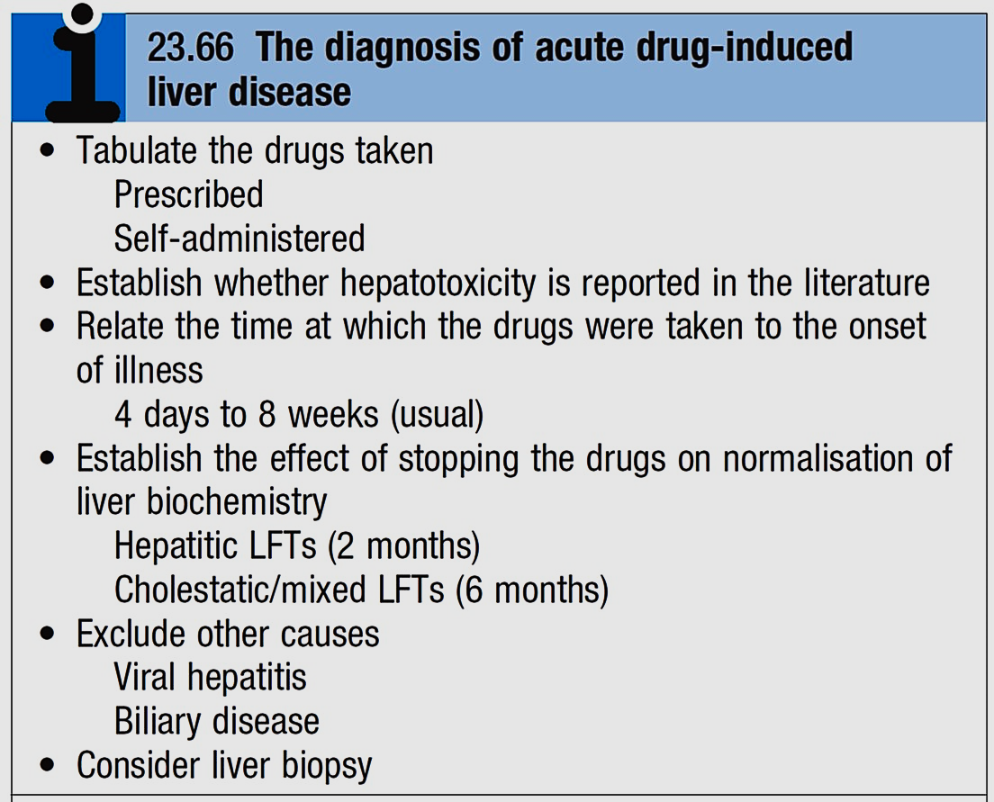
Drug-induced liver disease

Slide 16
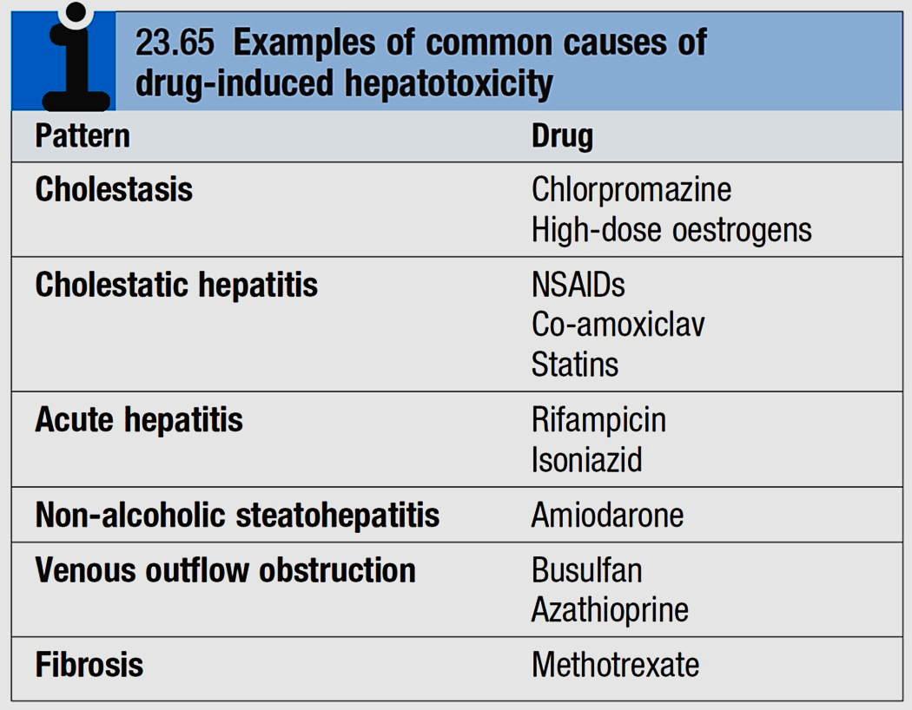

Slide 17


