Slide 1
Viral Hepatitis
Dr. Abdulwahhab S. Abdullah
CABM, FICMS-G&H

Slide 2
Viral hepatitis
Viral hepatitis must be considered in any patient presenting with hepatitis on LFTs (high ALT & AST).
Viral hepatitis is usually caused by 2 enterally-transmitted and 2 parenterally-transmitted hepatitis viruses.
The enterically-transmitted viruses (hepatitis A and hepatitis E) cause acute self-limited hepatitis.
The parenterally-transmitted viruses (hepatitis B and C) can cause acute or chronic hepatitis.

Slide 3
Causes of viral hepatitis
Common: Hepatitis A
Hepatitis B (± D)
Hepatitis C
Hepatitis E
Less common: Cytomegalovirus
Epstein–Barr virus
Rare: Herpes simplex
Yellow fever

Slide 4
Clinical features of acute viral hepatitis
Acute viral hepatitis can be: Asymptomatic
Anicteric
Icteric (jaundice)
A typical episode includes:
Prodromal period (few days to 2 weeks):
malaise, nausea, anorexia.
Icteric period (1-4 weeks):
jaundice heralded by darkening of urine often with improvement of prodromal symptoms.
Recovery period (few weeks to several months):
rapid in children, slow in adults

Slide 5
Clinical features of acute viral hepatitis
Signs may include Jaundice, tender hepatomegaly, splenomegaly, and cervical lymphadenopathy.
Possible complications include:
Acute liver failure (especially HEV in pregnancy)
Chronic liver disease & cirrhosis (HBV & HCV)
Prolonged cholestasis (HAV & HEV)
Relapses (especially HAV)
Aplastic anemia

Slide 6
Lab tests in acute viral hepatitis
Hepatitic pattern of LFTs ( ALT and AST several hundreds to several thousands U/L and ALP less than 2-3 times the upper limit of normal).
PT (INR) indicates the severity of hepatitis, and PT >25 sec usually indicates acute liver failure.
CBC may only show relative lymphocytosis.
Serological tests (IgM Ab) confirm the diagnosis.

Slide 7
Management of acute viral hepatitis
Outpatient supportive therapy is appropriate for most patients. Antivirals are not used.
Hepatotoxic drugs (e.g. paracetamol), sedatives, and alcohol should be avoided.
No special diet is recommended.
Elective surgery must be postponed after recovery.
Persistent nausea/vomiting, any mental confusion, and prolonged PT warrants hospitalization.
Liver transplantation may be indicated in patients with the rare complication of fulminant hepatitis.

Slide 8
Hepatitis A
Hepatitis A virus (HAV) is the commonest cause of acute viral hepatitis.
HAV is an RNA picornavirus (enterovirus ).
HAV is highly infectious, transmitted feco-orally with an average incubation period of 2-4 weeks.
Infection is more common in overcrowded areas with poor hygiene and sanitation.
HAV is present in stool for 2 weeks before and 2 weeks after onset of symptoms with maximal infectivity just before the onset of jaundice.

Slide 9
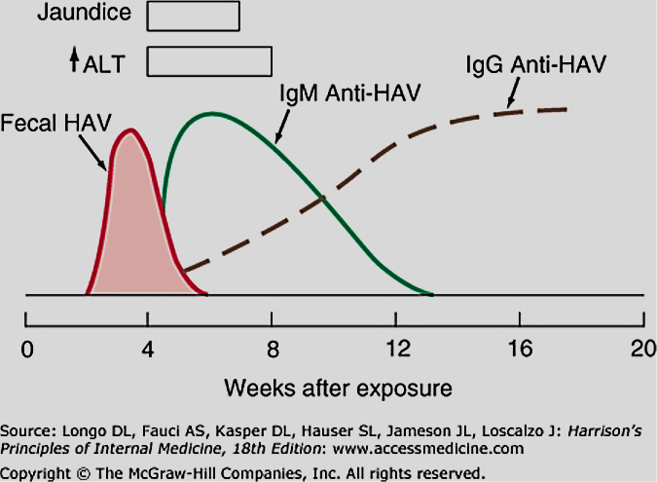

Slide 10
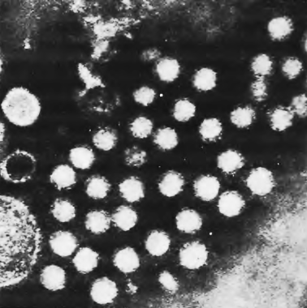
Electron microscopy of hepatitis A virions in feces. These are shown as 27 nm spheres. ( × 250 000.)

Slide 11
Hepatitis A
The presence and severity of symptoms depend on the patient’s age:
About 70% of adults develop symptoms, including jaundice. In contrast, only 10-30% of children <6 years old develop symptoms, which usually are non-specific and flu-like without jaundice.
Mortality (fulminant hepatitis) occur in 0.1% of patients aged <14 yr and in 2% of those >40 yr.

Slide 12
Investigations in hepatitis A
Liver biochemistry:
Prodromal stage:
Serum bilirubin is normal (bilirubinuria may be found).
Serum ALT & AST is elevated.
Icteric stage:
Serum bilirubin is elevated and ALP is usually <3x ULN.
ALT reach a peak 1–2 days after onset of jaundice.
After jaundice subsides, ALT & AST may remain elevated for some weeks and occasionally for up to 6 months.

Slide 13
Investigations in hepatitis A
Hematological tests:
Leucopenia with a relative lymphocytosis.
Very rarely Coombs’-positive hemolysis or aplastic anemia.
PT is prolonged in severe cases.
ESR is raised.
Viral markers:
IgM anti-HAV is diagnostic of acute hepatitis A.
IgG anti-HAV denotes past exposure and immunity.

Slide 14
Course and prognosis of hepatitis A
Prognosis is excellent in most patients.
Mortality in young adults is 0.1% but it increases with age.
Recovery may be complicated by relapse of the hepatitis in 5-15% of cases followed by resolution.
Adult patients may have a prolonged cholestatic phase with elevated ALP for up to several months.
Patients with underlying chronic liver disease and the elderly with comorbidities may have a serious or life-threatening disease course.

Slide 15
Prevention of hepatitis A
In the community, improving social conditions of overcrowding, poor hygiene and sanitation is vital.
Active immunization with inactivated vaccine, especially during outbreaks, and for people at risk of severe disease, such as the elderly and patients with chronic hepatitis B or C is recommended.
Passive immunization (post-exposure prophylaxis) of close contacts within 2 weeks using immune serum globulin can prevent secondary spread of HAV.

Slide 16
Hepatitis E
Hepatitis E is caused by an RNA virus that is endemic in India and the Middle East.
Transmission, clinical features, diagnosis and management of HEV are similar to that of HAV.
HEV vaccine has been developed recently.
HEV differs from HAV in two aspects:
High mortality (20%) reported in pregnancy.
Chronic infection reported in some immune-compromised patients.

Slide 17

Take a deep breath
It calms the mind

Slide 18
What is “chronic hepatitis”?
Chronic hepatitis is a liver disorder in which hepatic necroinflammatory activity continues for at least 6 months.
Hepatitis B and C are the most common causes of chronic hepatitis worldwide.
Patients with chronic viral hepatitis are usually asymptomatic until they develop cirrhosis.

Slide 19
Hepatitis B
What’s the size of the problem?
Globally, hepatitis B is a major cause of cirrhosis (chronic liver disease), fulminant hepatitis (acute liver failure), and hepatocellular cancer, with over 1 million deaths annually.
Prevalence of chronic hepatitis B varies geographically (0.5-2% in Western Europe and USA and 10-20% in parts of Africa, the Middle East and the Far East).

Slide 20
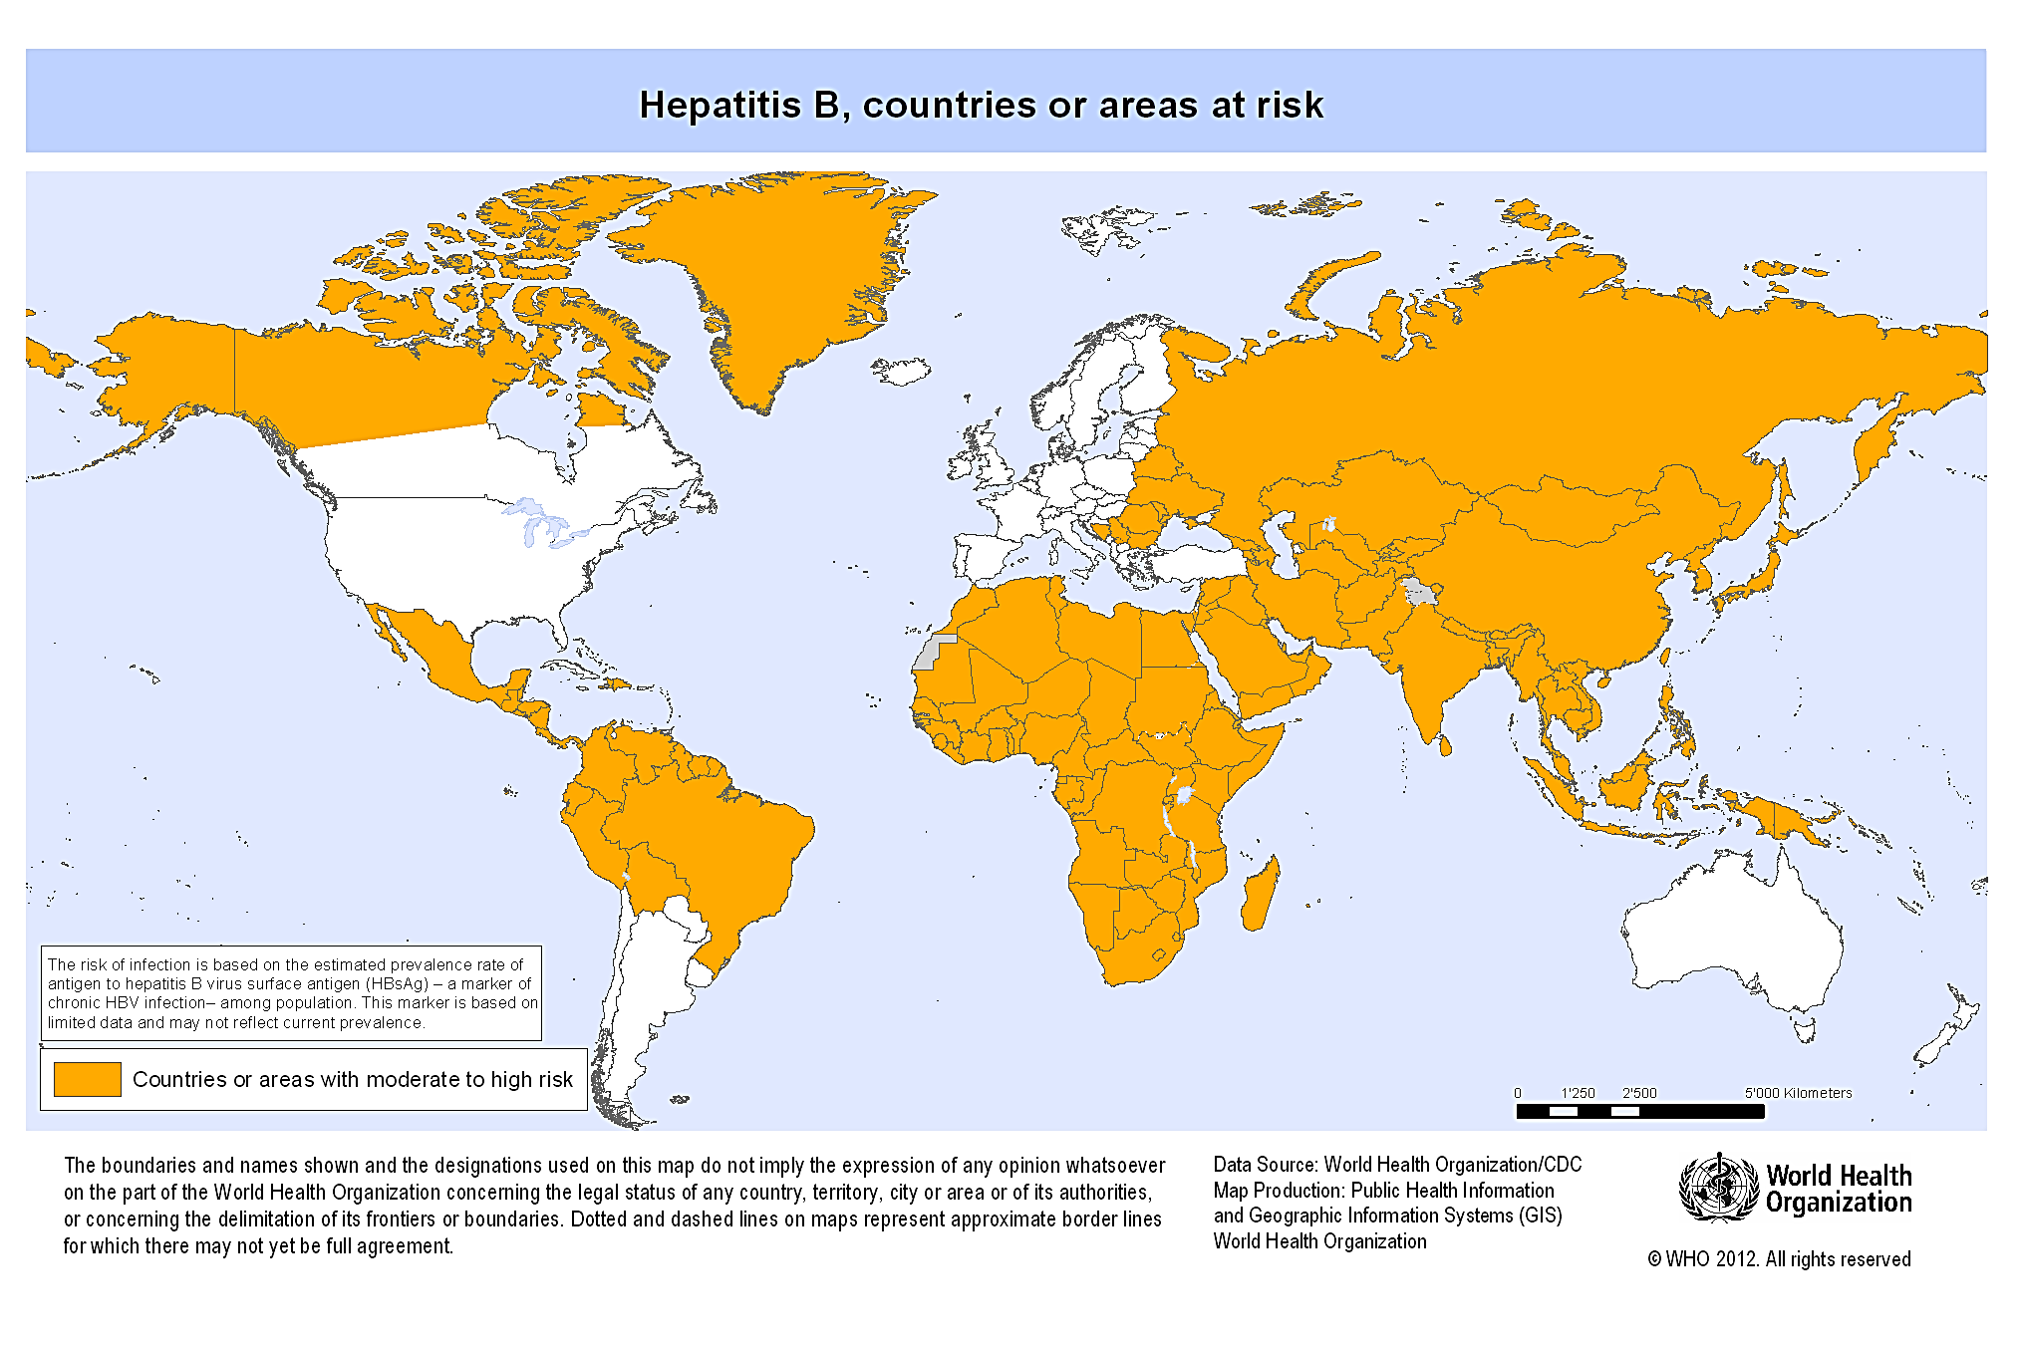

Slide 21
Structure of HBV (Dane particle)
surface antigen
(HBsAg)
DNA genome
e antigen
(HBeAg)
core antigen (HBcAg)

Slide 22
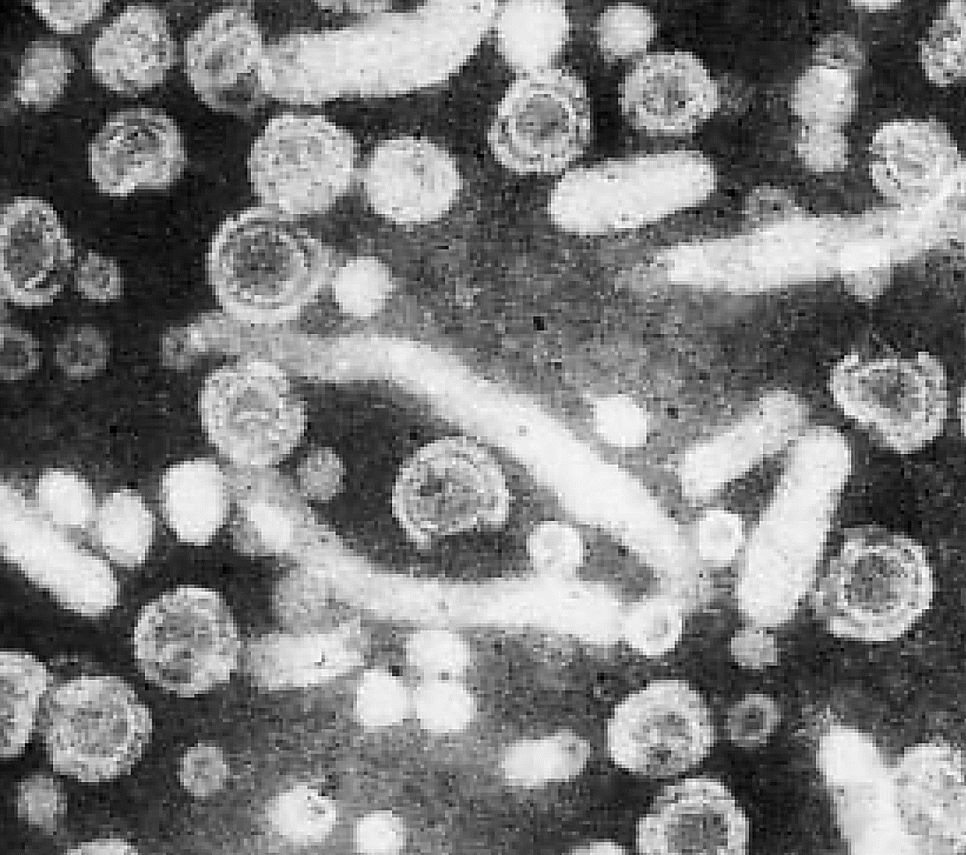
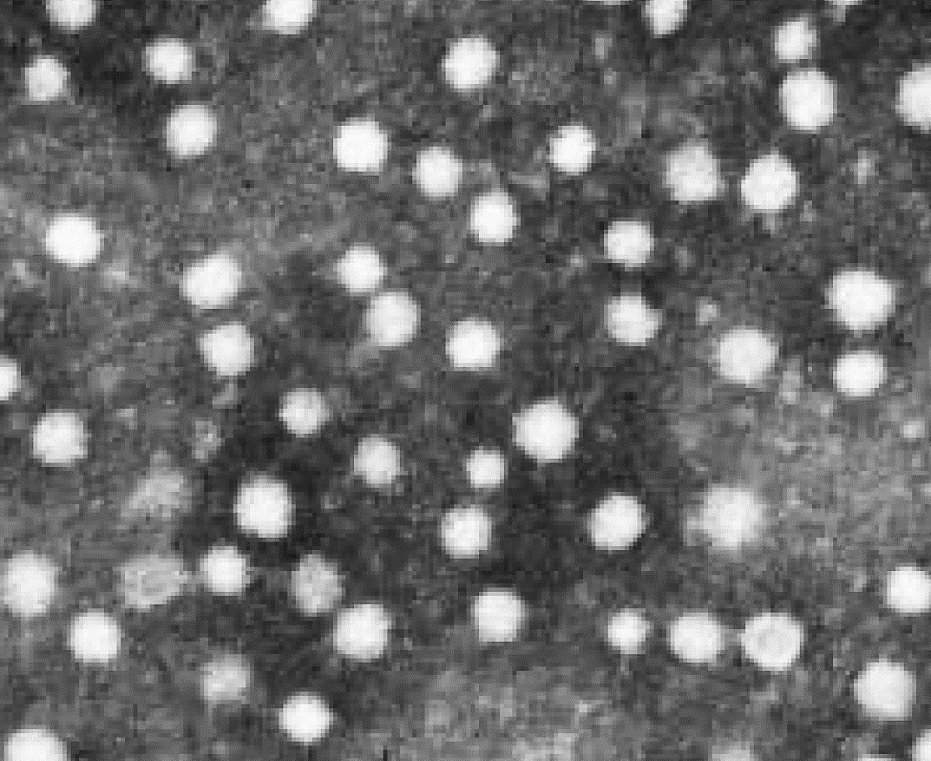

Slide 23
How is HBV transmitted?
Perinatal (mother to child at birth)
Close contact among young children
Sexual
Contaminated needles and tools (iv drug use, tattooing, acupuncture, razors, etc..)
Infected unscreened blood products (rare)

Slide 24
How is HBV transmitted?
The main route of transmission varies by geographical region:
In high-prevalence areas:
vertical (perinatal)
horizontal (close contact among toddlers)
In low-prevalence areas:
sexual
iv drug abuse

Slide 25
Does HBV cause acute or chronic infection?
Upon exposure to HBV, the risk of progression from acute to chronic infection is inversely related to the patient’s age at time of infection:

Slide 26
Risk of chronic HBV infection
Rate of chronic infection | Age at time of infection

Slide 27
Risk of chronic HBV infection
Rate of chronic infection | Age at time of infection
90-95% | at birth

Slide 28
Risk of chronic HBV infection
Rate of chronic infection | Age at time of infection
90-95% | at birth
20-50% | children < 5 years-old

Slide 29
Risk of chronic HBV infection
Rate of chronic infection | Age at time of infection
90-95% | at birth
20-50% | children < 5 years-old
1-10% | Older children and adults

Slide 30
What are the possible clinical presentations of hepatitis B?
Silent chronic infection is common in children while symptomatic acute infection often occur in adults.
Acute hepatitis B: Jaundice, malaise, and RUQ pain may develop 1-4 months after infection.
Acute (fulminant) liver failure is rare (up to 1% of adults).
Chronic hepatitis B: defined by persistent HBsAg in serum for >6 months. Patients are usually asymptomatic until cirrhosis develops.

Slide 31
What are the complications and prognosis of chronic hepatitis B?
Cirrhosis and decompensation (chronic liver failure), such as ascites, variceal bleeding, encephalopathy, etc…
Hepatocellular carcinoma (usually in cirrhotics)
Other: Membranous glomerulonephritis
Polyarteritis nodosa (vasculitis)

Slide 32
How to diagnose hepatitis B?
Surface antigen (HBsAg)
Surface antibody (anti-HBs)
IgM core antibody (IgM anti-HBc)
IgG core antibody (IgG anti-HBc)
e antigen (HBeAg)
e antibody (anti-HBe)
HBV DNA (viral load)
>20,000 IU/L
<20,000 IU/L
Current infection (6/12?)
Immunity (anti-HBc?)
Recent infection (flare?)
Remote infection (HBsAg?)
High replication (always)
?Low replication (DNA?)
High replication (HBeAg±)
Low replication (HBeAg-)

Slide 33
What is the natural history of chronic hepatitis B?
Chronic HBV infection is a dynamic process that can be divided into 4 phases. These are not necessarily sequential and not all patients will go through all of them.
HBV is not directly cytopathic but a prolonged ineffective immune response in patients with chronic hepatitis B can mediate liver damage.

Slide 34
tolerance
clearance
inactive carrier
reactivation
mutantHBV
DNA
HBeAg-positive
HBeAg-negative
ALT
No inflammation or fibrosis
Significant inflammation mild fibrosis
Mild or no inflammation
Variable fibrosis
Significant inflammation & fibrosis/Cirrhosis
time (years)
chronic
infection

Slide 35
How to manage a patient with acute hepatitis B?
Supportive care and monitoring for acute liver failure (<1% ). Antivirals are usually not used.
Full recovery expected in 90-95% of immune-competent adults and remaining 5-10% develop chronic infection that usually persists for life.
Resolution occurs within 6/12 and is shown by:
HBsAg (-), HBeAg (- ), anti-HBs (+)
Progression to chronicity is shown on follow up by:
HBsAg (+) for >6/12 or HBeAg (+) for >3/12

Slide 36
How to manage a patient with chronic hepatitis B?
The goal is to prevent cirrhosis and cancer (HCC) by clearing HBsAg but this is not yet achievable.
Current aims: HBeAg seroconversion (if HBeAg+)
low or undetectable HBV DNA
normal serum ALT
Treatment is indicated for patients with:
-high viral load and
-active hepatitis (↑ALT or significant inflammation & fibrosis on liver biopsy)

Slide 37
Which drugs are used for chronic hepatitis B?
Monotherapy with 1 of 2 types of drugs is used:
nucleos(t)ide analogues (single daily oral tab):
Best for HBeAg- patients and those with cirrhosis
Entecavir or Tenofovir: 1st choice but expensive
Lamivudine: cheaper but resistance is a problem
Adefovir,Telbivudine: expensive & not so effective
pegylated interferon-α (weekly s.c. injection):
Best for pre-cirrhotics with HBeAg+ and ↑ALT.
Side effects is the main problem.

Slide 38
How to prevent hepatitis B?
Avoiding risky behaviors
Active immunization (vaccine) for:
all newborns
all “at risk” persons
patients with chronic liver disease
Post-exposure prophylaxis with active-passive immunization (vaccine & immune globulin) in e.g.:
needle-stick injury from HBsAg+ patient
neonate of HBsAg+ mother
sexual partner of HBsAg+ patient

Slide 39
What about hepatitis D?
HDV is an RNA-defective virus that has no independent existence (requires HBV to replicate) and has the same sources and modes of spread.
Can be acquired as coinfection or superinfection and can be acute or chronic.
Cirrhosis is more frequent & rapid with chronic hepatitis B+D than with chronic hepatitis B alone.
Diagnosis is by serum anti-HDV (IgM & IgG).
Prevention of hepatitis B prevents hepatitis D.

Slide 40
What about Hepatitis C?
HCV is an RNA flavivirus that has a worldwide distribution & is a major cause of cirrhosis & HCC.
Initial infection is usually clinically silent & leads to chronic infection in 80% of cases who will stay mostly asymptomatic until cirrhosis develops.
Exposure to infected blood & blood products is the most important mode of transmission.
Sexual & perinatal transmission is uncommon.
Males, alcoholics, and HIV-coinfected patients has more aggressive disease course.

Slide 41
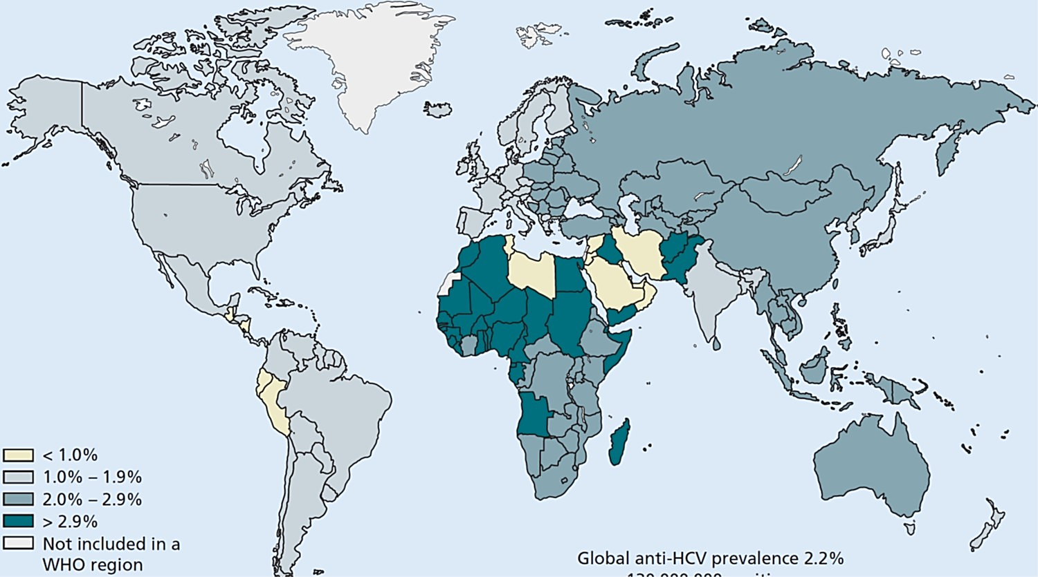
Estimated HCV prevalence by region. (Source: Perz J et al ., unpublished data. Centers for Disease Control, 2002.)

Slide 42
How to diagnose HCV infection?
Screening is by serum anti-HCV antibody and confirmation is by serum HCV RNA (PCR).
Anti-HCV Ab persist even after HCV clearance, whether spontaneous or post-treatment.
HCV genotype has no effect on natural course of disease but affect therapeutic response.
LFTs may be normal or show fluctuating ALT.
ALT & AST in hepatitis C are poor predictors of liver damage and cirrhosis may be present with normal ALT & AST.

Slide 43
How to treat chronic hepatitis C?
The aim is to achieve a sustained viral response evidenced by undetectable HCV RNA 12 or 24 weeks after completion of therapy (SVR12 or SVR24).
Traditional HCV therapy ( weekly s.c. peg IFN-α injections with daily oral ribavirin) has now been replaced by more effective and convenient oral regimens using direct acting antiviral drugs (DAAs).
No active or passive immunization against HCV is available yet.

Slide 44
What about liver transplantation for hepatitis B and C?
In chronic viral hepatitis, liver transplantation is only indicated for decompensated end-stage cirrhosis and certain patients with early HCC.
HCV almost always recurs in the allograft but current IFN-free regimens can effectively eradicate the virus in pre- and post-transplant patients.
Recurrent HBV post-transplant is markedly reduced by pre-transplant antiviral drugs and post-transplant drugs and immunoglobulin.

Slide 45
Thank you

