Slide 1
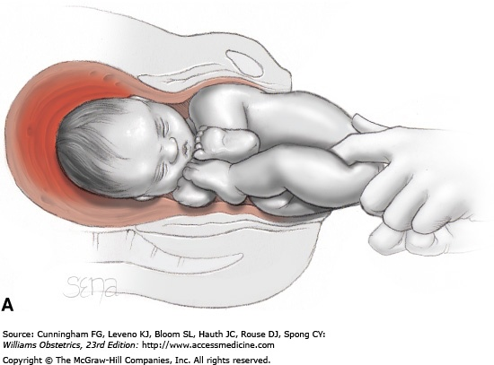
Extraction of frank breech using fingers in groins in frank breech

Slide 2
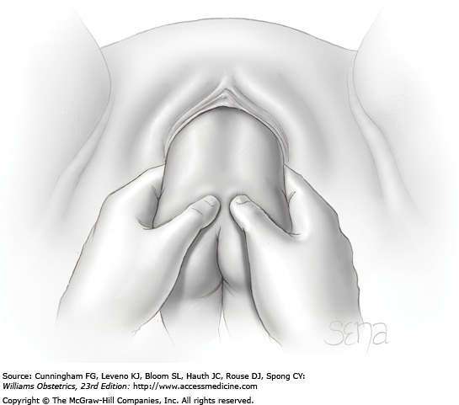

Slide 3
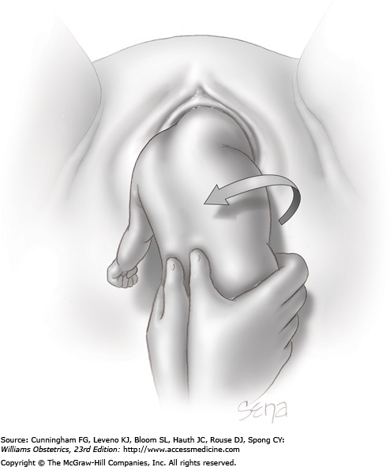
Lovset maneuver for delivery of arms

Slide 4
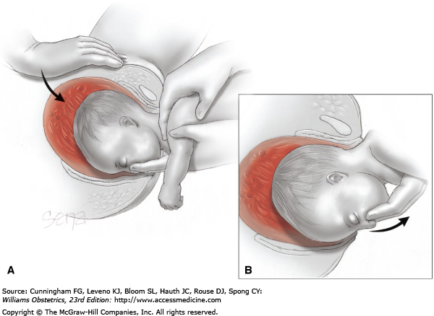
Delivery of the after coming head using the Mauriceau maneuver

Slide 5
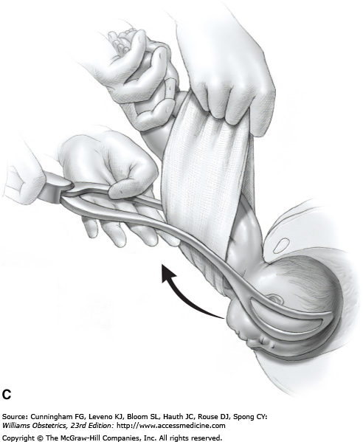
Piper forceps

Slide 6
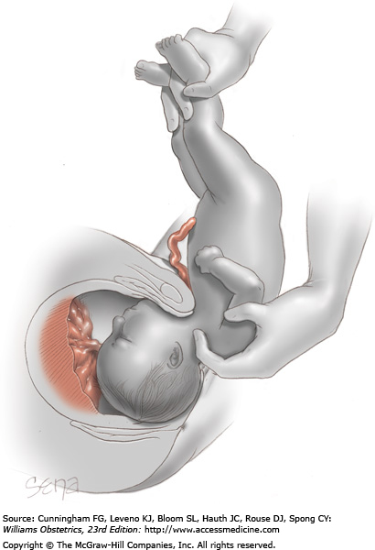
Delivery of the aftercoming head using the modified Prague maneuver necessitated by failure of the fetal trunk to rotate anteriorly

Slide 7
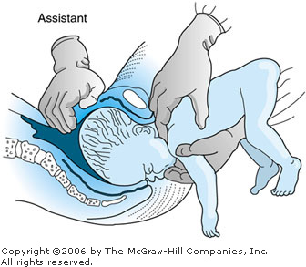
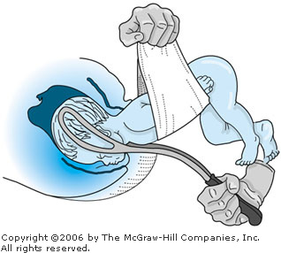
Mauriceou maneuver for after coming of head in breech delivery
Piper forceps for delivery of after coming head in breech delivery

