Slide 1
plain Chest film
1 name , date of exposure
2.Lung apex..
3. trachea..
4. hilum ..
5. heart..
6. diaphragm..
7. cost phrenic angles..
8 .lung fields
9.Bones..ribs, clavicle, scapula
10. soft tissue. Neck , breast, gas under diaph.

Slide 2
Chest trauma

Slide 6
Pulmonary contusion

Slide 7
contusion
Disruption of the micro- scopical architecture of the lung with hemorrhage in the alveoli as a result of damage to capillaries. This will interfere with gas exchange leading to hypoxia , it dose not involve tear or cut of the lung tissue

Slide 10
laceration
More serious condition .. With penetrating trauma .stab wound ..there is macro scopical lung disruption with the lung torn or cut.. It can cause air to leak out of the lacerated lung in to the pleural space .

Slide 11
Pneumo thorax due to pulmonary laceration

Slide 13
Pulmonary contusion may mask pulmonary laceration on plain chest film.. Associated flail chest and sub cut. Emphysema

Slide 14
Flail chest

Slide 15
A broken seg . Of the rib cage which become detached from the rest of the chest wall ..it occur when multiple adjacent ribs are broken in to multiple places.. It is usually accompanied by pulmonary contusion ..causing paradoxical breathing in which the flail seg move in to opposite direction to the rest of the chest wall

Slide 18
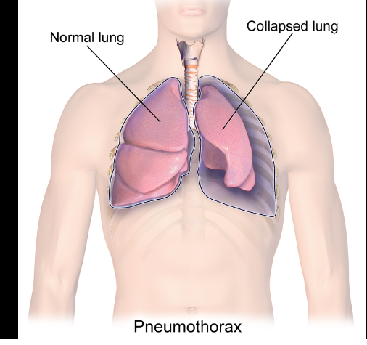

Slide 24
Continuous diaphragm sign

